Slide 1
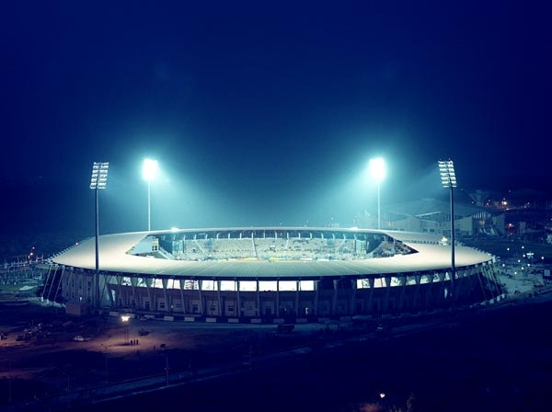
A. STADIUM
B. SPORT
C. AMBULANCE

Slide 2

A. STAR
B. MILK
C. MOTORCYCLE

Slide 3

A. MARKET
B. BALLOON
C. BALLOONS

Slide 4
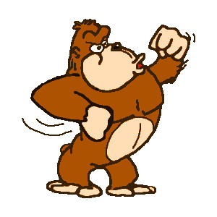
A. CAKE
B. GORILLA
C. PICNIC

Slide 5

A. A AMBULANCE
B. AN AMBULANCE

Slide 6
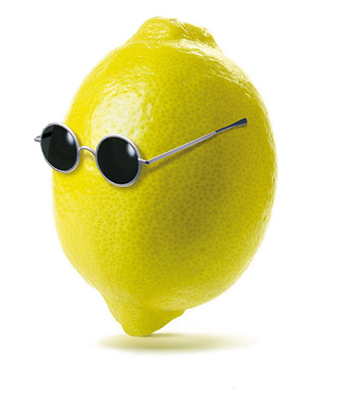
A. A LEMON
B. AN LEMON
C. A BALLOON

Slide 7

A. A DOCTOR
B. AN DOCTOR
C. DOCTORS

Slide 8
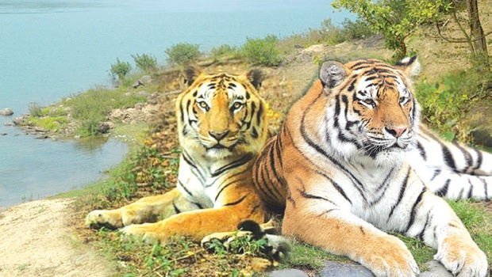
A. TIGER
B. TIGERS

Slide 9

A. MOM
B. DAD

Slide 10

A. MOM
B. DAD

Slide 11
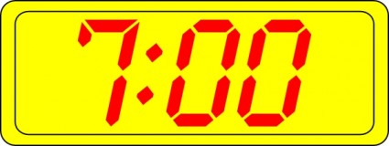

A. GOOD MORNING
B. GOOD AFTERNOON
C. GOOD EVENING
D. GOOD NIGHT

Slide 12
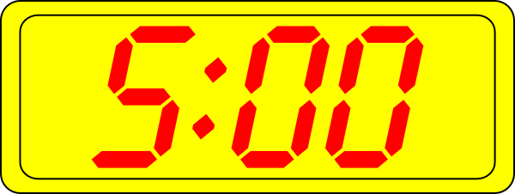

A. GOOD MORNING
B. GOOD AFTERNOON
C. GOOD EVENING
D. GOOD NIGHT

Slide 13

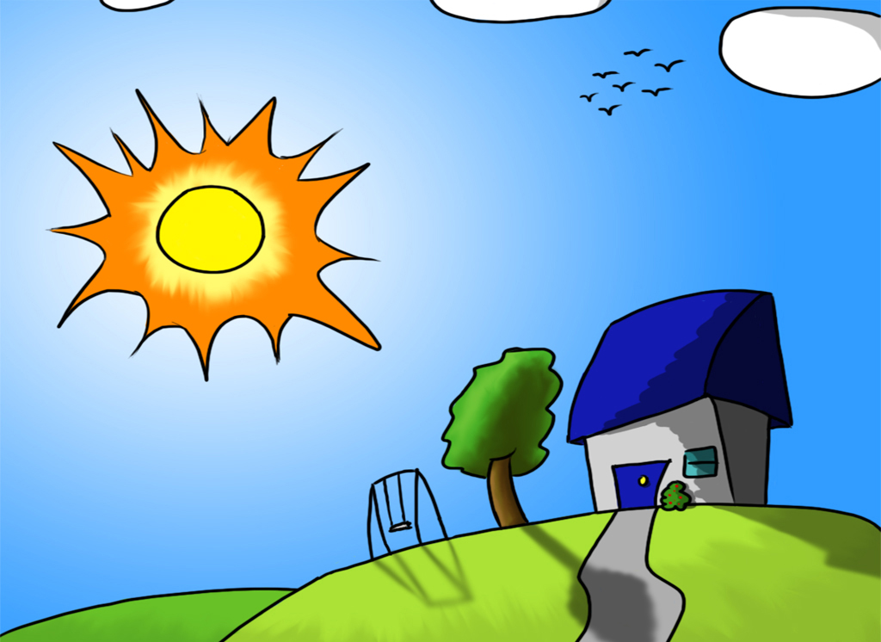
A. GOOD MORNING
B. GOOD AFTERNOON
C. GOOD EVENING
D. GOOD NIGHT

Slide 14
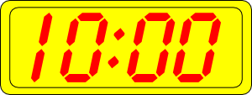

A. GOOD MORNING
B. GOOD AFTERNOON
C. GOOD EVENING
D. GOOD NIGHT

Slide 15

A. BYE
B. WHAT IS YOUR NAME?

Slide 16

www.eegitimim.com

