Slide 1
ANIMALS

Slide 2



Slide 3


Slide 4


Slide 5


Slide 6


Slide 7


Slide 8


Slide 9
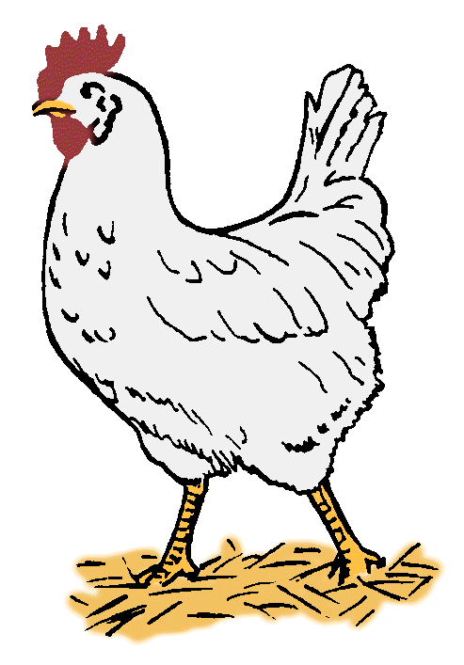

Slide 10
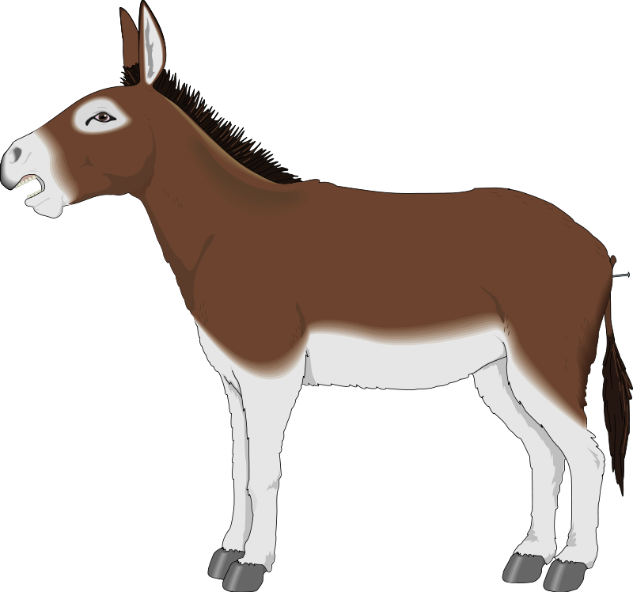

Slide 11



Slide 12


Slide 13


Slide 14

The end!...
www.eegitimim.com

