Slide 1

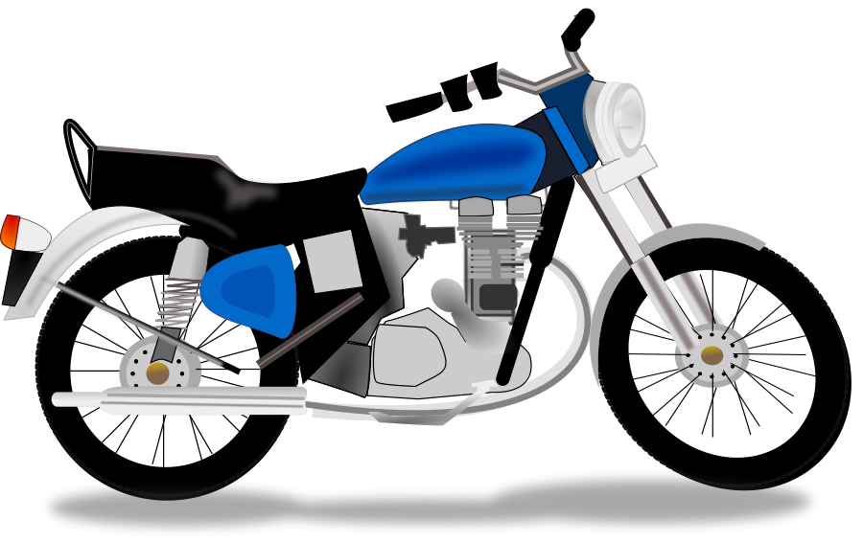

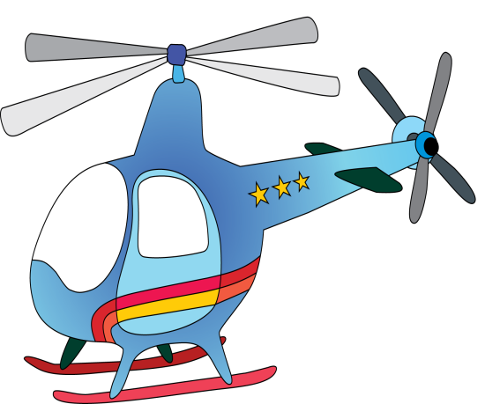

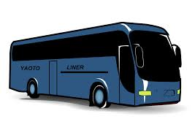
Transportations

Slide 2
bus

Slide 3

Car

Slide 4
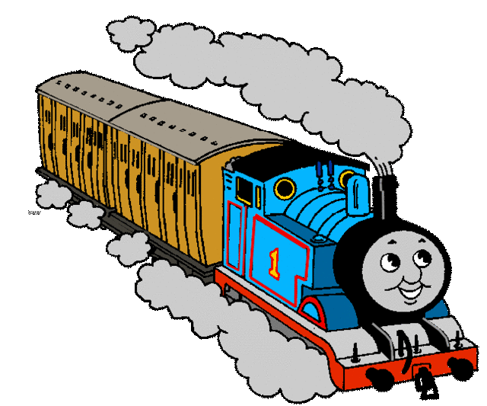
Train

Slide 5
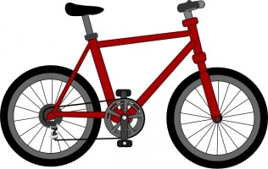
Bicycle – bike

Slide 6
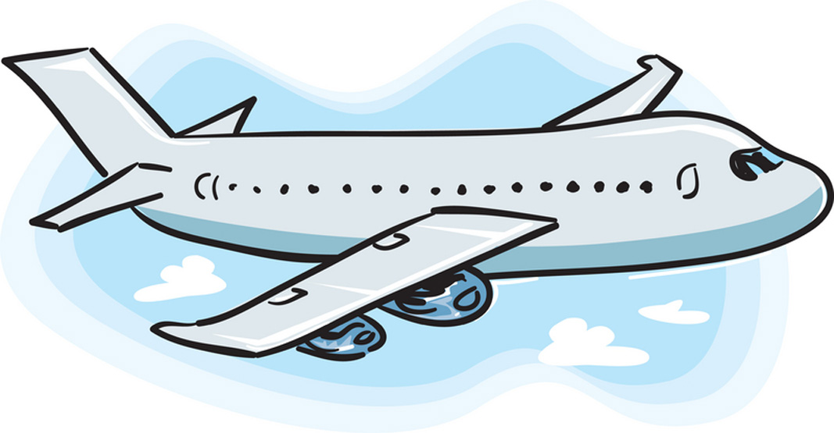
Plane – airplane

Slide 7

helicopter

Slide 8
Motorcycle – motorbike

Slide 9


Boat

Slide 10
Ship

Slide 11


Hot air baloon

Slide 12
How can I go to konya ?
You can go by bus.
You can go by car.

Slide 13
How can I go to Ankara?
You can go by bus.
You can go by train.
You can go by car.

Slide 14

How can I go to seydişehir ?
You can go by bicycle.
You can go by bus
You can go by motorcycle
You can go by car.

