Slide 1
PETS
Evcil Hayvanlar

Slide 2

Hello ! My name is TWEETY
I am a ………………………
A) DOG
B) BIRD

Slide 3

Hello ! I am a NINJA
I am a ………………………
A) TURTLE
B) RABBIT

Slide 4

Hello ! My name is NEMO
I am a ………………………
A) HAMSTER
B) FISH

Slide 5
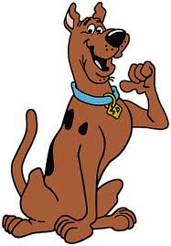
Hello ! I am SCOOBY DOO
I am a ………………………
A) DOG
B) BIRD

Slide 6

Hi ! My name is GARFİELD
I am a ………………………
A) TURTLE
B) CAT

Slide 7

Hello ! My name is JERRY
I am a ………………………
A) HAMSTER
B) CAT

Slide 8
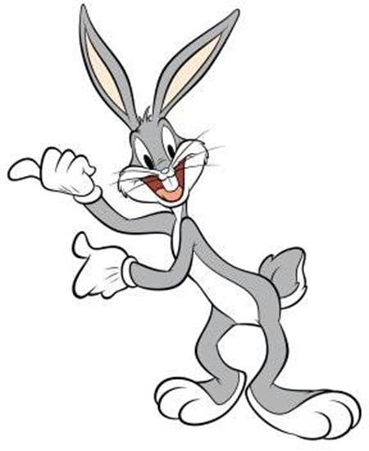
Hello ! My name is TWEETY
I am a ………………………
A) FISH
B) RABBIT

Slide 9
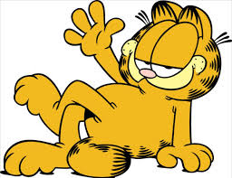
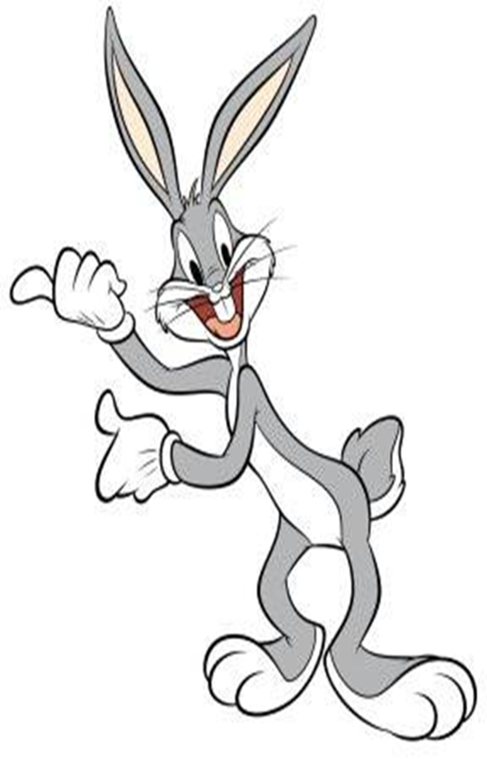
1
4
6
2
7
5
3

Slide 10

THE END !...
www.eegitimim.com

