Slide 1
UNIT 9 :
FRUITS
Listen and Choose

Slide 2



1
2

Slide 3


1
2

Slide 4


1
2

Slide 5


1
2

Slide 6

1
2

Slide 7

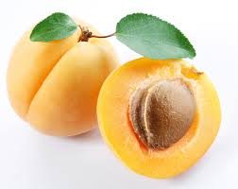
1
2

Slide 8
1
2

Slide 9
1
2

Slide 10
1
2

Slide 11
1
2

Slide 12
1
2

Slide 13
Prepared by:
Elt. Hasret KARADAĞ

