Slide 1
UNIT 9 :
FRUITS

Slide 2



Slide 3


Apple

Slide 4



Banana

Slide 5


Orange

Slide 6



Lemon

Slide 7



Strawberry

Slide 8



Grapes

Slide 9

Peach

Slide 10

Melon

Slide 11


Watermelon

Slide 12
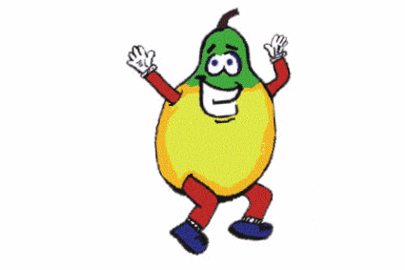

Pear

Slide 13

Apricot

