Slide 1


BOARD www.eegitimim.com

Slide 2

BOOK

Slide 3

CHAIR

Slide 4
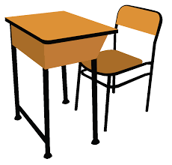
DESK

Slide 5

DOOR

Slide 6

WINDOW

Slide 7

ERASER

Slide 8
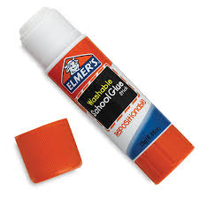
GLUE

Slide 9
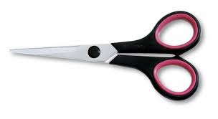
SCISSORS

Slide 10
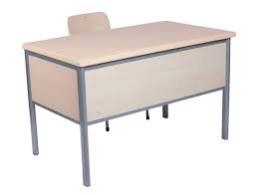
TABLE

Slide 11

NOTEBOOK

Slide 12
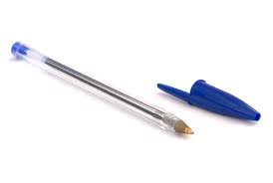
PEN

Slide 13

PENCIL

Slide 14
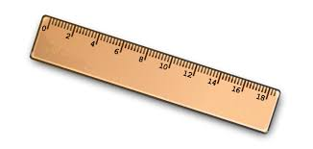
RULER

Slide 15
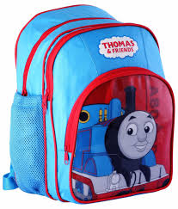
SCHOOLBAG

Slide 16
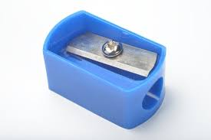
SHARPENER

