Slide 1
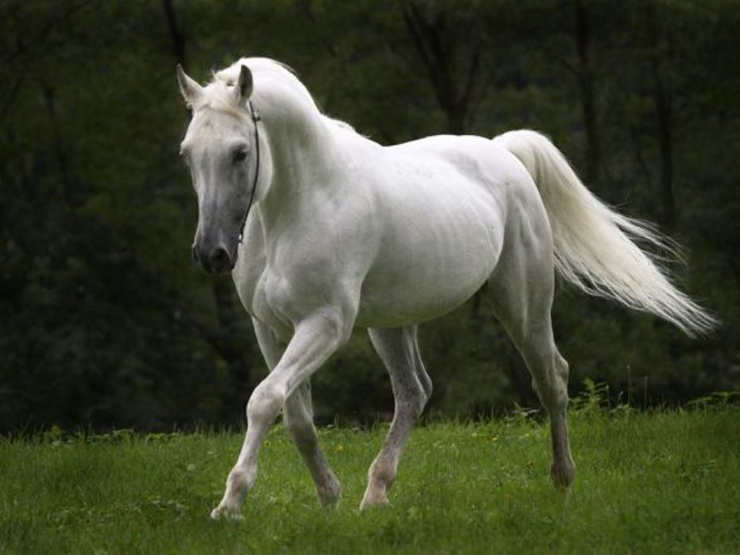
WHITE

Slide 2
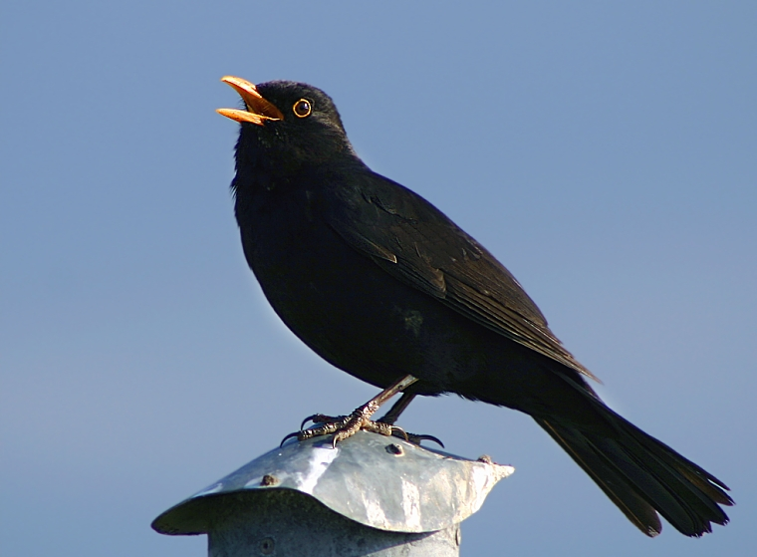
BLACK

Slide 3
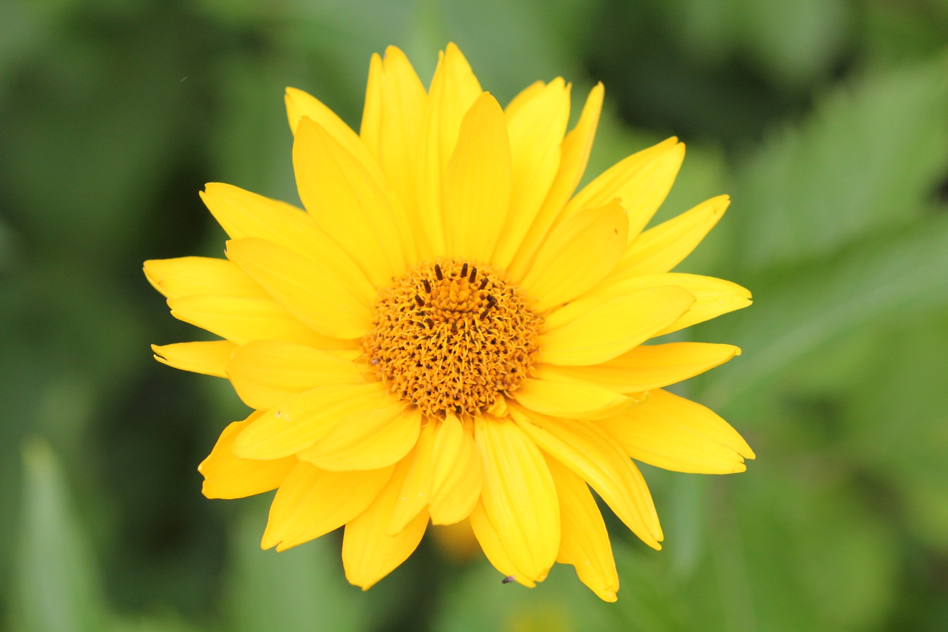
YELLOW

Slide 4
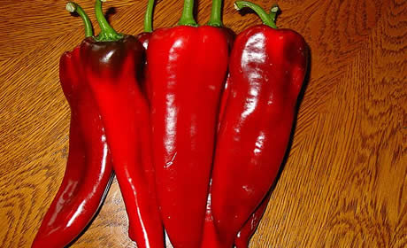
RED

Slide 5
BLUE

Slide 6
GREEN

Slide 7
ORANGE

Slide 8
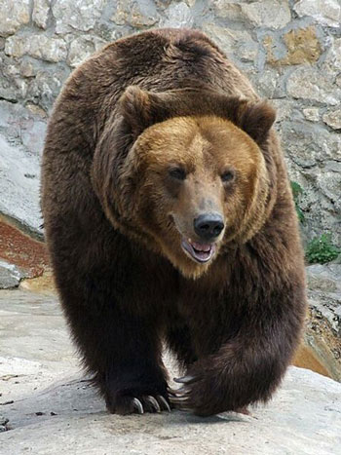
BROWN

Slide 9
PINK

Slide 10
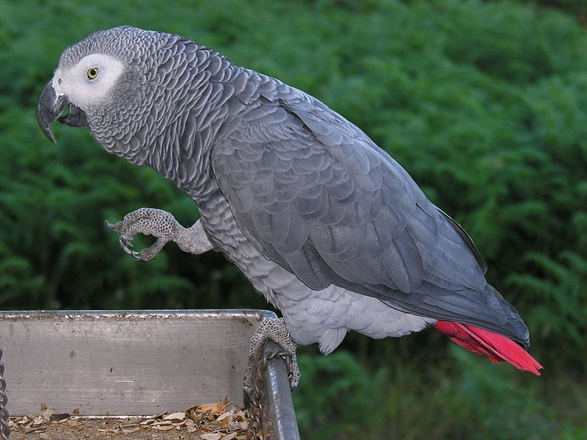
GRAY

Slide 11
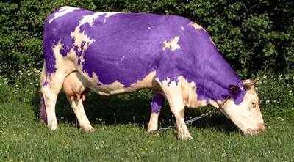
PURPLE

Slide 12
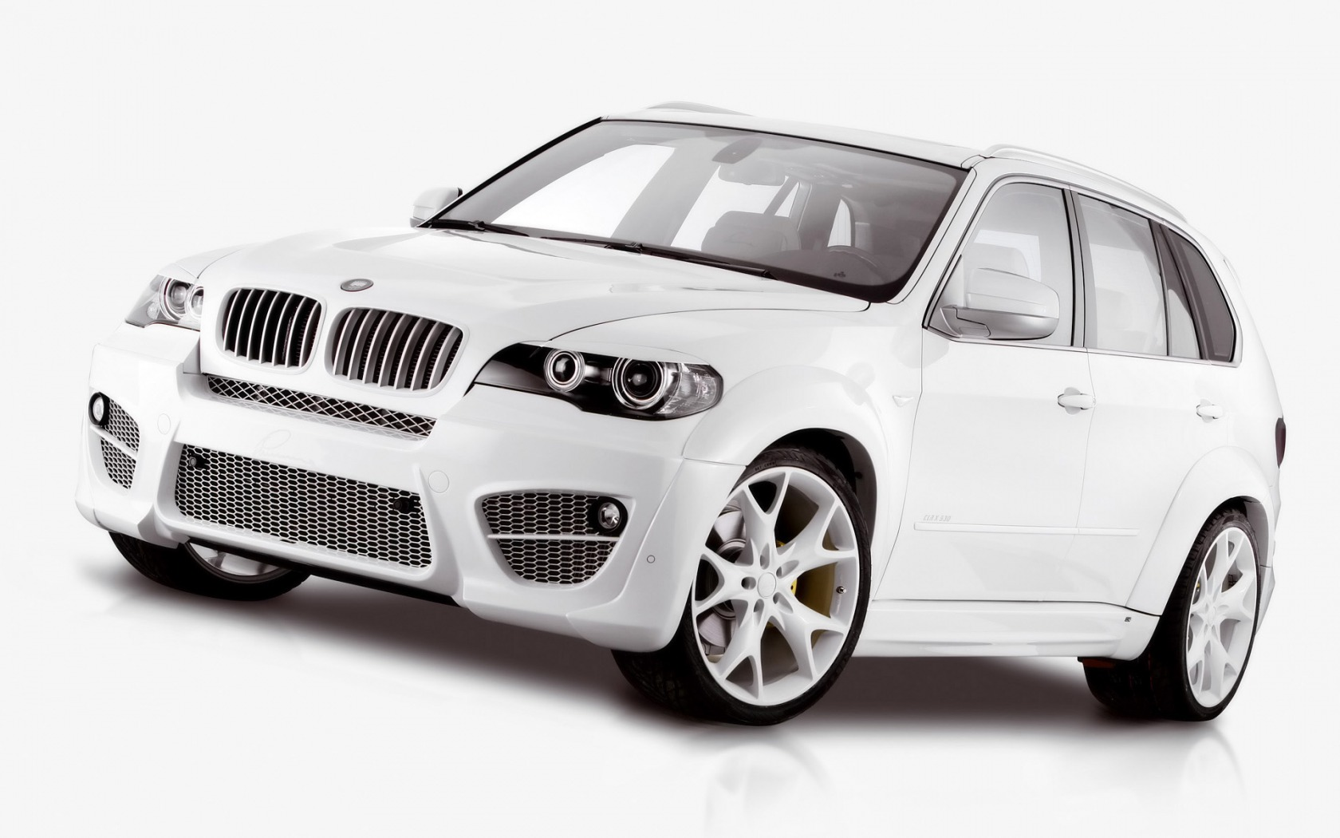
WHITE

Slide 13
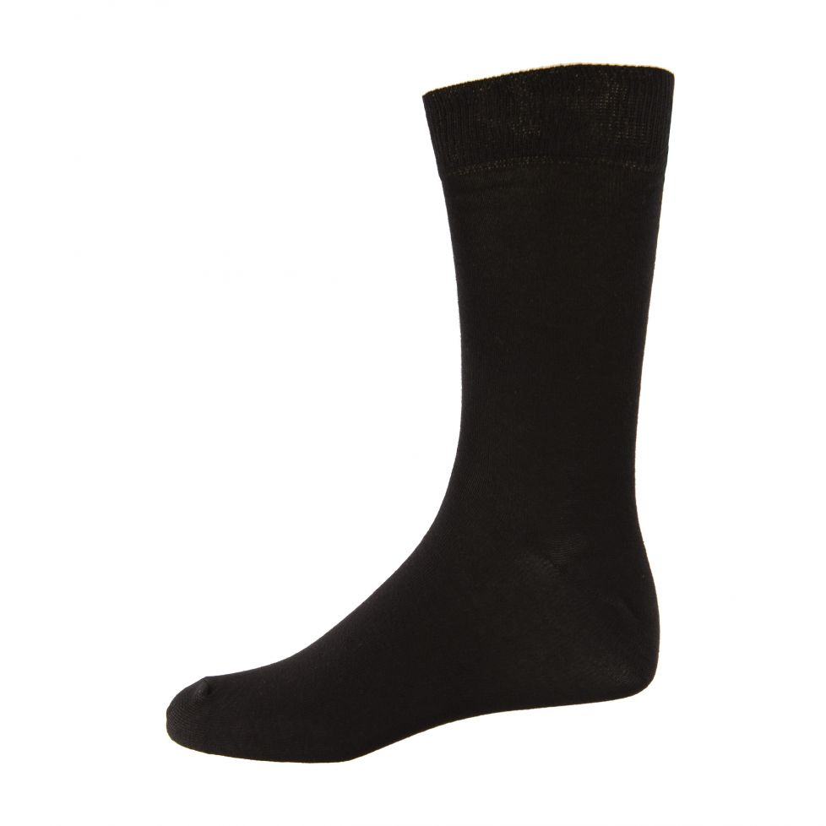
BLACK

Slide 14
YELLOW

Slide 15
RED

Slide 16
BLUE

Slide 17
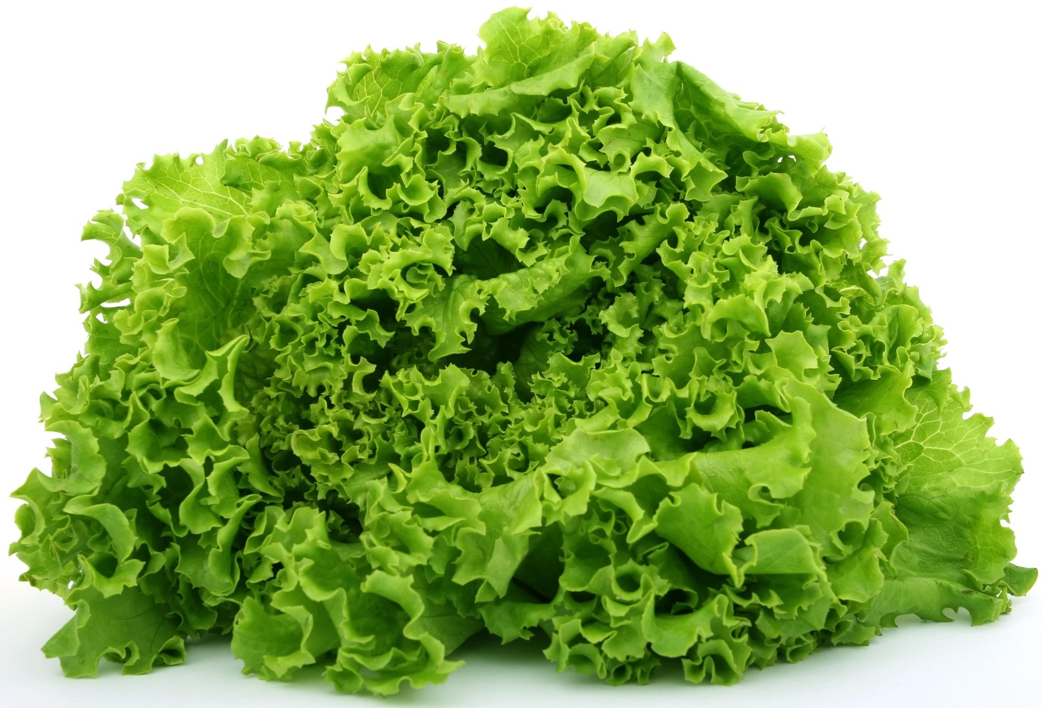
GREEN

Slide 18
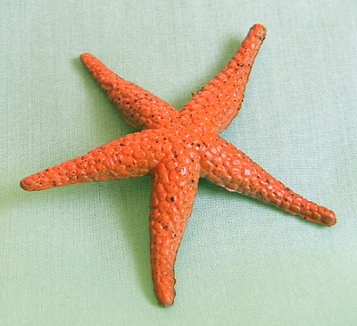
ORANGE

Slide 19
BROWN

Slide 20
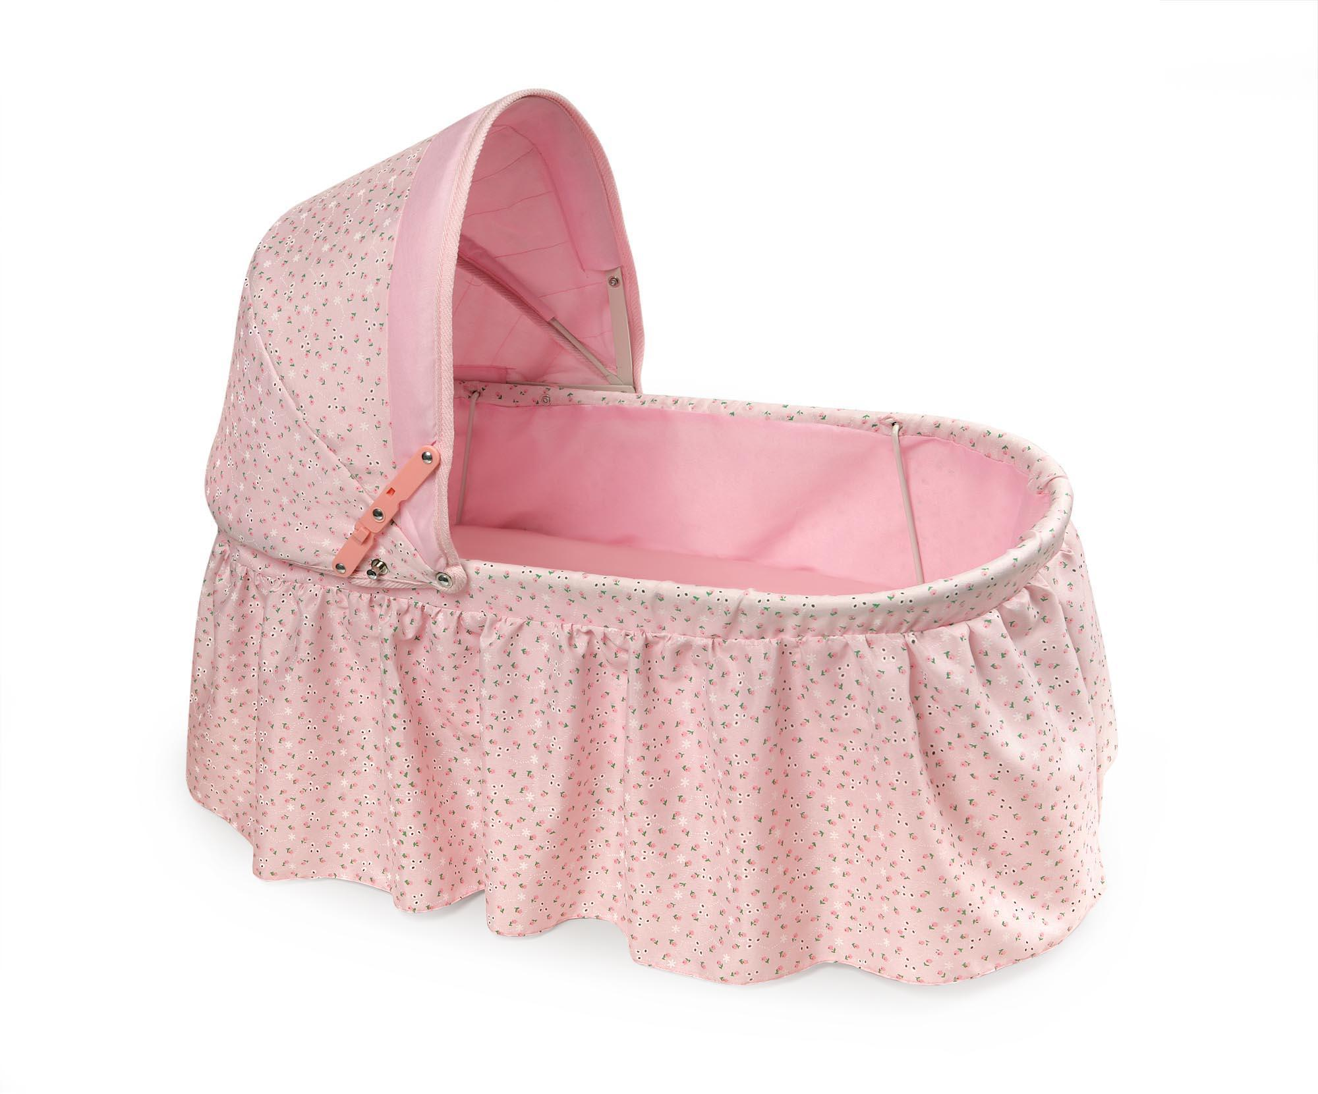
PINK

Slide 21
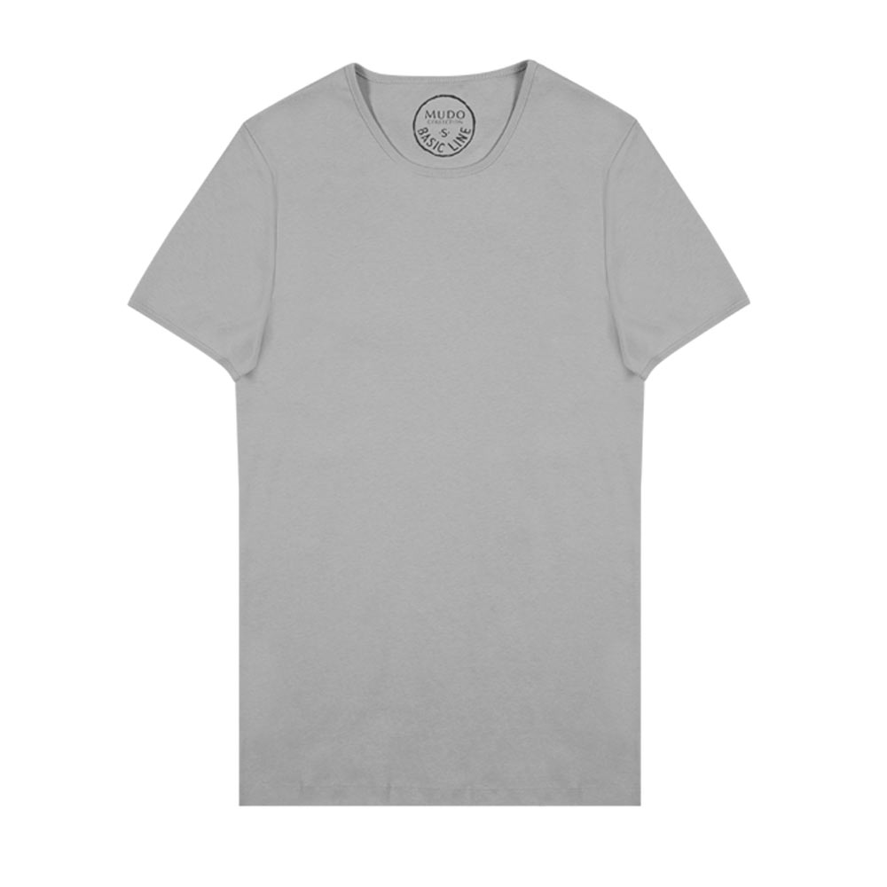
GRAY

Slide 22
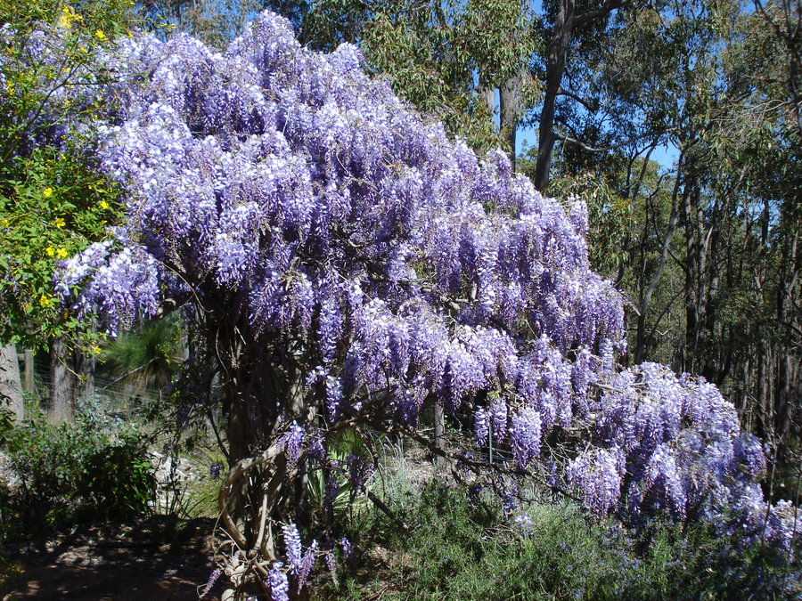
PURPLE

Slide 23
WHITE AND BLACK

Slide 24
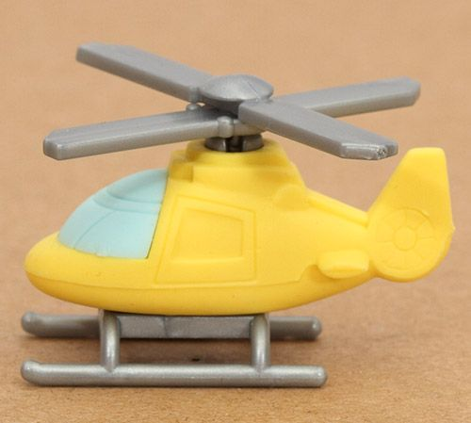
YELLOW AND RED

Slide 25
BLUE AND GREEN

Slide 26
ORANGE AND BROWN

Slide 27
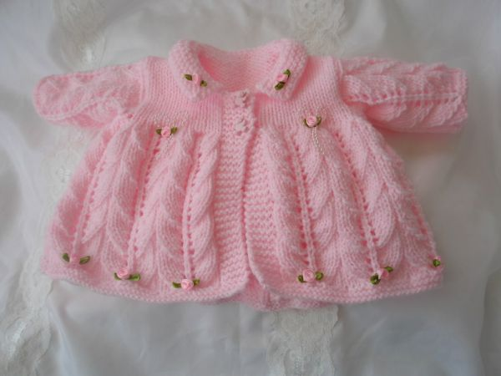
PINK AND GRAY

Slide 28
?

Slide 29
?

Slide 30
?

Slide 31
?

Slide 32
?

Slide 33
?

Slide 34
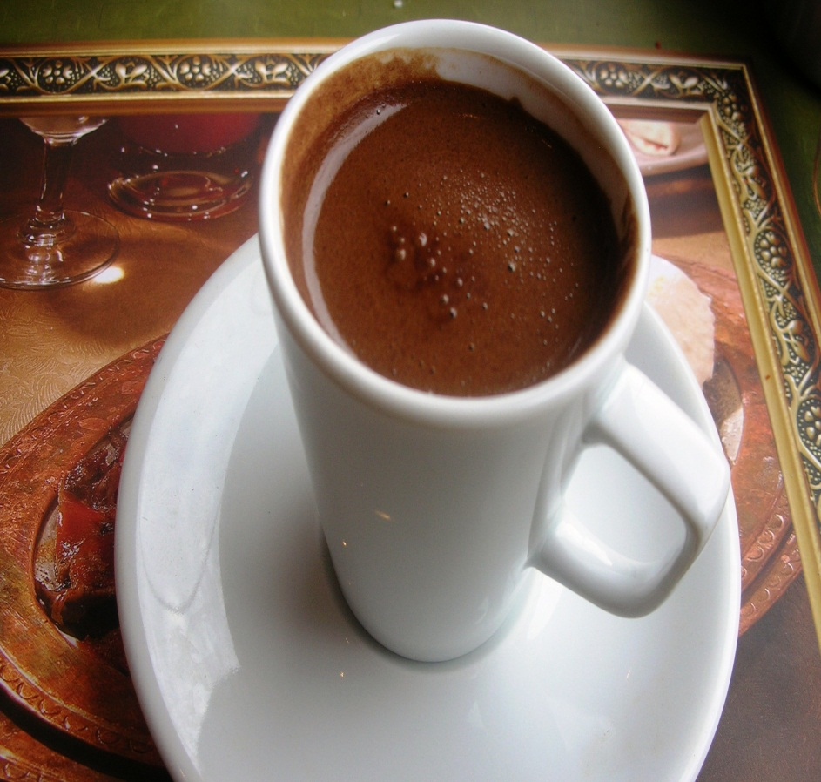
?

Slide 35
?

Slide 36
?

Slide 37
?

Slide 38
zB

