Slide 1
1 DEMEK İÇİN A AN

Slide 2
SESLİ HARFLE BAŞLAYAN KELİMELERDEN ÖNCE AN

Slide 3
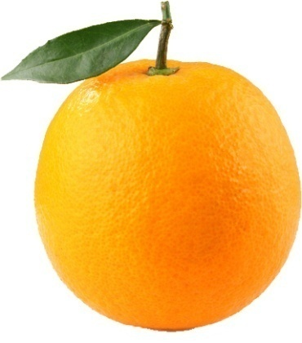
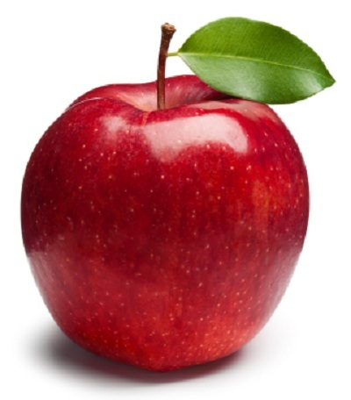
AN ORANGE
AN APPLE

Slide 4
SESSİZ HARFLE BAŞLAYAN KELİMELERDEN ÖNCE A

Slide 5
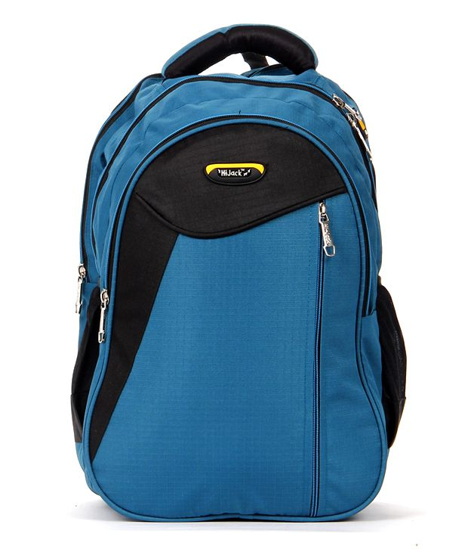
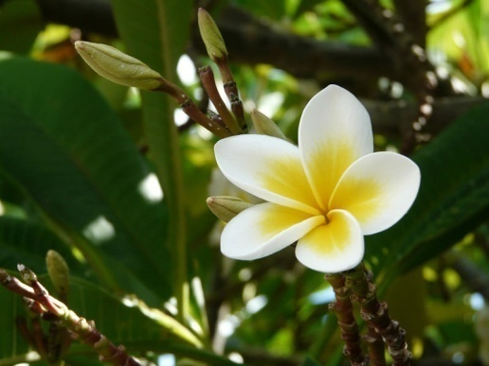
A SCHOOL BAG
A FLOWER

Slide 6
VAR

Slide 7
1 TANEYSE THERE IS

Slide 8
1’DEN ÇOKSA THERE ARE

Slide 9
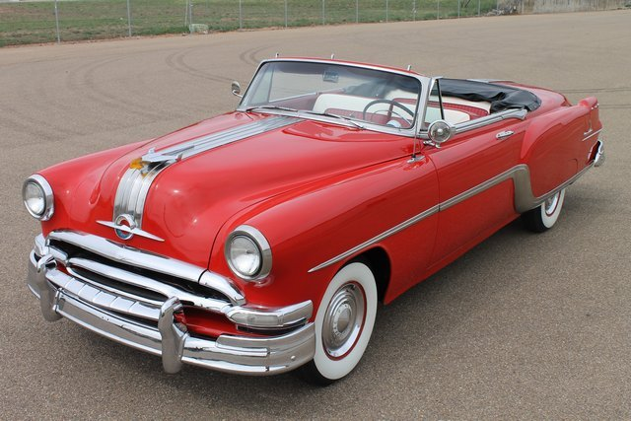
THERE IS A CAR

Slide 10
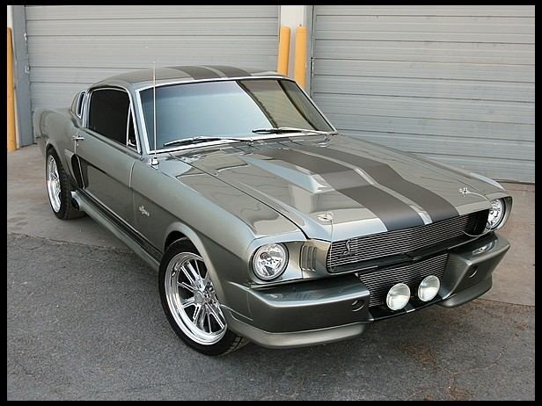
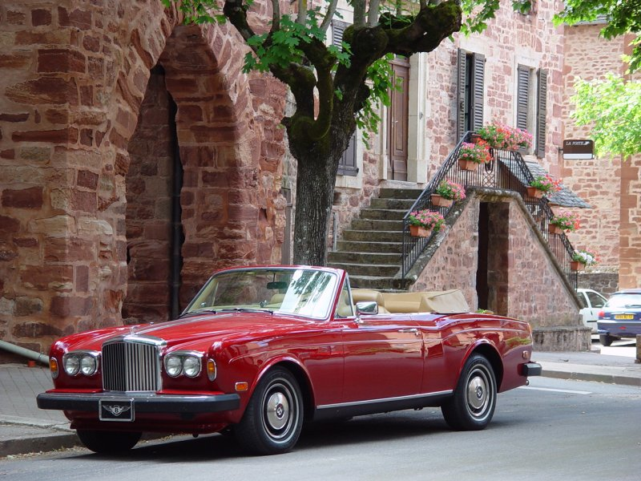
THERE ARE THREE CARS

Slide 11
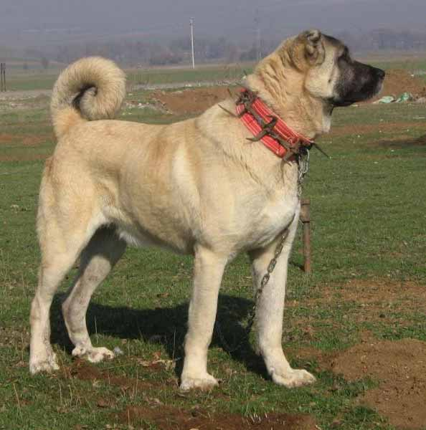
THERE IS A DOG

Slide 12
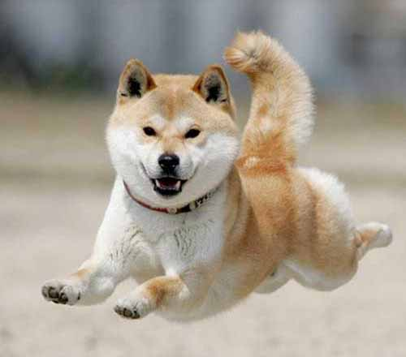
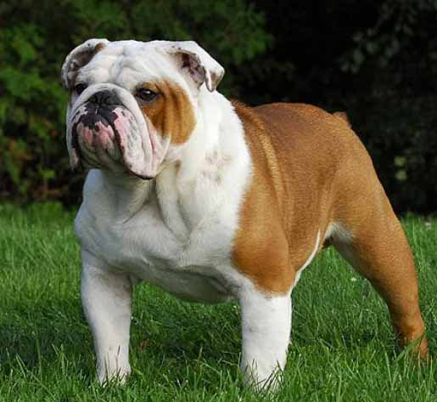
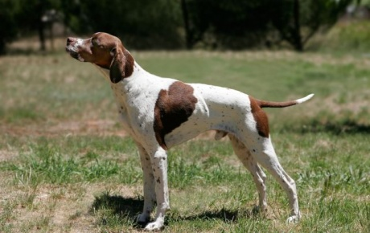
THERE ARE FOUR DOGS

Slide 13
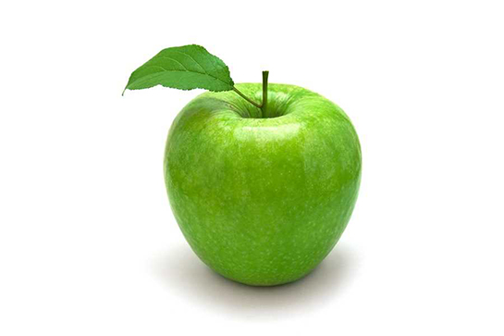
THERE IS AN APPLE.

Slide 14
THERE ARE SEVEN APPLES.

Slide 15
TEKİLSE THERE IS ÇOĞULSA THERE ARE

Slide 16
SESSİZ HARFTEN ÖNCE A SESLİ HARFTEN ÖNCE AN

Slide 17
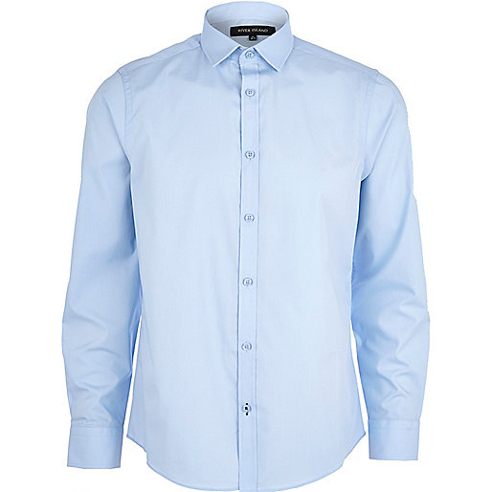
THERE IS A SHIRT.

Slide 18
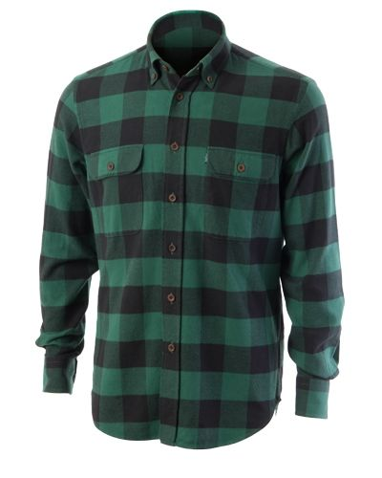
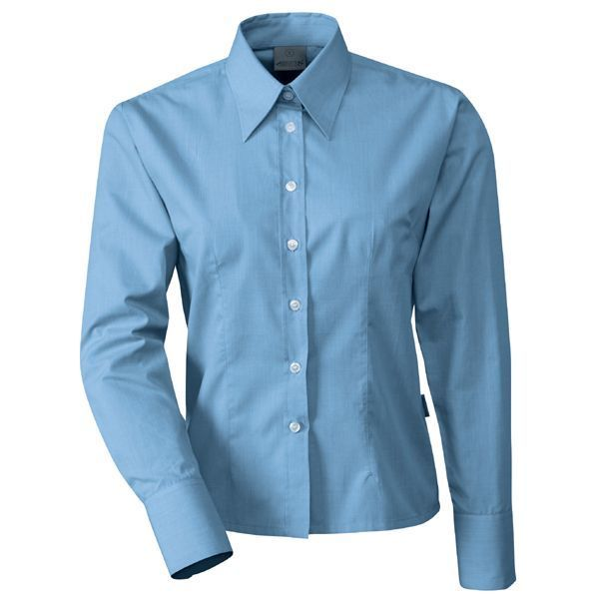
THERE ARE TWO SHIRTS.

Slide 19
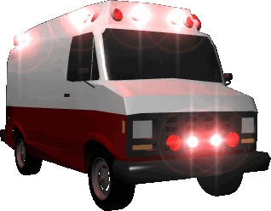
THERE IS AN AMBULANCE.

Slide 20
THERE ARE FIVE AMBULANCES.
zB17

