Slide 1
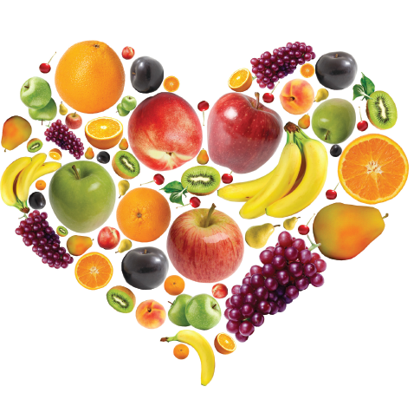
Fruits

Slide 2
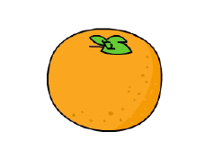
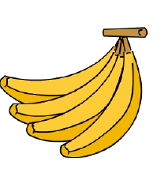
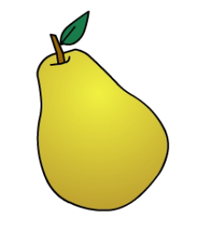
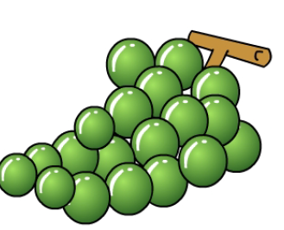
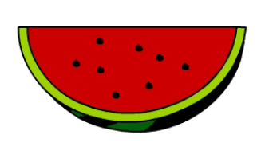
apple
orange
strawberry
banana
pear
grapes
watermelon
lemon

Slide 3
* grapes
* pear
* lemon
* apple
* watermelon
* strawberry
* orange
* banana

Slide 4
I like …………… . ………….. yı severim .
I like apple. Elmayı severim .
I like pear.
I like lemon.
I like apple.
I like strawberry.
I like grapes.
I like banana.
I like orange.
I like watermelon.

Slide 5
I don’t like ……… . …….. yı sevmem .
I don’t like apple. Elmayı sevmem .
I don’t like pear.
I don’t like lemon.
I don’t like apple.
I don’t like strawberry.
I don’t like grapes.
I don’t like banana.
I don’t like orange.
I don’t like watermelon.

Slide 6
1. I like apple .
I don’t like apple.
5. I like watermelon .
I don’t like watermelon.
2. I like banana .
I don’t like banana.
6. I like lemon .
I don’t like lemon.
7. I like orange .
I don’t like orange.
3. I like grapes .
I don’t like grapes.
4. I like pear .
I don’t like pear.
8. I like strawberry .
I don’t like strawnberry.

Slide 7
 | Apple | Banana | Grapes | Watermelon | Strawaberyy | Lemon | Orange | Pear
I like apple.
I like strawberry.
I like banana.
I don’t like lemon.
I don’t like grapes.
I like orange.
I like watermelon .
I don’t like pear.

Slide 8
a. I like pear
b. I like lemon
c. I don’t like pear
a. I like grapes.
b. I don’t like strawberry.
c. I don’t like grapes.
a. I like pear.
b. I like orange.
c. I don’t like orange.
a. I like strawberry.
b. I like watermelon.
c. I don’t like watermelon.
a. I don’t like banana.
b. I like banana.
c. I don’t like apple.
a. I like pear.
b. I like apple.
c. I don’t like apple.

Slide 9
a. I like pear.
b. I like lemon.
c. I don’t like lemon.
a. I like strawberry.
b. I don’t like watermelon.
c. I don’t like strawberry.

