Slide 1
What animal?
Notes:
www.egitimhane.com

Slide 2
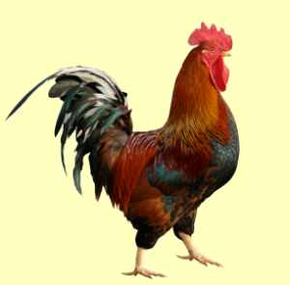
Who am I?
I am red.
I can sing. I can fly.

Slide 3
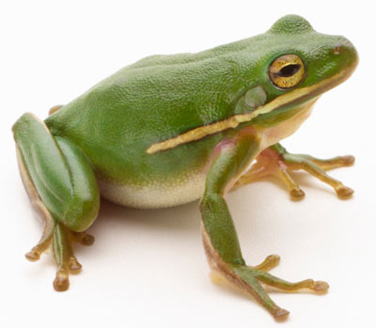
Who am I?
I am green.
I can jump. I can swim.

Slide 4
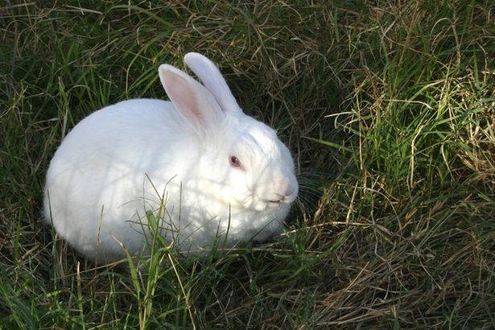
Who am I?
I am white.
I can jump.

Slide 5
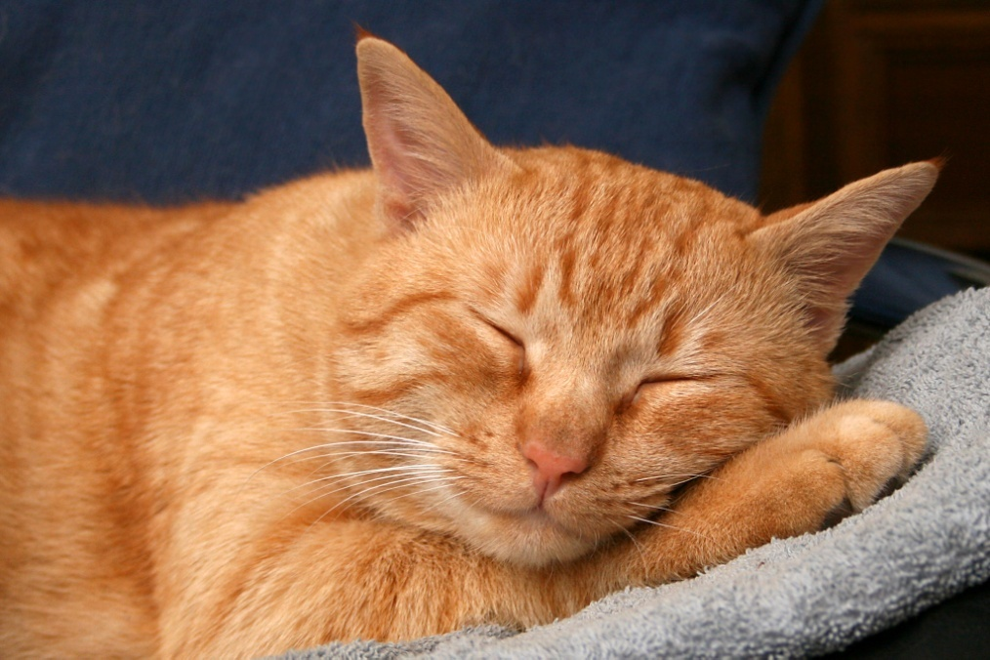
Who am I?
I am red.
I can run and jump.
I can`t fly.

Slide 6
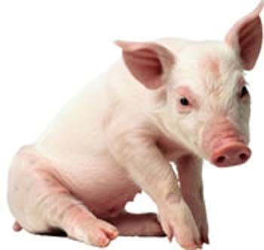
Who am I?
I am pink. I can run.

Slide 7
Links:
Template:
http://www.free-power-point-templates.com/chameleon-powerpoint-template/
Pictures:
http://static.ddmcdn.com/gif/frog-1.jpg - a frog
http://img.ehowcdn.com/article-new/ehow/images/a04/8m/t6/make-rabbit-costume-800x800.jpg - a rabbit
http://4.bp.blogspot.com/_9U64aLFKd9g/TJ8ZeTAhGwI/AAAAAAAAAFU/u1Y03_C9oEA/s1600/cockerel.jpg - a cockerel
http://upload.wikimedia.org/wikipedia/commons/4/48/RedCat_8727.jpg -
a red cat
http://technode.com/wp-content/uploads/2011/02/pig.jpg - a pig
M.Z.Biboletova. Enjoy English – 2 – Obninsk: Titul, 2012.
Vladislav Yurevich Bykov,
the teacher of English
of MEI “Borskaya Primary School”,
Leningradskaya oblast, Tikhvinsky region, village Bor, 2012
Notes:
www.egitimhane.com

