Slide 1
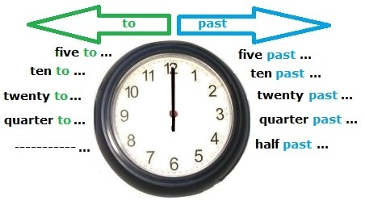
WHAT’S THE TİME ? – WHAT TİME İS İT ?

Slide 2


What’s the time ? – What time is it ?
It’s five to one.
It’s ten to two.
It’s quarter to three.
It’s twenty to four.
It’s twenty-five to five.
It’s twenty-seven to seven.
…
Note : Ante meridiem (am)
It’s five past one.
It’s ten past two.
It’s quarter past three.
It’s twenty past four.
Ity’s twenty-five past five.
It’s twenty-seven past seven.
It’s half past eight.
Note : post meridiem (pm)

Slide 3
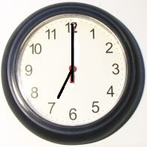
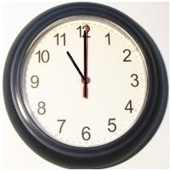
The Time - Hours
It’s seven o’clock.
It’s eleven o’clock.

Slide 4
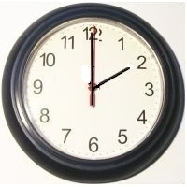
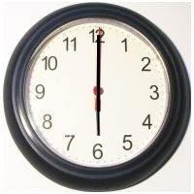
It’s two o’clock.
It’s six o’clock.

Slide 5
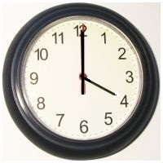
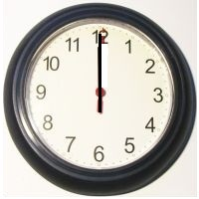
It’s four o’clock.
It’s twelve o’clock.

Slide 6
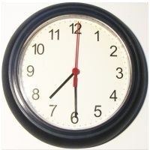
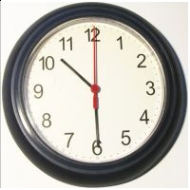
The Time – Half Past
İt’s half past seven.
İt’s half past ten.

Slide 7
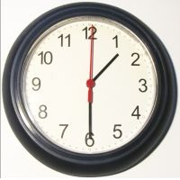
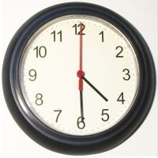
İt’s half past one.
İt’s half past four.

Slide 8
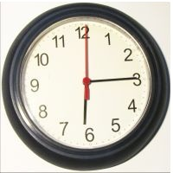
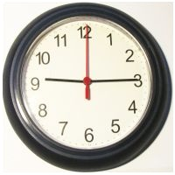
The Time – Quarter Past
İt’s quarter past six.
İt’s quarter past nine.

Slide 9
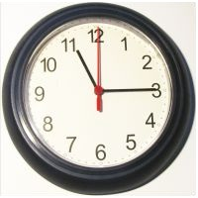
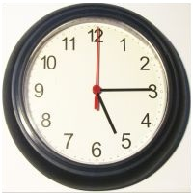
İt’s quarter past eleven.
İt’s quarter past five.

Slide 10
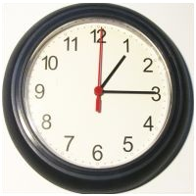
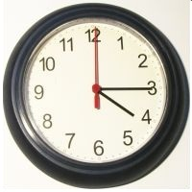
İt’s quarter past one.
İt’s quarter past four.

Slide 11
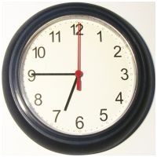
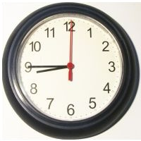
The Time – Quarter To
İt’s quarter to seven.
İt’s quarter to nine.

Slide 12
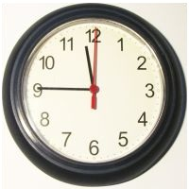
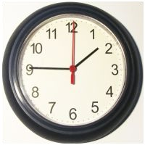
İt’s quarter to twelve.
İt’s quarter to two.

Slide 13
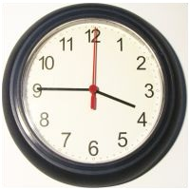
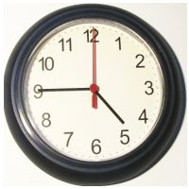
İt’s quarter to four.
İt’s quarter to five.

Slide 14
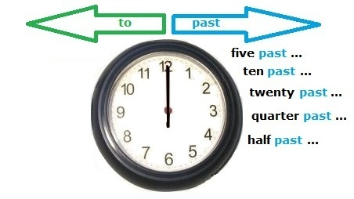
Time – «Past»

Slide 15
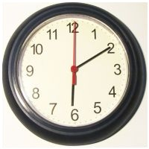
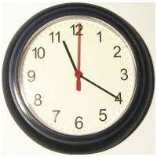
İt’s ten past six.
İt’s twenty past eleven.

Slide 16
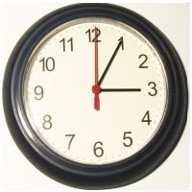
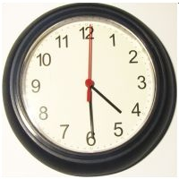
İt’s five past three.
İt’s twenty-nine past four.

Slide 17
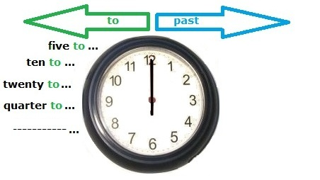
Time – «To»

Slide 18
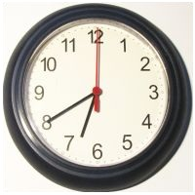
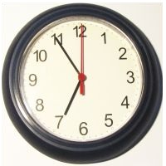
İt’s twenty to seven.
İt’s five to seven.

Slide 19
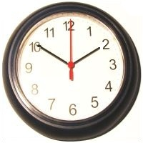
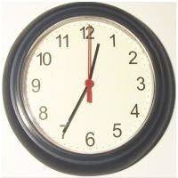
İt’s ten to two.
İt’s twenty-five to one.

Slide 20
English Time Exercises

Slide 21
İt’s ……. ……. .
İt’s ……. ……. ……. .

Slide 22
İt’s ……. ……. ……. .
İt’s ……. ……. ……. .

Slide 23
İt’s ……. ……. ……. .
İt’s ……. ……. ……. .

Slide 24
İt’s ……. ……. ……. .
İt’s ……. ……. ……. .

Slide 25
İt’s ……. ……. ……. .
İt’s ……. ……. ……. .

