Slide 1
Unit 1 – Words
Unit 1 – Words
www.eegitimim.com

Slide 2
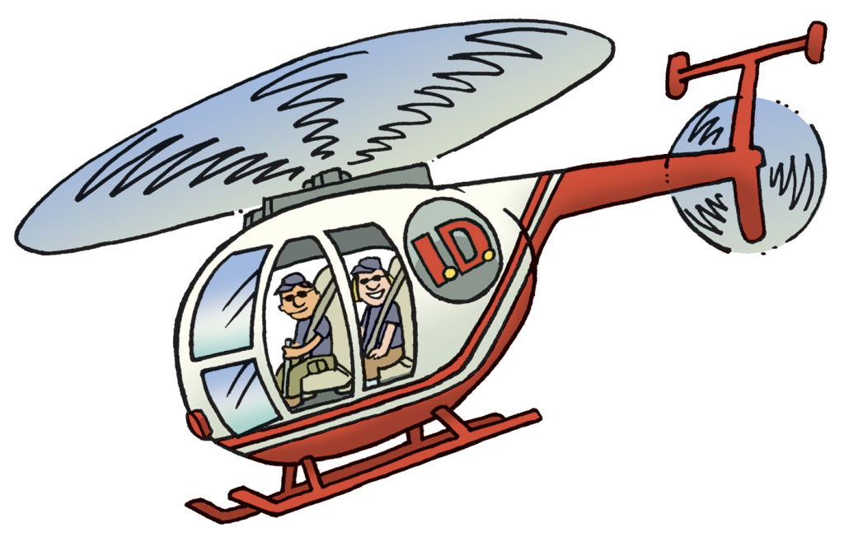
Unit 1 – Words
Helicopter

Slide 3
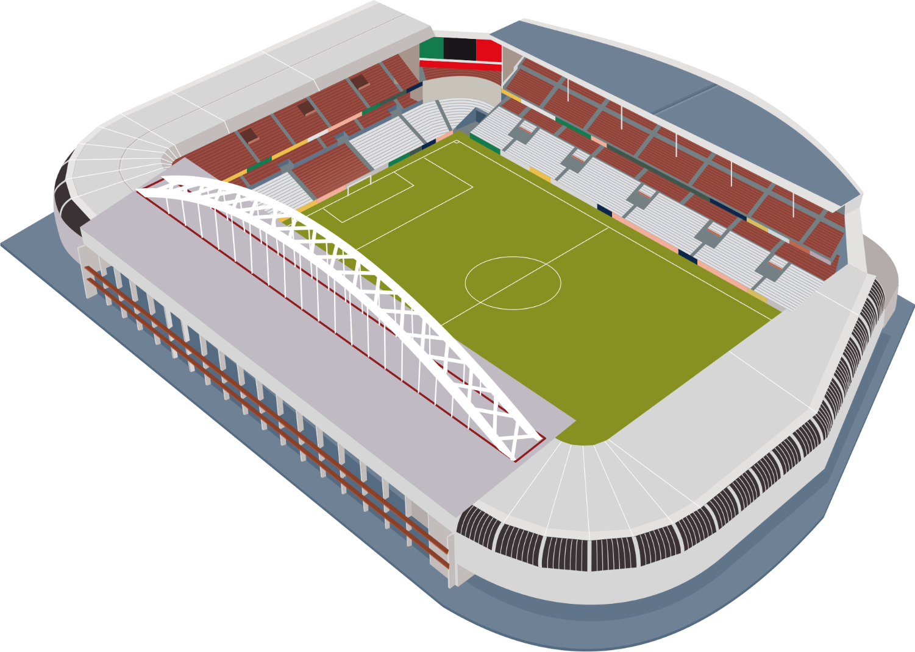
Unit 1 – Words
Stadium

Slide 4
Unit 1 – Words
Hospital
Ambulance

Slide 5
Unit 1 – Words
Hotel

Slide 6
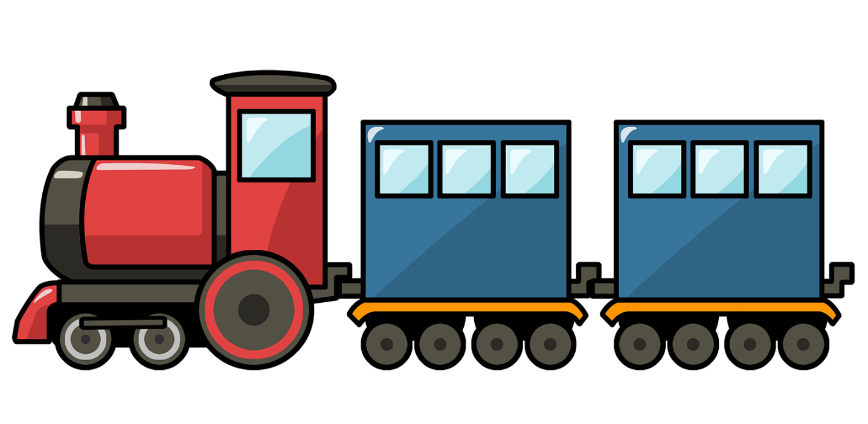
Unit 1 – Words
Train

Slide 7
Unit 1 – Words
Gorilla

Slide 8
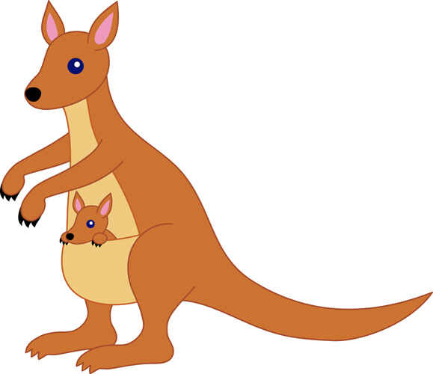
Unit 1 – Words
Kangaroo

Slide 9
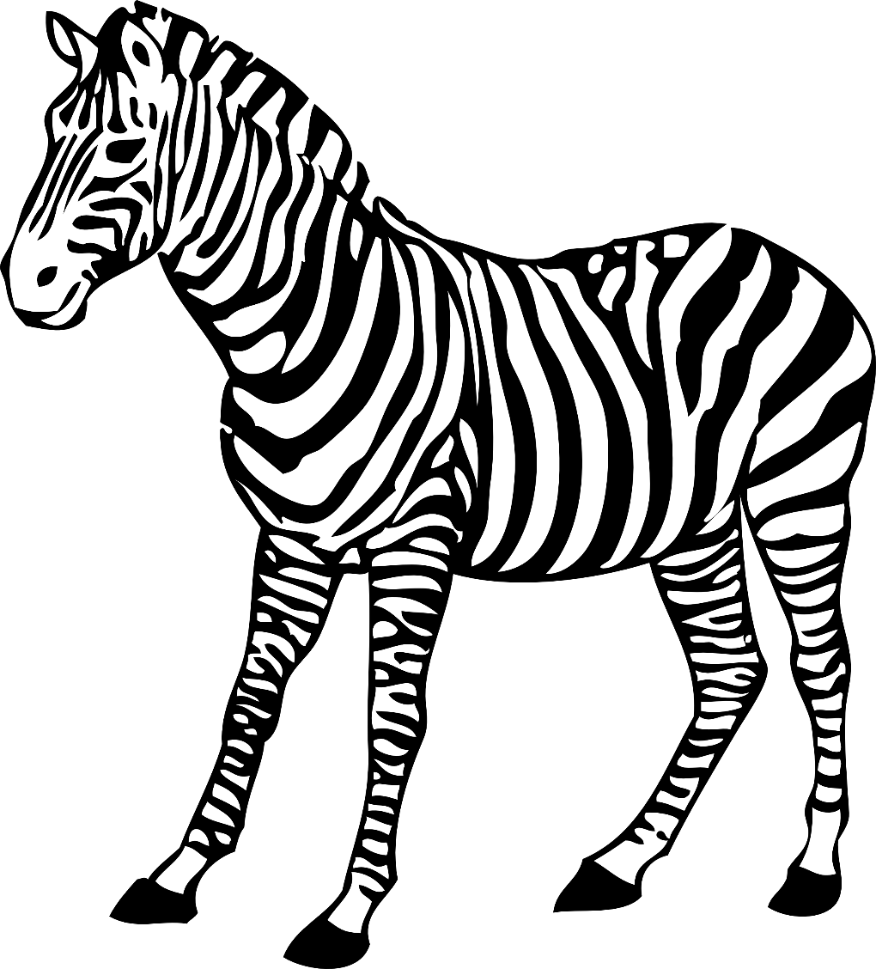
Unit 1 – Words
Zebra

Slide 10
Unit 1 – Words
Lemon

Slide 11
Unit 1 – Words
Balloon

Slide 12
Unit 1 – Words
Camp

Slide 13
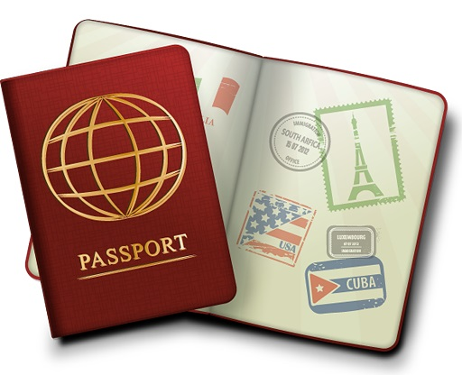
Unit 1 – Words
Passport

Slide 14
Unit 1 – Words
Wagon

Slide 15
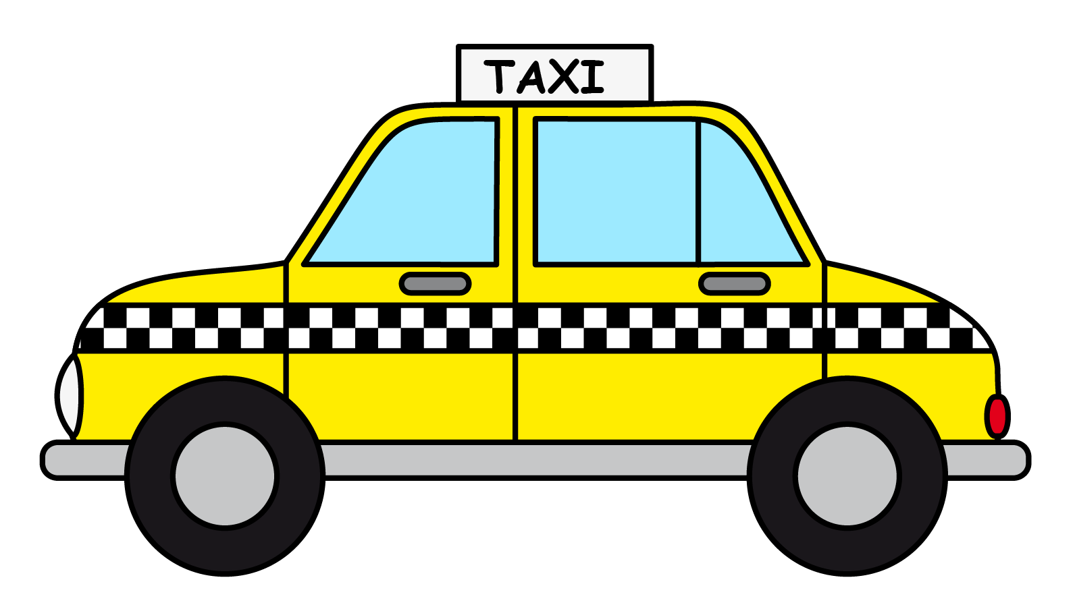
Unit 1 – Words
Taxi

Slide 16
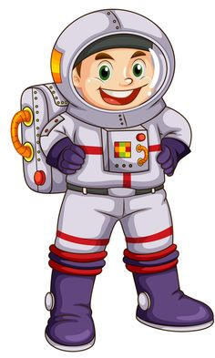
Unit 1 – Words
Astronaut

Slide 17
Unit 1 – Words
Cake

Slide 18
Unit 1 – Words
Microphone

Slide 19
Unit 1 – Words
Radio

Slide 20
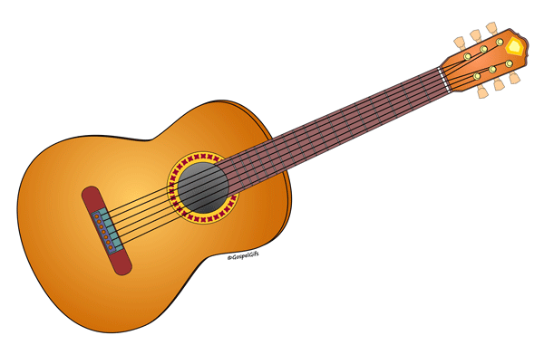
Unit 1 – Words
Guitar

Slide 21
Unit 1 – Words
Television

Slide 22
Unit 1 – Words
Piano

Slide 23
Unit 1 – Words

