Slide 1
UNIT 1
WORDS

Slide 2
Word(s)

Slide 3
ambulance

Slide 4
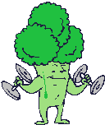
broccoli

Slide 5
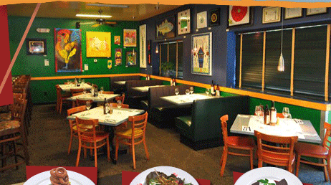
cafeteria

Slide 6
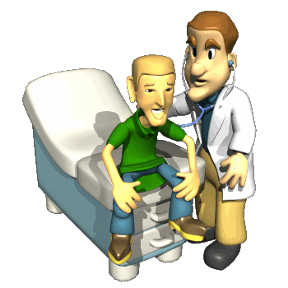
doctor

Slide 7
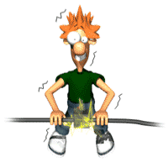
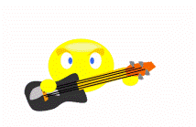
electric

Slide 8
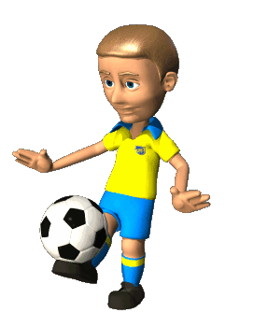
football

Slide 9
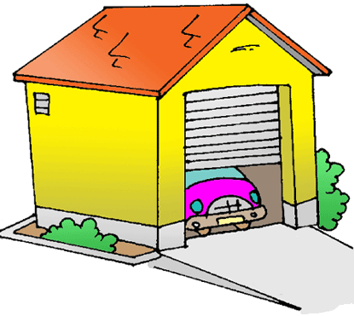
garage

Slide 10
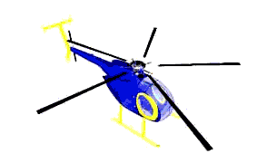
helicopter

Slide 11
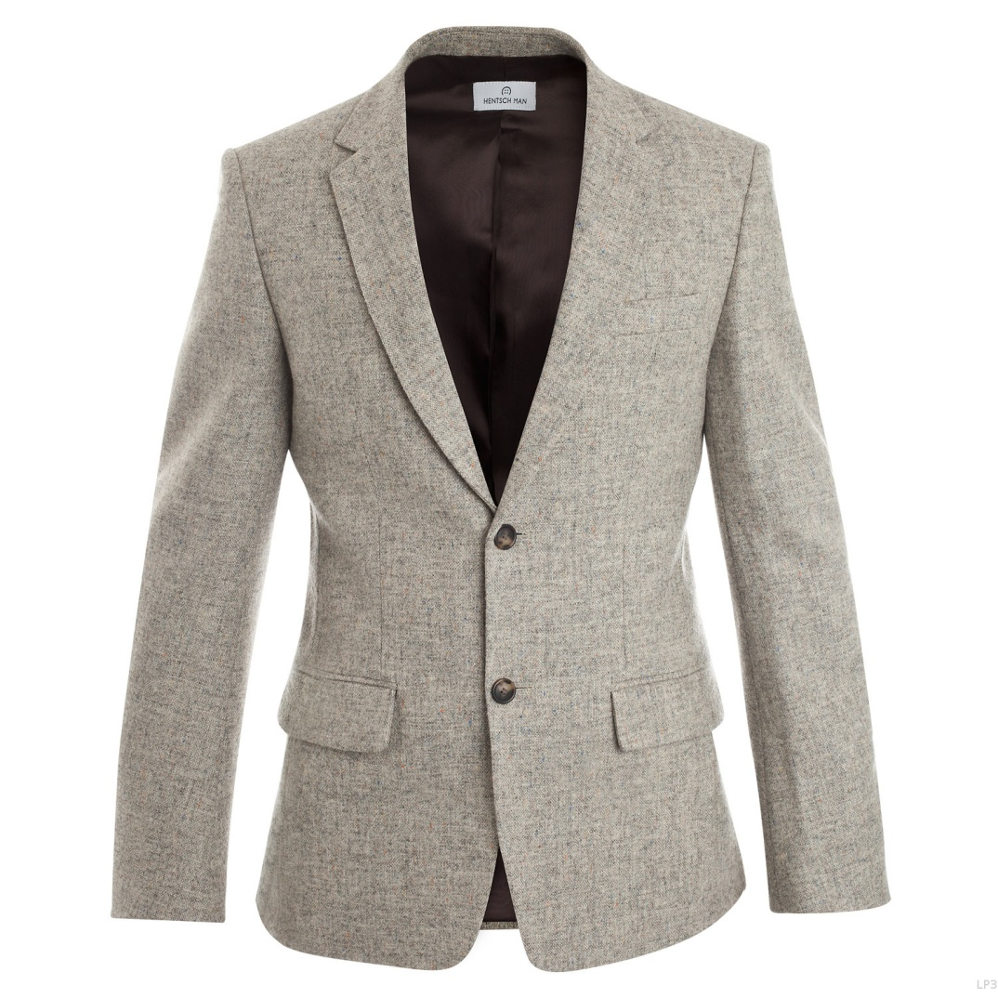
jacket

Slide 12
Italy

Slide 13
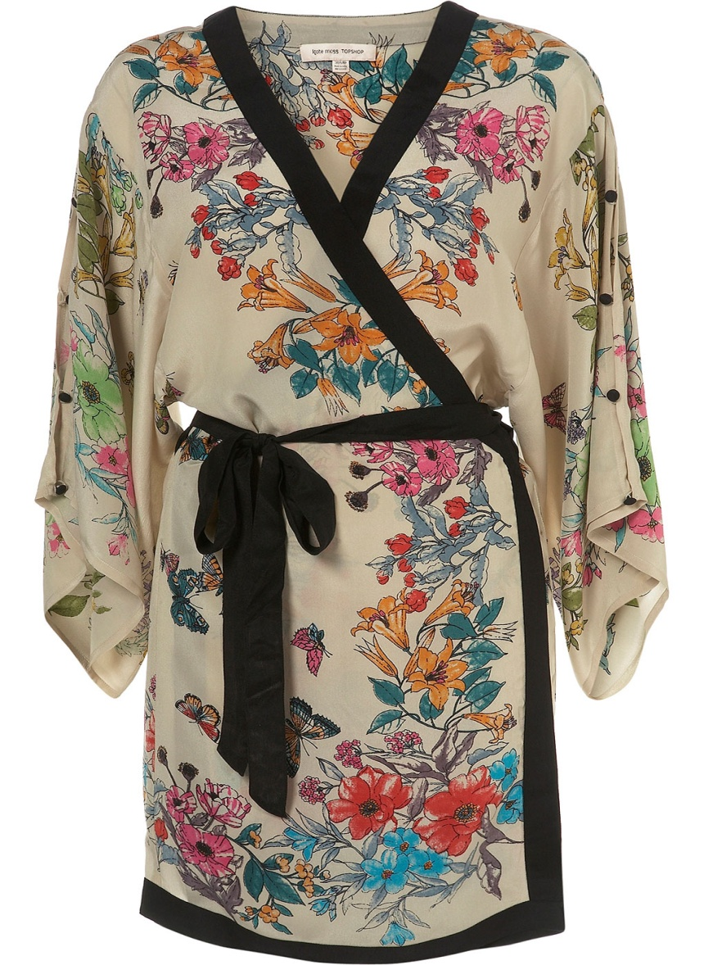
kimono

Slide 14
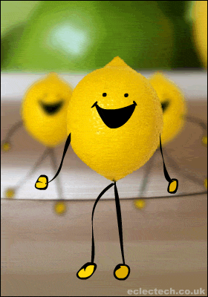
lemon

Slide 15
music

Slide 16
negative

Slide 17
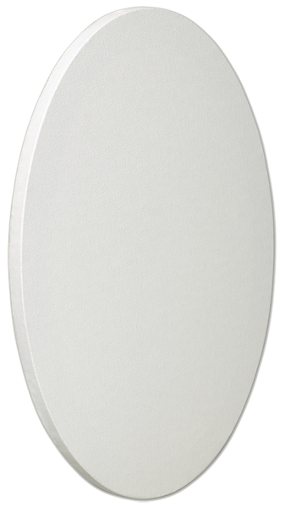
oval

Slide 18
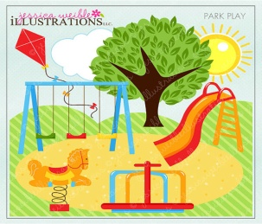
park

Slide 19
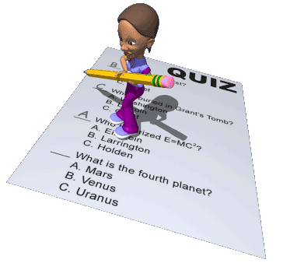
xxxxx
quiz

Slide 20
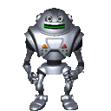
robot

Slide 21
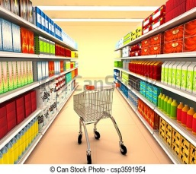
supermarket

Slide 22
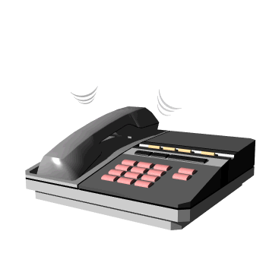
telephone

Slide 23
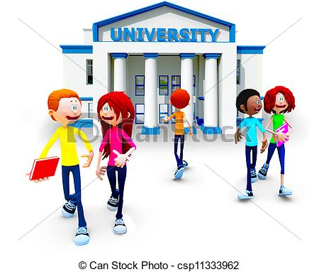
xxxxxxxxxxxxx
university

Slide 24
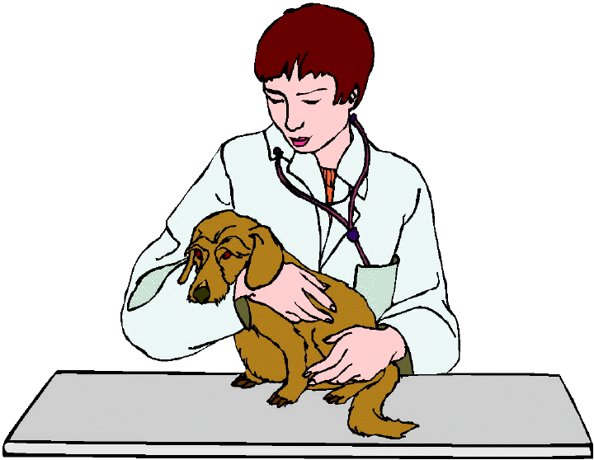
veterinerian

Slide 25
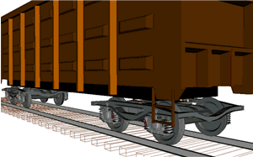
wagon

Slide 26
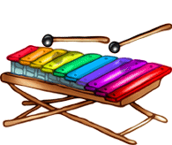
xylophone

Slide 27
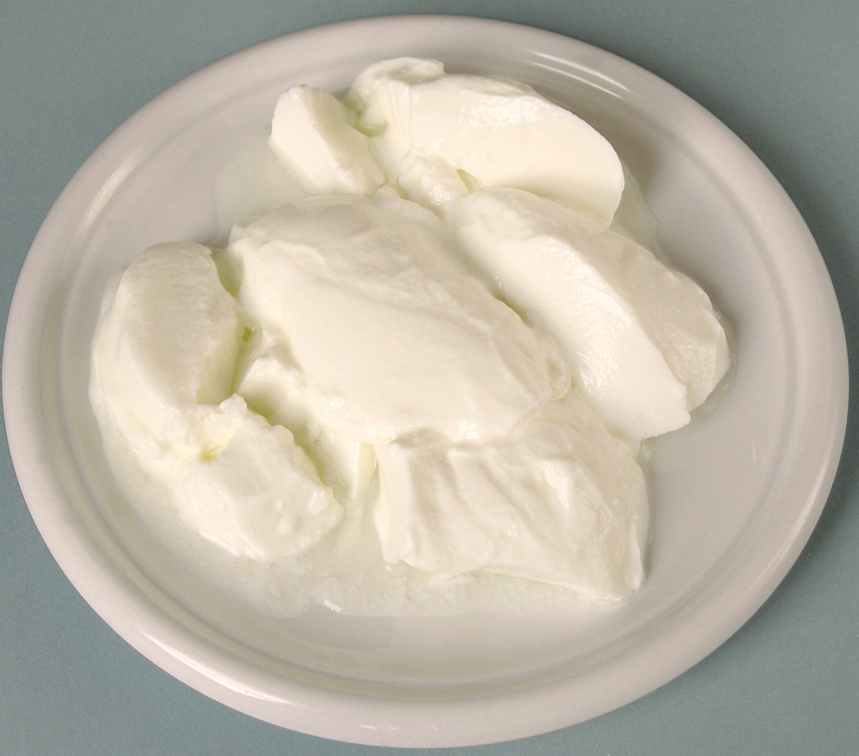
yoghurt

Slide 28
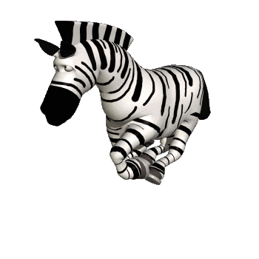
zebra

Slide 29
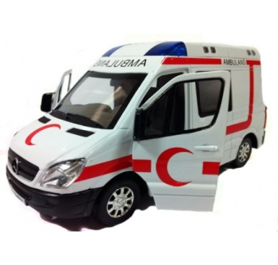
What ? = ne ? That = o,şu
A: What’s that?
B: That’s a robot.
That’s an ambulance.
That’s electric.

Slide 30
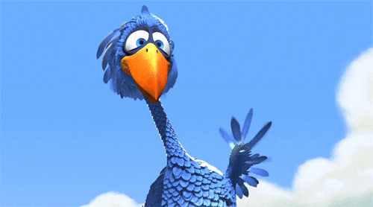
Tolga BENLİ E.L. Teacher

