Slide 1
ANIMALS

Slide 9
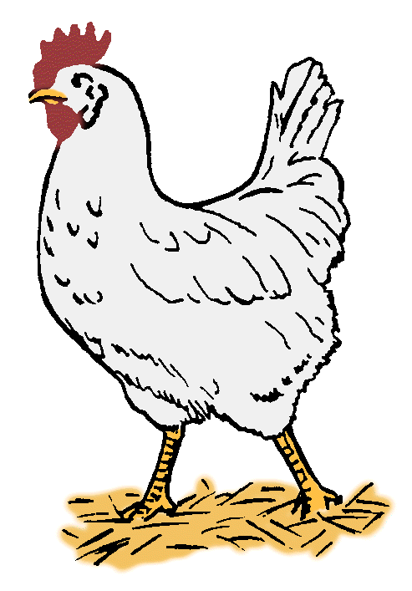

Slide 10
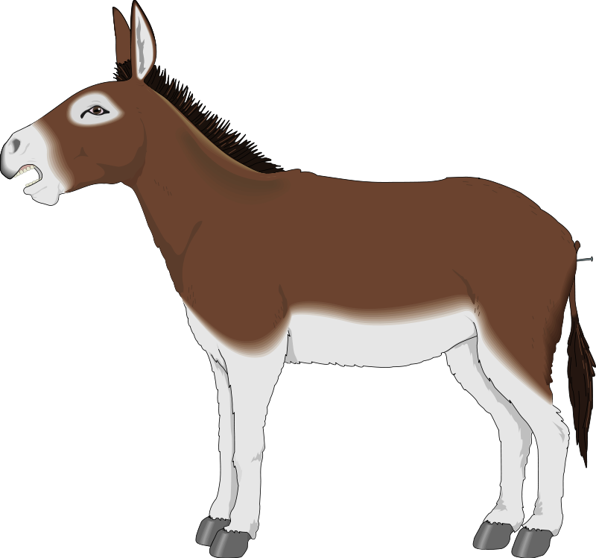

Slide 14
The end!...
www.eegitimim.com

