Slide 1
A School

Slide 2
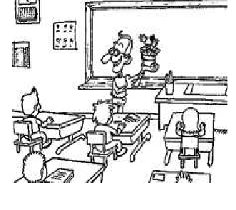
A classroom
teacher
students

Slide 3
A door

Slide 4
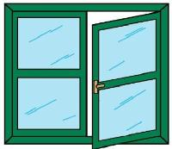
A window

Slide 5
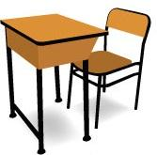
A desk
A chair

Slide 6
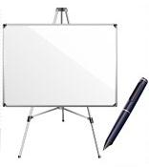
A board

Slide 7
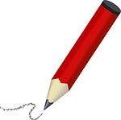
A pencil

Slide 8
A ruler

Slide 9
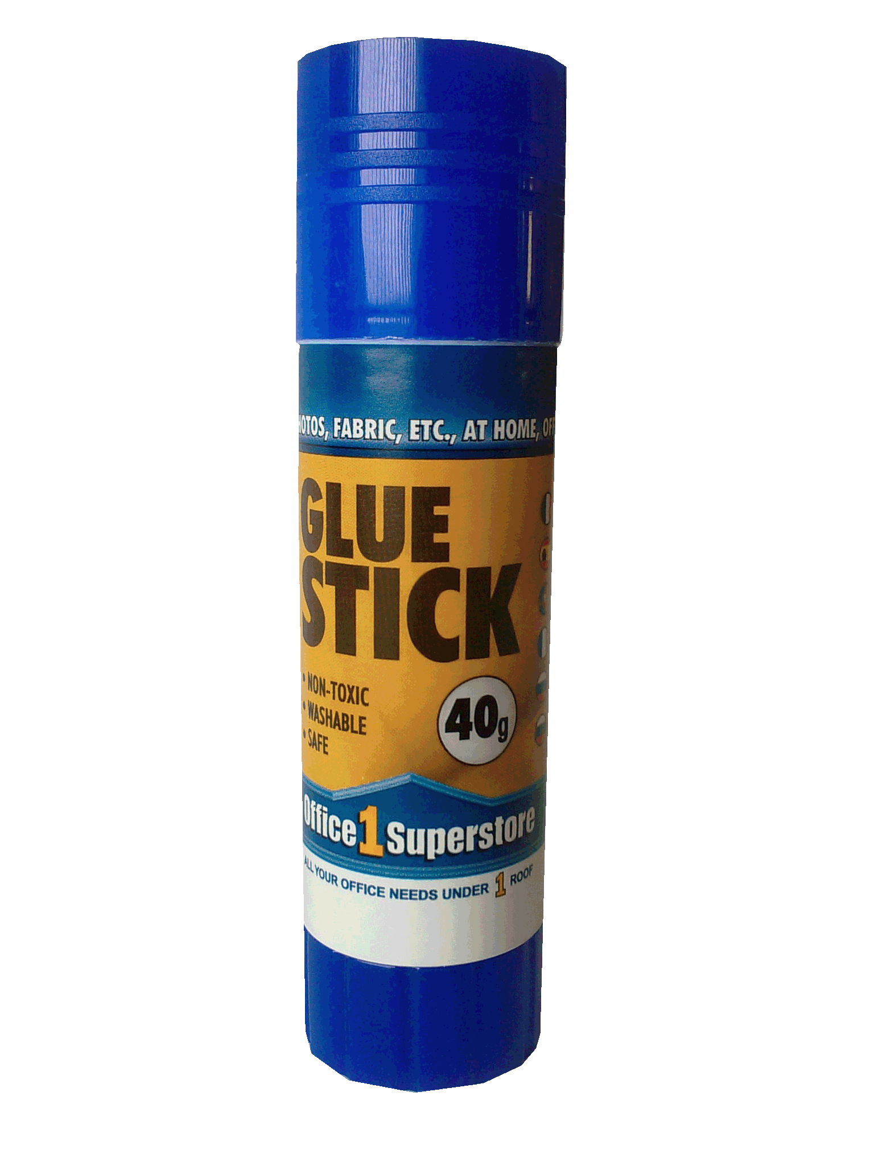
A glue

Slide 10
Scissors

Slide 11
A rubber

Slide 12
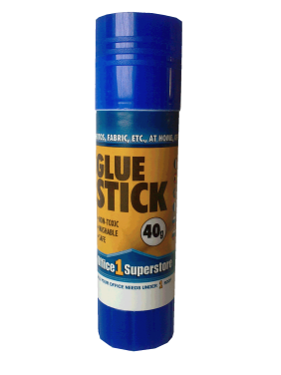

Slide 13
A notebook

Slide 14
A book

Slide 15
A schoolbag

Slide 16
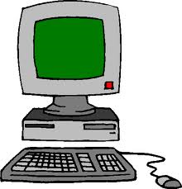
A computer

Slide 17
A dustbin

