Slide 1
UNIT 4
NUMBERS

Slide 2
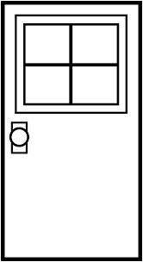
How many doors are there?

Slide 3
a door

Slide 4
two doors

Slide 5
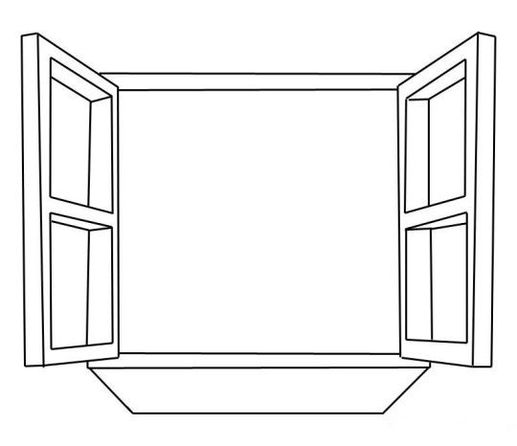
How many windows are there?

Slide 6
a window

Slide 7
four windows

Slide 8
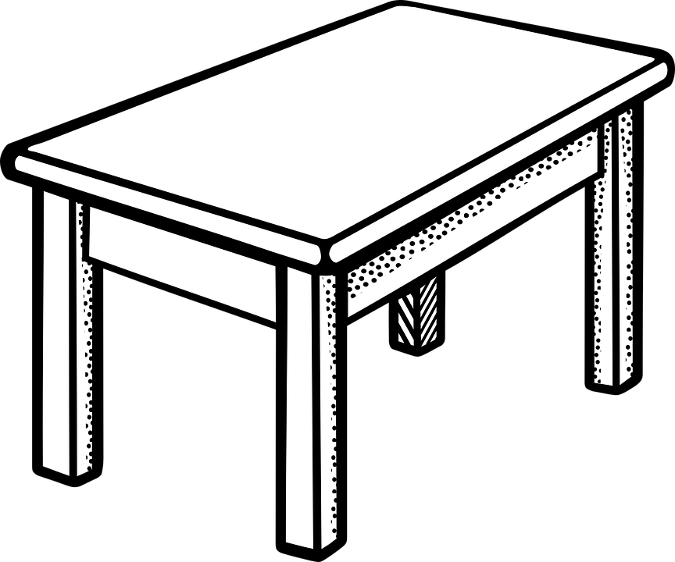
How many tables are there?

Slide 9
a table

Slide 10
six tables

Slide 11
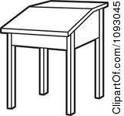
How many desks are there?

Slide 12
a desk

Slide 13
seven desks

Slide 14
How many school bags are there?

Slide 15
a school bag

Slide 16
ten school bags

Slide 17
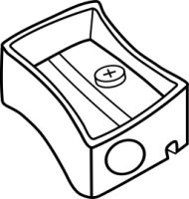
How many pencil sharpeners are there?

Slide 18
a pencil sharpener

Slide 19
five pencil sharpeners

Slide 20
How many pencils are there?

Slide 21
a pencil

Slide 22
eight pencils

Slide 23
How many rulers are there?

Slide 24
a ruler

Slide 25
nine rulers

