Slide 1
A BALL

Slide 2
A BLUE BALL

Slide 3
TWO BLUE BALLS

Slide 4
THREE BLUE BALLS

Slide 5
AN APPLE

Slide 6
A RED APPLE

Slide 7
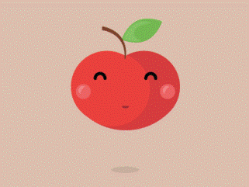
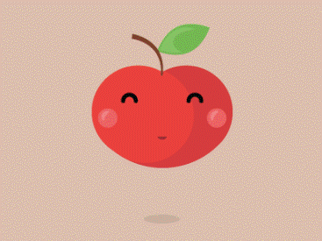
FOUR RED APPLES

Slide 8
A CAR

Slide 9
A GREEN CAR

Slide 10
FIVE GREEN CARS

Slide 11
EIGHT GREEN CARS

Slide 12
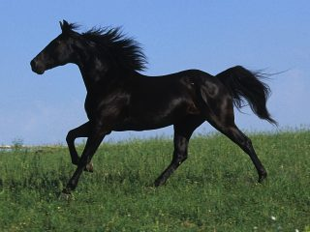
BLACK HORSE

Slide 13
A BLACK HORSE

Slide 14
TEN BLACK HORSES

Slide 15
FOUR BLACK HORSES

Slide 16
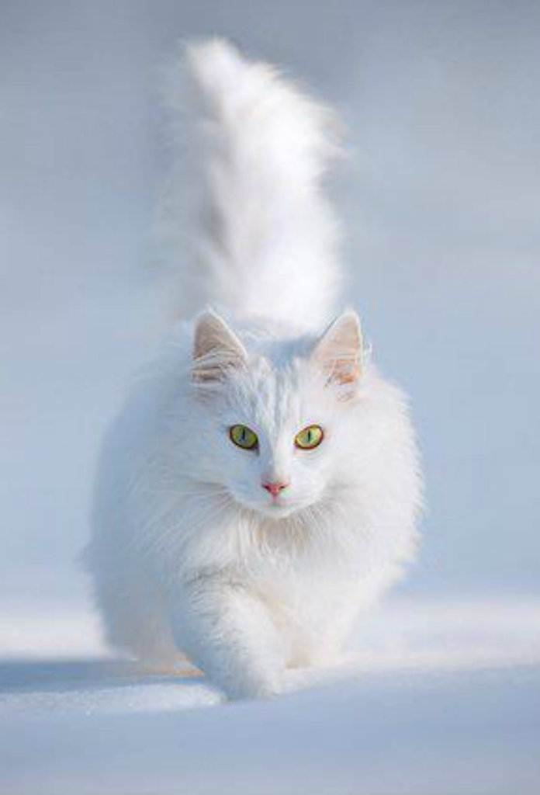
THERE IS A WHITE CAT

Slide 17
THERE ARE THREE WHITE CATS

Slide 18
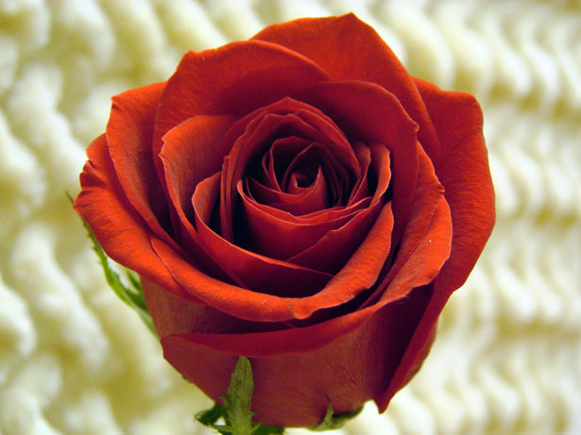
THERE IS A RED FLOWER

Slide 19
THERE ARE TWO FLOWERS

Slide 20
THERE IS A BROWN STAR

Slide 21
THERE ARE NINE BROWN STARS

Slide 22
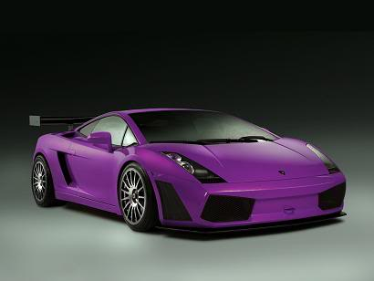
THERE ARE ____ _____ CARS.

Slide 23
THERE IS ___ ____ PENCIL.

Slide 24
THERE ARE ____ ______ BOOKS.

Slide 25
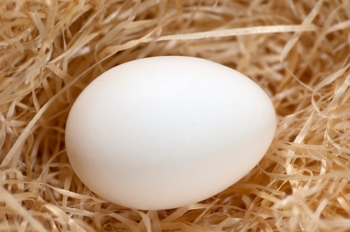
THERE ARE _____ _____ EGGS.

Slide 26
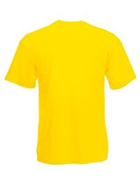
THERE ____ _____ _____ T-SHIRTS.

Slide 27
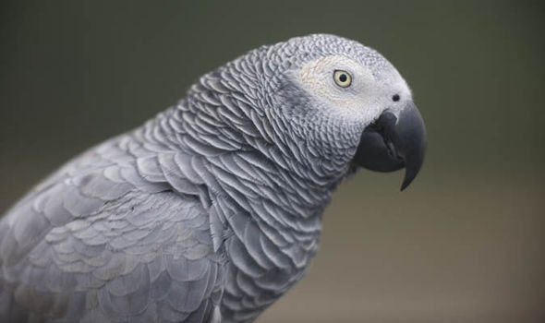
THERE ___ ____ ____ BIRD.

Slide 28
THERE ____ _____ ____ SCISSORS.

Slide 29
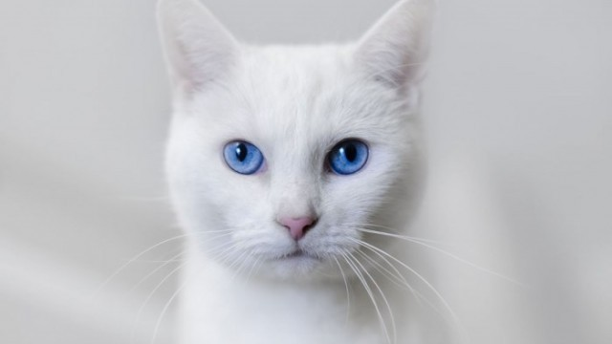
THERE ___ ____ ____ CAT.

Slide 30
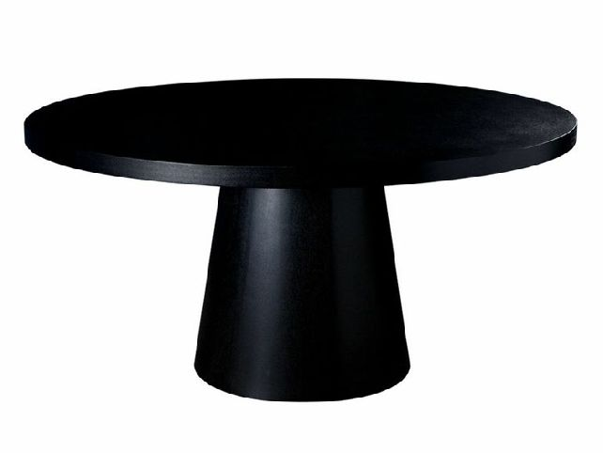
THERE ___ ___ ___ TABLES.
zB17

