Slide 1
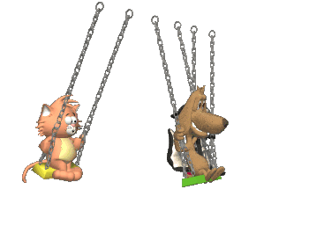
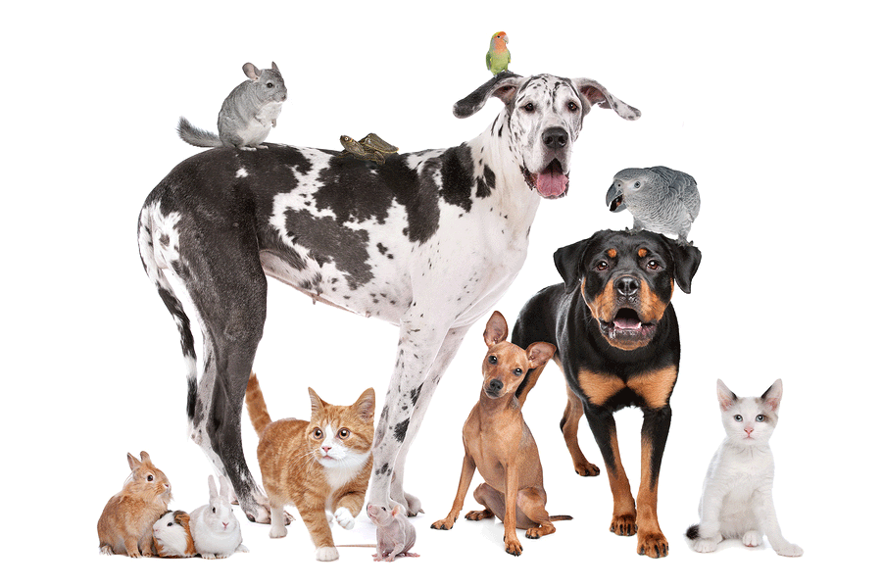
PETS

Slide 2
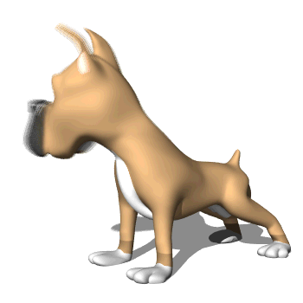
dog

Slide 3
cat

Slide 4
bird

Slide 5
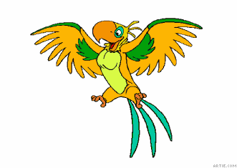
parrot

Slide 6
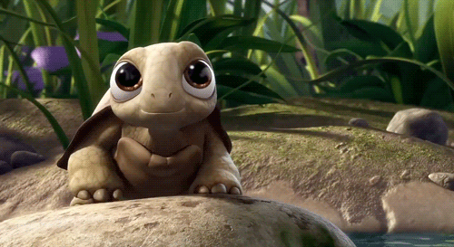
turtle

Slide 7
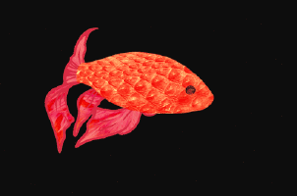
fish

Slide 8
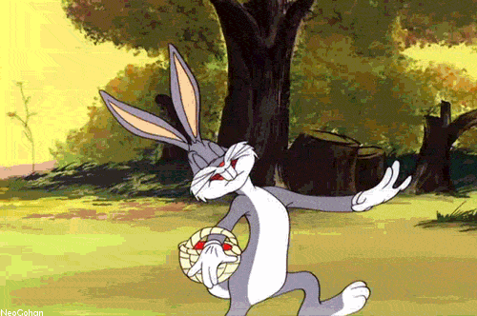
rabbit

Slide 9
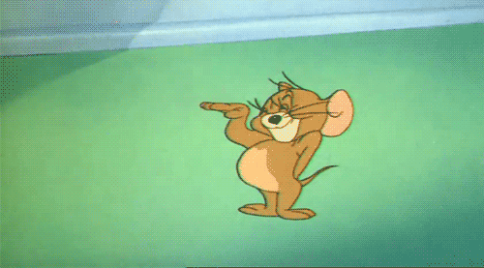
mouse

Slide 10
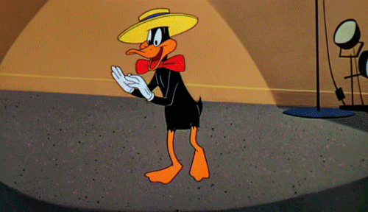
duck

Slide 11
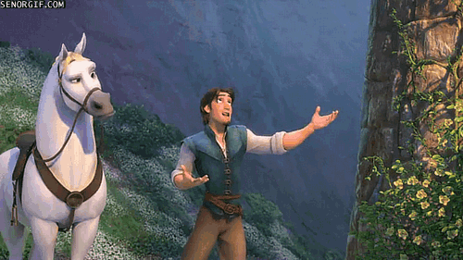
horse

Slide 12
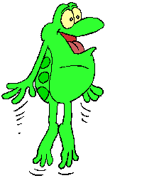
frog

Slide 13
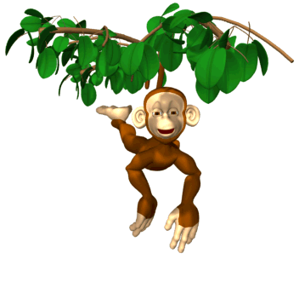
monkey

Slide 14
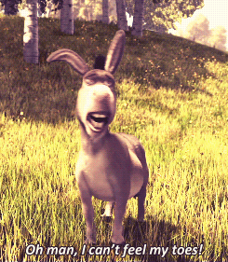
donkey

Slide 15
tree

Slide 16
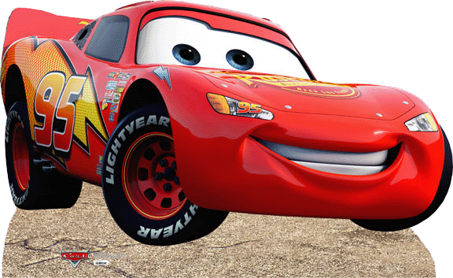
car

Slide 17
Where

Slide 18
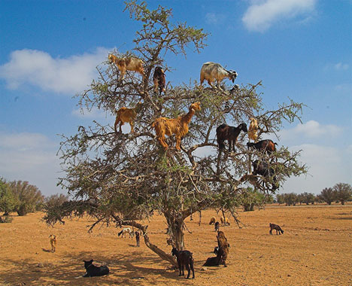
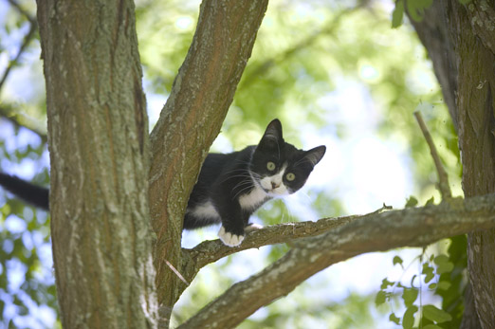
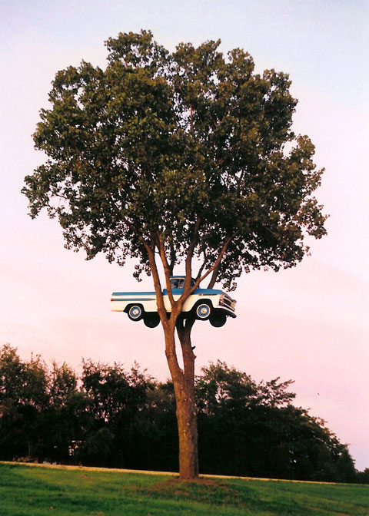
in the tree

Slide 19
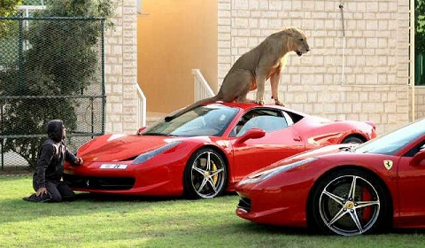
on the car

Slide 20
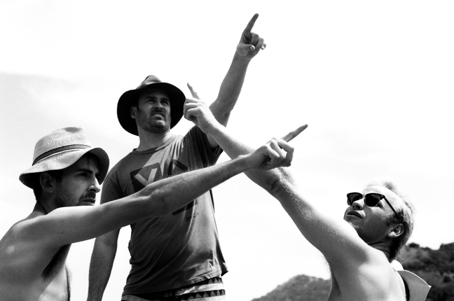
over there / right there

Slide 21
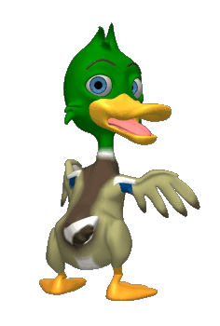
fish
rabbit
duck

Slide 22
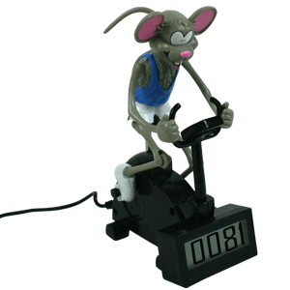
dog
mouse
cat

Slide 23
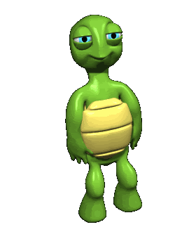
fish
frog
turtle

Slide 24
A- What is this?
B- It is a dog.

Slide 25
A- What is this?
It is a rabbit
B- ………………..

Slide 26
A- What is this?
It is a bird
B- ………………..

Slide 27
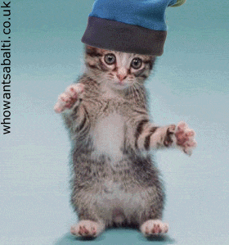
A- What is this?
It is a cat
B- ………………..

Slide 28
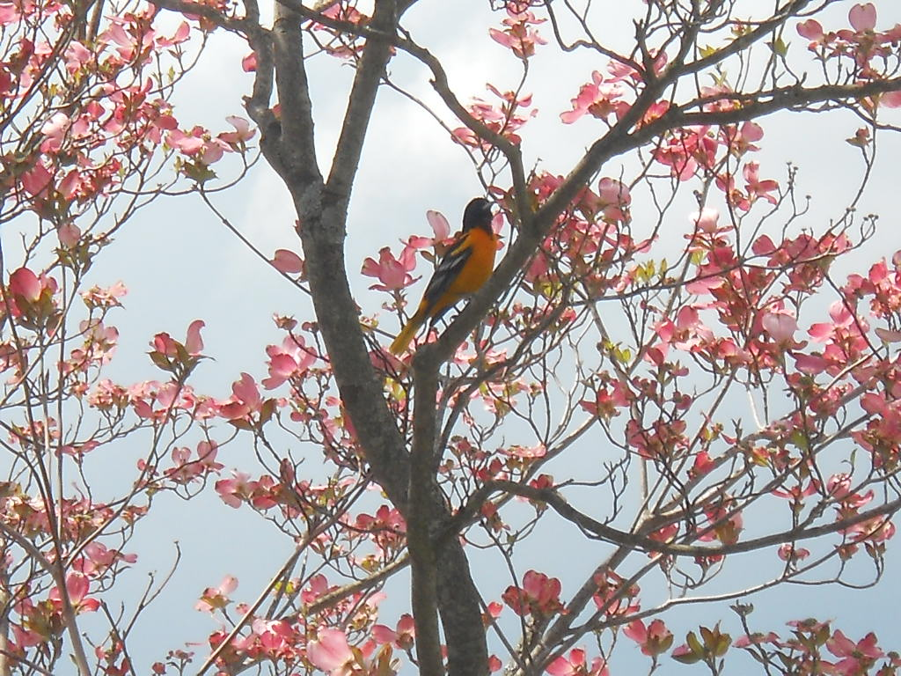
A- Where is the bird ?
It is in the tree
B- ………………..

Slide 29
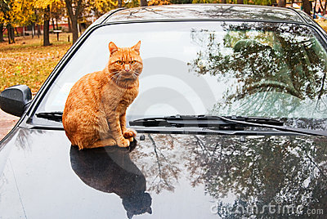
A- Where is the cat ?
It is on the car
B- ………………..

Slide 30
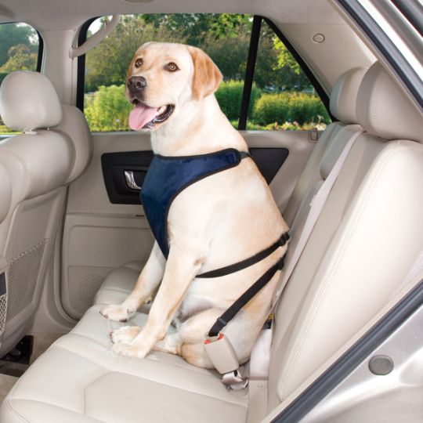
A- ……………………..?
Where is the dog
It is in the car
B- ………………..

Slide 31
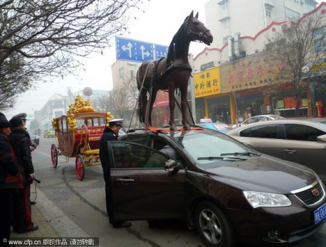
A- ……………………..?
Where is the horse
It is on the car
B- ………………..

Slide 32
A- ………………………?
Where is the bird
It is over there
B- ………………..

Slide 33
www.eegitimim.com

