Slide 1
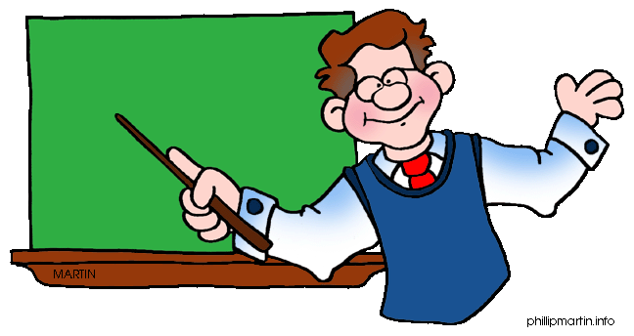
There is
There are

Slide 2
There is one bag.
There are three bags.

Slide 3
There is one clock.
There are two clocks.

Slide 4
There is one window.
There are four windows.

Slide 5
There is one duck.
There are five ducks.

Slide 6
There are eight balloons.

Slide 7
There is one pencil.

Slide 8
There are six books.

Slide 9
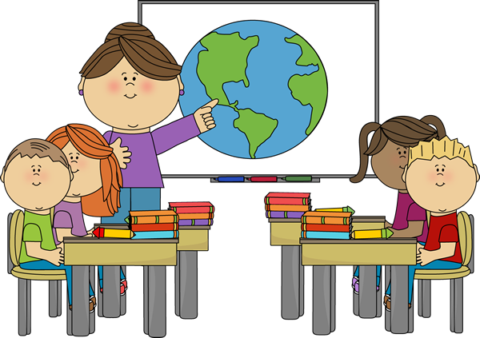
There are four students.

Slide 10
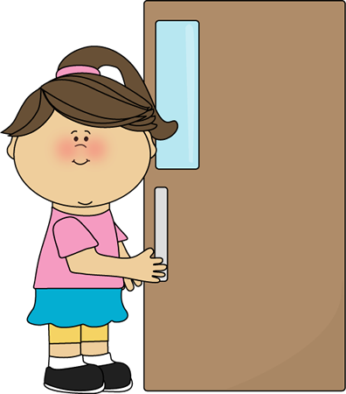
There is one door.

Slide 11
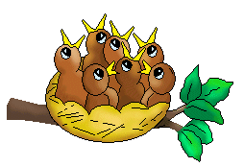
There are seven birds.

Slide 12
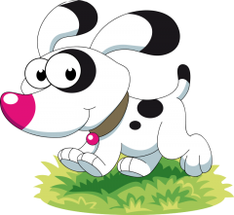
There is one dog.

Slide 13
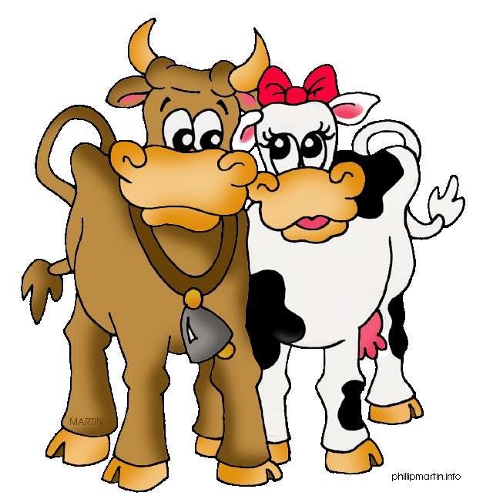
There are two cows.

Slide 14
There is one cake.

Slide 15
There are two gifts.

Slide 16
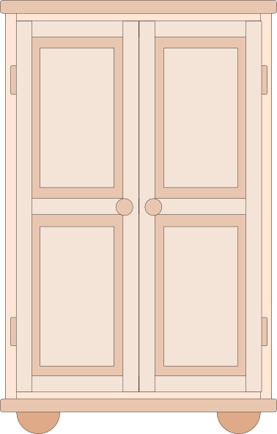
There is one cupboard.

Slide 17
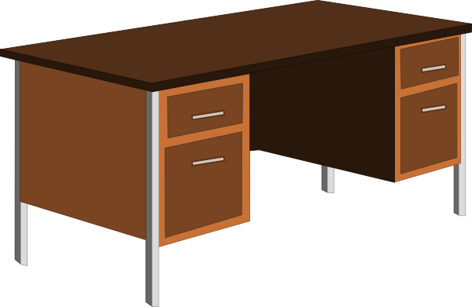
There is one table.

Slide 18
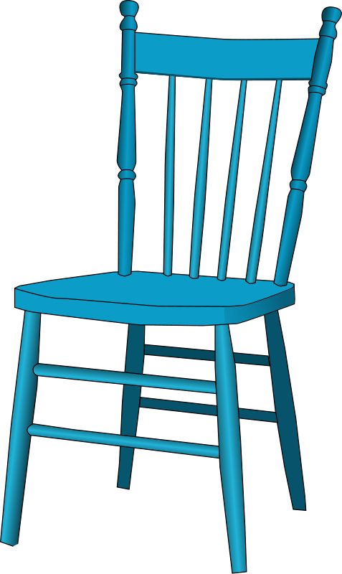
There are four chairs.

Slide 19
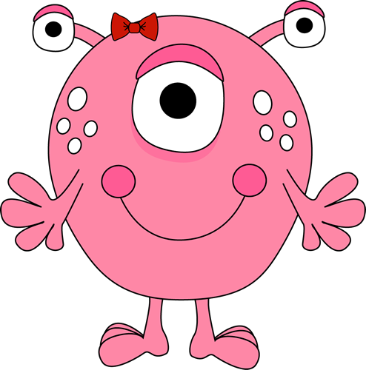
There are three eyes.

Slide 20
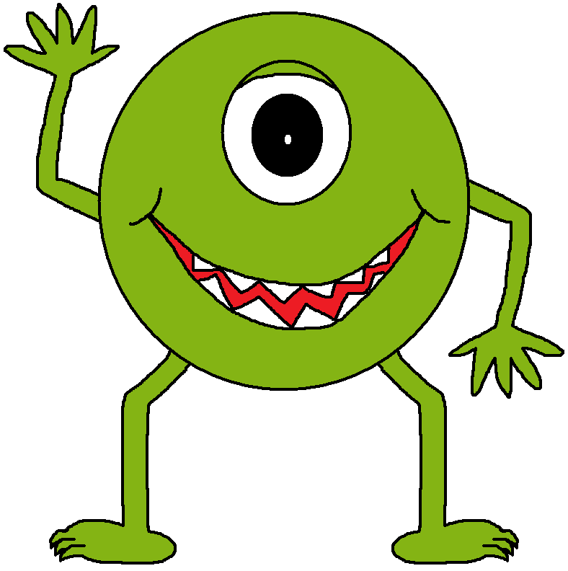
There is one eye.

Slide 21
The end!...

Slide 22
www.eegitimim.com

