Slide 1
DRAW

Slide 2
COLOR
PAINT

Slide 3
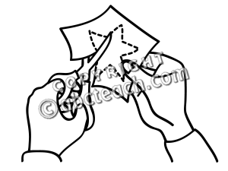
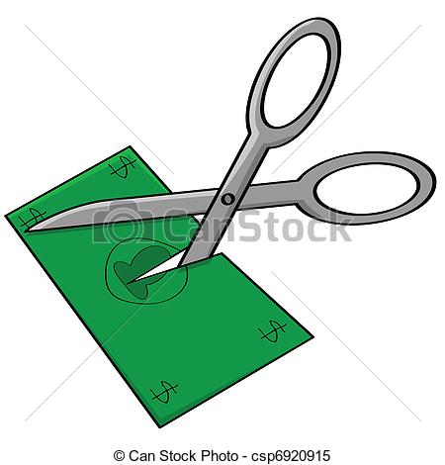
CUT

