Slide 1
What is this ?
This is a book.

Slide 2
What is this ?
This is a bag.

Slide 3
What is this ?
This is an eraser.

Slide 4
What is this ?
This is a pencil.

Slide 5
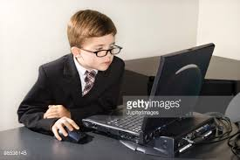
What is this ?
This is a computer.

Slide 6
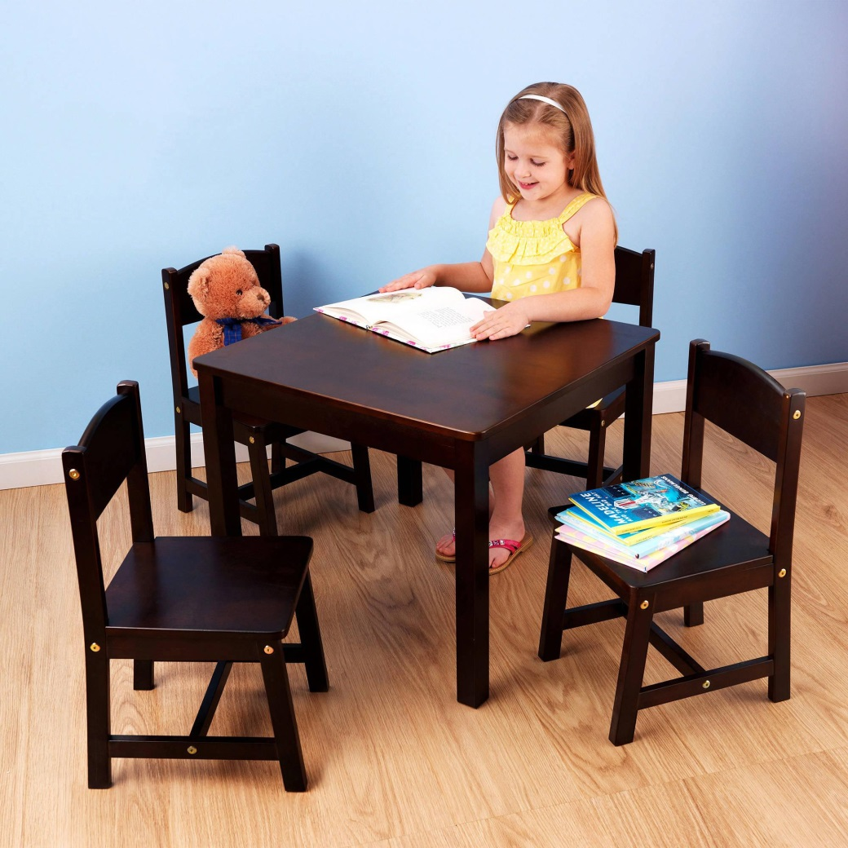
What is this ?
This is a table.

Slide 7
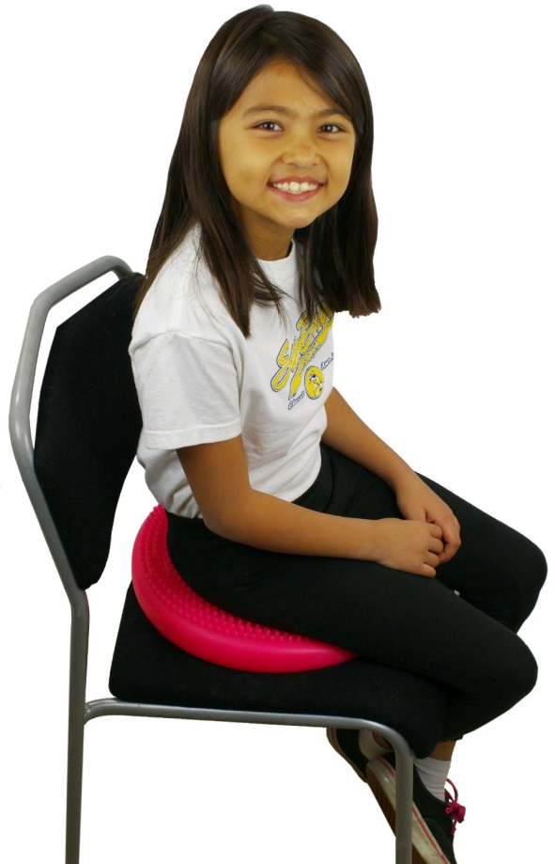
Sit down
Sit down please

Slide 8
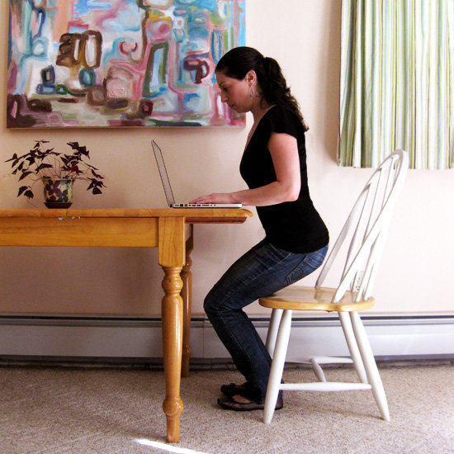
Stand up
Stand up please

Slide 9
Come here
Come here please

Slide 10
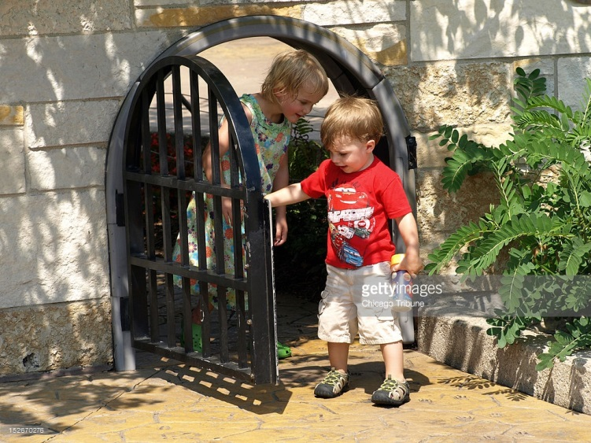
Go out
Go out please

Slide 11
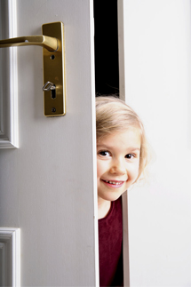
Open the door
Kapıyı aç

Slide 12
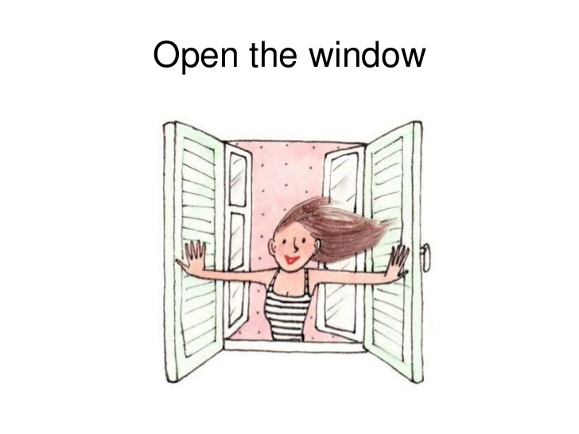
Open the window
Pencereyi aç

Slide 13
Close the door
Kapıyı kapat

Slide 14
Close the window
Pencereyi kapat

Slide 15
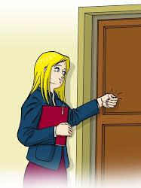
Come in
İçeri gir

Slide 16
Be quiet
Sessiz ol

Slide 17
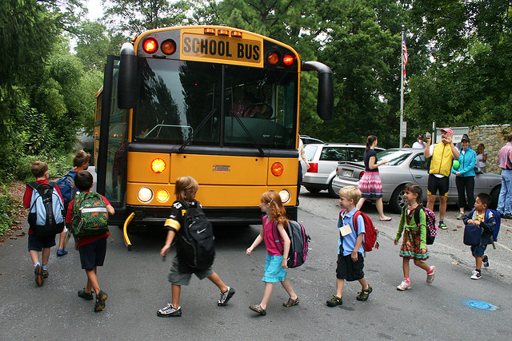
Let’s go
Haydi gidelim

Slide 18
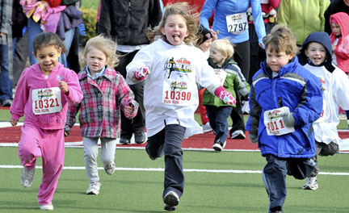
Let’s run
Haydi koşalım

Slide 19
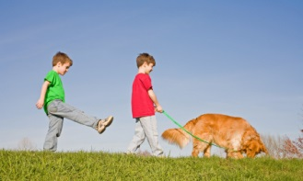
Let’s walk
Haydi yürüyelim

Slide 20
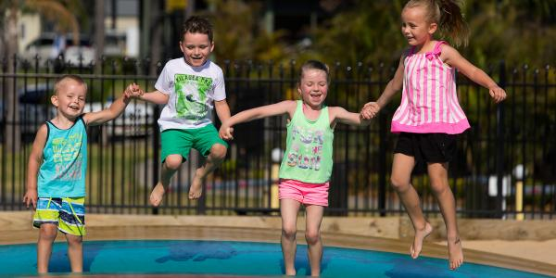
Let’s jump
Haydi zıplayalım

Slide 21
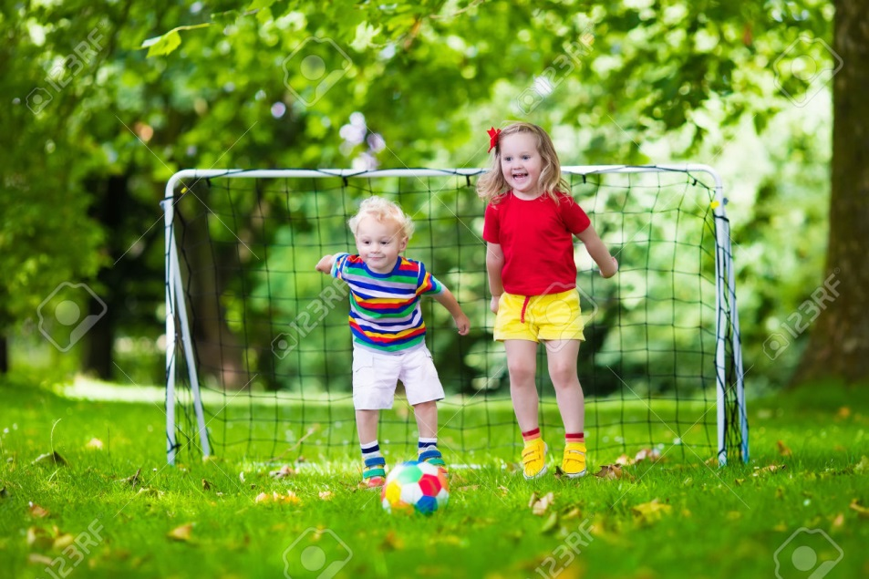
Let’s play football
Haydi futbol oynayalım

Slide 22
DAHA FAZLA MATERYALE ULAŞMAK İÇİN AŞAĞIDAKİ LİNKİ TIKLAYINIZ
www.eegitimim.com

