Slide 1
ARE YOU READY? a) Yes, I am b) Yes, I can

Slide 2
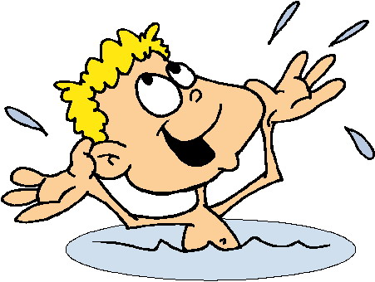
CAN YOU SWIM? a) Yes, I can b) No, I can’t

Slide 3
CAN YOU SWIM? a) Yes, I can b) No, I can’t

Slide 4
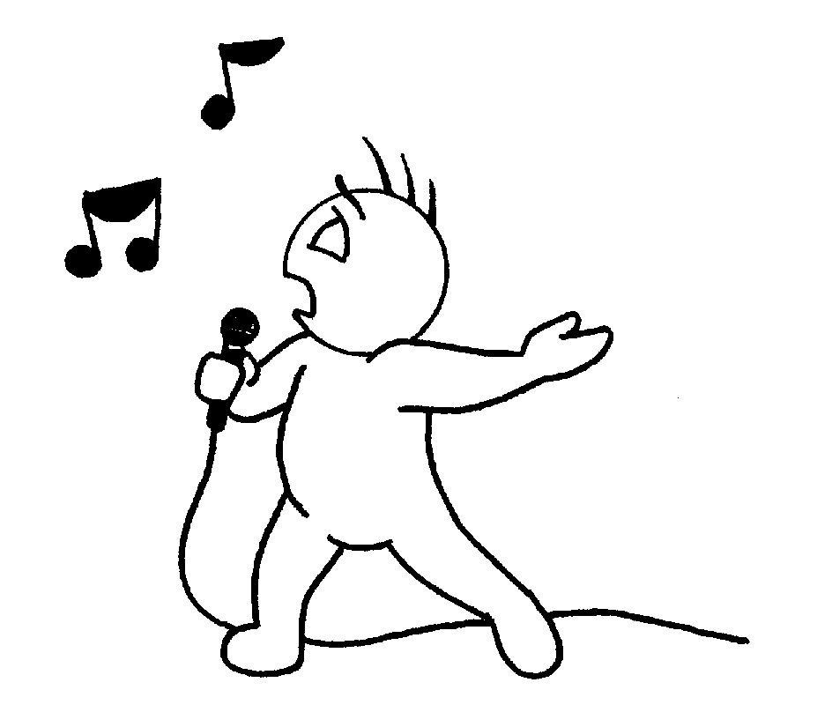
CAN YOU SING? a) Yes, I can b) No, I can’t

Slide 5
CAN YOU SING? a) Yes, I can b) No, I can’t

Slide 6
CAN YOU JUMP? a) Yes, I can b) No, I can’t

Slide 7
CAN YOU JUMP? a) Yes, I can b) No, I can’t

Slide 8
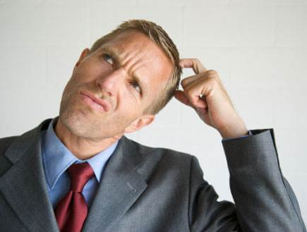
SAY IT AGAIN ………….. a) Please b) Welcome c) Ready

Slide 9
WHAT COLOR IS A LEMON? a) White b) Yellow

Slide 10
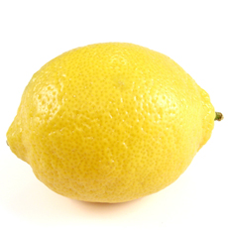

Slide 11
WHAT COLOR IS A TOMATO? a) Red b) Yellow

Slide 12
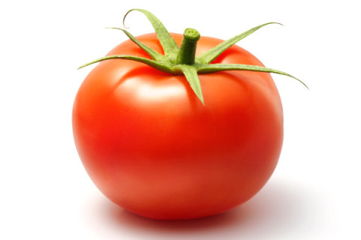

Slide 13
WHAT COLOR IS A TANGERINE? a) Brown b) Orange

Slide 14
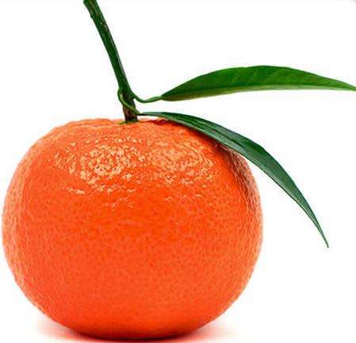

Slide 15
WHAT COLOR IS AN OLIVE? a) Black b) Pink

Slide 16
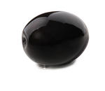

Slide 17
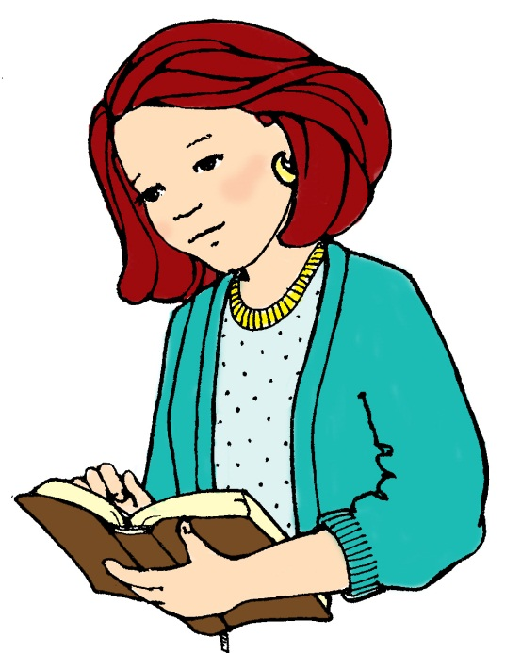
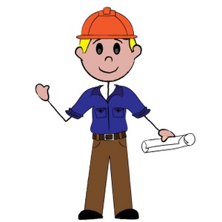
WHO IS HE? a) Uncle b) Aunt

Slide 18
WHO IS SHE? a) Uncle b) Aunt

Slide 19
WHO ARE THEY? a) Uncle - aunt b) Aunt c) Uncle – father d) Aunt - mother

Slide 20
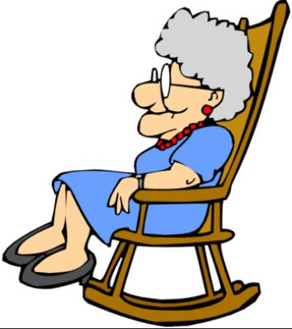
HE IS MY GRANDFATHER a) b)

Slide 21
SHE IS MY GRANDMOTHER a) b)

Slide 22
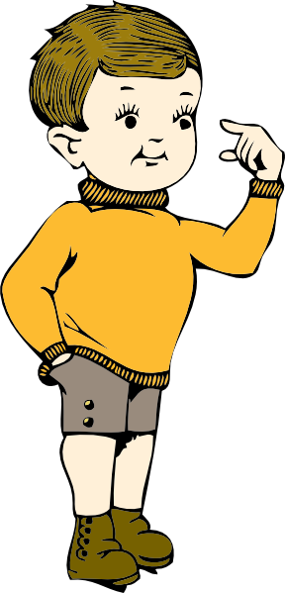
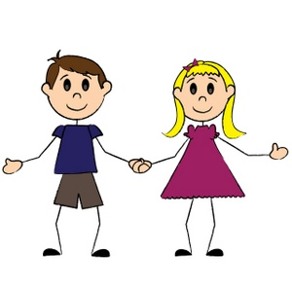
THEY ARE MY COUSINS a) b)

Slide 23
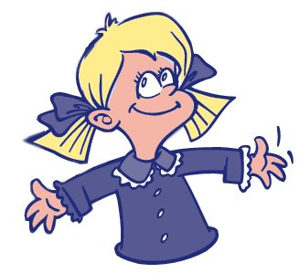
THIS IS MY COUSIN a) b)

