Slide 1
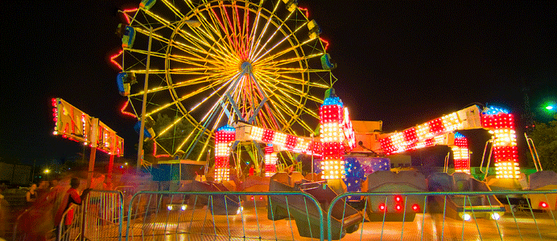
CARNIVAL

Slide 2
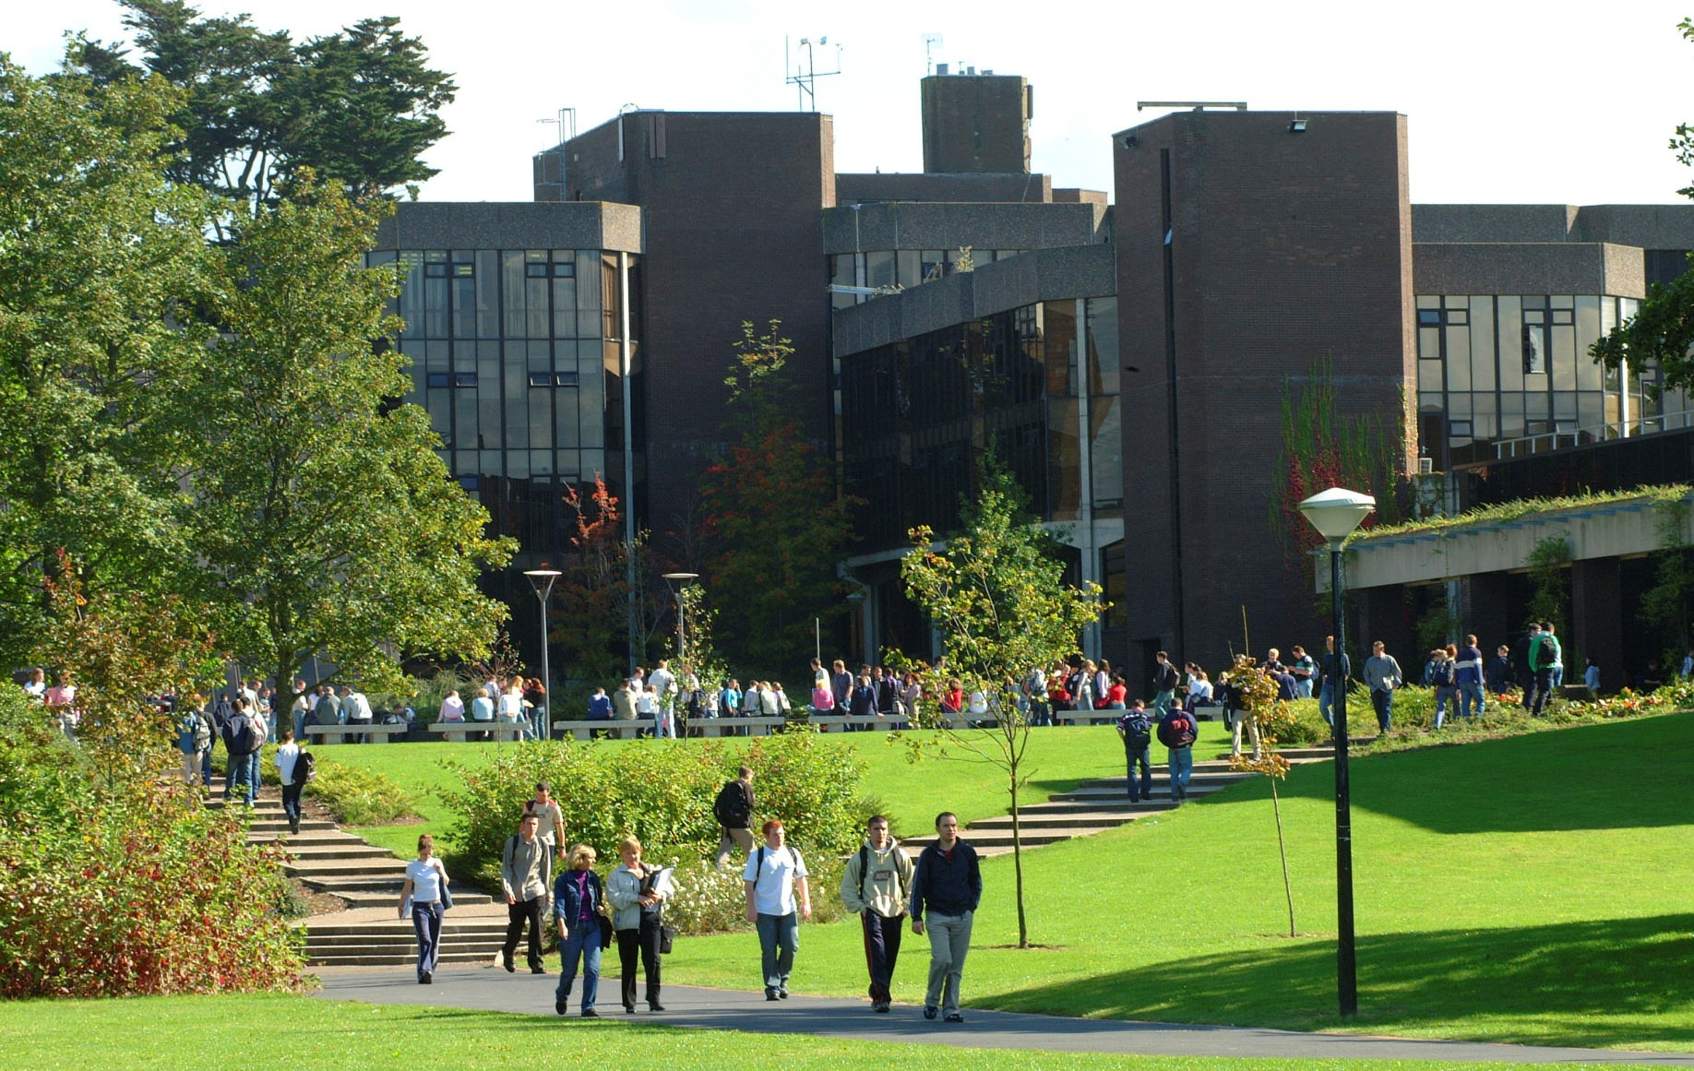
CAMPUS

Slide 3
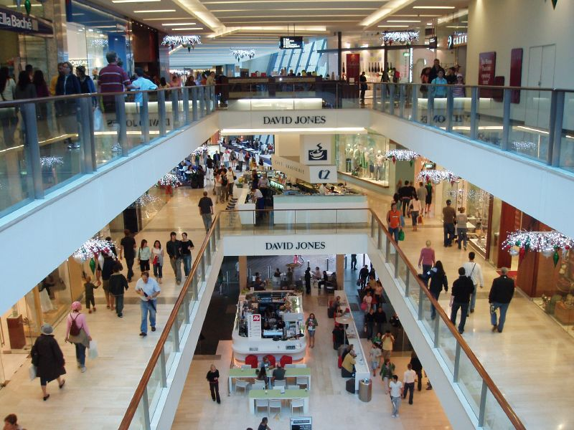
SHOPPING CENTRE

Slide 4
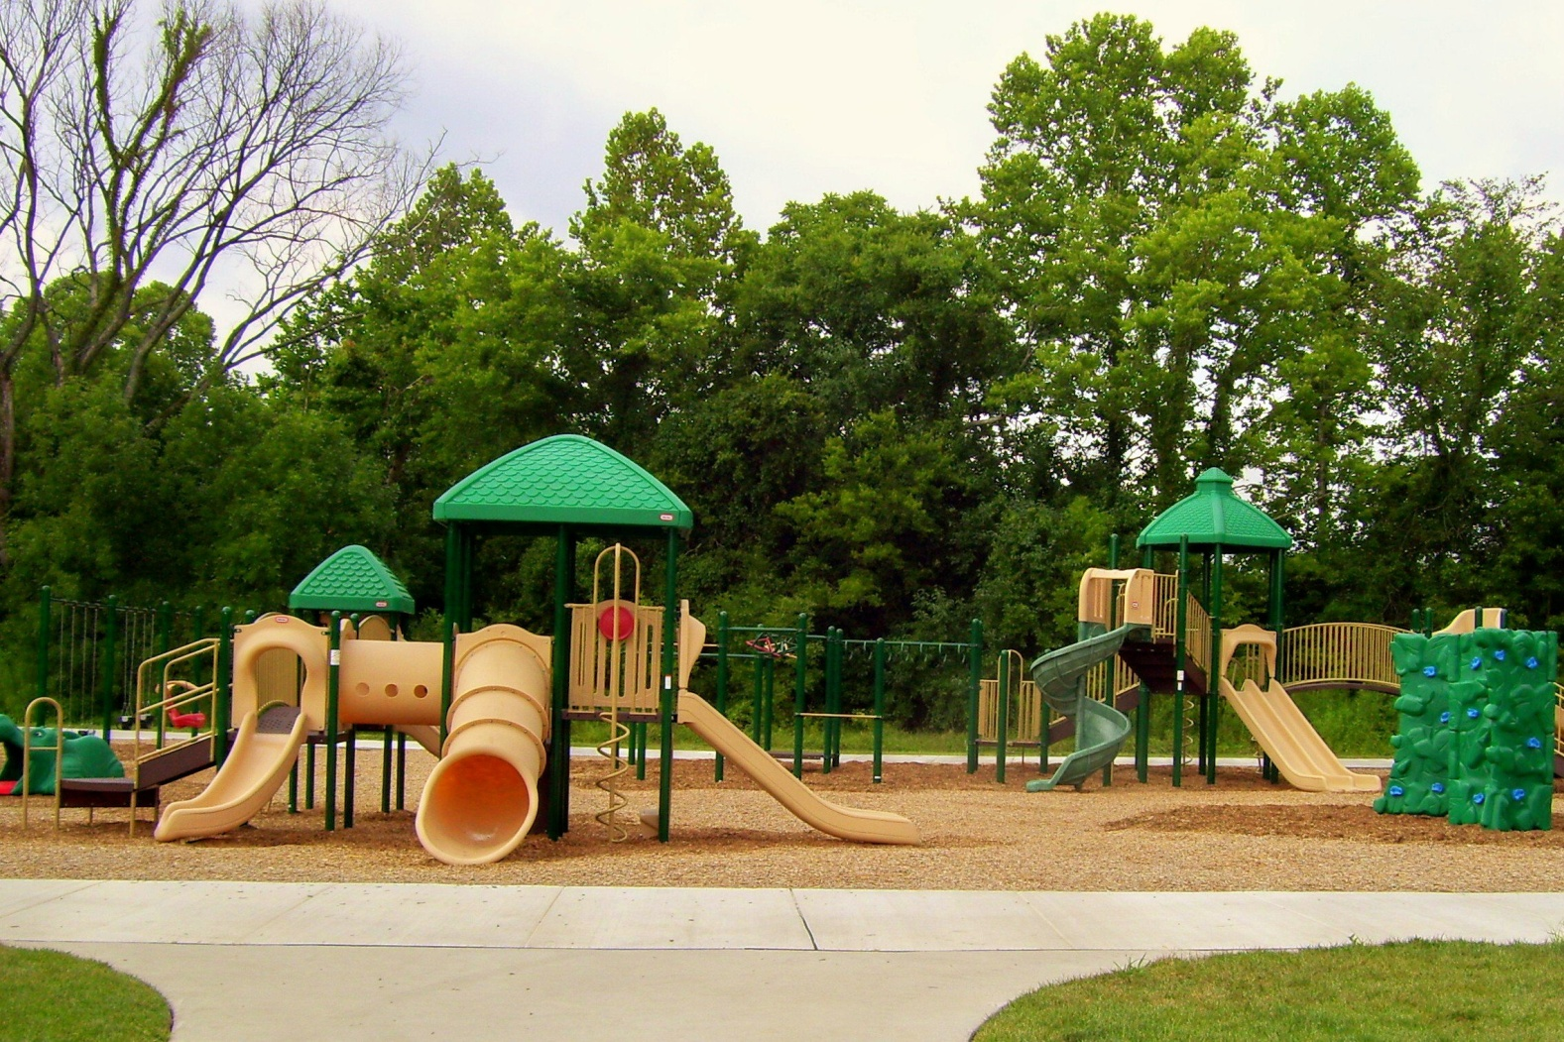
PARK

Slide 5
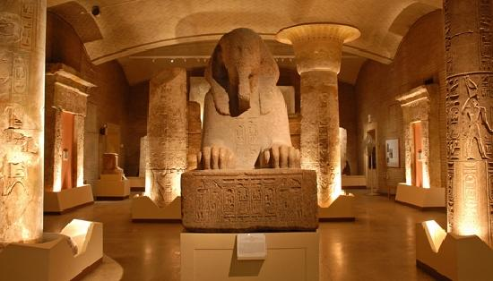
MUSEUM

Slide 6
SCHOOL

Slide 7
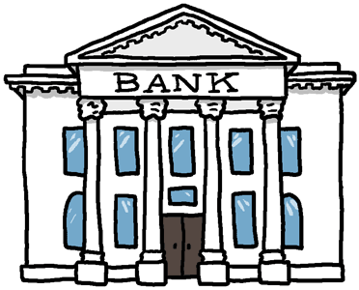
BANK

Slide 8
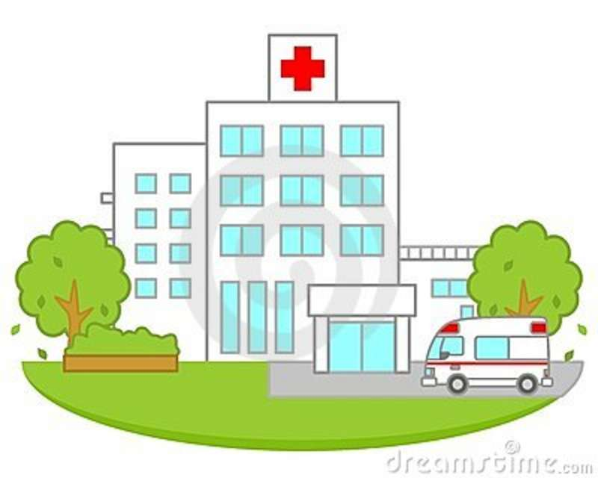
HOSPITAL

Slide 9
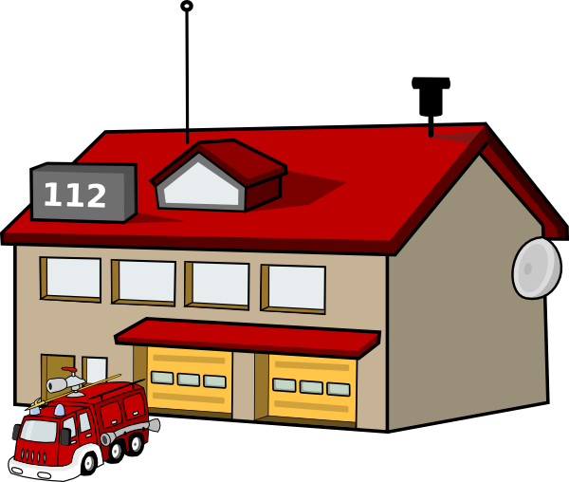
FIRE STATION

Slide 10
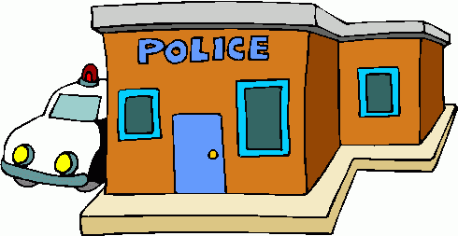
POLICE STATION

Slide 11
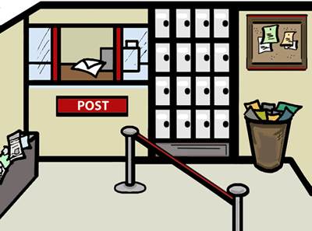
POST OFFICE

Slide 12
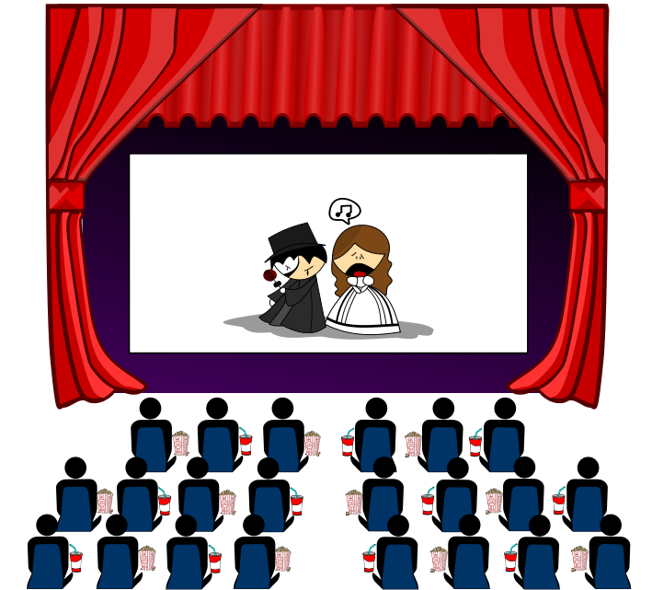
CINEMA

Slide 13
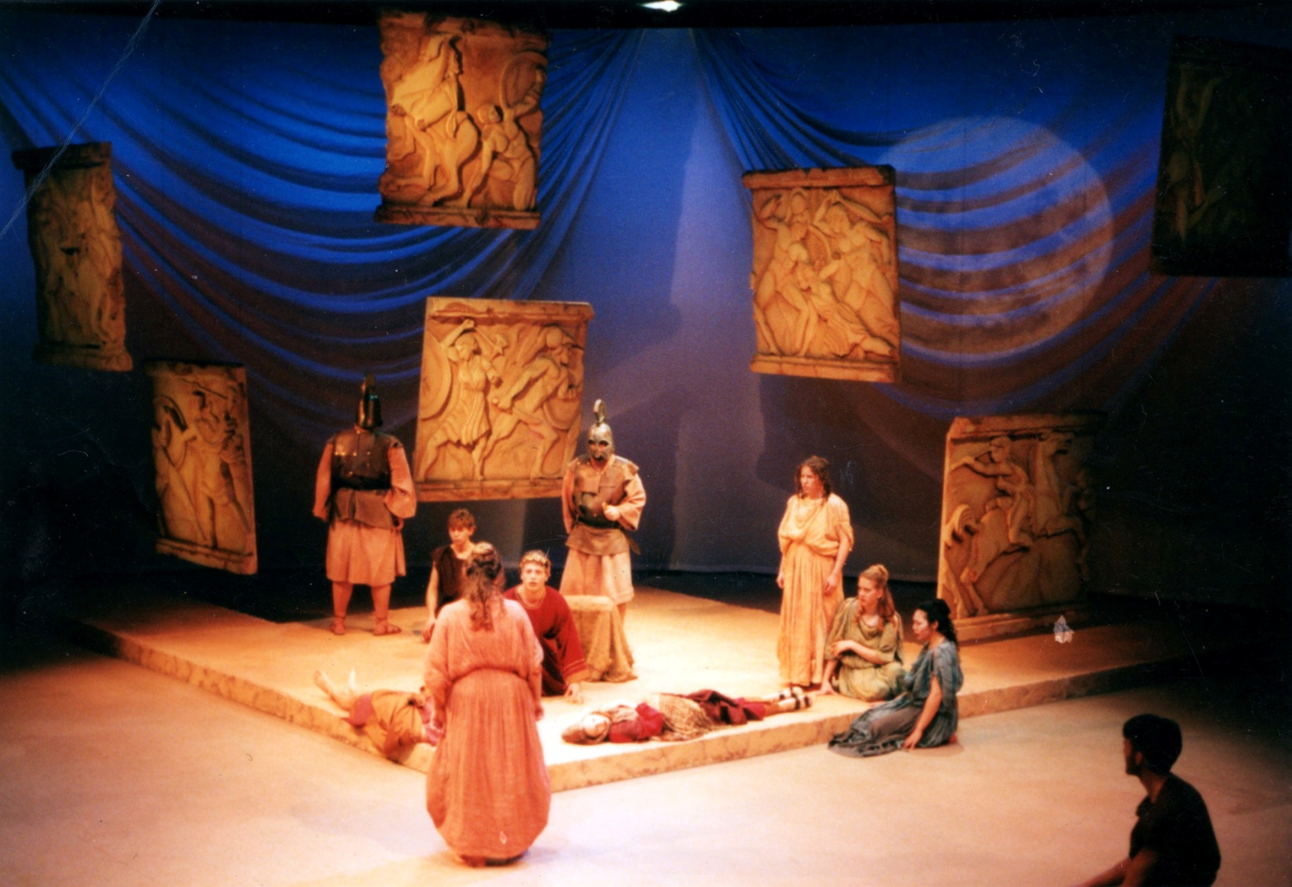
THEATRE

Slide 14
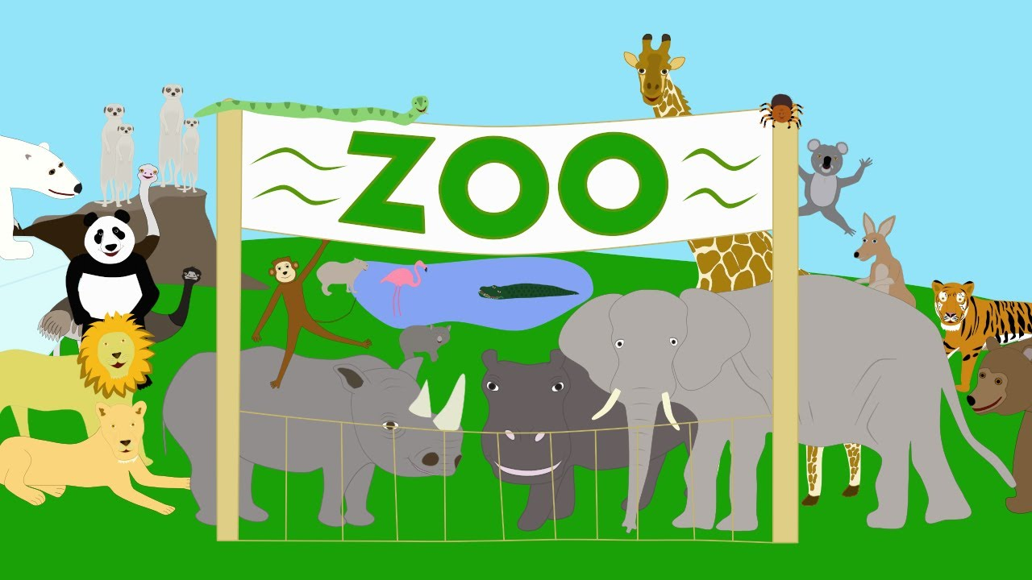
ZOO

Slide 15
www.eegitimim.com

