Slide 1
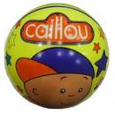
It is a big ball.
www.eegitimim.com
It is a small ball.

Slide 2
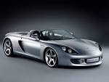
A:Is it a fast car?
B: Yes,it is.
A:Is it a fast car?
B:No,it isn’t.
It is slow car.

Slide 3
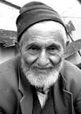
A:Is he young?
B:No,he isn’t.
He is old.
A:Is he young?
B:Yes,he is.

Slide 4
He is short.
He isn’t tall.
A:Is she short ?
B:No, she isn’t.
She is tall.

Slide 5
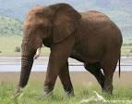
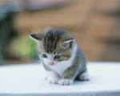
An elephant is
A big animal.
A cat is a small
Animal.It isn’t big.

Slide 6
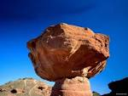
A:Is it heavy?
B:Yes,it is.
A:Is it heavy?
B:No,it isn’t.
It is light.

Slide 7
A:Is she thin?
B:No,she isn’t.
She is fat.
A:Is she thin?
B:Yes,she is.

Slide 8
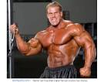
A:Is he strong?
B:Yes,he is.
A:Is he strong?
B:No,he isn’t.
He is weak.

Slide 9
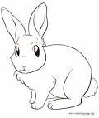
A:Is a rabbit fast?
B:Yes,it is.
A:Is a turtle fast ?
B:No,it isn’t.
It is a slow animal.

