Slide 1
bathroom

Slide 2
Towel

Slide 3
washbasin / sink

Slide 4
Soap

Slide 5
Tooth brush

Slide 6
Mirror

Slide 7
bathtub

Slide 8
Bedroom

Slide 9
Bed

Slide 10
Wardrobe / closet

Slide 11
Dining room

Slide 12
Play room

Slide 13
Living room

Slide 14
Curtain

Slide 15
window

Slide 16
Computer

Slide 17
sofa

Slide 18
Armchair

Slide 19
Table

Slide 20
Chair

Slide 21
Kitchen

Slide 22
cupboard

Slide 23
Fork

Slide 24
Spoon

Slide 25
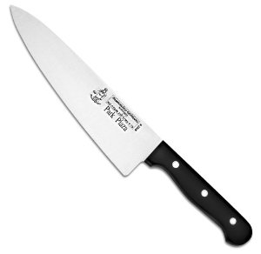
knife

Slide 26
teapot

Slide 27
Cup

Slide 28
Hall

Slide 29
Stairs

Slide 30
Garden

Slide 31
Garage

