Slide 1
My home

Slide 2
ROOF
DOOR

Slide 3
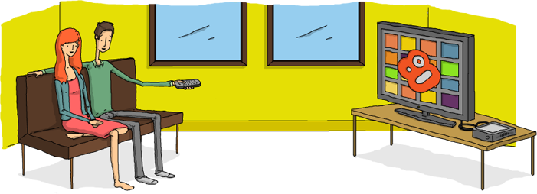
ROOF
This is my living room.
LIVING ROOM

Slide 4
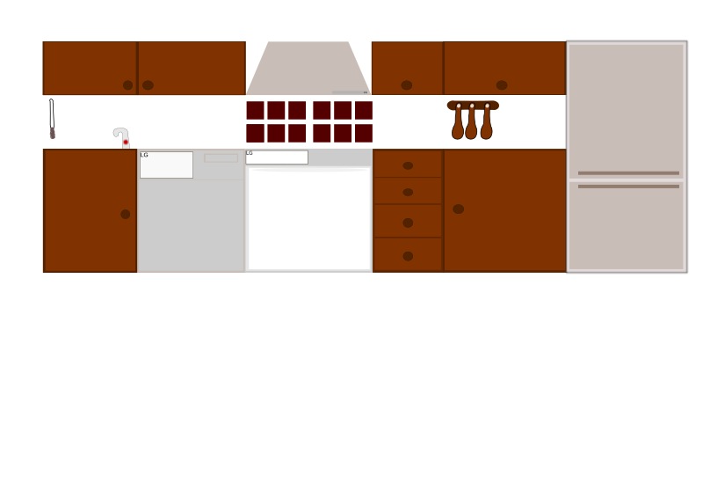
ROOF
This is my kitchen.
KITCHEN
LIVING ROOM

Slide 5
ROOF
This is my bedroom.
BEDROOM
KITCHEN
LIVING ROOM

Slide 6
ROOF
This is my bathroom.
BEDROOM
BATHROOM
KITCHEN
LIVING ROOM

Slide 7
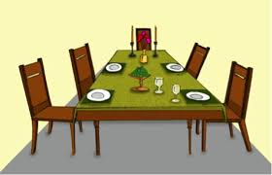
ROOF
This is my dining room.
BEDROOM
BATHROOM
DINING ROOM
KITCHEN
LIVING ROOM

Slide 8
ROOF
This is my play room.
PLAY ROOM
BEDROOM
BATHROOM
DINING ROOM
KITCHEN
LIVING ROOM

Slide 9
ROOF
UPSTAIRS
DOWNSTAIRS
PLAY ROOM
BEDROOM
BATHROOM
DINING ROOM
KITCHEN
LIVING ROOM

Slide 10
ROOF
This is my garage.
UPSTAIRS
DOWNSTAIRS
PLAY ROOM
BEDROOM
BATHROOM
DINING ROOM
GARAGE
KITCHEN
LIVING ROOM

Slide 11
ROOF
This is my garden.
UPSTAIRS
DOWNSTAIRS
PLAY ROOM
GARDEN
BEDROOM
BATHROOM
DINING ROOM
GARAGE
KITCHEN
LIVING ROOM

Slide 12
ROOF
I LOVE MY HOME
UPSTAIRS
DOWNSTAIRS
PLAY ROOM
GARDEN
BEDROOM
BATHROOM
DINING ROOM
GARAGE
KITCHEN
LIVING ROOM

Slide 13
THANK YOU FOR WATCHING
Prepared by
Belgüzar KARA

