Slide 1
WHAT IS THE WEATHER LIKE?
3.VE 6.SINIF

Slide 2
S U SUNNY N Y

Slide 3
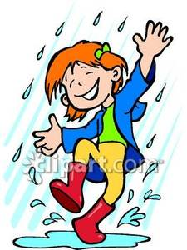
R A RAINY N Y

Slide 4
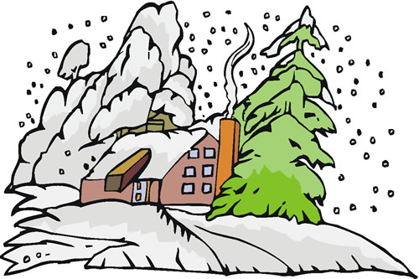
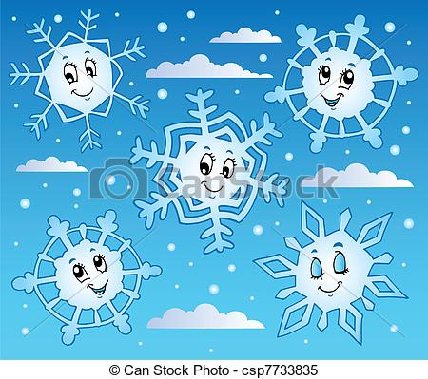
S N SNOWY W Y

Slide 5
C L CLOUDY U D Y

Slide 6
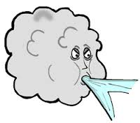
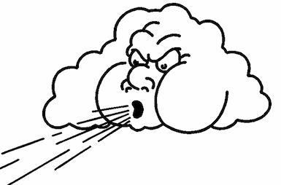
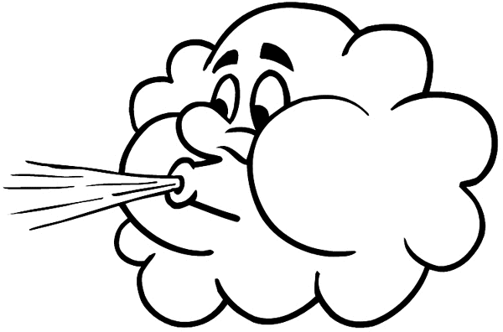
W I WINDY D Y

Slide 7
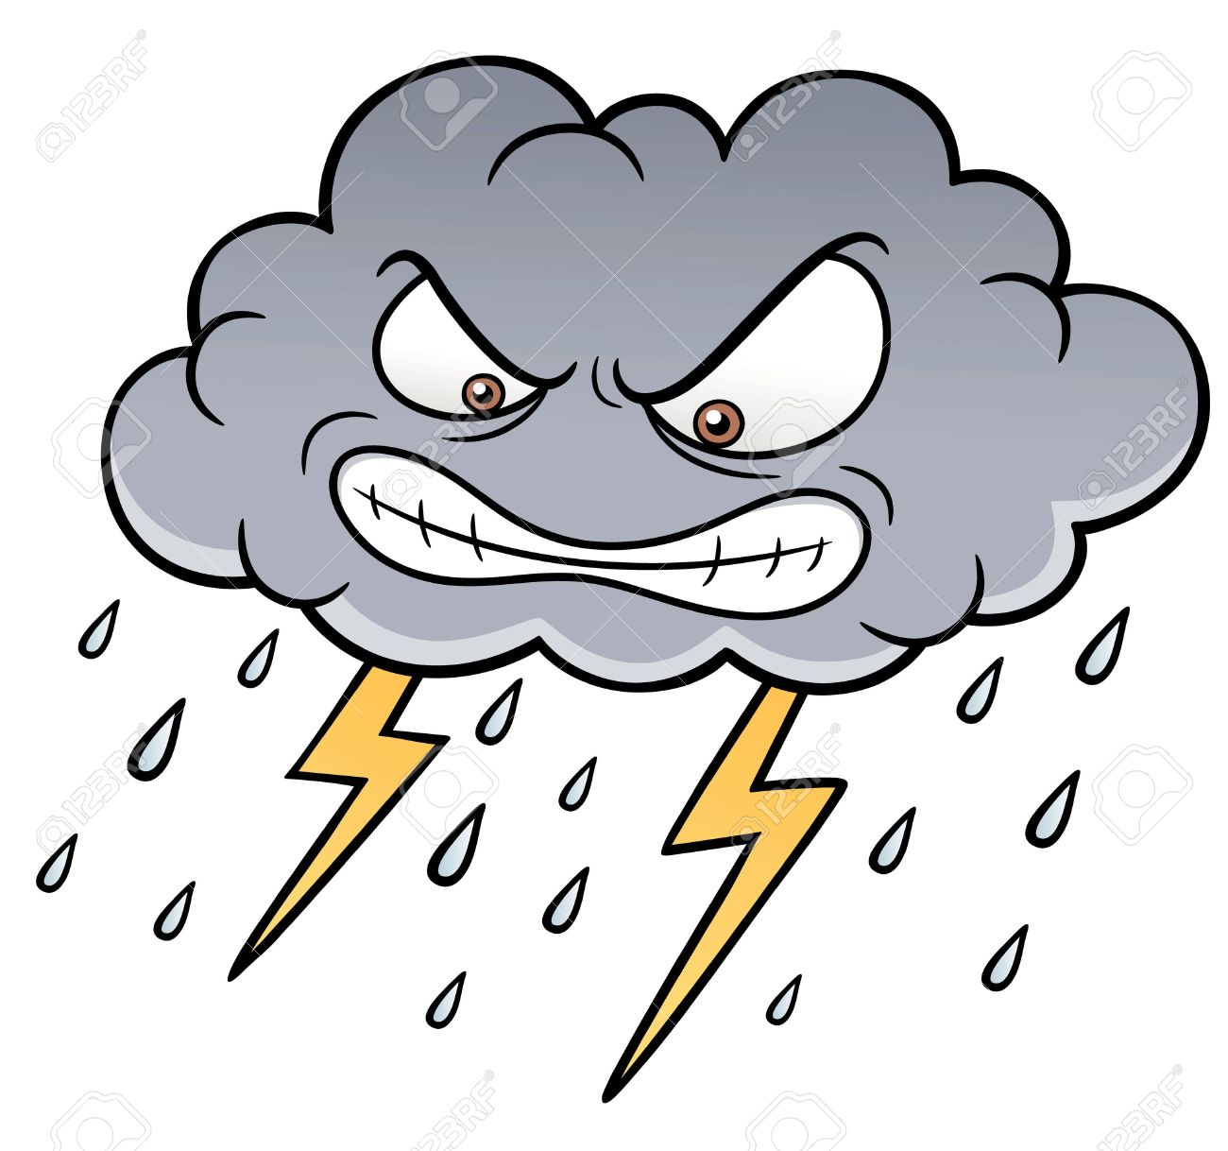
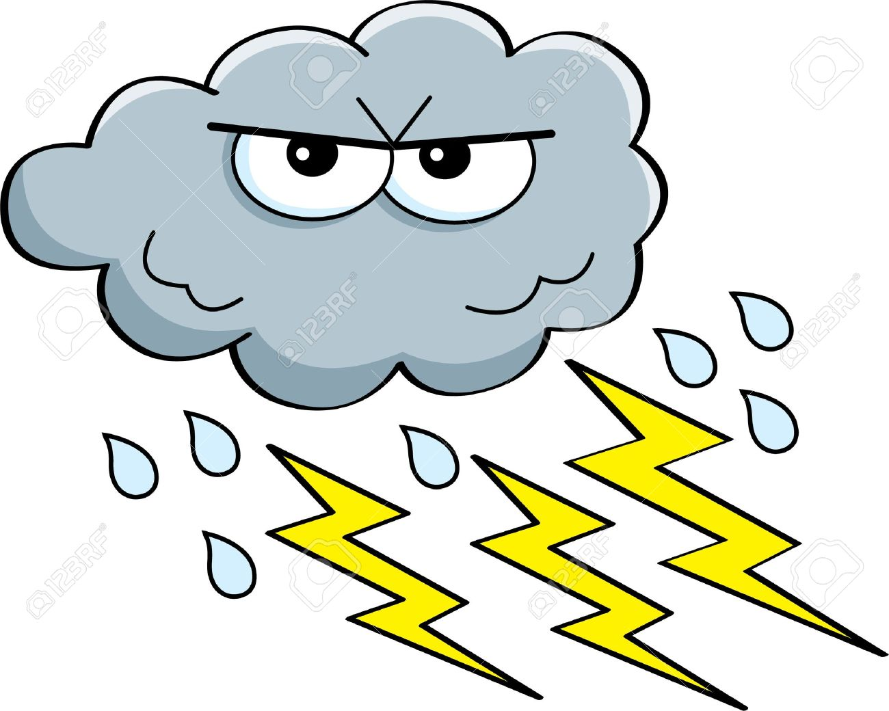
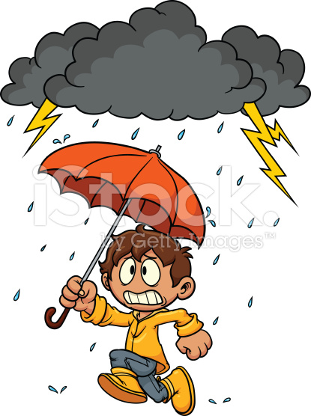
S T STORMY R M Y

Slide 8
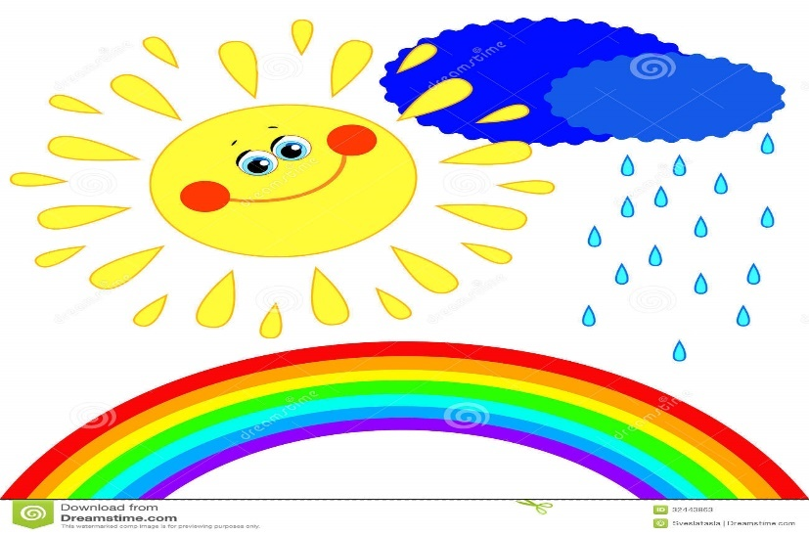
R A RAINBOW N B O W

Slide 9
L I LIGHTING H T I N G

Slide 10
T O TORNEODO N E D O

Slide 11
S T STAR R

Slide 12
M O MOON N

Slide 13
PREPARED BY
MEHMET DEGERLI

