Slide 1
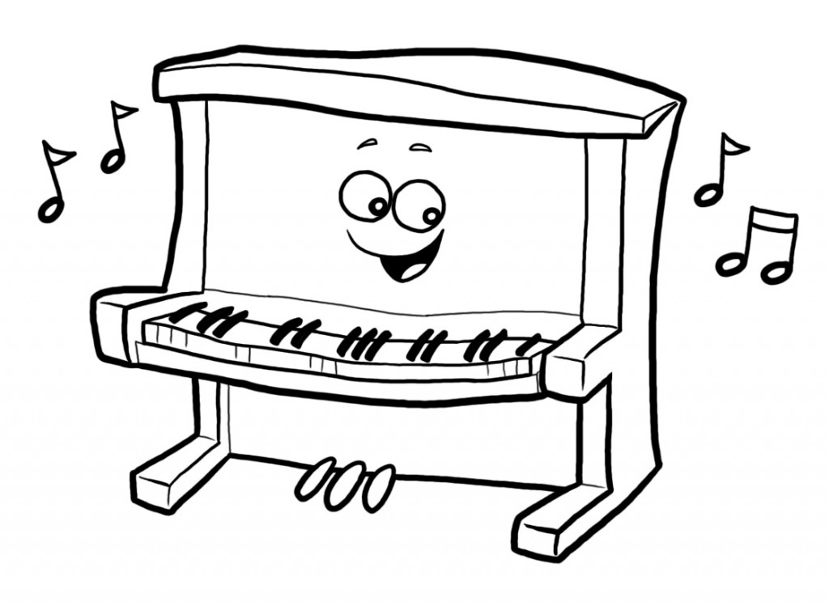
a. I can play the piano b. I can’t play the piano

Slide 2
a. I can fly b. I can’t fly

Slide 3
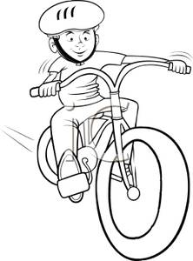
a. He can ride a bike b. He can ride a horse

Slide 4
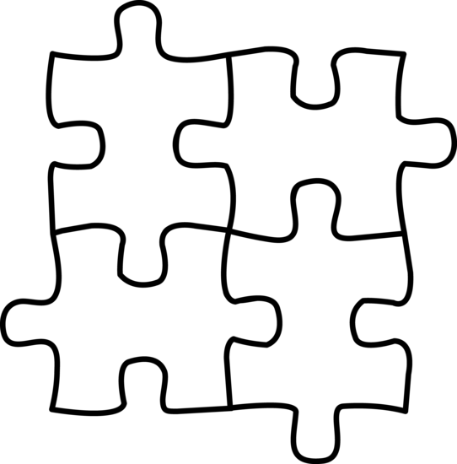
a. She can play chess b. She can do a puzzle c. She can’t do a puzzle

Slide 5
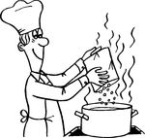
a. He can cook b. She can cook

Slide 6
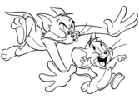
a. He can’t catch Jerry b. He can cath Jerry

Slide 7
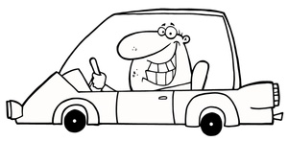
a. She can drive a car b. He can’t drive a car c. He can drive a car

Slide 8
a. They can take photos b. They can’t take photos

Slide 9
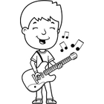
a. I can play football b. I can play the guitar c. I can’t play the guitar

Slide 10
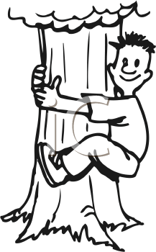
a. He can fly b. He can climb a tree c. She can climb a tree

Slide 11
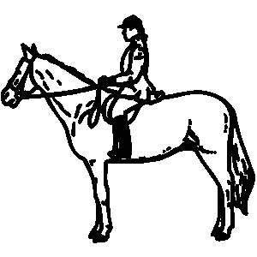
a. She can ride a bike b. She can ride a horse c. She can’t ride a horse

Slide 12
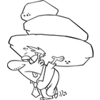
a. He can’t carry the rocks b. He can carry the rocks

Slide 13
a. You can’t read English books b. You can read English books

Slide 14
a. She like riding a horse b. She likes riding a horse

Slide 15
a. I like play the piano b. I like playing the piano

Slide 16
a. He likes play the guitar b. He likes playing the guitar c. He like playing the guitar

Slide 17
«I like playing chess» olumsuzu? a. I don’t like play chess. b. I don’t like playing chess. c. I doesn’t like playing chess.

Slide 18
«I can swim» olumsuzu? a. I can’t swim. b. I can swimming. c. I can’t swimming.

Slide 19
Can you carry the rocks? a. Yes, I can’t b. Yes, she can c. Yes, I can d. No I can

Slide 20
Do you like swimming? A. Yes, I can b. No, ı can’t c. Yes, I do d. No, I do

