Slide 1
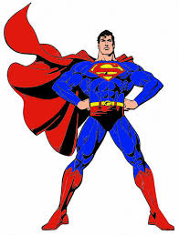
CAN- CAN’T (yapabilmek-yapamamak)

Slide 2
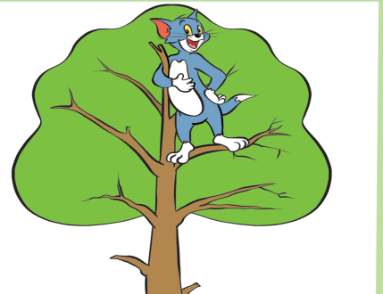
climb a tree

Slide 3
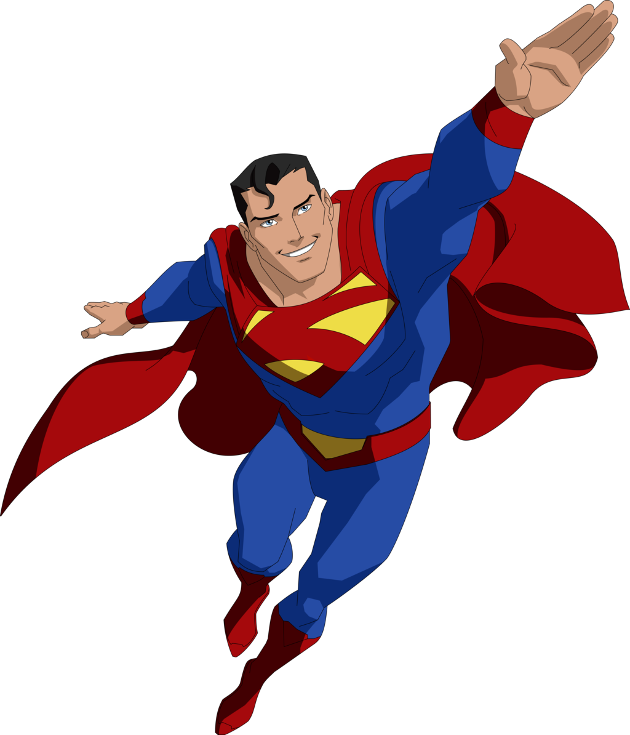
fly

Slide 4
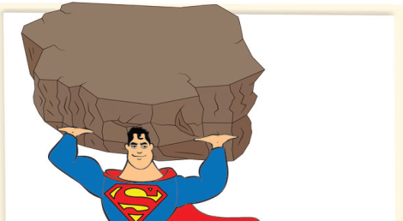
Carry heavy things

Slide 5
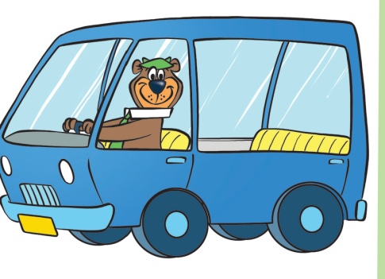
drive a car

Slide 6
speak English

Slide 7
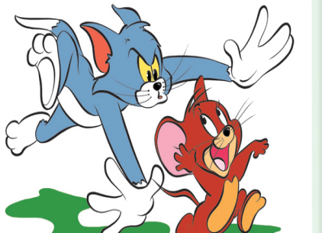
catch

Slide 8
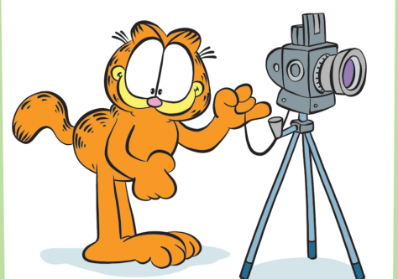
take picture
(take photo)

Slide 9
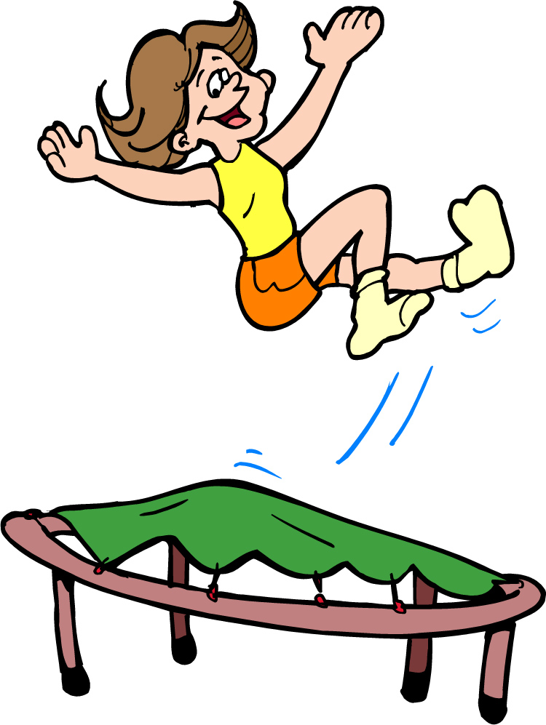
jump

Slide 10
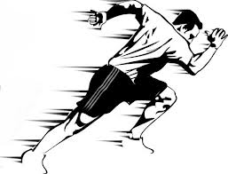
Run fast

Slide 11
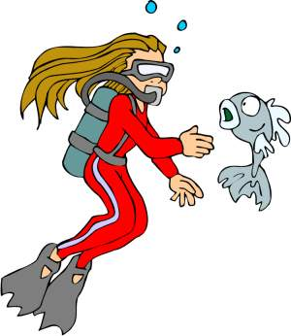
dive

Slide 12
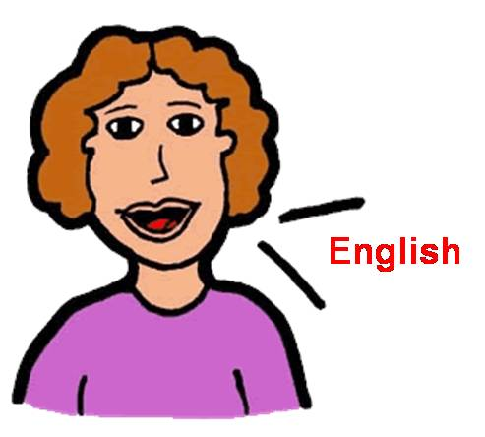
I can speak English

Slide 13
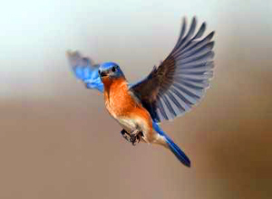
A bird can fly

Slide 14
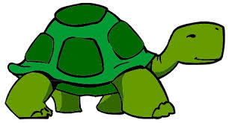
A turtle can’t jump

Slide 15
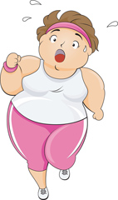
My mother can’t run fast

Slide 16
Ben piyano çalabilirim
Kedi ağaca tırmanabilir
Sen araba süremezsin
Biz dalış yapamayız

Slide 17
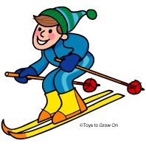
Can you ski?
Yes, I can

Slide 18
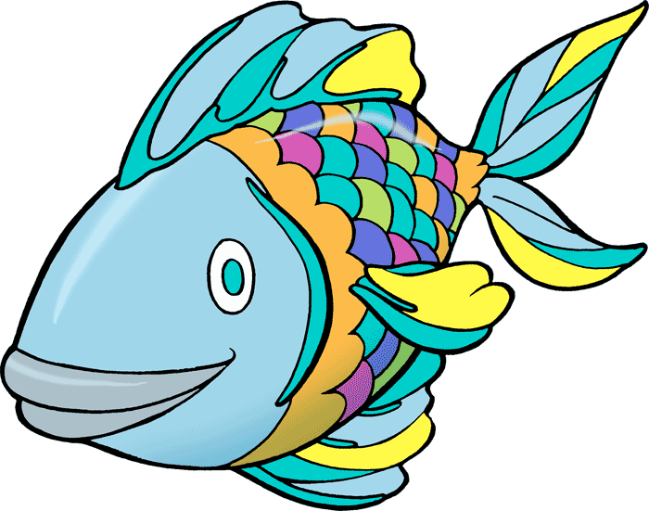
Can a fish fly?
No, it can’t

