Slide 1
İngilizce Saatler ve Aletler.
Teacher:Rana Karatay
4/E
Pilot Binbaşı Ali Tekin İ.O

Slide 2
Clock

Slide 3
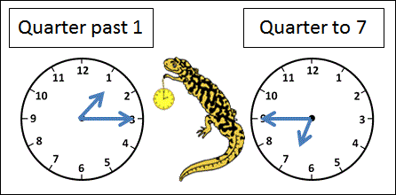
Quarter Past
ÇEYREK GEÇİYOR
09:15=It’s quarter past nine.=9’u çeyrek geçiyor.
10:15=It’s fifteen past ten

Slide 4
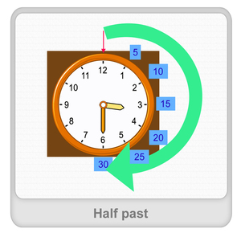
Half Past
15:30=It’s half past three
16:30=It’s thirty past four

Slide 5
Quarter To
15:45=It’s quarter to three

Slide 6
PAST
21:18=It’s eighteen past nine.

Slide 7
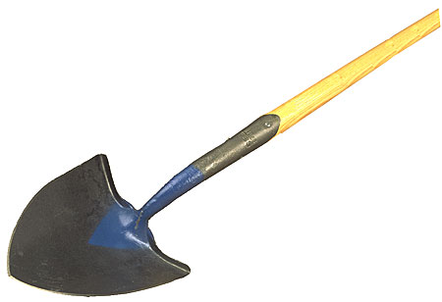
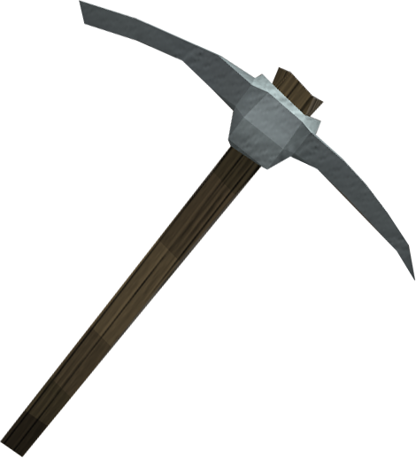
Kazı Aletler
Shovel=Kürek
Pickaxe=Kazma

Slide 8
Mutfak Aletleri
Cooker=Tencere
Kaşık:Spoon
Çatal:Fork
Bıçak=Knife

Slide 9
Saldırı araçlar ☹
GUN:Silah
Knife : Bıçak
Bomba:Bomb
Turbot:Kalkan ☹☹☹☹

