Slide 1
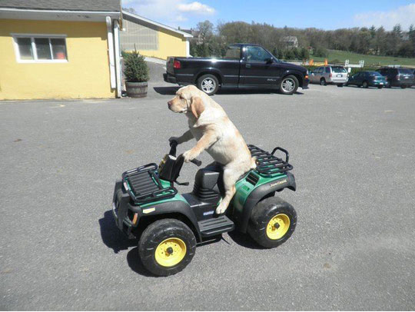
1. A. IT CAN DRIVE A CAR B. IT CAN’T DRIVE A CAR C. IT CAN RIDE A BIKE D. IT CAN SING A SONG

Slide 2
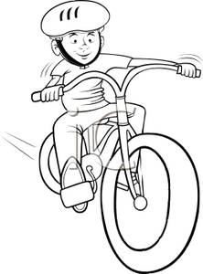
2. A. I LIKE PLAYING CHESS B. HE LIKES RIDING A HORSE C. HE LIKES RIDING A BIKE SHE LIKES RIDING A BIKE

Slide 3
3. A.I DON’T LIKE DO A PUZZLE B. I DON’T LIKE COOKING C. I DON’T LIKE DOING A PUZZLE D. I DON’T LIKE SINGING A SONG

Slide 4
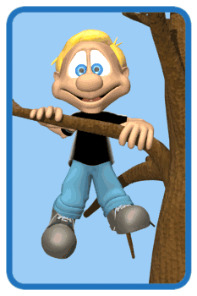
4. A. SHE CAN CLIMB A TREE B. HE CAN CLIMB A TREE C. HE CAN’T CLIMB A TREE D. HE CAN JUMP

Slide 5
5. A. SHE CAN CARRY THE BAG B. HE CAN CARRY THE BAG C. HE CAN’T CARRY THE BAG D. IT CAN CARRY THE BAG

Slide 6
6. A. I LIKE PLAYING THE PIANO B. I LIKES PLAYING THE GUITAR C. HE LIKES PLAY THE GUITAR D. HE LIKES PLAYING THE GUTAR

Slide 7
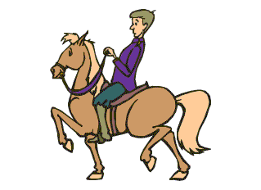
7. A. HE CAN RIDE A BIKE B. HE CAN’T RIDE A HORSE C. HE CAN RIDE A HORSE D. HE CAN’T RIDE A BIKE

Slide 8
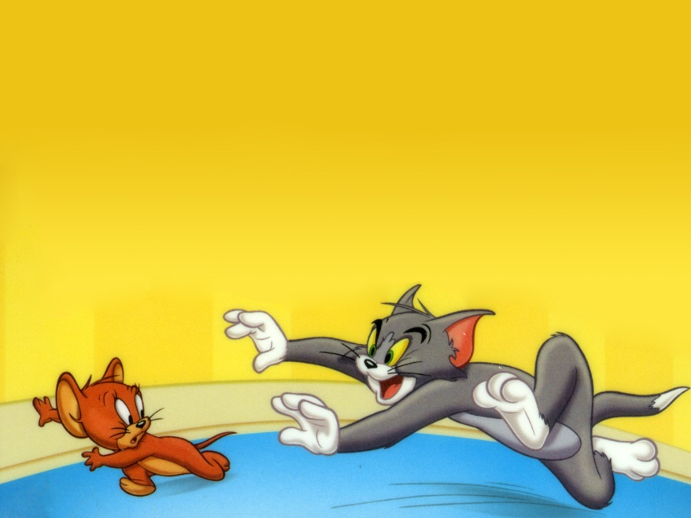
8. A. HE CAN’T CATCH JERRY B. HE CAN CATCH JERRY C. HE CAN FLY A KITE D. HE CAN COOK

Slide 9
9. CAN YOU DIVE? A. YES, I CAN’T B. YES, SHE CAN C. YES, I CAN D. NO I CAN

Slide 10
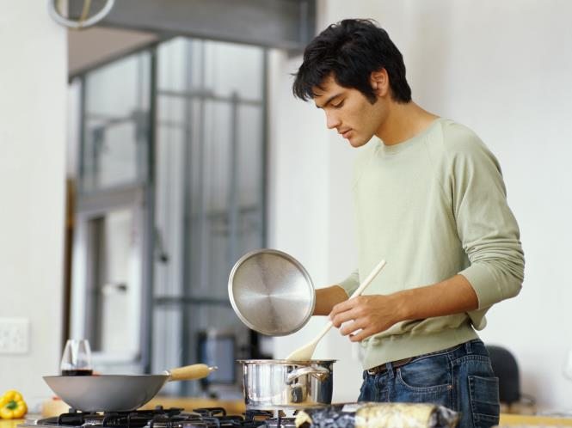
10. A. HE LIKE COOKING B. HE LIKES COOKING C. HE LIKES COOK D. HE CAN COOKING

Slide 11
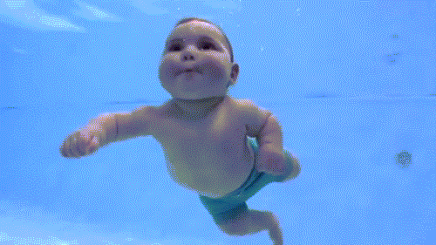
11. DO YOU LIKE SWIMMING? A. YES, I CAN B. NO, I CAN’T C. YES, I DO D. NO, I DO

Slide 12
12. A. IT LIKES WATCHING CARTOONS B. IT DOESN’T LIKE WATCHING CARTOONS C. IT LIKES PLAYING THE GUITAR D. IT LIKE WATCHING CARTOONS

Slide 13
13. A. FLY B. DIVE C. COOK D. SING

Slide 14
14. A. SING B. SWING C. DIVE D. COOK

Slide 15
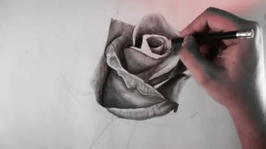
15. A. DRIVE B. RIDE C. DRAW D. SING

Slide 16
16. A. RUN B. SWIM C. SWING D. PLAY CHESS

Slide 17
17. A. SWIMMING B. DIVING C. COOKING D. COLORING

Slide 18
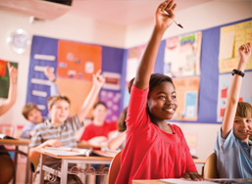
18. A. PLAY CHESS B. LEARN ENGLISH C. PLAY HOPSCOTCH D. DIVE

Slide 19
19. A. OUR B. THEIR C. HER D. HIS
I | MY
YOU | YOUR
HE | ?

Slide 20
20. A. OUR B. YOUR C. HER D. HIS
I | MY
SHE | HER
WE | ?

Slide 21
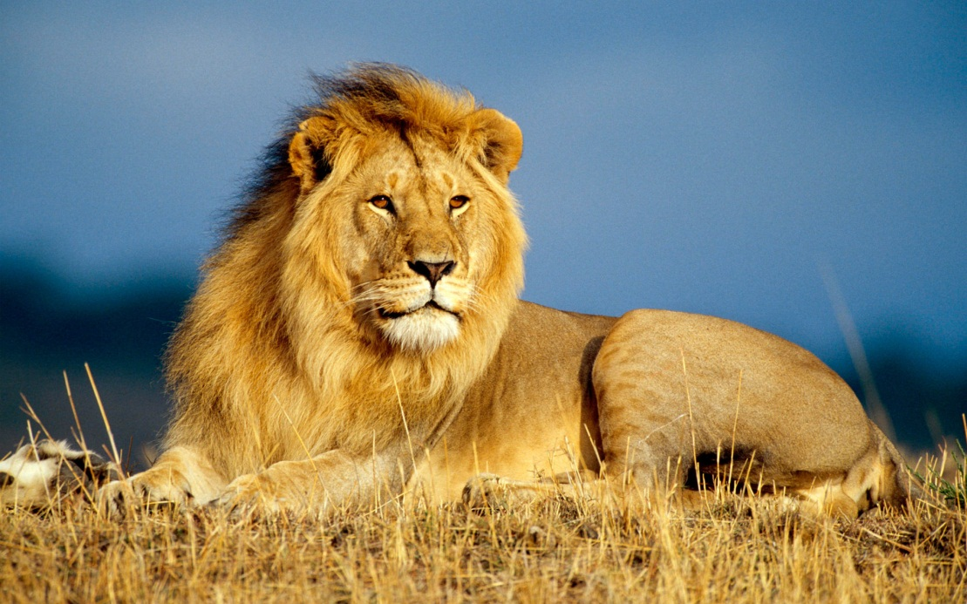
21. A. THIS IS AN LION B. THIS IS A LION C. THESE ARE TWO LIONS THESE ARE TWO LION

Slide 22
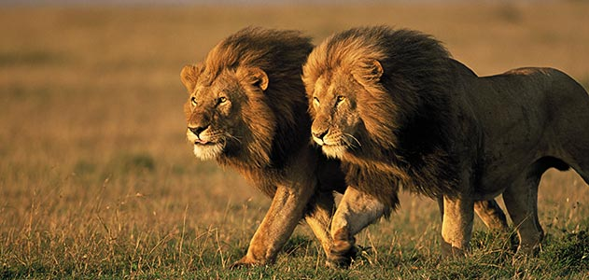
22. A. THIS IS A LION B. THESE ARE TWO LION C. THIS IS AN LION THESE ARE TWO LIONS

Slide 23
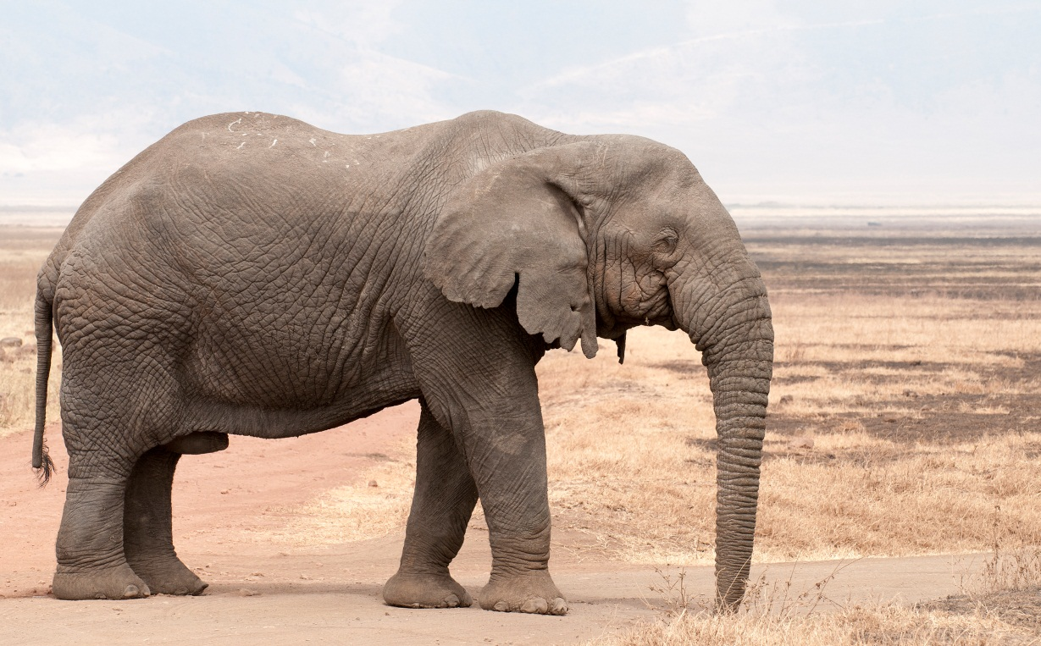
23. A. THIS IS A ELEPHANT B. THIS IS AN ELEPHANT C. THIS IS A ELEPHANTS D. THESE ARE ELEPHANTS

Slide 24
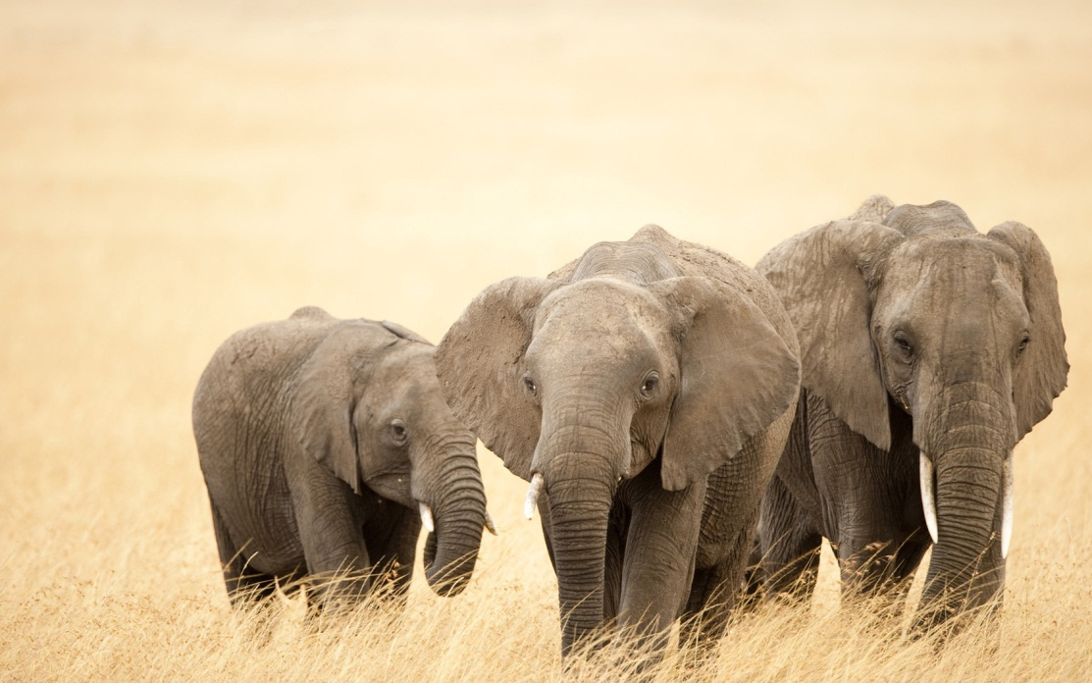
24. A. THESE ARE TWO ELEPHANTS B. THESE ARE AN ELEPHANTS D. THESE ARE THREE ELEPHANTS D. THIS IS AN ELEPHANT

Slide 25
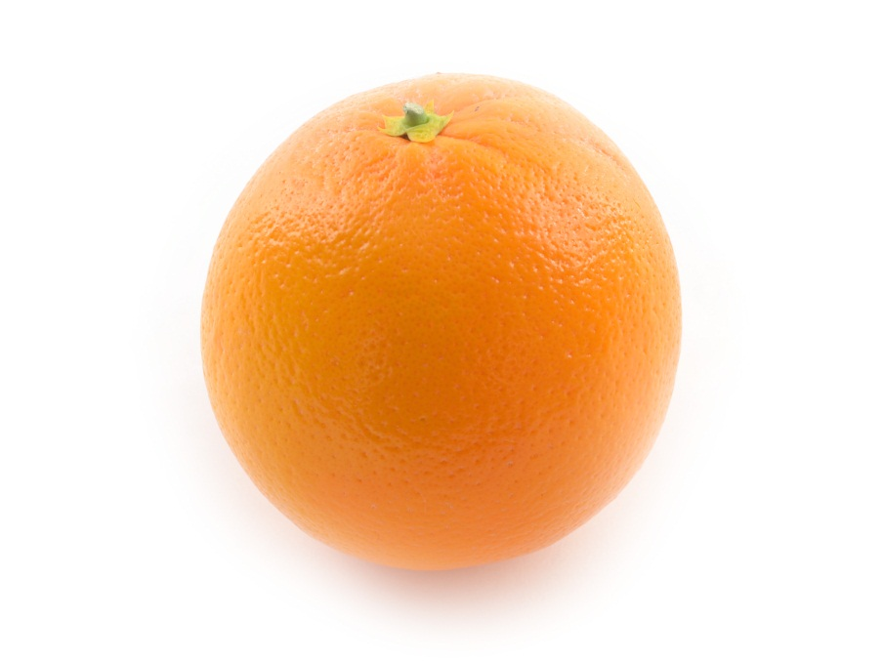
25. A. THIS IS A ORANGE B. THIS IS AN ORANGE C. THIS IS AN ORANGES D. THESE ARE ORANGES

