Slide 1
............ IS MY BROTHER. A. HE B. SHE C. THEY D. WE

Slide 2
........... IS MY SISTER. A. HE B. SHE C. THEY D. WE

Slide 3
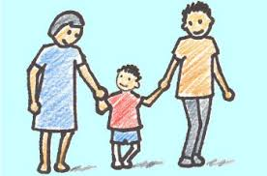
........... ARE MY PARENTS. A. HE B. SHE C. THEY D. WE

Slide 4
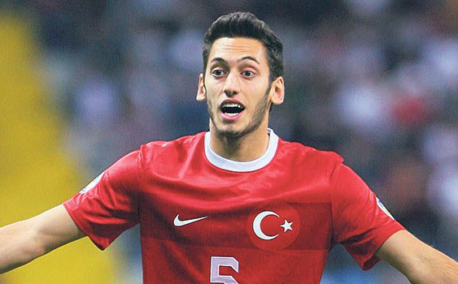
HELLO! .......... AM HAKAN. A. HE B. I C. THEY D. WE

Slide 5
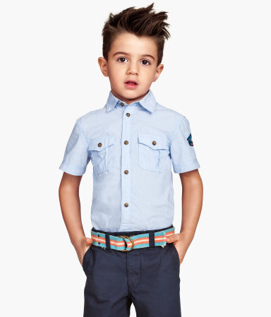
ECE: WHAT IS ...... NAME? ERAY: MY NAME IS ERAY. A. MY B. YOUR C. HIS D. OUR

Slide 6
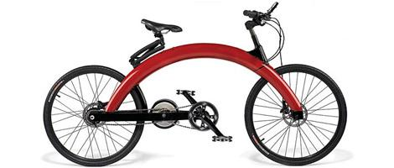
THIS IS .......... BICYCLE. A. I B. SHE C. THEY D. MY

Slide 7
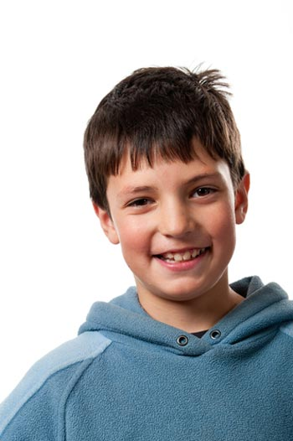
THIS IS JACK’S BROTHER. ............... NAME IS JOHN. A. THEY B. HIS C. HE D. THEIR

Slide 8
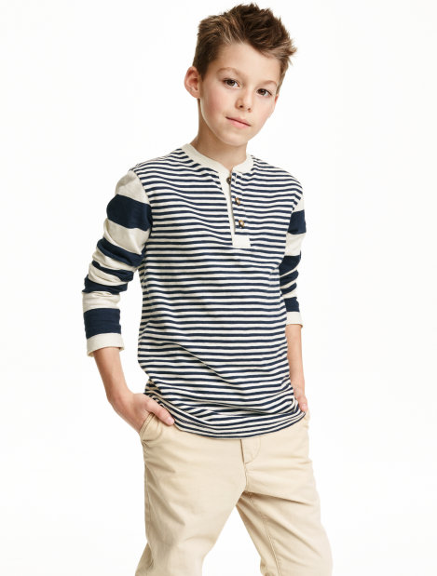
KAAN: HOW OLD ARE .......? FATİH: ..... AM NINE YEARS OLD. A.YOU/MY B. YOUR / I C. YOU / I D. YOUR / MY

Slide 9
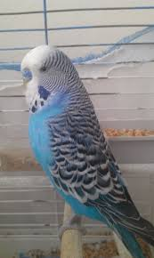
WE ARE OZAN AND EFE. THIS IS ...... BIRD BONCUK A. OUR B. WE C. SHE D. IT

Slide 10
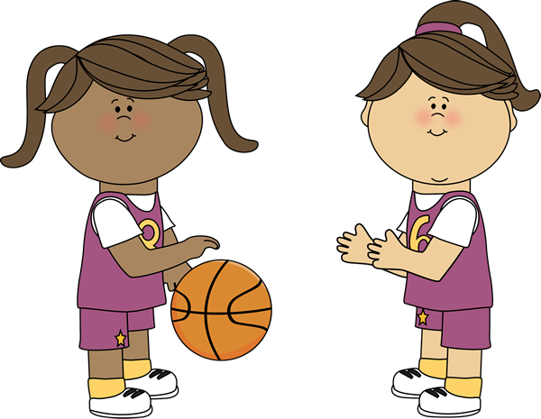
THEY ARE MY FRIENDS. ........... NAMES ARE LINDA AND SUE. A. THEY B. SHE C. THEIR D. HER

Slide 11
......... CAN PLAY TENNIS A. I B HER C. HIS D. ITS

Slide 12
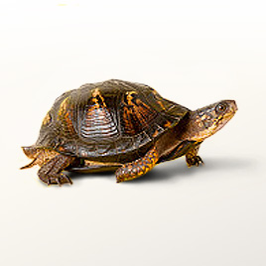
THIS IS MY TURTLE. ............. NAME IS LEONARDO. A. IT B. ITS C. HE D. OUR

Slide 13
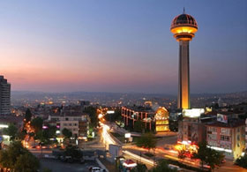
ONUR: WHERE ARE YOU FROM? SERDAR: ........ ....... FROM ANKARA. A. I AM B. YOU ARE C. MY AM D. I IS

Slide 14
THIS IS MARY. ....... CAN SWIM BUT ...... CAN’T DIVE. A. SHE / HER B. SHE /SHE C. HER / SHE D. HER / HER

Slide 15
WE LOVE ....... SCHOOL. A. WE B. OUR C. SHE D. IT

Slide 16
.......... ARE MY GRANDPARENTS. A. THEY B. THEIR C. SHE D. HE

Slide 17
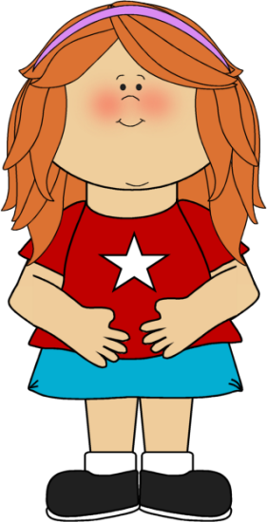
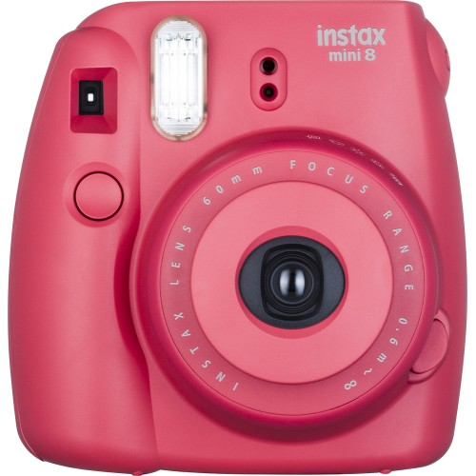
THIS IS ...... CAMERA. A. HIS B. SHE D. OUR D. HER

Slide 18
CAN HE LIFT WEIGHT? A. YES, HE CAN B. NO, SHE CAN’T C. YES, HE CAN’T D. NO, HE CAN’T

Slide 19
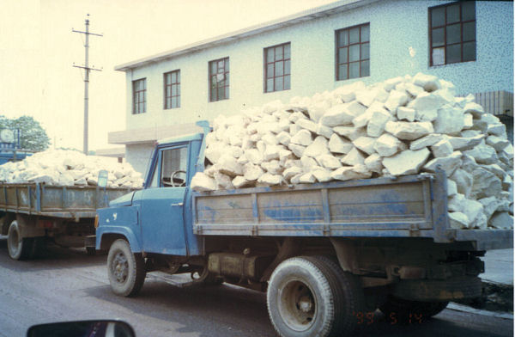
CAN IT CARRY THE ROCKS? A. YES, I CAN B. YES, IT CAN C. NO, IT CAN’T D. YES, IT CAN’T

Slide 20
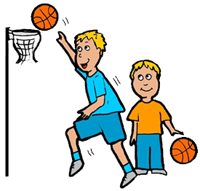
....... ........ PLAYING BASKETBALL. A. THEY LIKE B. THEY CAN C. THEY D. THEIR

Slide 21
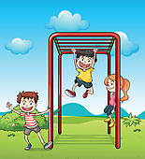
.......... ....... CLIMB BARS. A. THEY CAN B. THEY LIKE C. SHE CAN D. IT LIKES

Slide 22
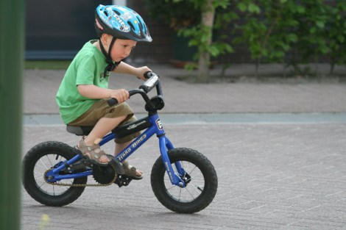
DO YOU LIKE RIDING A BIKE? A. YES, I AM B. YES, I CAN C. YES, I DO D. YES, YOU DO

Slide 23
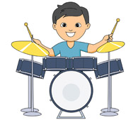
CAN YOU PLAY THE DRUMS? A. NO, SHE CAN’T B. YES, HE CAN C. YES, I CAN’T D. YES, I CAN

Slide 24
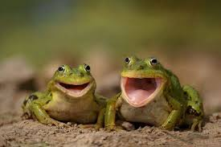
A. THEY CAN JUMP B. THEY CAN FLY C. SHE CAN JUMP D. THEY CAN RUN

Slide 25
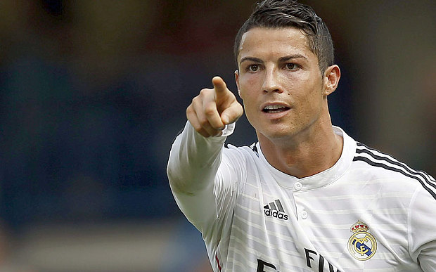
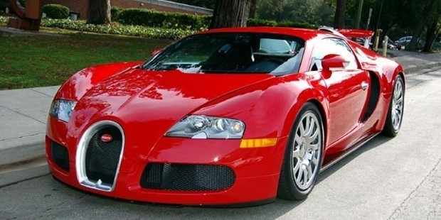
HE IS RONALDO. IT IS ....... CAR. A. IT B. HIS C. HER D. HE

Slide 26
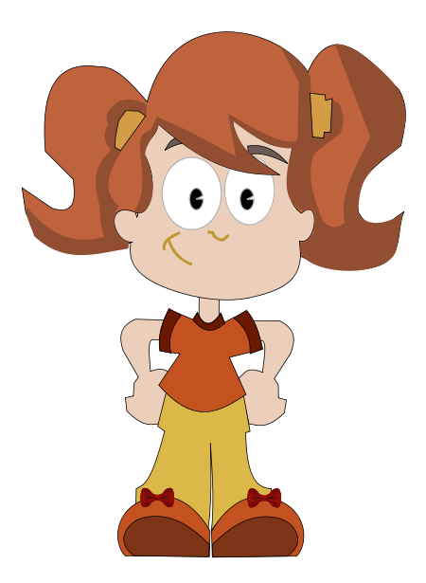
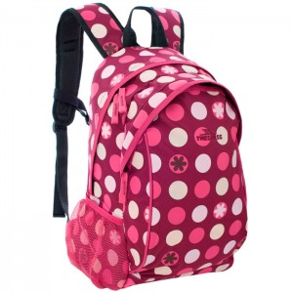
SHE IS TINA. IT IS ............... SCHOOL BAG. A. SHE B. HE D. HIS D. HER

Slide 27
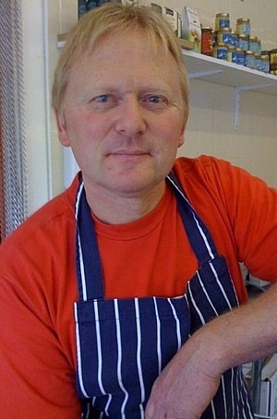
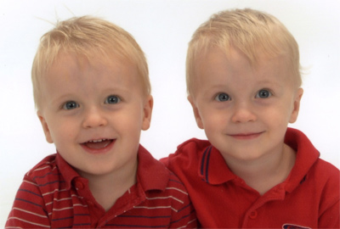
WE ARE TIM AND TOM. HE IS ....... FATHER. A. OUR B. WE C. HE D. HIS

Slide 28
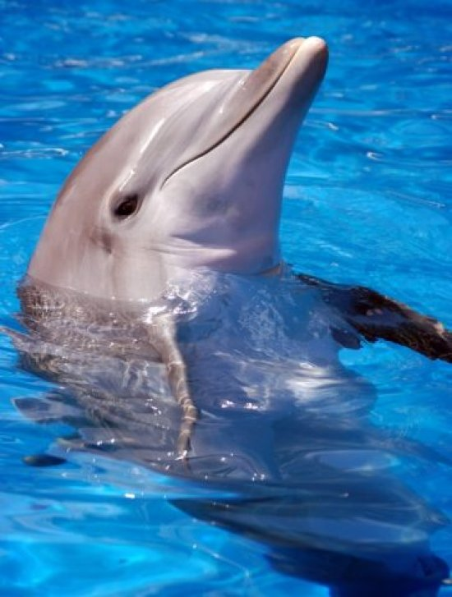
IT IS A DOLPHIN. ....... CAN’T FLY BUT ....... CAN SWIM A. IT / ITS B. IT /IT C. ITS / IT D. IT / SHE

Slide 29
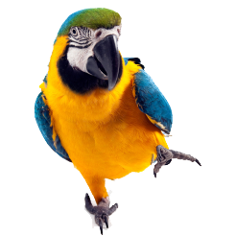
IT CAN SPEAK...... IT CAN FLY A. AND B. BUT C. WHAT D. HOT

Slide 30
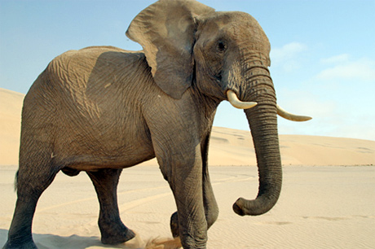
IT CAN WALK..... IT CAN’T JUMP. A. BUT B. AND C. IT D. SHE

Slide 31
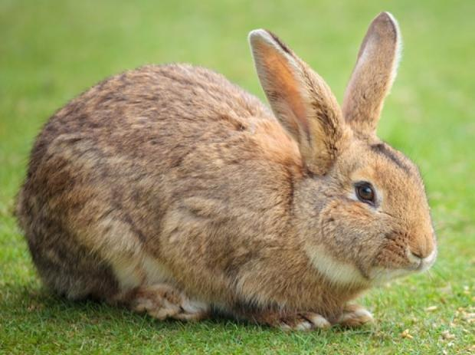
IT CAN ...... ........ A. SWIM FAST B. READ FAST C. RUN FAST D. PLAY FOOTBALL

Slide 32
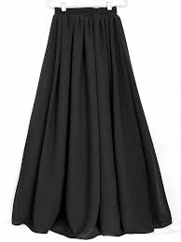
IT IS ....... SKIRT. A. SHE B. HE C. HER D. HIS

Slide 33
THIS IS ........ CAGE A. HE B. HER C. ITS D. IT

Slide 34
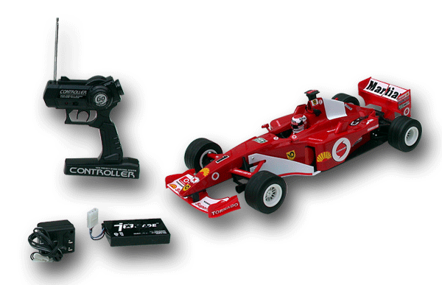
THIS IS ...... CAR. A. HIS B. HE S. SHE D. HER

Slide 35
THEY ARE JESSICA AND SALLY. THIS IS ...... HOUSE. A. HER B. SHE C. THEY D. THEIR

Slide 36
I CAN’T WALK. A. B. C. D.

Slide 37
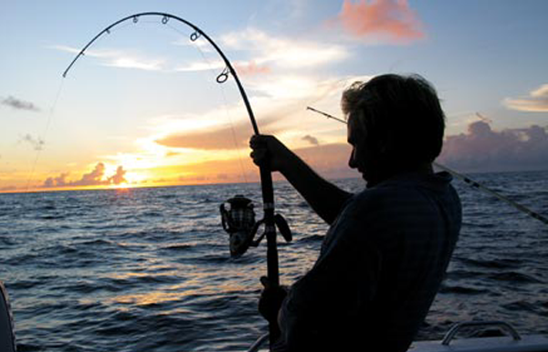
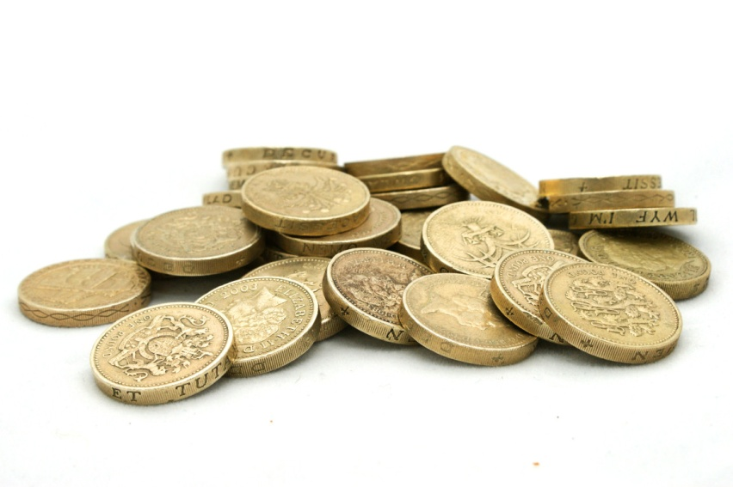
I LIKE COLLECTING COINS. A. B.

Slide 38
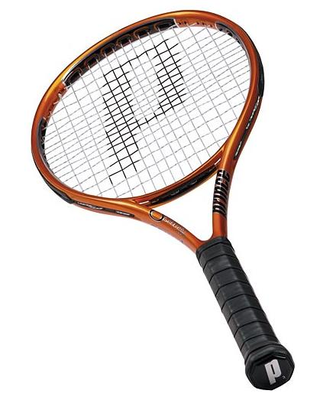
I CAN SING A. B.

Slide 39
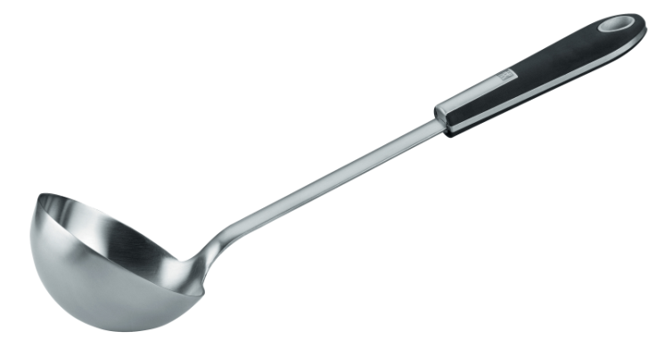
I CAN COOK A. B.

Slide 40
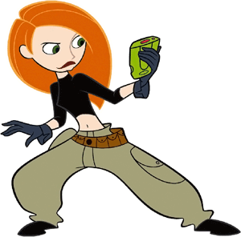
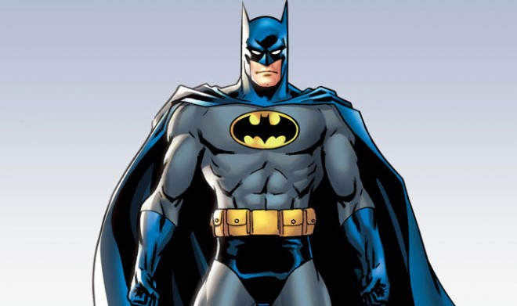
SHE IS MY HEROINE A. B.

Slide 41
zB2016

