Slide 1
17+32:? A.FIFTY-SEVEN B.FIFTY-NINE C.NINETY-NINE D.FORTY-NINE

Slide 2
15+15 A. THIRTEEN B.THIRTY C.THREETEEN D. THIRTY-THREE

Slide 3
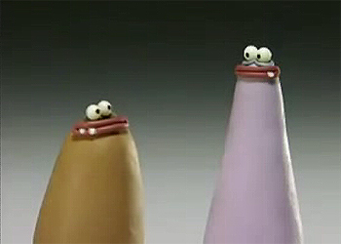
A. PINK-BLACK B. BROWN-PURPLE C.BROWN – GREY D. BROWN - ORANGE

Slide 4
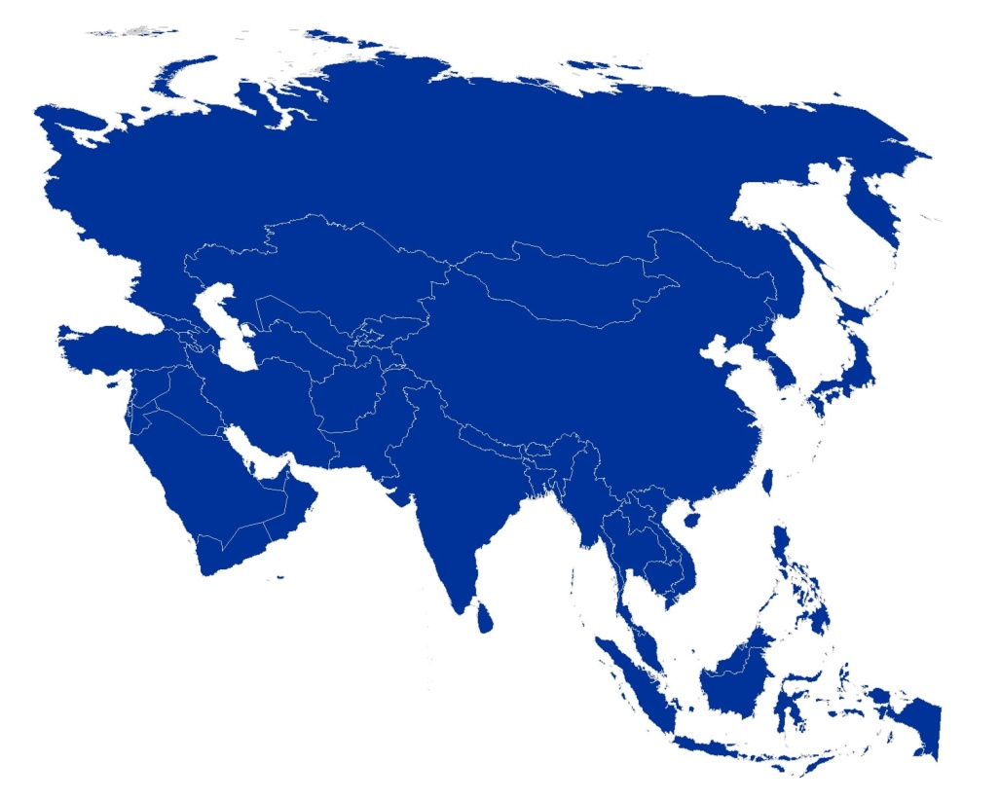
A. ASIA B. EUROPE C. SOUTH AMERICA D. AFRICA

Slide 5
A. GERMANY B.FRANCE C. ITALY D. GREECE

Slide 6
A. ITALIAN B. PORTUGUESE C. GREEK D. FRANCE

Slide 7
A. TURKEY B. SPAIN C. AMERICAN D. RUSSIA

Slide 8
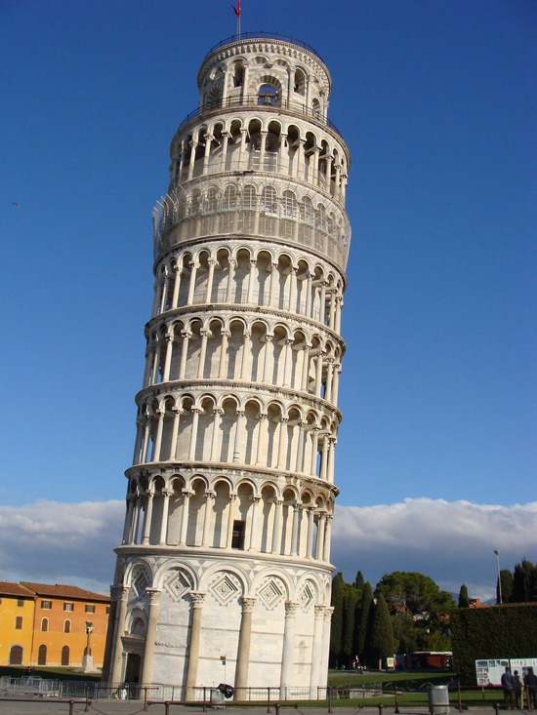
A. I AM FROM GERMANY B. I AM FROM RUSSIA C. I AM FROM ITALIAN D. I AM FROM ITALY

Slide 9
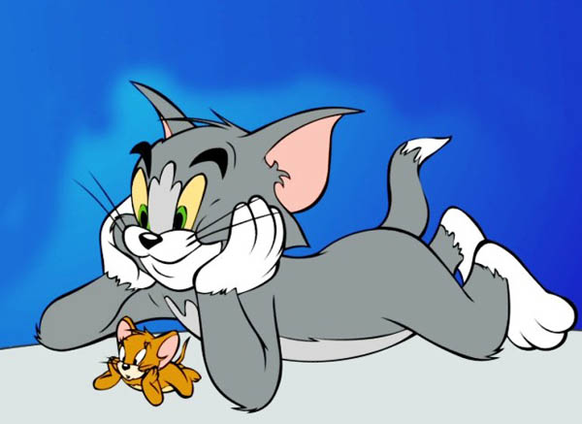
DO YOU LIKE WATCHING CARTOONS? A. YES, I DON’T B. NO, I DON’T C. YES, I DOES D. YES, I DO

Slide 10
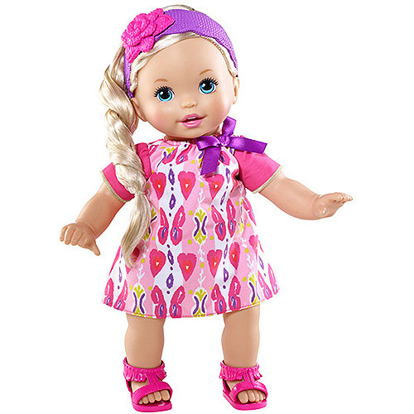
I DON’T LIKE................. A. PLAYING WITH DOLLS B. PLAYING COMPUTER GAMES C. PLAY WITH DOLLS D. SKIPPING A ROPE

Slide 11
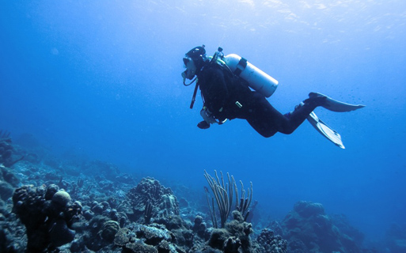
A. I LIKE FISHING B. I LIKE DIVING C. I LIKE PLAYING CHESS D. I LIKE READING

Slide 12
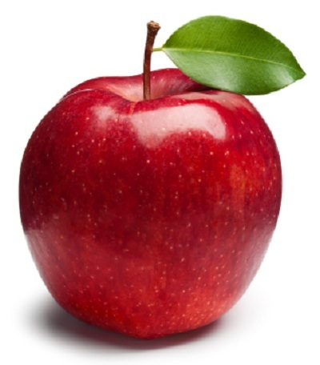
............... APPLE A. A B. AN C. X

Slide 13
............... RULER A. A B. AN C. X

Slide 14
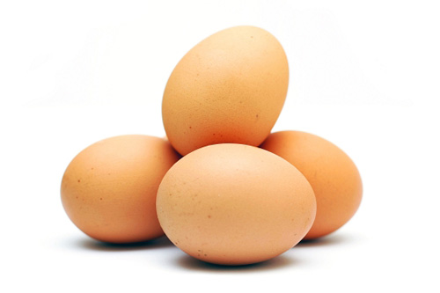
............... EGGS A. A B. AN C. X

Slide 15
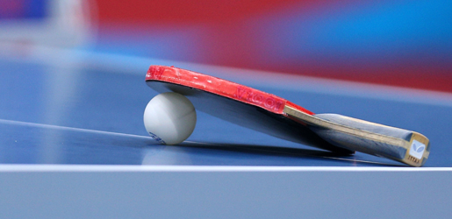
1- I LIKE PLAYING TABLE TENNIS 2- SHE DON'T LIKES PLAYING TABLE TENNIS 3- HE LIKES PLAY TABLE TENNIS A. 1 B. 1-2 C. 1-2-3 D. 1-3

Slide 16
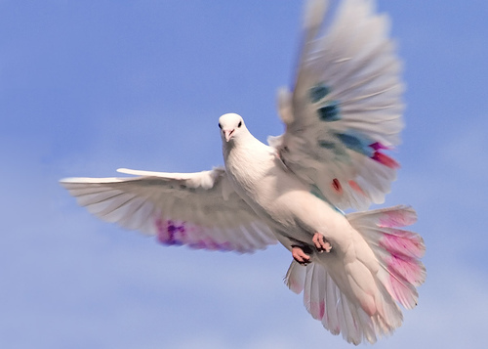
A. I CAN FLY B. I CAN’T DIVE C. I CAN’T FLY D. I CAN DANCE

Slide 17
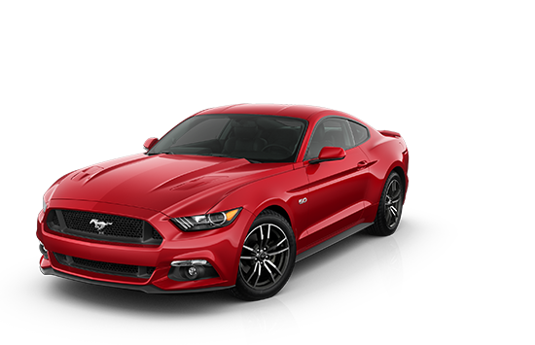
A. I CAN DRIVE B. I CAN FLY C. I CAN SWIM D. I CAN’T DRIVE

Slide 18
A. I CAN’T FLY A KITE B. I CAN DANCE C. I CAN SKIP A ROPE D. I CAN FLY A KITE

Slide 19
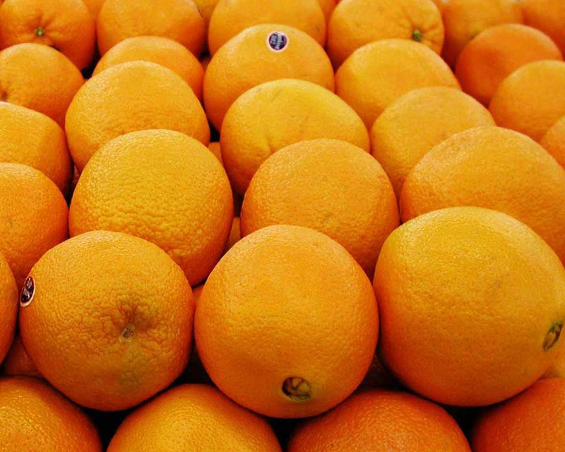
......... ORANGES A. A B. AN C. X

Slide 20
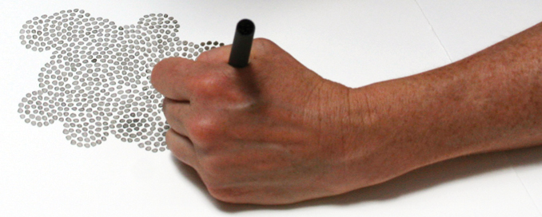
A. I CAN DRIVE B. I LIKE DRAWING C. I CAN’T DRAW D. I DON’T LIKE READING

Slide 21
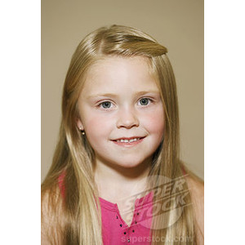
SHE IS MARY. ....... IS FROM CANADA A. HE B. SHE C. HIS D. HER

Slide 22
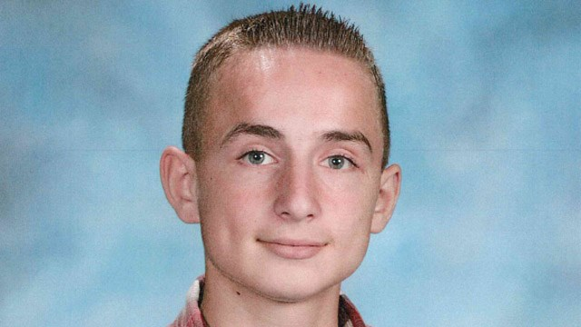
THIS IS JAMES. .........IS FROM THE U.S.A A. HE B.SHE C. HER D. HIS

Slide 23
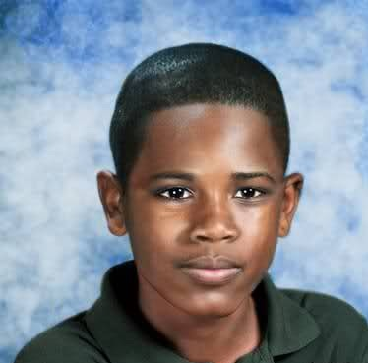
HELLO! ...... NAME IS KAREEM A. I B. YOUR C. MY D. HER

Slide 24
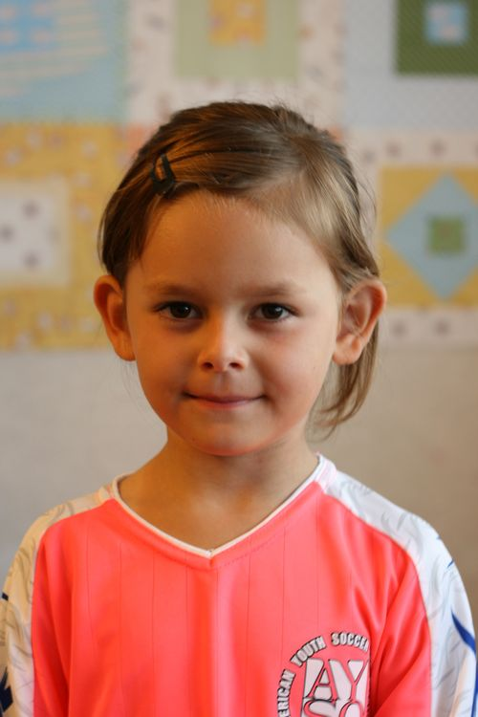
....... NAME IS NADIA. SHE IS FROM GERMANY A. SHE B. HE C. HER D. HIS

Slide 25
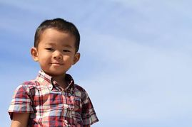
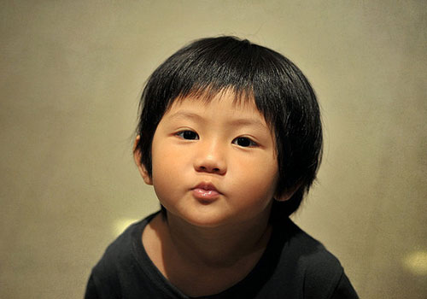
THEY ARE FROM JAPAN ......... NAMES ARE SOTA AND YUKI A. HIS B. HER C. OUR D. THEIR

Slide 26
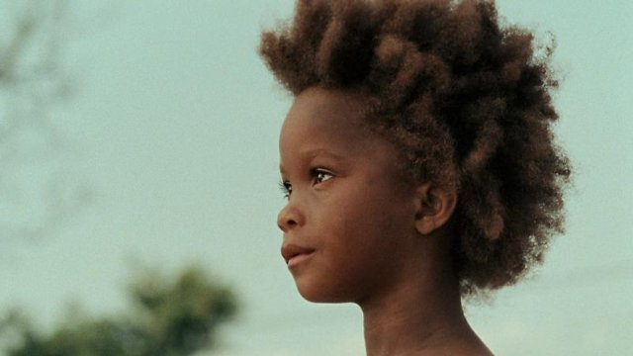
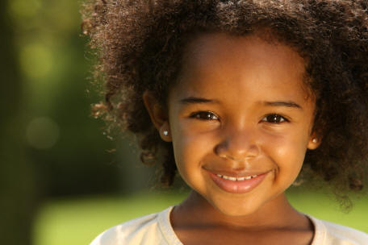
HELLO! WE ARE FROM KENYA ........ NAMES ARE DAYO AND ABEBI A. WE B. OUR C. THEIR D. THEY

Slide 27
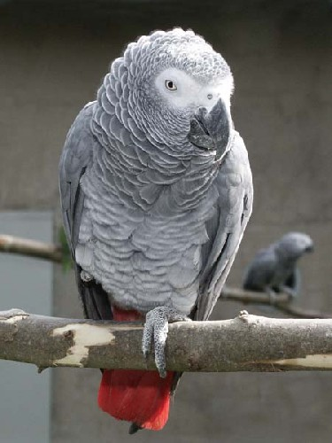
THIS IS MY BIRD. .......... NAME IS YARAMAZ A. ITS B. IT C. THEY D. OUR

Slide 28
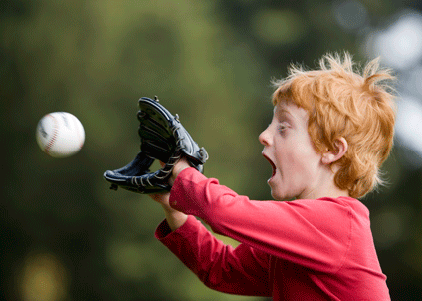
A. I CAN CATCH THE BALL B. I CAN READ A BOOK C. I CAN’T CATCH THE BALL D. I CAN WATCH CARTOONS

Slide 29
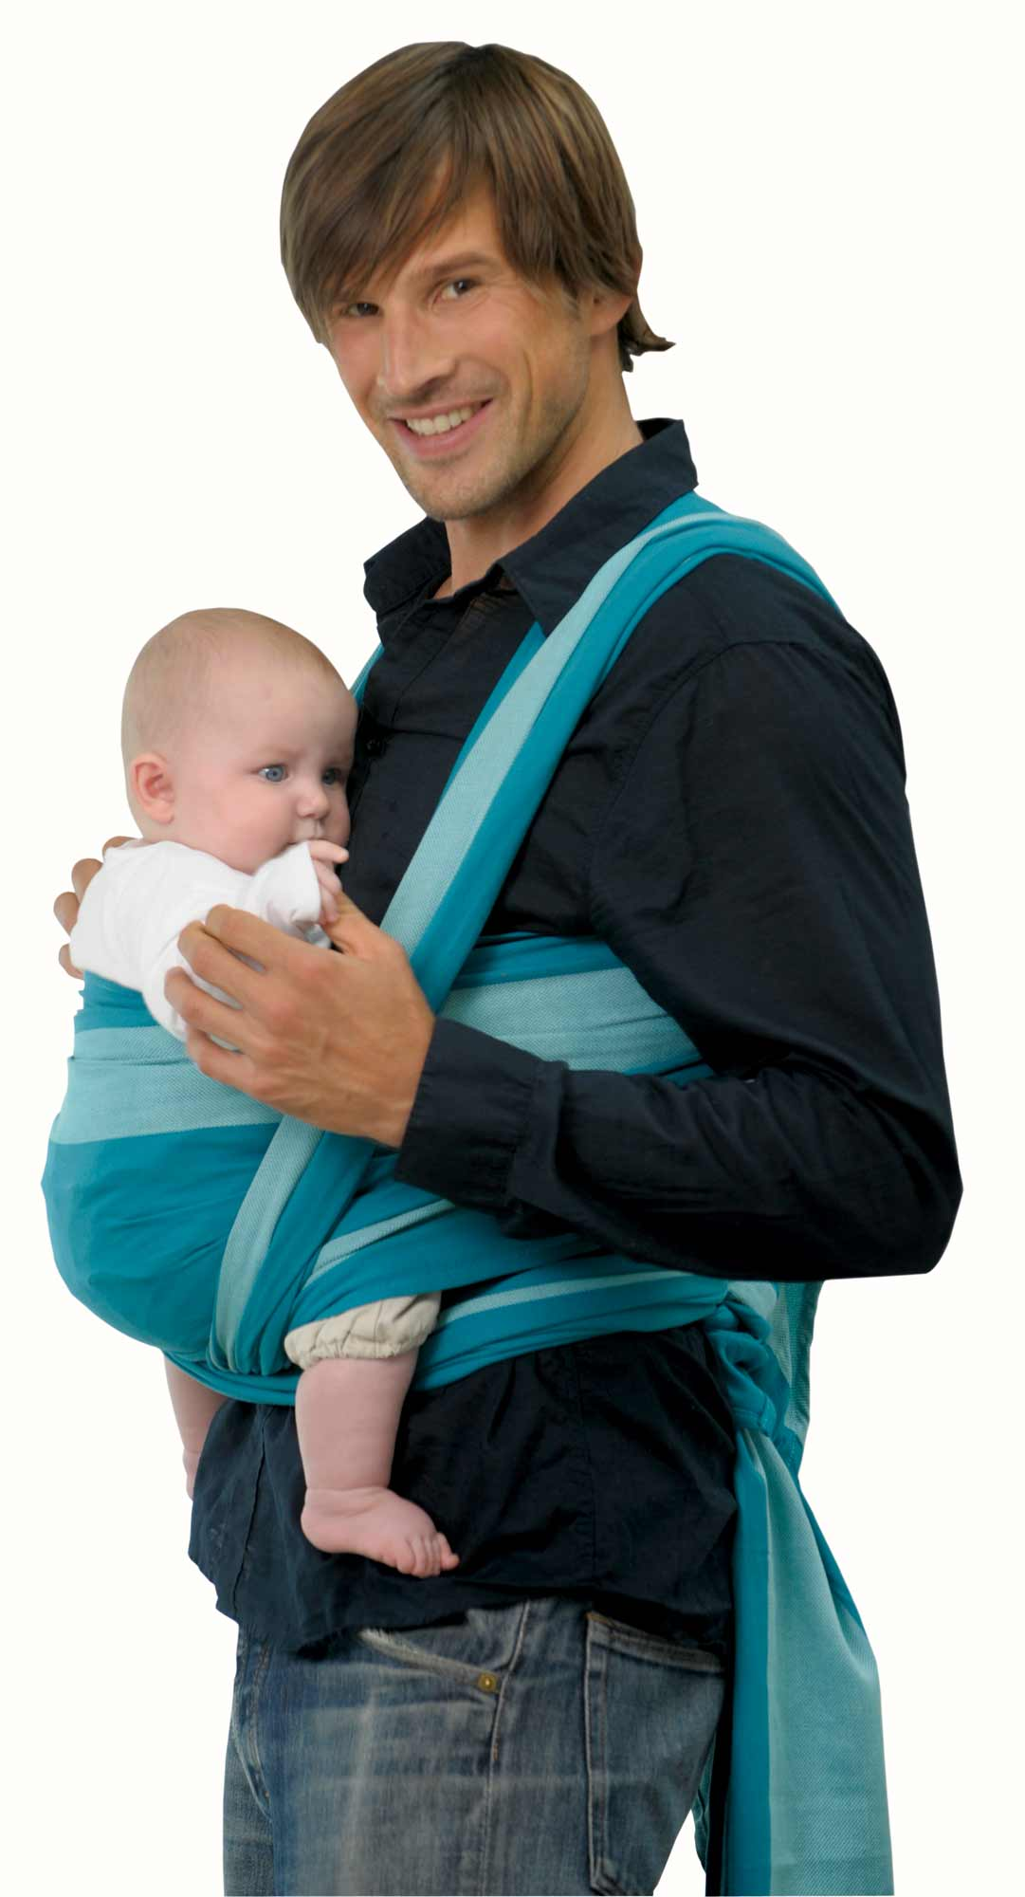
A. WATCH B. DRAW C. CARRY D. FLY

Slide 30
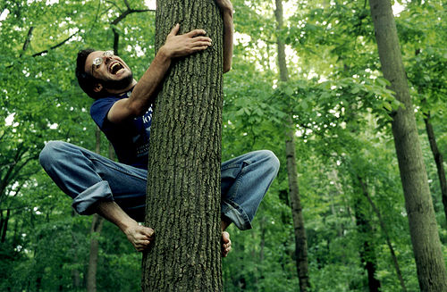
A. I CAN CARRY THE ROCKS B. I CAN CLIMB A TREE C. I CAN SWING D. I CAN DIVE

Slide 31
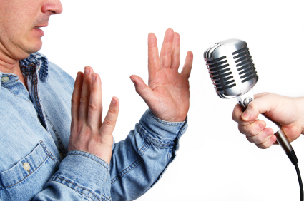
A. I CAN’T RUN B. I CAN SPEAK ENGLISH C. I CAN’T SPEAK ENGLISH D. I CAN CLIMB A TREE

Slide 32
THIRTY+THIRTEEN=? A. FORTY-THREE B. FIFTY-THREE C. SIXTY D. THIRTY- NINE

Slide 33
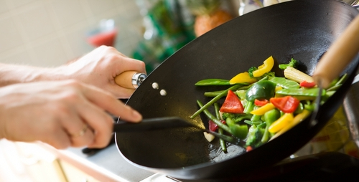
A. I LIKE COOK B. I CAN COOK C. I DON’T LIKE COOKING D. I CAN’T COOKING

Slide 34
......... FLOWER A. A B. AN C. X

Slide 35
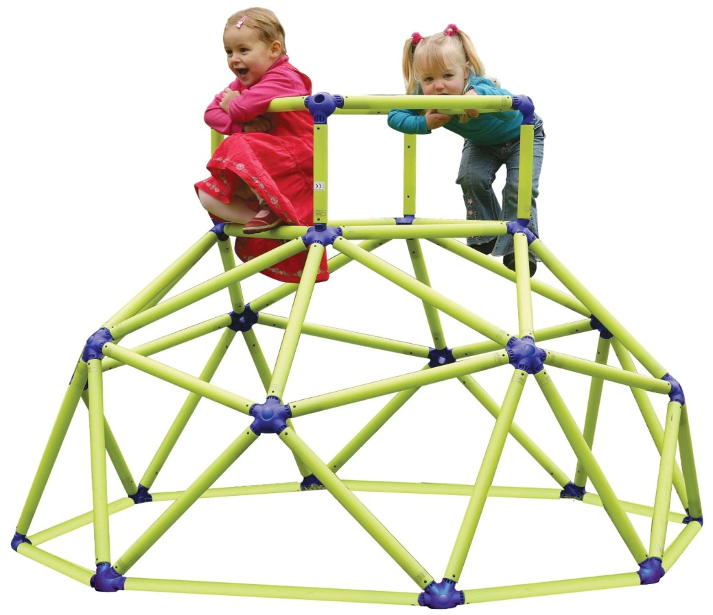
A. I CAN CLIMB A TREE B. WE CAN CLIMB A TREE C. I CAN’T CLIMB A BAR D. WE CAN CLIMB A BAR

Slide 36
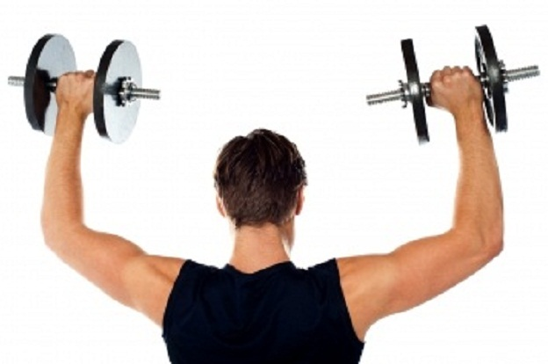
A. I CAN LIFT WEIGHTS B. I CAN DRIVE C. I CAN CARRY THE ROCKS D. I CAN’T LIFT WEIGHTS

Slide 37
A. SING B. LIFT C. CARRY D. SWIM

Slide 38
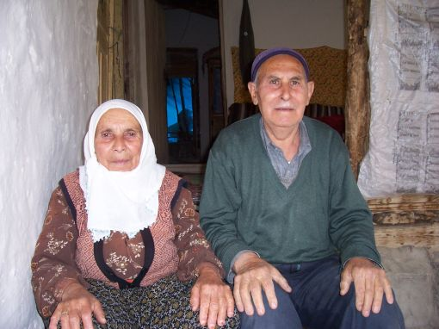
.......... MY GRANDFATHER AND GRANDMOTHER A. HE B. SHE C. WE D. THEY

Slide 39
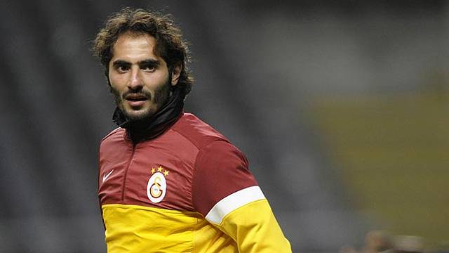
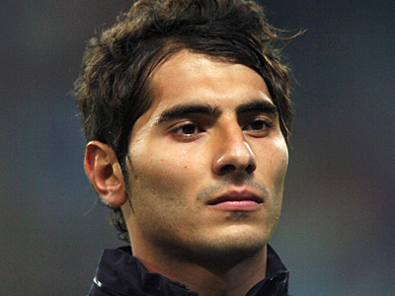
I AM HAMİT. ..... IS ..... BROTHER HALİL. A. HE – MY B. HE – HIS C. HIS – HE D. HE - THEY

Slide 40
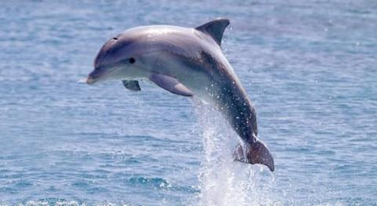
CAN A DOLPHIN RUN? A. NO, IT CAN’T B. YES, IT CAN C. YES, I CAN D, NO , IT ISN’T

Slide 41
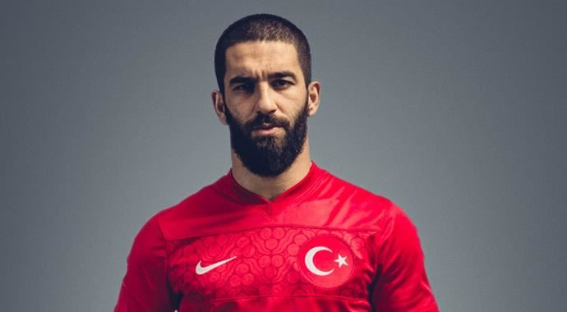
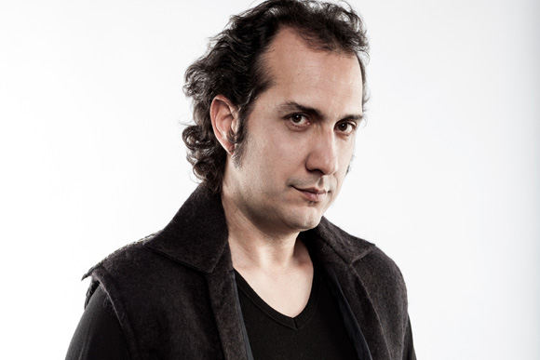
WHO CAN PLAY THE GUITAR? A. B. C.

Slide 42
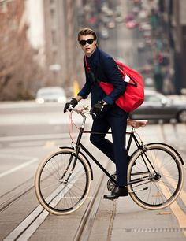
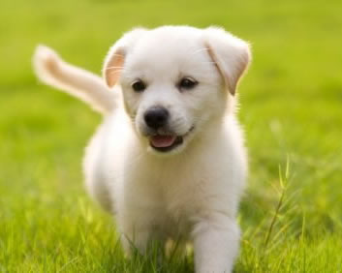
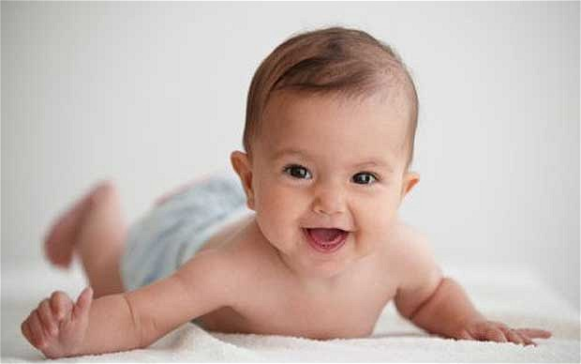
WHO CAN RIDE A BIKE? A. B. C.

Slide 43
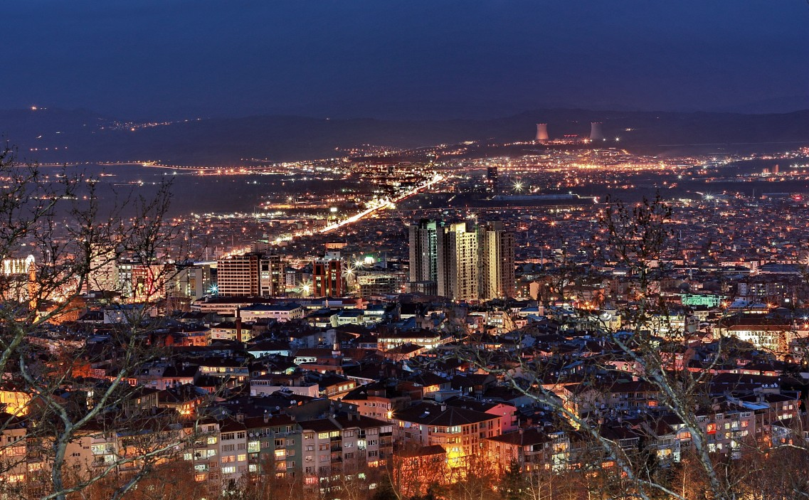
WHERE IS YOUR HOMETOWN? A. PARIS B. LONDON C. BERLIN D. BURSA

Slide 44
A. I DON’T LIKE DIVING B. I DON’T LIKE DRIVING C. I LIKE DRAWING D. I DON’T LIKE FISHING

Slide 45
CAN YOU SING A SONG? A. YES, I AM B. YES, HE CAN C. YES, I CAN D. YES, I DO

Slide 46
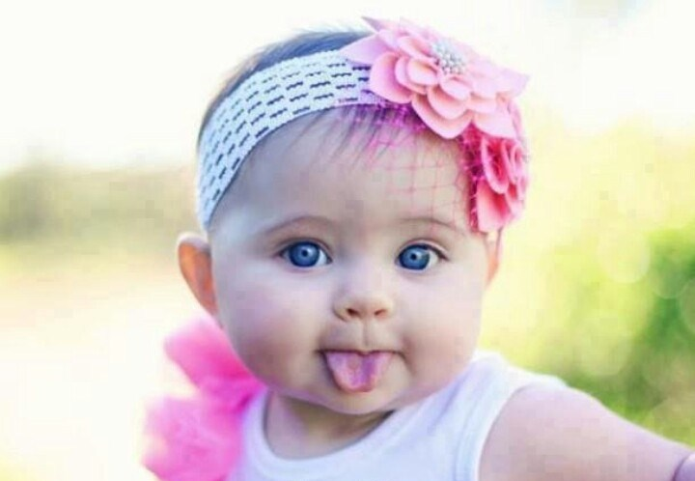
A. HE CAN’T DO PUZZLES B. SHE CAN’T DO PUZZLES C. HE CAN DO PUZZLES D. SHE CAN’T DRAW A PICTURE

Slide 47
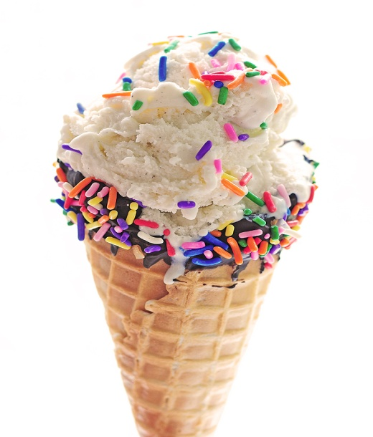
A. I LIKE ICE CREAM AND COMICS B. I LIKE ICE CREAM BUT I DON’T LIKE FISHING C. I LIKE CHEESE BUT I DON’T LIKE ICE CREAM D. I LIKE ICE CREAM BUT I DON’T LIKE COMICS

Slide 48
A. WE CAN JUMP BUT WE CAN’T READ B. WE CAN JUMP BUT WE CAN’T PLAY CHESS C. WE CAN PLAY CHESS BUT WE CAN’T JUMP D. WE CAN JUMP AND WE CAN PLAY CHESS

Slide 49
A. MAY I GO OUT? B. MAY I USE YOUR MOBILE PHONE? C. MAY I GO TO THE TOILET? D. MAY I COME IN?

Slide 50
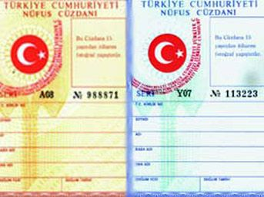
A. ID CARD B. DRIVING LICENCE C. BOOK D. NOTEBOOK

Slide 51
zB

