Slide 1
J O B S

Slide 2
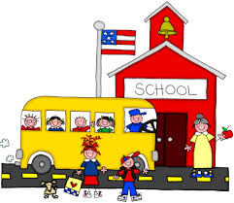
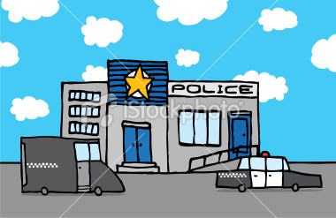
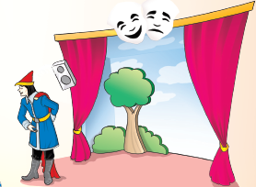
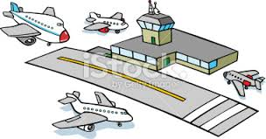
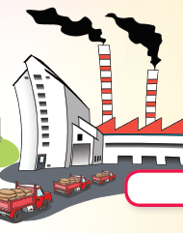
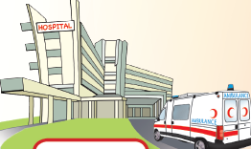
airport
police station
theater
school
farm
hospital
factory

Slide 3
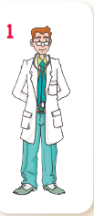
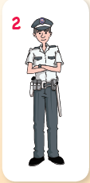
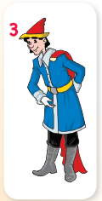
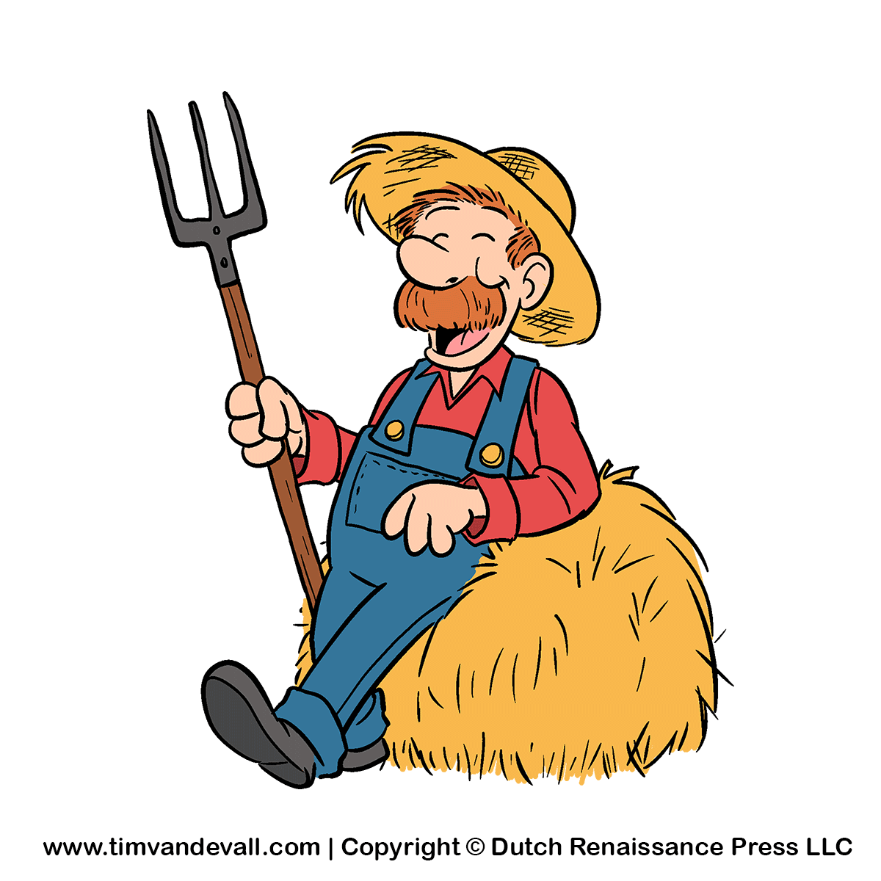
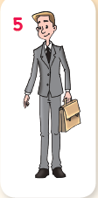
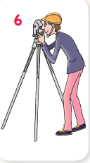
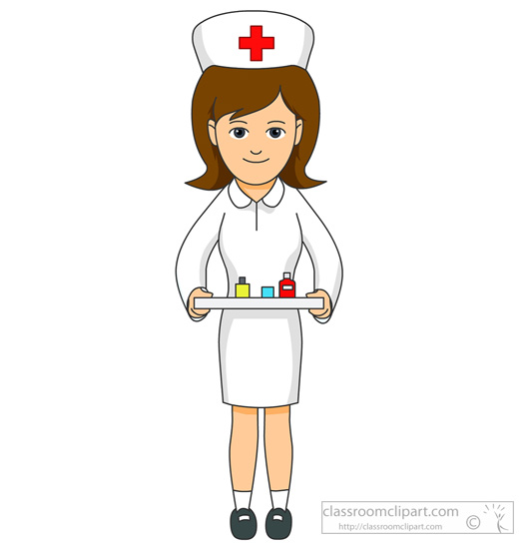
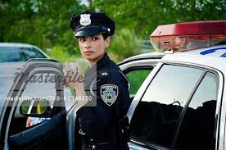
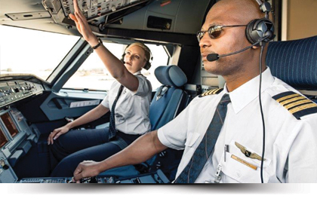
doctor
actor
farmer
businessman
policeman
engineer
nurse
policewoman
pilot

Slide 4
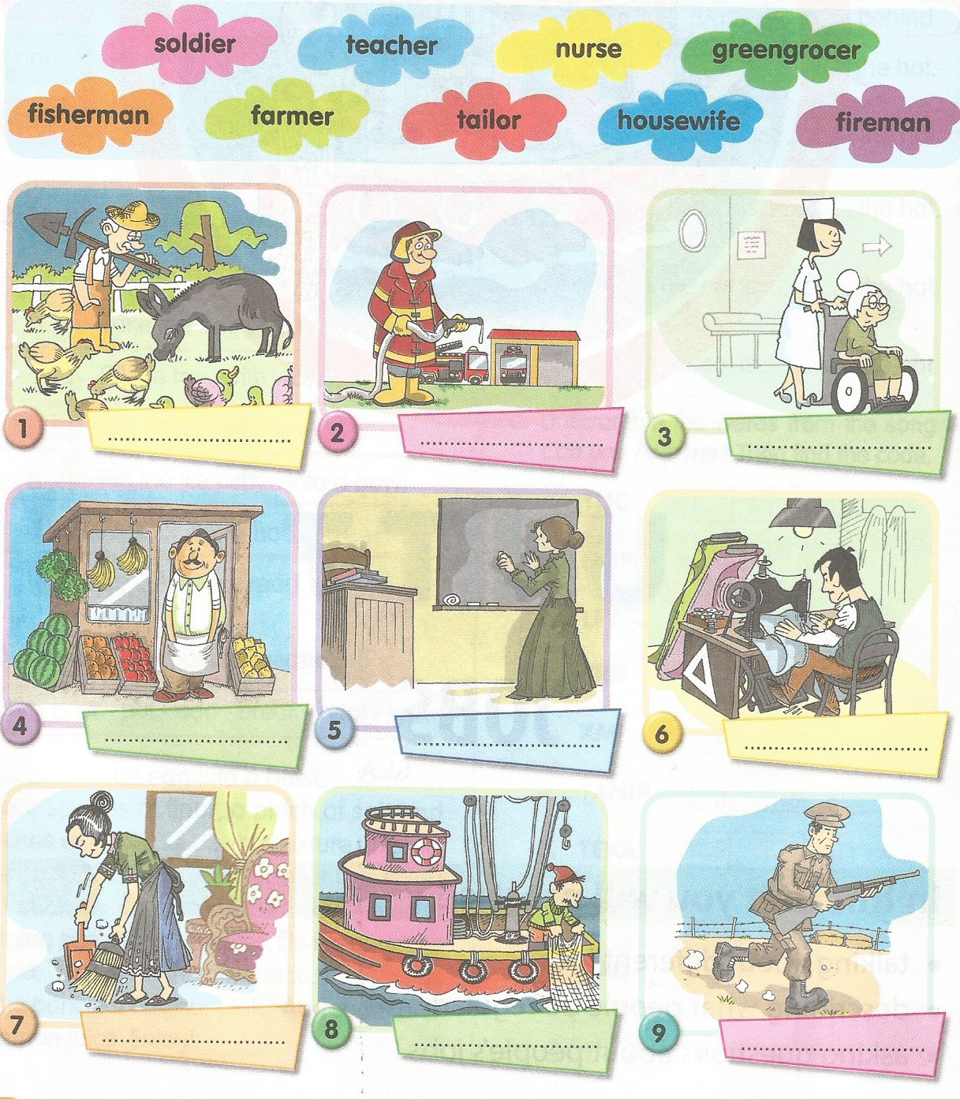
farmer
fireman
nurse
greengrocer
teacher
tailor
housewife
fisherman
soldier

Slide 5
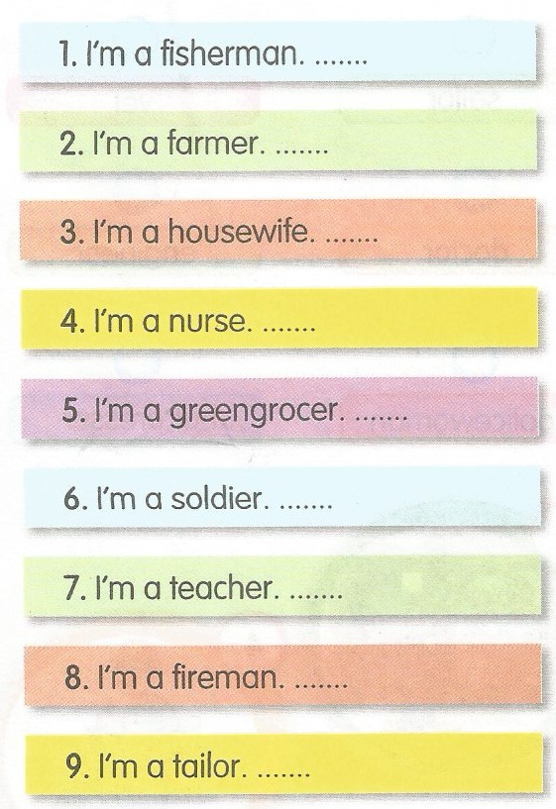
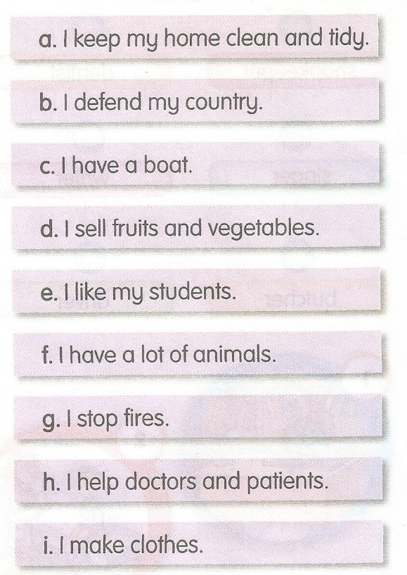
c
clean : temiz tidy : düzenli
f
defend: savunmak country: ülke
a
boat: bot/gemi
h
sell : satmak
d
b
e
Fire: yangın
g
help: yardım etmek
patient: hasta
i
make: yapmak clothes : giysi/kıyafet

Slide 6
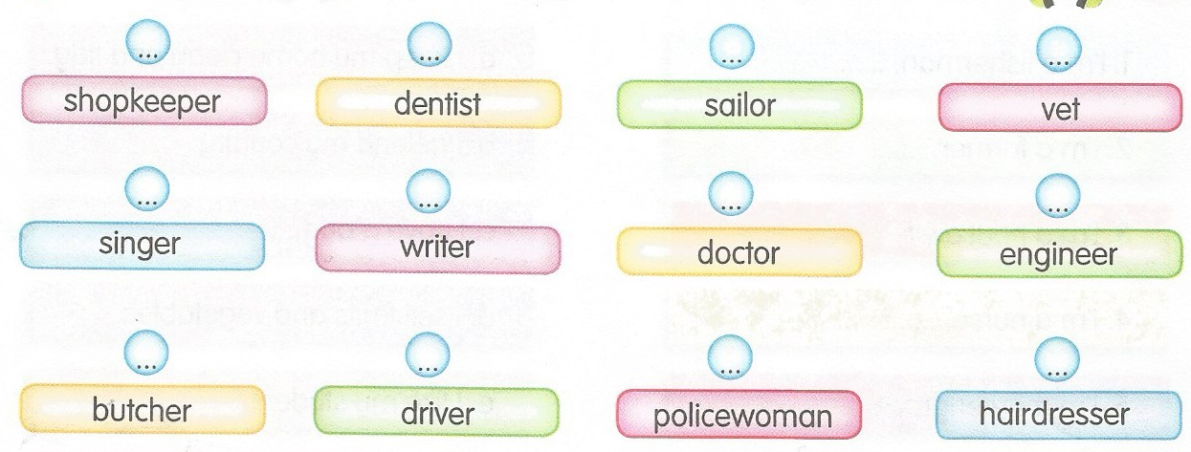
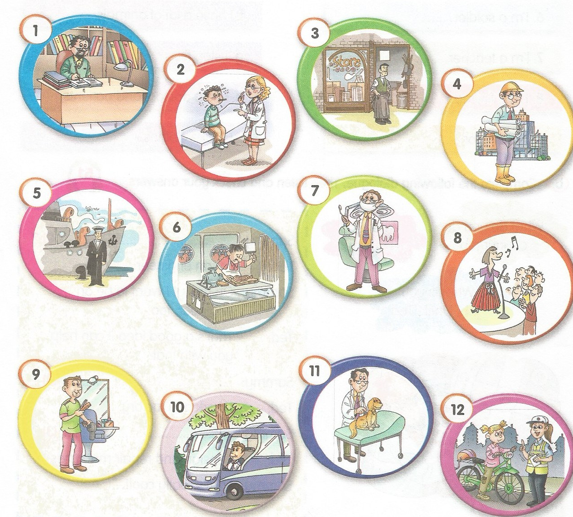
3
7
5
11
8
1
2
4
6
10
12
9

Slide 7
5
7
4
1
3
6
2

Slide 8
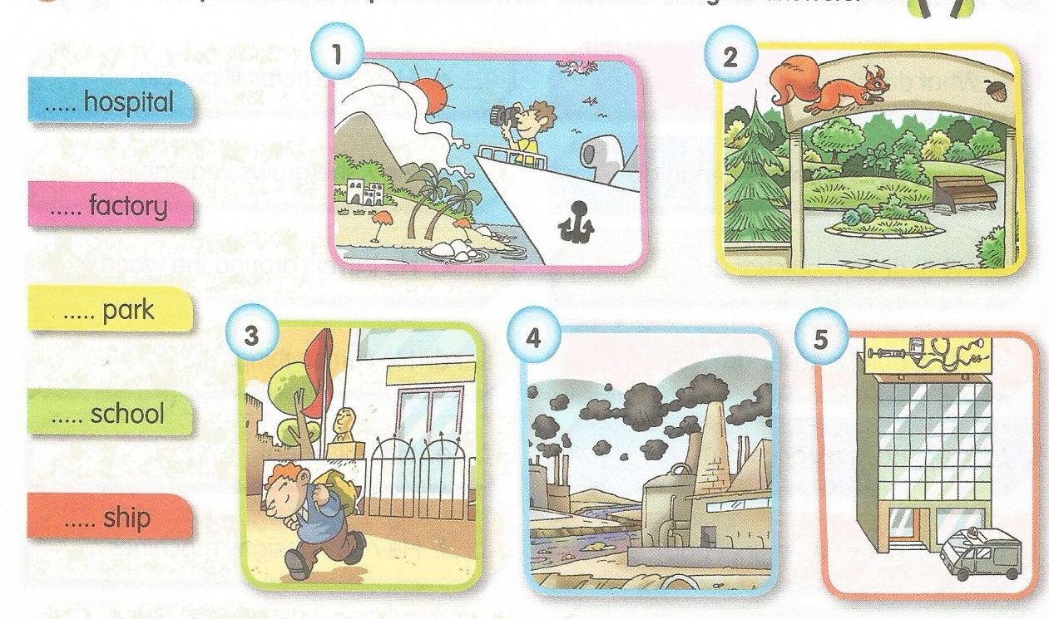
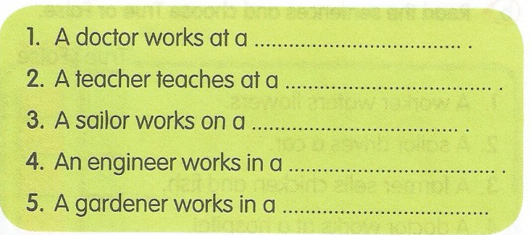
hospital.
school.
ship.
factory.
garden.

Slide 9
4
6
3
2
5
1

Slide 10
