Slide 1
HOBBIES

Slide 2
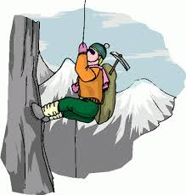
CLIMB A MOUNTAIN

Slide 3
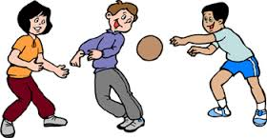
PLAY DODGEBALL

Slide 4
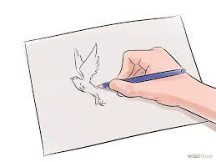
DRAW PICTURES

Slide 5
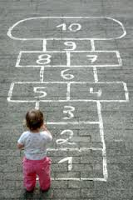
PLAY HOPSCOTCH

Slide 6
ICE SKATING

Slide 7
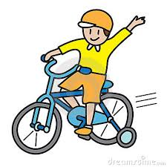
RIDE A BIKE / CYCLE

Slide 8
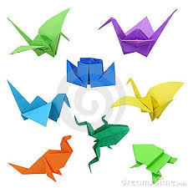
ORIGAMI

Slide 9
COLLECT STAMPS

Slide 10
CHINESE WHISPERS

Slide 11
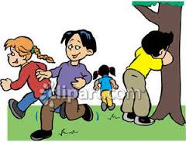
HIDE AND SEEK

Slide 12
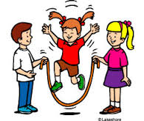
SKIP A ROPE

Slide 13
PLAY TAG

Slide 14
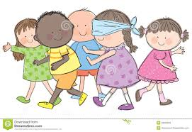
BLIND MAN’S BUFF

Slide 15
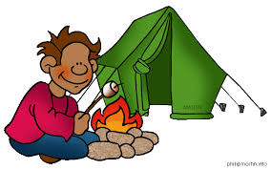
CAMPING

Slide 16
DO PUZZLES

Slide 17
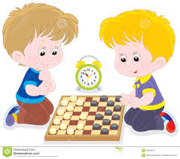
PLAY CHECKERS

Slide 18
PLAY CHESS

Slide 19
FISHING

Slide 20
KNITTING

Slide 21
ONLINE GAMES

Slide 22
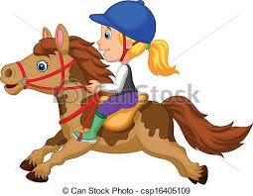
RIDE A HORSE

Slide 23
SING A SONG

Slide 24
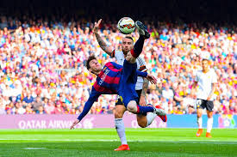
Play football / play soccer

Slide 25
Tic tac toe

