Slide 1
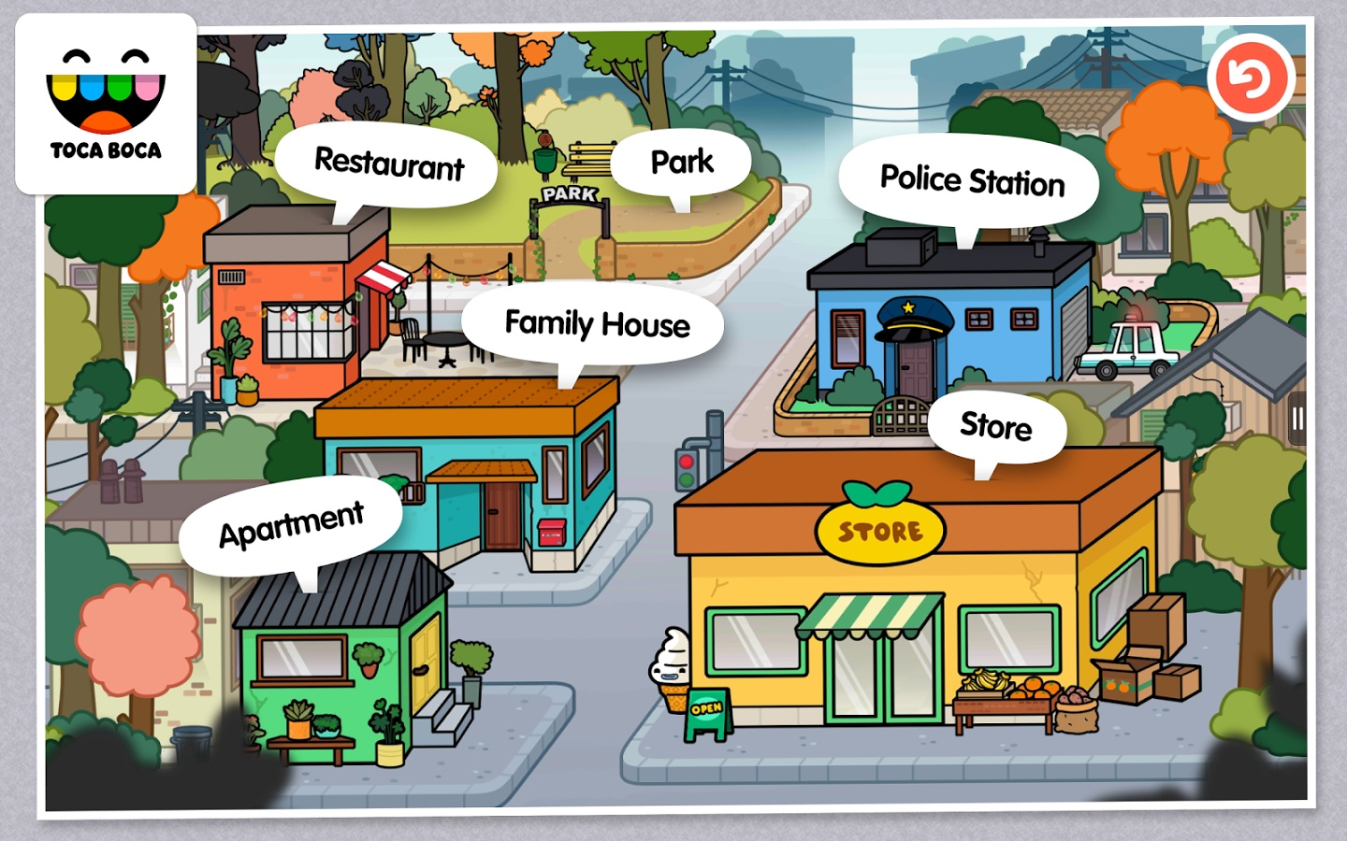
PLACES IN MY TOWN

Slide 2
BANK

Slide 3
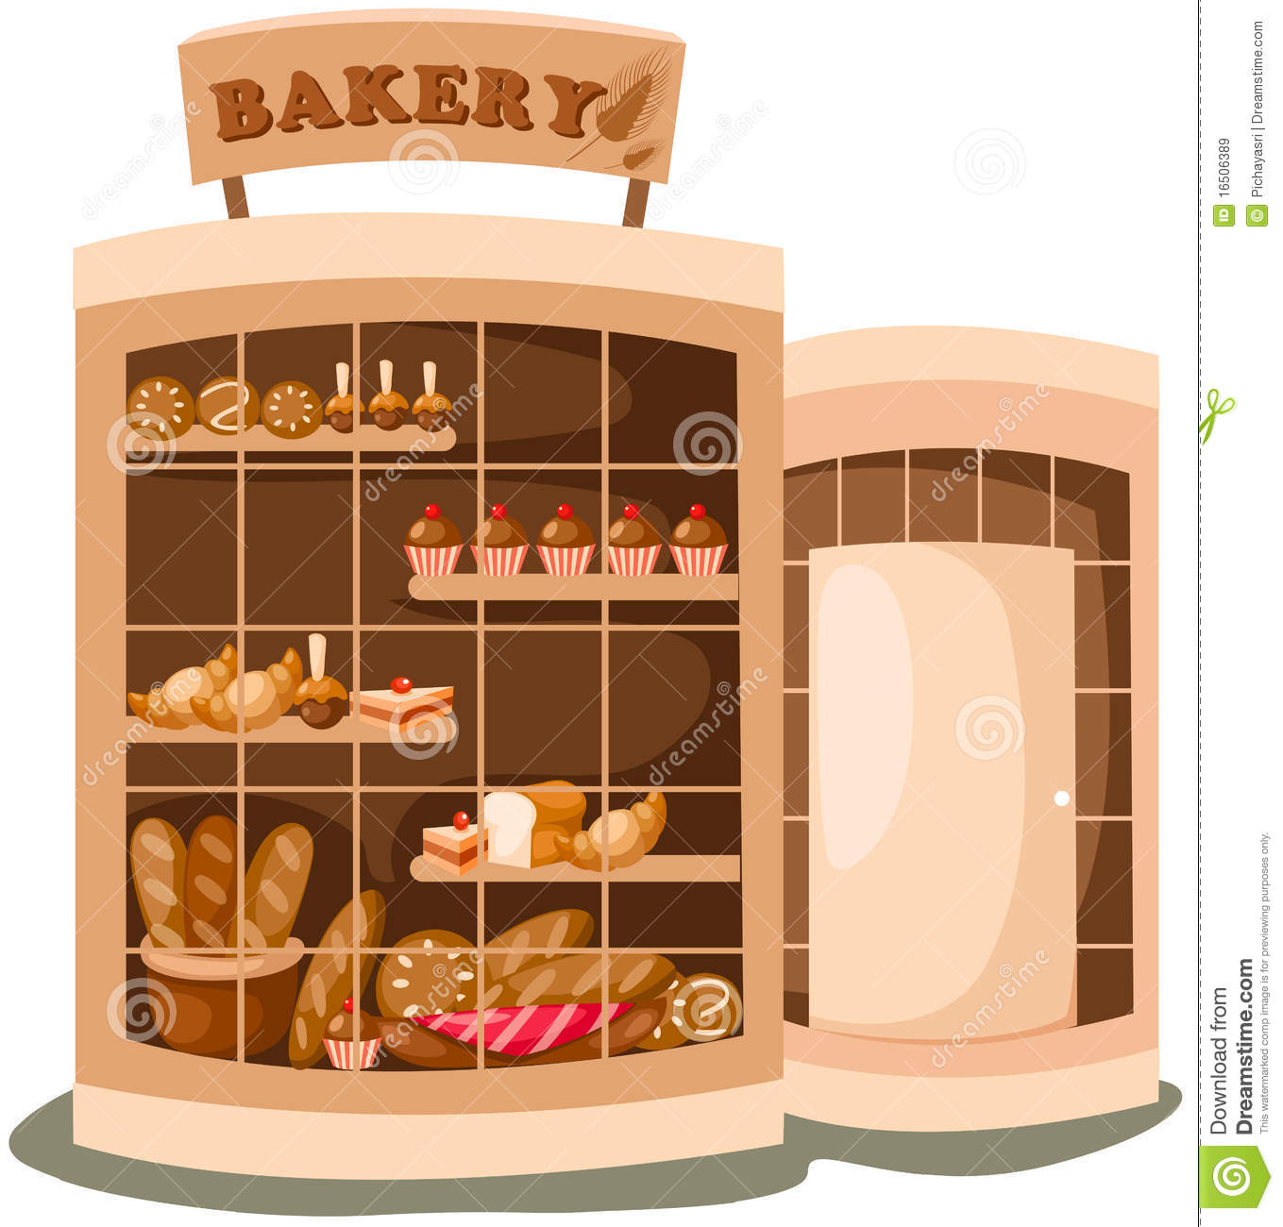
BAKERY

Slide 4
BARBER

Slide 5
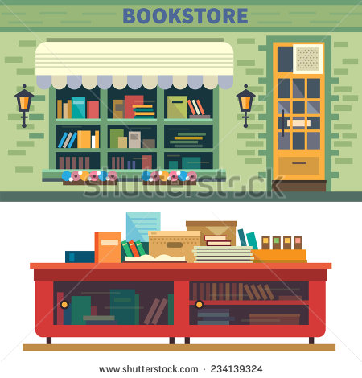
BOOKSHOP

Slide 6
BUS STOP

Slide 7
CAFE

Slide 8
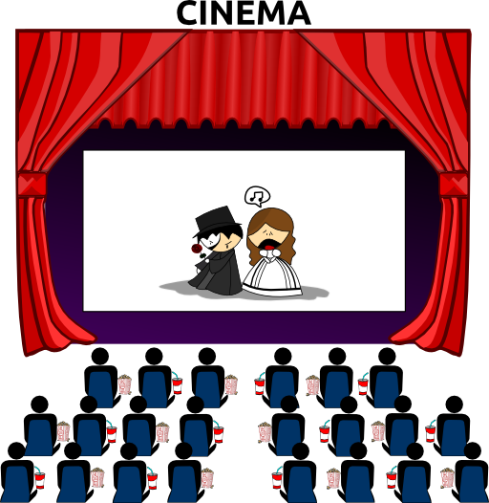
CINEMA

Slide 9
CONCERT HALL

Slide 10
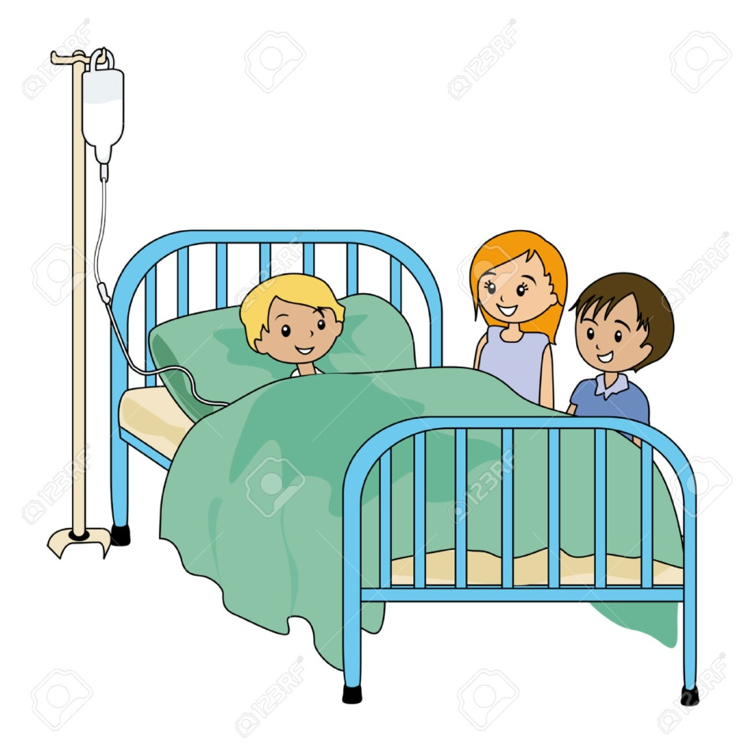
HOSPITAL

Slide 11
LIBRARY

Slide 12
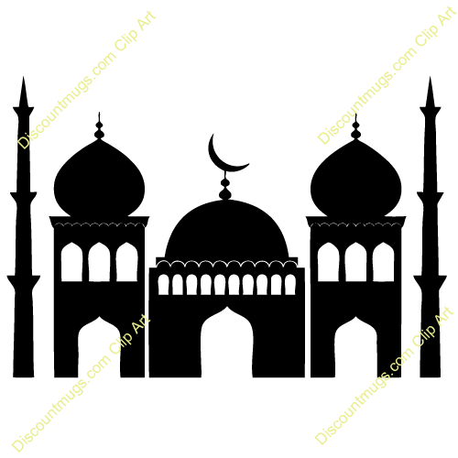
MOSQUE

Slide 13
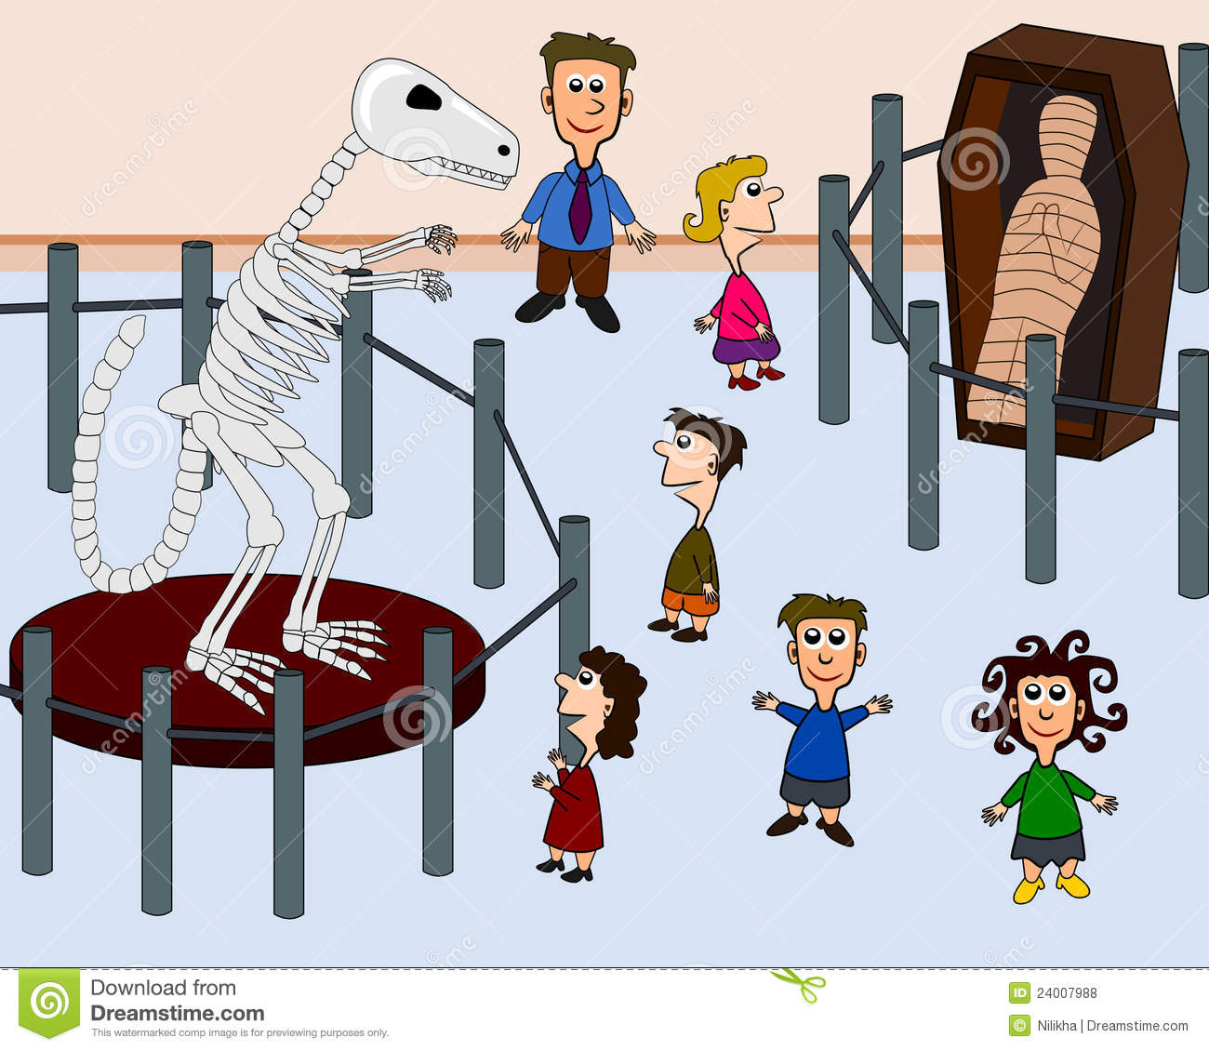
MUSEUM

Slide 14
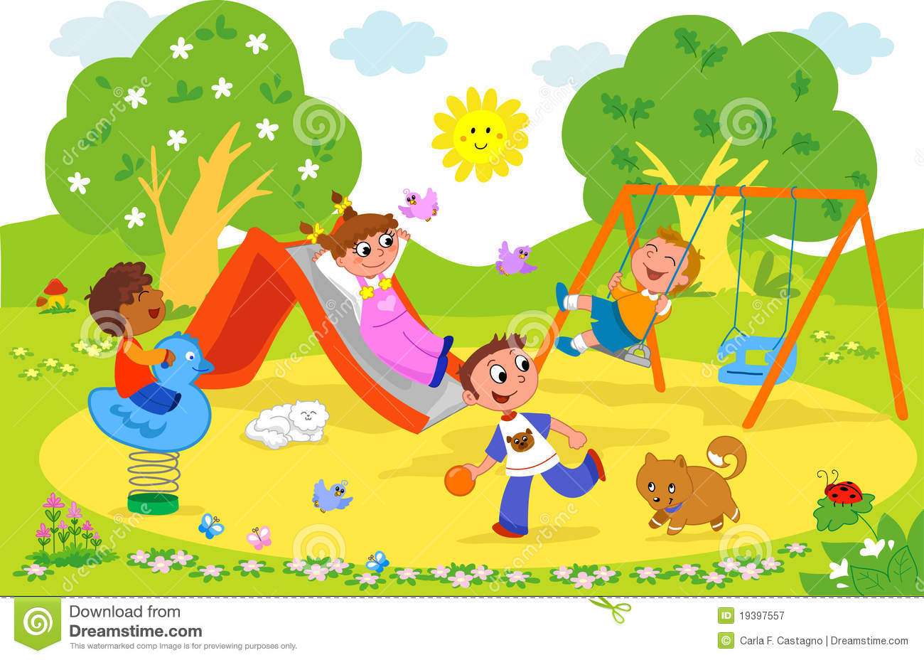
PARK

Slide 15
PHARMACY

Slide 16
POLICE STATION

Slide 17
POOL

Slide 18
POST OFFICE

Slide 19
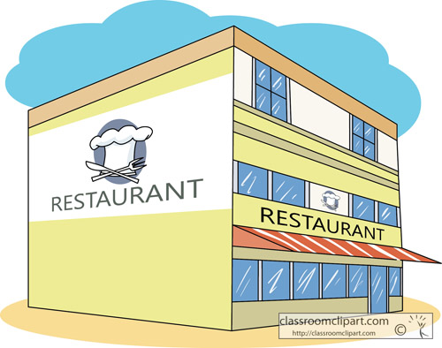
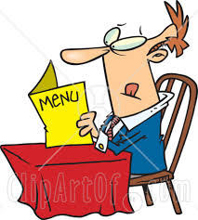
RESTAURANT

Slide 20
SCHOOL

Slide 21
STREET

Slide 22
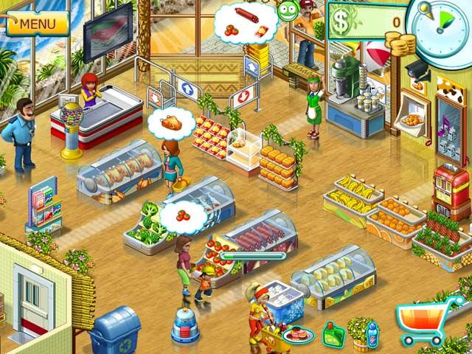
SUPERMARKET

Slide 23
TOY SHOP

Slide 24
ZOO

Slide 25
MEHİBE ŞENEL
ELT

