Slide 1
AT THE FAIR
GRADE 6 UNIT 5

Slide 2
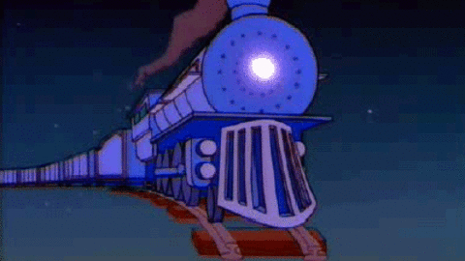
GHOST TRAIN

Slide 3
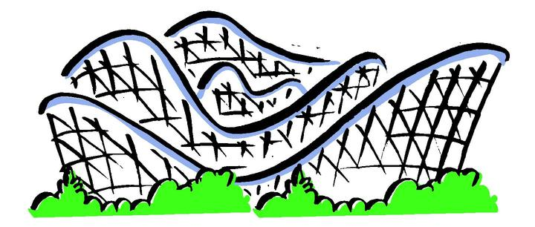
ROLLER COASTER

Slide 4
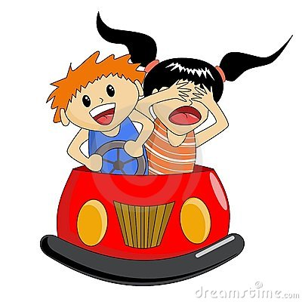
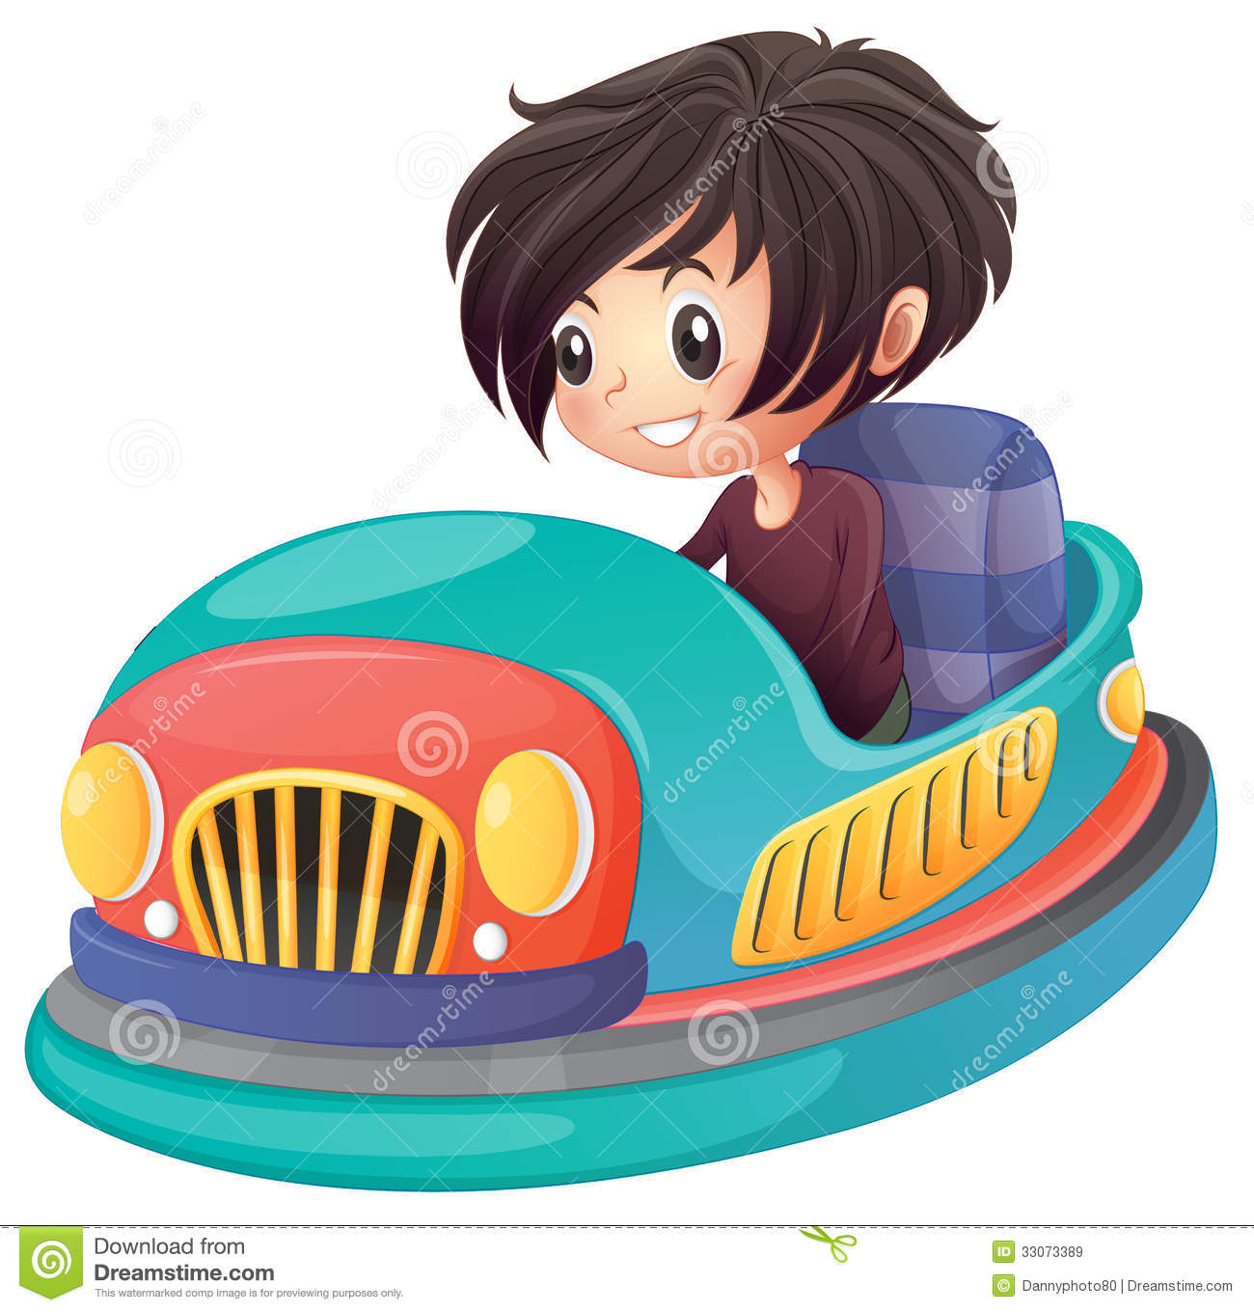
BUMPER CARS

Slide 5
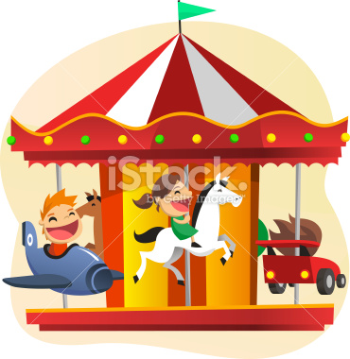
MARY GO ROUND

Slide 6
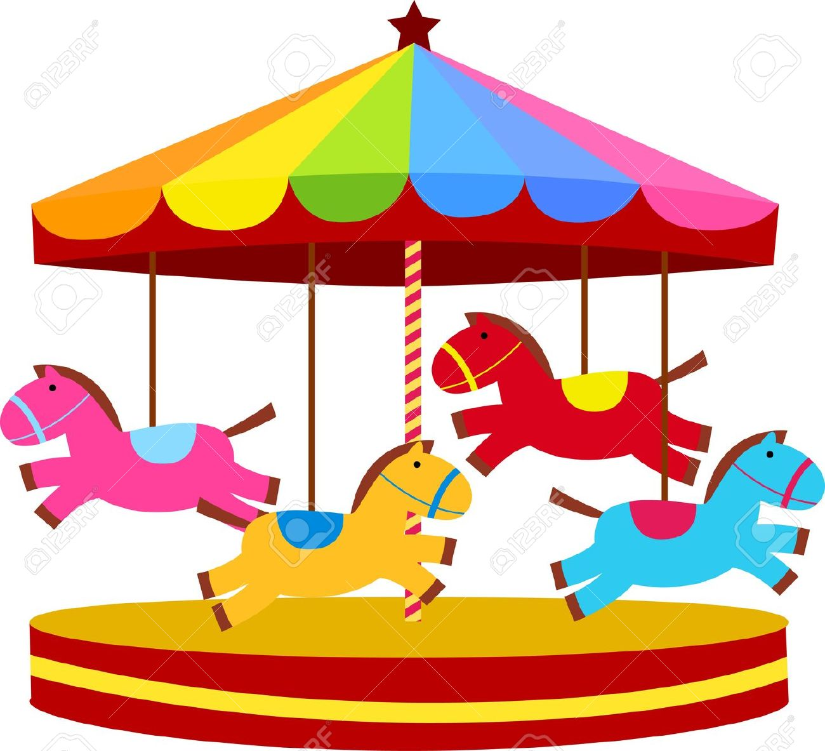
CAROUSEL

Slide 7
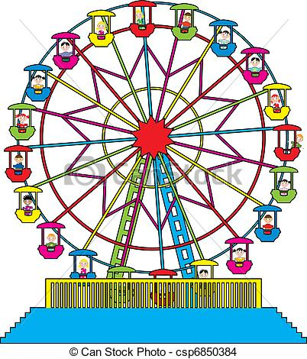
BIG WHEEL

Slide 8
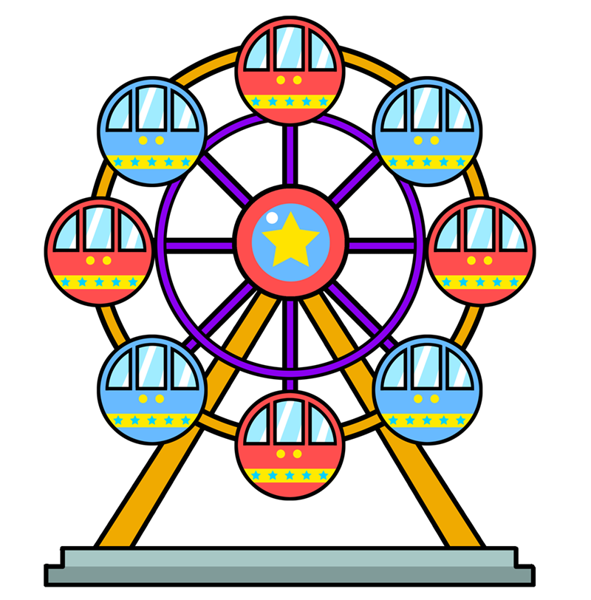
FERRIS WHELL

Slide 9
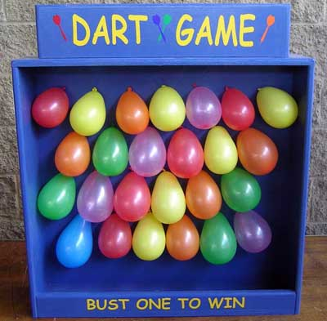
DART GAME

Slide 10
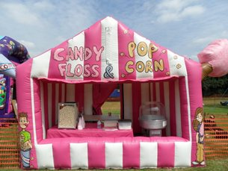
CANDY STALL

Slide 11
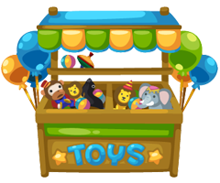
TOY STALL

Slide 12
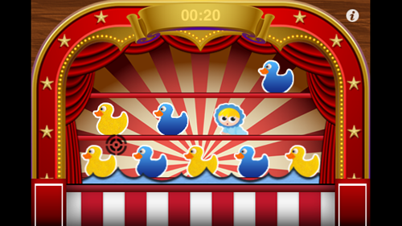
SHOOT THE DUCK

Slide 13
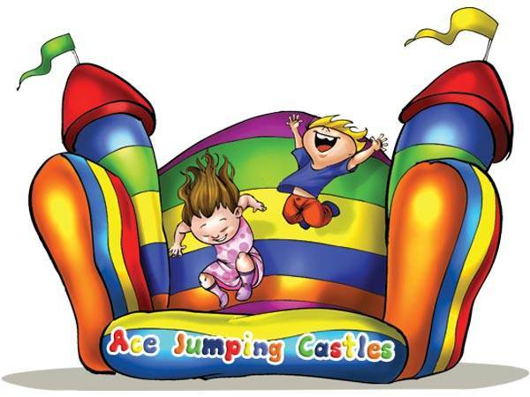
JUMPING CASTLE

Slide 14
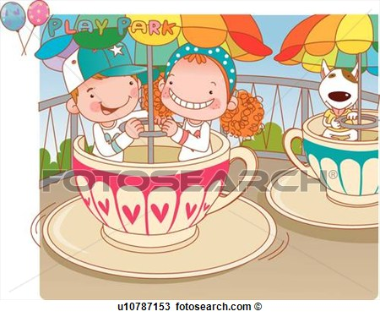
TEA CUP RIDE

Slide 15
PREPARED BY MEHMET DEGERLI

