Slide 1
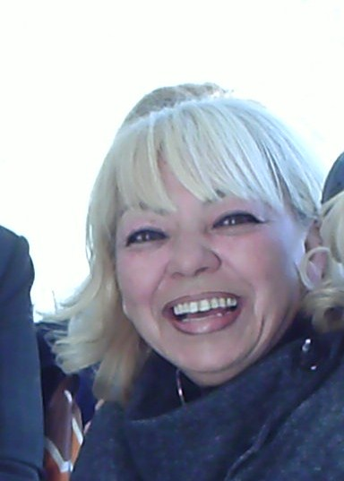
THIS IS NURCAN AKALTUN’S WORK
BU BİR NURCAN AKALTUN ÇALIŞMASIDIR.
SESLENDİRME İÇİN SANDRA SMITH’E TEŞEKKÜR EDERİM
İNTERNET DERSLERİ
O 533 733 24 37
nur77akaltun@hotmail.com
©

Slide 2
speaking | coming | shining | quarreling
reading | beach | singing | frowning
It’s Sunday and the Green family is at the ---------- (1). It's a beautiful day. The sun is------- (2) brightly and the birds are --------- (3).
Mr Green is ---------- (4) a newspaper. Mrs Green is ------(5)to her children.
Next to them there is another family.The children are ----------(6)and shouting each other.Their father is---------(7).Their mother is swimming in the sea.A dog is -------towards them.

Slide 3
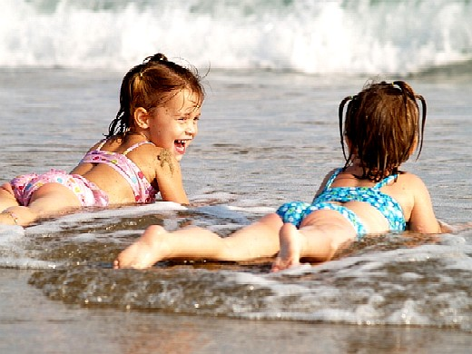
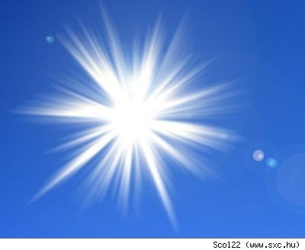
It's Sunday and the Green family is at the beach (1). It's a beautiful day. The sun is shining (2) brightly and the birds are singing (3).
Mr Green is reading (4) a newspaper. Mrs Green is speaking(5)to her children.
Next to them there is another family.The children are quarreling (6)and shouting at each other.Their father is frowning (7).Their mother is swimming in the sea.A dog is coming towards them.

Slide 4
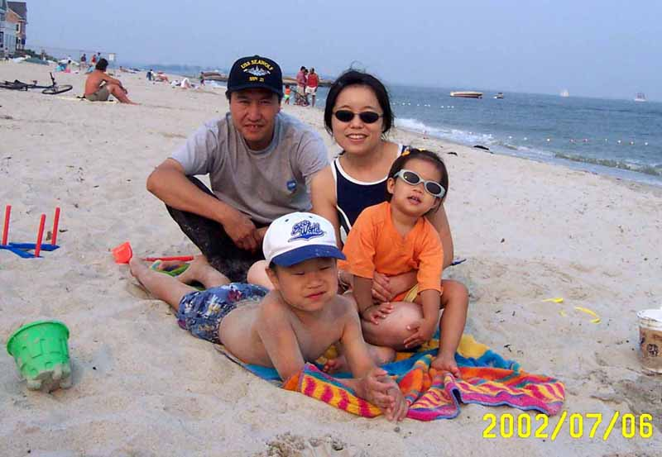
Where is the Green family?
In the sea
At the beach
At the restaurant

Slide 5
Is it a rainy day?
Yes
No
I dont’know

Slide 6
How is the sun shining?
Slowly
Fast
Brightly

Slide 7
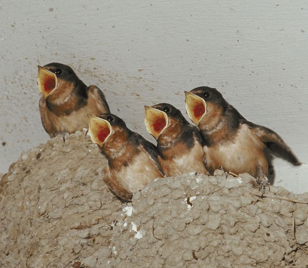
What are the birds doing?
Flying
Singing
Sleeping

Slide 8
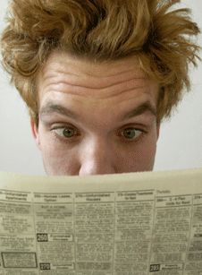
What is Mr.Green doing?
Reading a newspaper
Watching the sea
Sitting in the garden

Slide 9
What is Mr.Green reading?
A magazine
A newspaper
A book

Slide 10
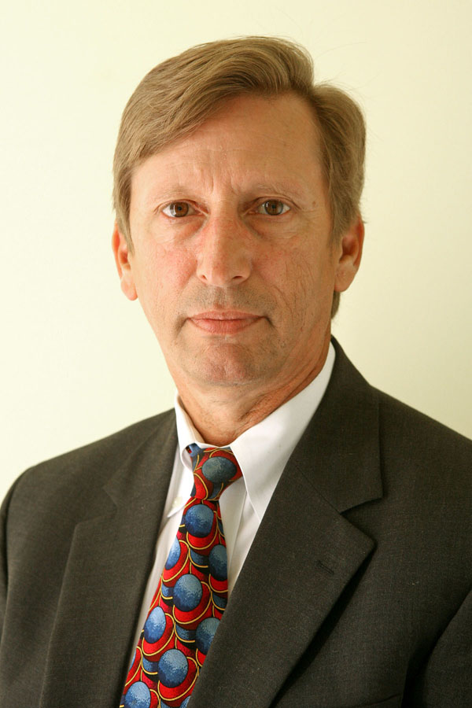
Who is reading a newspaper?
Mr Green
Mrs Green
The children

Slide 11
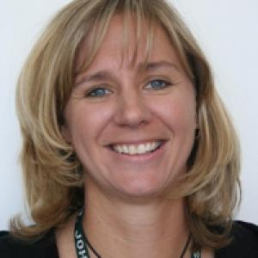
Who is speaking to the children?
Mrs Green
Mr Green
The other children

Slide 12
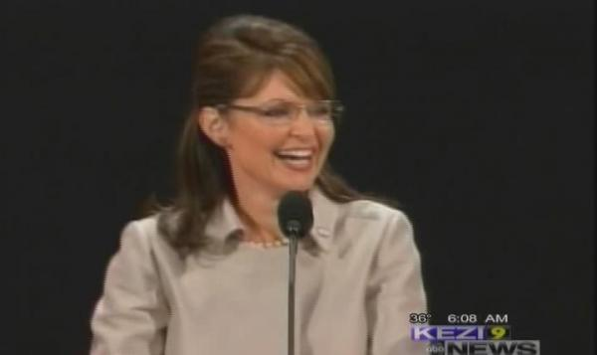
What is Mrs Green doing?
Washing the dishes
Swimming
Speaking

Slide 13
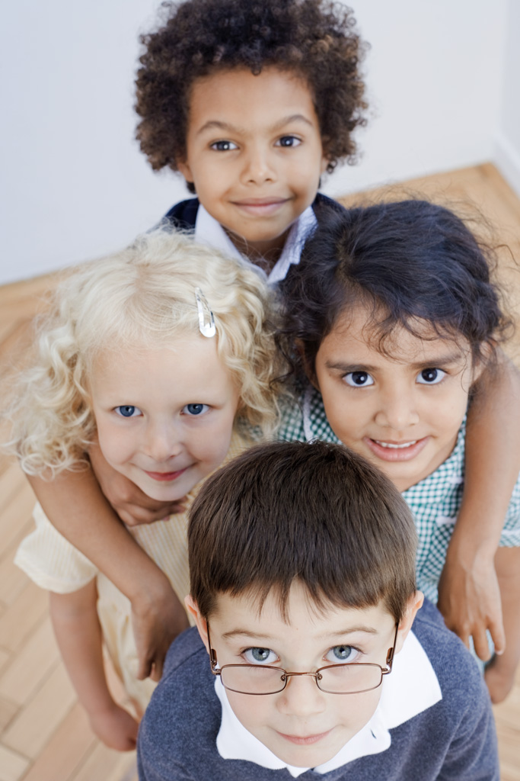
Who is Mrs Green speaking to?
The other family
Mr Green
Her children

Slide 14
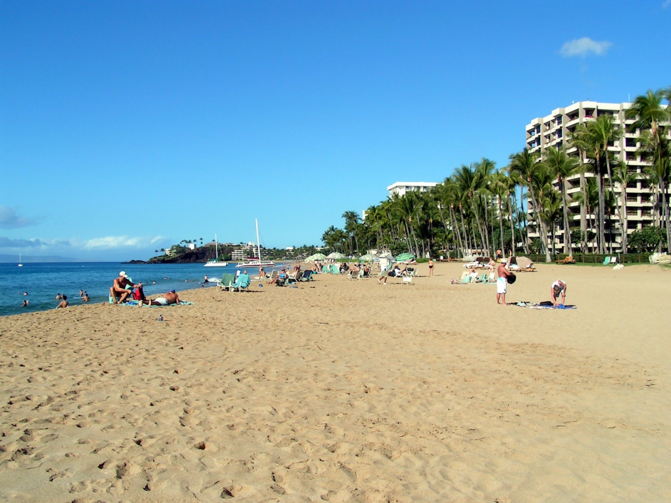
Where is the other family?
At the beach
At the restaurant
At school

Slide 15
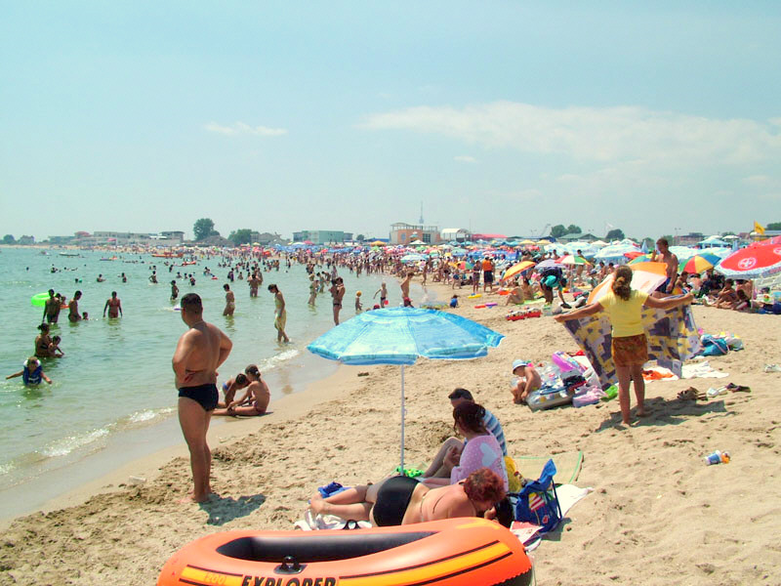
Is The Green family alone?
Yes
No
I can’t remember

Slide 16
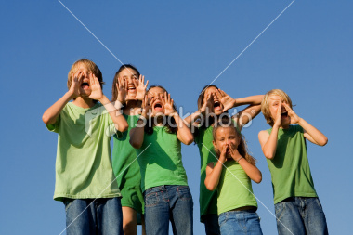
What are the other children doing?
Quarreling and shouting
Swimming and shouting
Playing and shouting

Slide 17
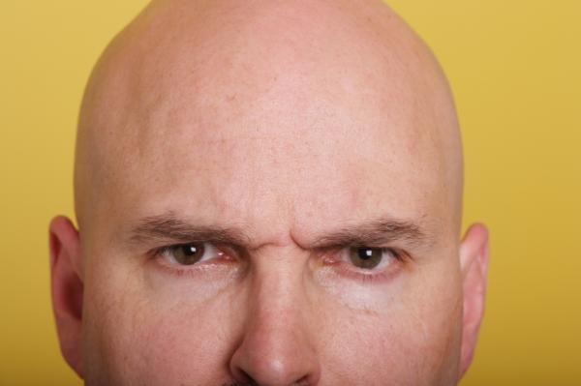
Who is frowning?
The other father
Mr Green
Mrs Green

Slide 18
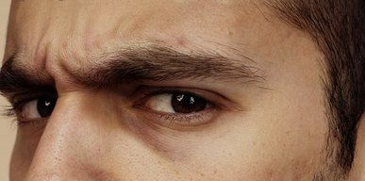
What is their father doing?
He is listening to music
He is playing ball
He is frowning

Slide 19
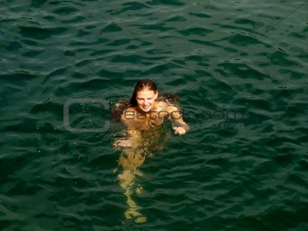
Where is their mother?
In the car
In the sea
In the bathroom

Slide 20
What is she doing?
Swimming
Swinging
Swearing

Slide 21
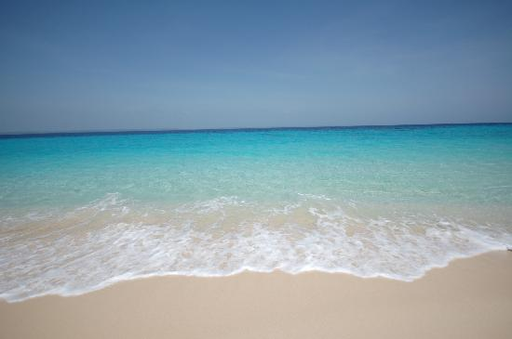
Where is she swimming?
In the pool
In the river
In the sea

Slide 22
Who is swimming?
Their mother
Mr Green
Mrs Green

Slide 23
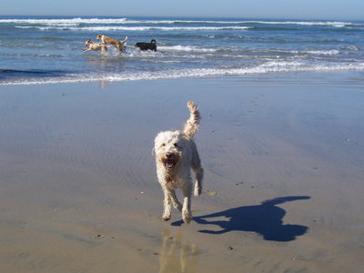
What is coming towards them?
A cat
A bird
A dog

Slide 24
learning | sitting | yawning | eats
improving | singing | shining | do
Dear Janet,
It's now 5 o'clock in the afternoon and I'm ---------(1) in the garden writing this letter. It's a lovely day outside. The weather is great. The sun's ---------(2) and the birds are ---------- (3). My cat, Princess, is --------- (4) under my chair. She always --------()and sleeps.
I'm ------------ (6) Turkish now at evening course. My Turkish is -------- (7) slowly. I ------( 8 )my homework and some practice everyday.
I hope you are well and happy and that your family is also well. Please write to me soon.
Bye for now,
Kelly

Slide 25
Dear Janet,
It's now 5 o'clock in the afternoon and I'm sitting(1) in the garden writing this letter. It's a lovely day outside. The weather is great. The sun's shining (2) and the birds are singing (3). My cat, Princess, is yawning (4) under my chair . She always eats (5)and sleeps.
I'm learning (6) Turkish now at evening course. My Turkish is improving ( 7) slowly. I do (8) my homework everyday,but Turkish is a really difficult language.
I hope you are well and happy and that your family is also well. Please write to me soon.
Bye for now,
Kelly

Slide 26
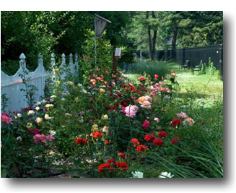
What time is it now?
5 o’clock in the morning
5 o’clock in the afternoon
7 o’clock inthe morning

Slide 27
Where is she?
in class
in the pool
in the garden

Slide 28
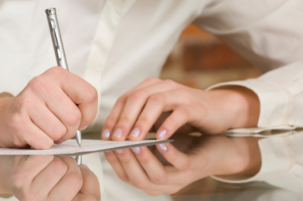
What is she doing?
Sleeping
Yawning
Writing a letter

Slide 29
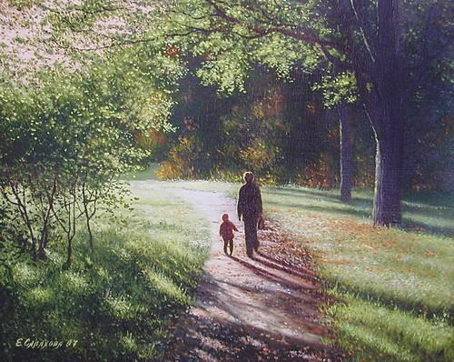
How is the weather outside?
Sunny
Rainy
Windy

Slide 30
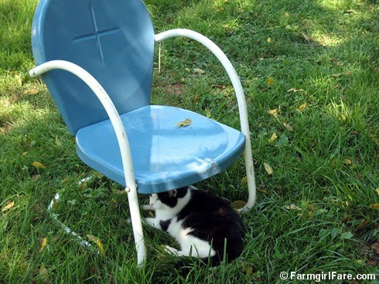
Where is the cat?
Under the chair
At the table
Under the table

Slide 31
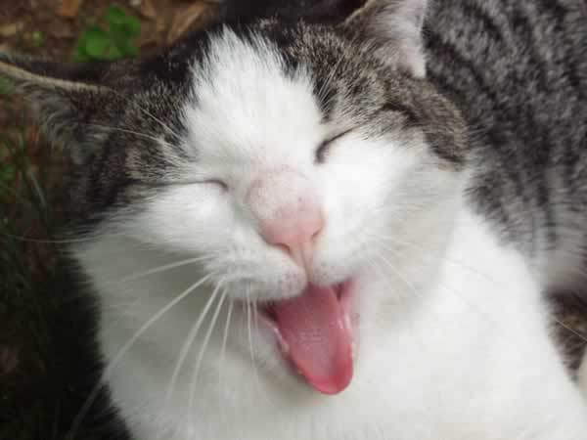
Is her cat yawning?
Yes
No
I dont know

Slide 32
What is she learning?
English
Turkish
German

Slide 33
What is improving slowly?
Her German
Her Turkish
Her English

Slide 34
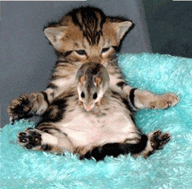
What does her cat always do?
Eats and sleeps
Cleans and sleeps
Yawns and sleeps

Slide 35
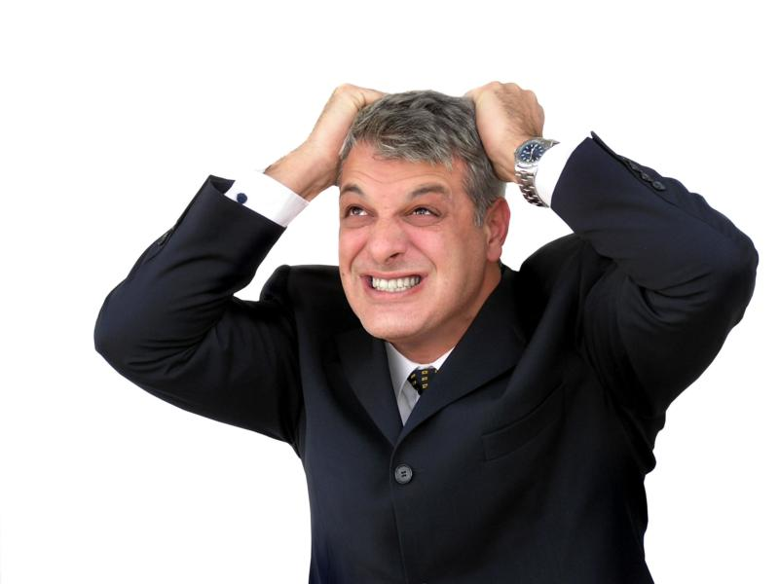
Is Turkish easy?
Yes
No
I cant remember.

Slide 36
repairing | watching | home | staying
crawling | cleaning | raining | is
Today is Sunday and the Clark family is at --------- (1). The weather isn't very good. The sky is black and it is --------(2) heavily.
Mr Clark is --------- (3) his motorcycle in the garage. Mrs Clark is ---- ------( 4) the house. Two of their children, Liz and Tom, are ----- ----(5) cartoons. The baby, Sue, is -------- (6) on the floor.
The Clark family is ---------- (7) at home today because the weather---- terrible.

Slide 37
Today is Sunday and the Clark family is at home(1). The weather isn't very good. The sky is black and it is raining (2) heavily.
Mr Clark is repairing (3) his motorcycle in the garage. Mrs Clark is cleaning ( 4) the house. Two of their children, Liz and Tom, are watching(5) cartoons. The baby, Sue, is crawling (6) on the floor.
The Clark family is staying (7) at home today because the weather is terrible.

Slide 38
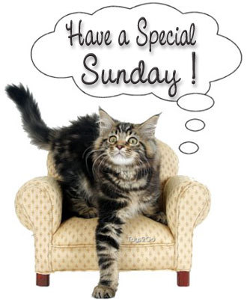
What is today?
Monday
Sunday
Saturday

Slide 39
Where is the Clark family?
At the beach
In the garden
At home

Slide 40
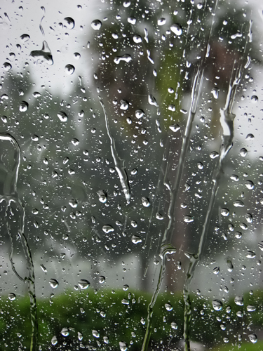
Is the weather good?
Yes
No
I dont know

Slide 41
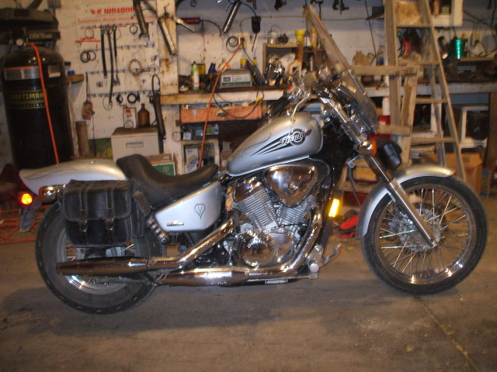
Who is repairing the motorcycle?
Mrs Clark
Mr Clark
Tom

Slide 42
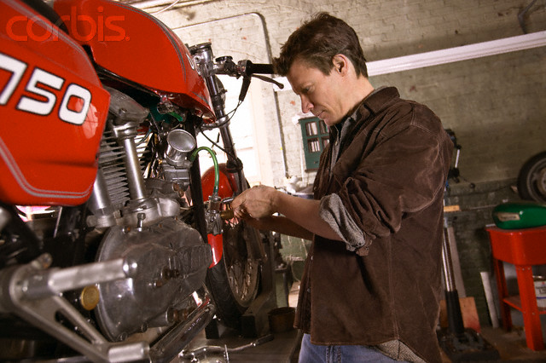
What is Mr Clark doing?
Repairing his motorcycle
Repairing his car
Repairing the roof

Slide 43
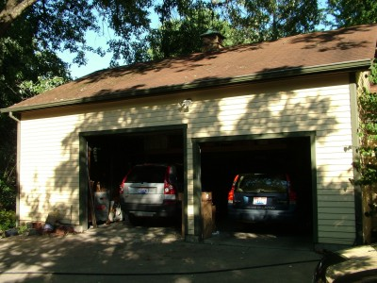
Where is he?
In the garden
In the garage
In the sitting room

Slide 44
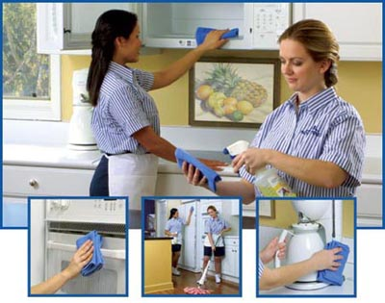
What is Mrs Clark doing?
cleaning the house
cleaning the motorcycle
cleaning the room

Slide 45
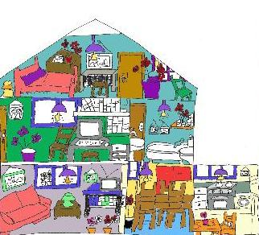
What is she cleaning?
The house
The motorcycle
The car

Slide 46
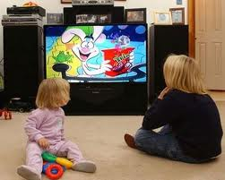
What are the children doing?
Watching cartoons
Repairing the motorcycle
Cleaning the house

Slide 47
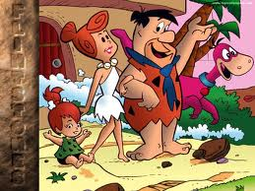
What are they watching?
News
Cartoons
Film

Slide 48
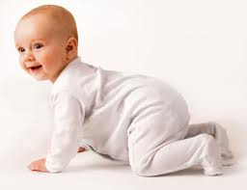
Who is crawling on the floor?
Tom
Liz
Sue

Slide 49
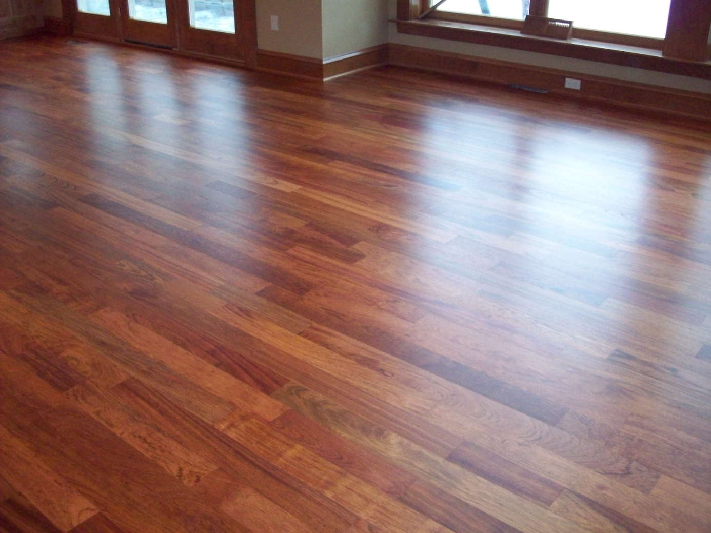
Where is she crawling
On the floor
On the earth
On the carpet

Slide 50
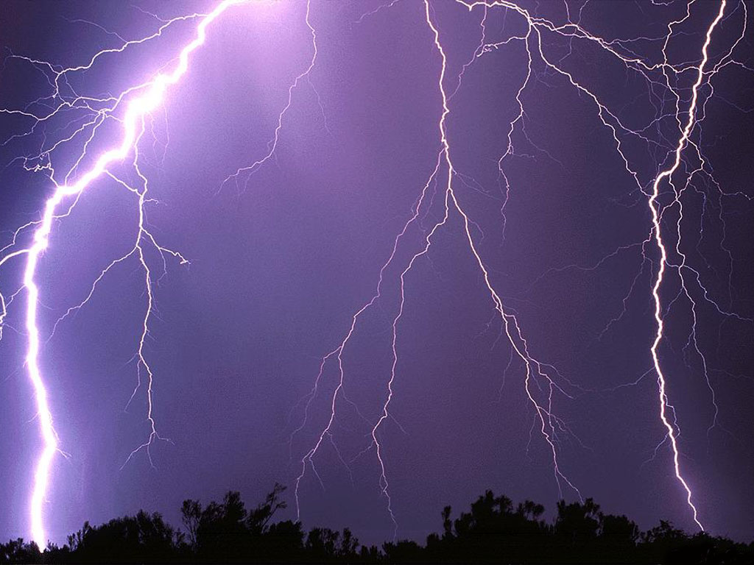
Why are they staying at home?
Because they dont have money.
Because Mrs Clark is cleaning the house.
Because the weather is terrible.

Slide 51
THIS IS NURCAN AKALTUN’S WORK
BU BİR NURCAN AKALTUN ÇALIŞMASIDIR.
SESLENDİRME İÇİN SANDRA SMITH’E TEŞEKKÜR EDERİM
İNTERNET DERSLERİ
O 533 733 24 37
nur77akaltun@hotmail.com
©

