Slide 1
by Salih ÖZDEMİR
We are going to learn:
Making comparisons
DAHA FAZLA BU TARZ ETKİNLİK İÇİN THE CHAMPION VE PRESTIGE KİTABIMIZIN AKILLI TAHTA UYGULAMASINI altinkarne.com SİTEMİZDEN ÜCRETSİZ İNDİREBİLİRSİNİZ.

Slide 2
COMMON EXPRESSIONS
UNIT QUESTIONS
Do you get on well with each other? Birbirinizle iyi geçiniyor musunuz?
What does your best friend look like? Senin en iyi arkadaşın nasıl görünüyor?
What is he like? O nasıl biri?
Where do they live? Onlar nerede yaşarlar?
What does he like doing in his free time? O boş zamanında ne yapmayı sever?
Is he cheerful? O neşeli midir?
Does she have black hair? Onun saçları siyah mı?
Is she wearing a headscarf? O baş örtüsü takıyor mu?
Why is he so popular at school? O neden okulda popülerdir?
Is he a hardworking student? O çalışkan bir öğrenci midir?
What do they like doing together? Birlikte ne yapmayı severler?
She is tall and slim. O uzun ve incedir.
He’s handsome. O yakışıklıdır.
She has long curly hair. Onun uzun kıvırcık saçı var.
My cousin is more outgoing than me. Kuzenim benden daha dışa dönüktür.
She has a lot of friends. Onun birçok arkadaşı var.
He likes eating junk food. O abur cubur yemeyi sever.
He can play basketball well. O iyi basketbol oynayabilir.
I’ve got blonde hair and blue eyes. Benim sarı saçım ve mavi gözüm var.
I want to be a vet. Veteriner olmak istiyorum.
I like watching movies and listening to music. Film izlemeyi ve müzik dinlemeyi severim.
My favourite activity is riding a bike. Favori aktivitem bisiklet sürmek.
She likes spending time with her friends. O arkadaşlarıyla zaman geçirmeyi sever.
Jack is more punctual than his brother. Jack erkek kardeşinden daha dakiktir.

Slide 3
APPEARANCE
PERSONALITY ADJECTIVES
plump balık etli
well-built yapılı, kaslı
good-looking iyi görünen
cute sevimli
beautiful güzel
handsome yakışıklı
slim ince, zayıf
thin ince, zayıf
tall uzun
short kısa
attractive çekici
fit zinde, formda olan
blonde sarışın (kadın)
blond sarışın (erkek)
curly kıvırcık
wavy dalgalı
straight düz
long uzun
dark koyu
honest dürüst
stubborn inatçı
outgoing dışa dönük
generous cömert
easy-going uysal
selfish bencil
smart zeki
hardworking çalışkan
cheerful neşeli
shy utangaç
helpful yardımsever
creative yaratıcı
talkative konuşkan
thoughtful düşünceli
friendly arkadaş canlısı
punctual dakik
funny komik
mean cimri
nervous gergin
OTHER ADJECTIVES
EYES
easy kolay
difficult zor
similar benzer
happy mutlu
different farklı
popular popüler
green yeşil
hazel ela
blue mavi
dark koyu, siyah
brown kahverengi

Slide 4
NOUNS
VERBS
shelf raf
job meslek
person kişi
vet veteriner
movie film
twin ikiz
glasses gözlük
story hikaye
joke şaka
personality kişilik
appearance dış görünüş
headscarf baş örtüsü
relationship ilişki
classmate sınıf arkadaşı
hobby hobi
cycling bisiklet sürme
share paylaşmak smile gülümsemek
change değiştirmek try denemek
forget unutmak reach ulaşmak
wear giymek feel hissetmek
spend harcamak
study çalışmak
live yaşamak
ACTIVITIES
VERB PHRASES
buy presents hediye almak
keep fit formunu korumak
go to the gym spor salonuna gitmek
listen to music müzik dinlemek
go cycling bisiklet sürmeye gitmek
watch movies film izlemek
surf on the Net internette gezinmek
get on well with someone biriyle iyi geçinmek
look like benzemek
spend time vakit geçirmek
have something in common ortak bir şeye sahip olmak
tell the truth doğruyu söylemek
tell lies yalan söylemek
tell stories hikaye anlatmak
tell jokes şaka yapmak

Slide 5
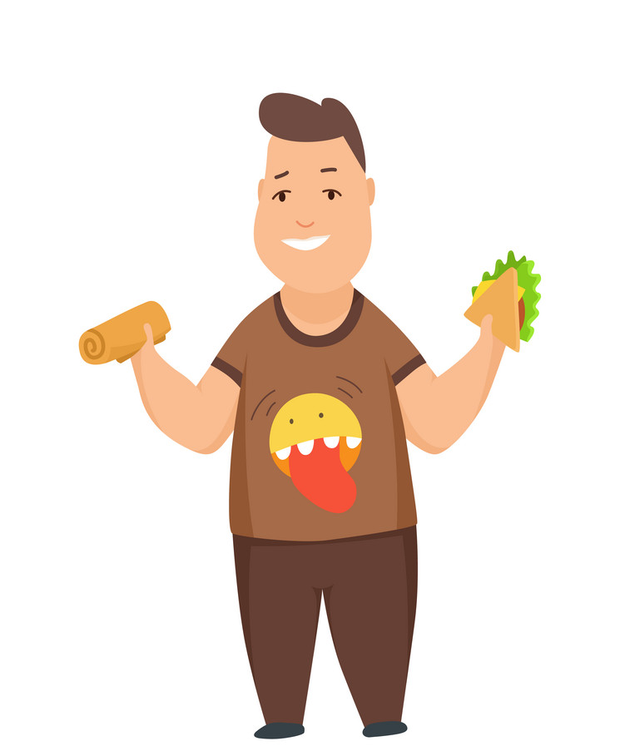
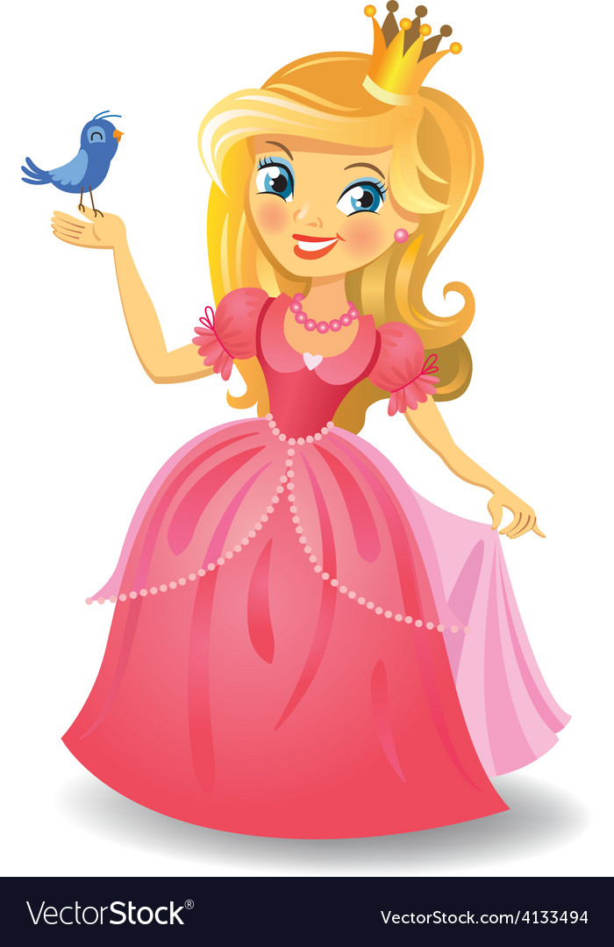
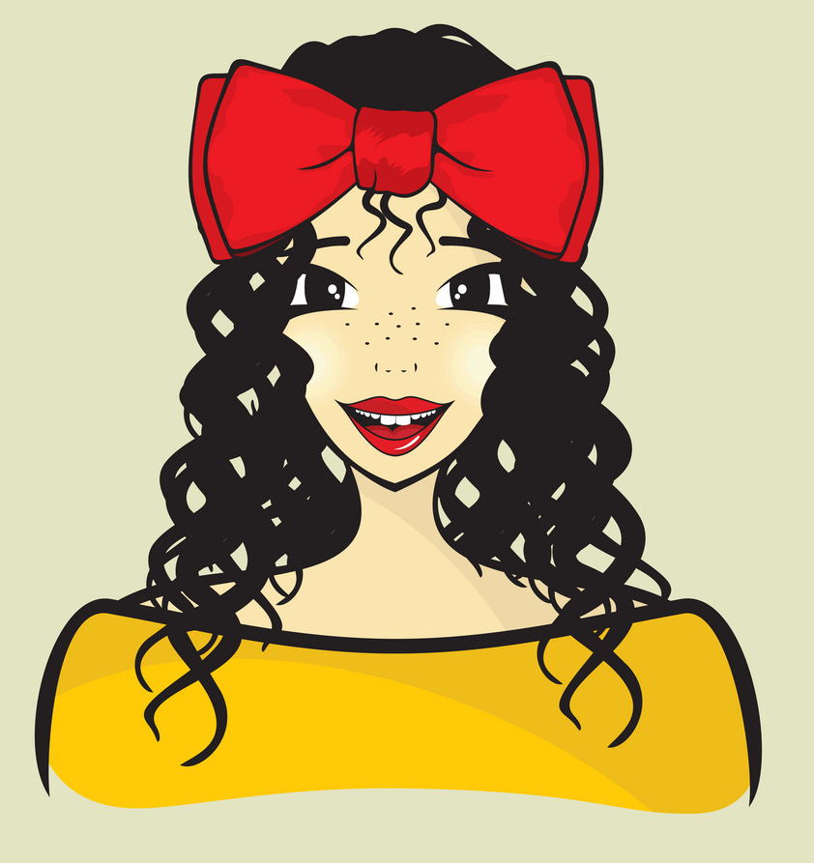
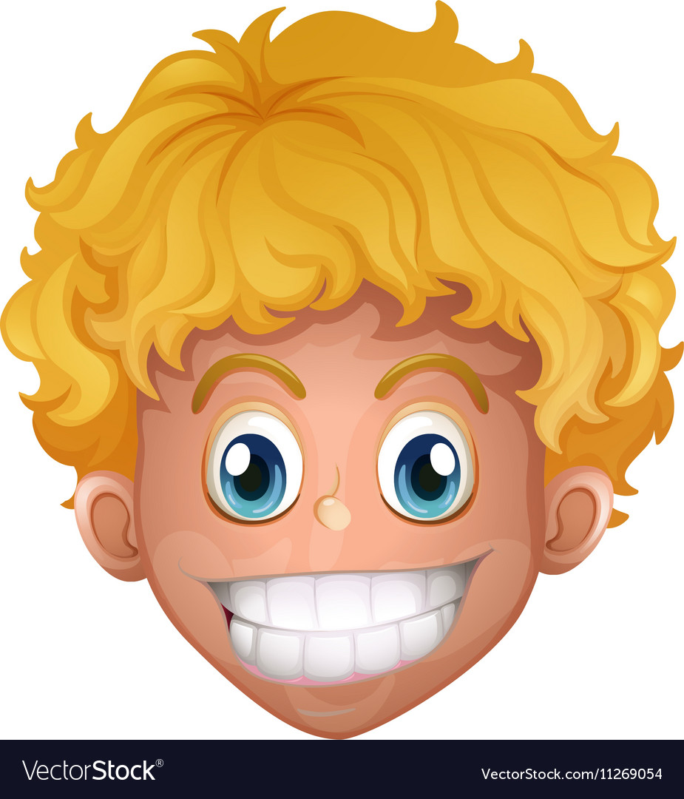
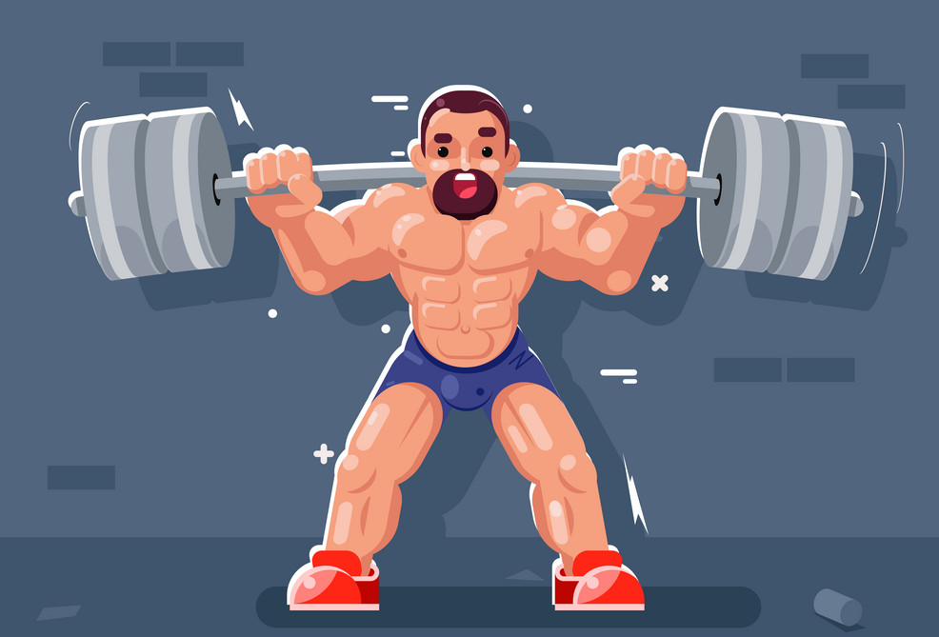
Vocabulary Exercises
1. Write the words under the pictures.
2. Complete the sentences with the verbs below.
well-built
curly
blond
outgoing
honest
wavy
talkative
beautiful
plump
slim
mean
cheerful
selfish
hardworking
1.
2.
3.
1. Betty is ______________ because she has lots of friends.
2. Drake is ____________ . He never tells lies.
3. Rosa is ______________ . She never stops speaking.
4. Helen always thinks herself. She is _____________ .
5. You are a very ________________ student. Your grades are very good.
6. My brother always smiles. He is a ___________ boy.
7. Tim is so __________ . He never shares his food.
8. Rebecca has long __________ hair.
outgoing
Nartest İngilizce
honest
talkative
plump
beautiful
slim
___________
___________
___________
4.
6.
selfish
5.
hardworking
cheerful
mean
well-built
curly
blond
___________
___________
___________
wavy

Slide 6
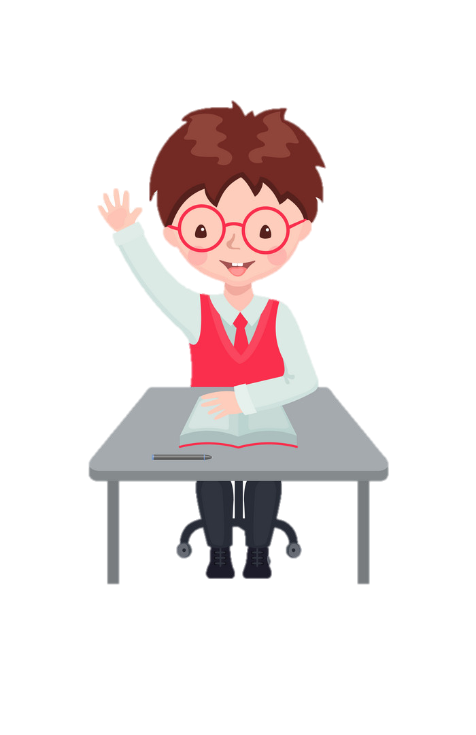
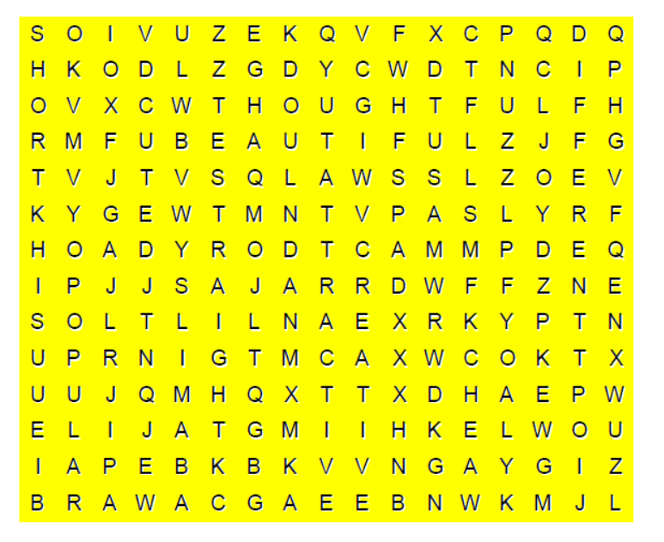
3. Match the halves of the phrases.
5. Find the 10 words in the word-search puzzle.
7
1. get on well ___ a) like
2. listen ___ b) cycling
3. tell ___ c) presents
4. go ___ d) movies
5. buy ___ e) with someone
6. watch ___ f) to music
7. look ___ g) lies
4
5
6
1
2
3
Nartest İngilizce
4. Circle the correct options to complete the sentences.
1. Jonas never cares about others. He is a selfish / helpful person.
2. She always shares her money with her friends. She is mean / generous.
3. My brother is tall so he can reach / feel to the top shelf in our kitchen.
4. I love Ankara. I want to live / try there.
5. Sarah wants to watch movies / keep fit. So she always goes to the gym.
6. Ray always forgets / wears his password. He doesn’t have a strong memory.

Slide 7
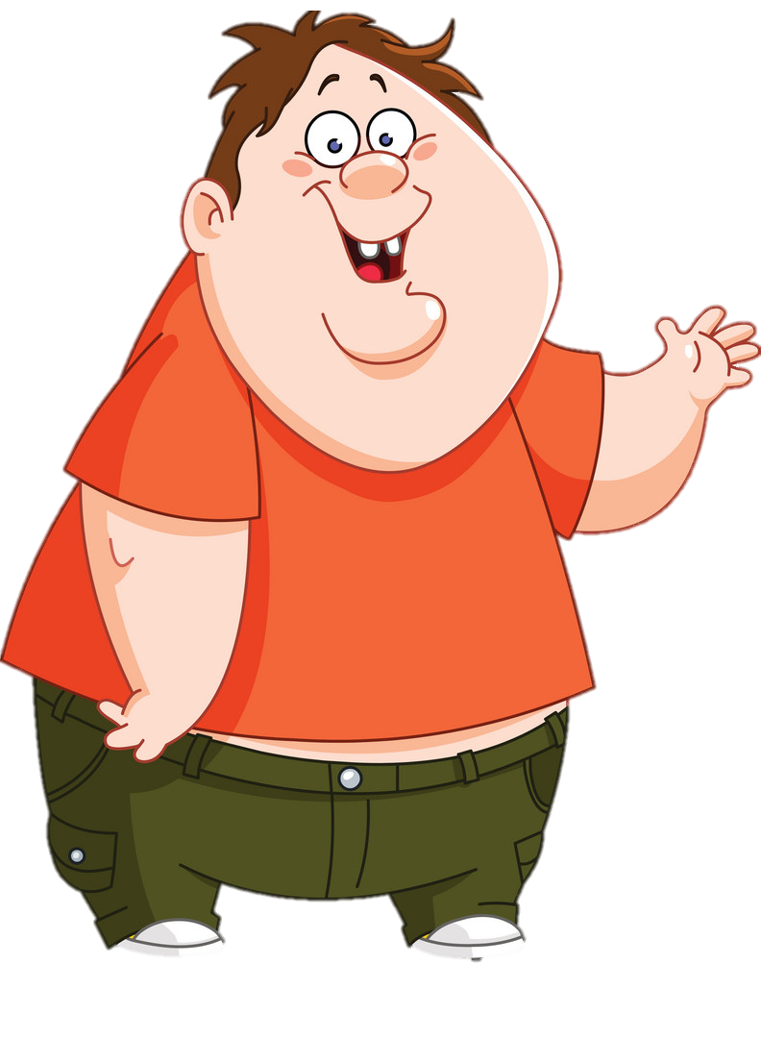
Categorize the words below.
plump
smart
well-built
easy-going
selfish
tall
friendly
handsome
slim
punctual
APPEARANCE
PERSONALITY
plump
smart
well-built
easy-going
tall
selfish
friendly
slim
punctual
handsome

Slide 8
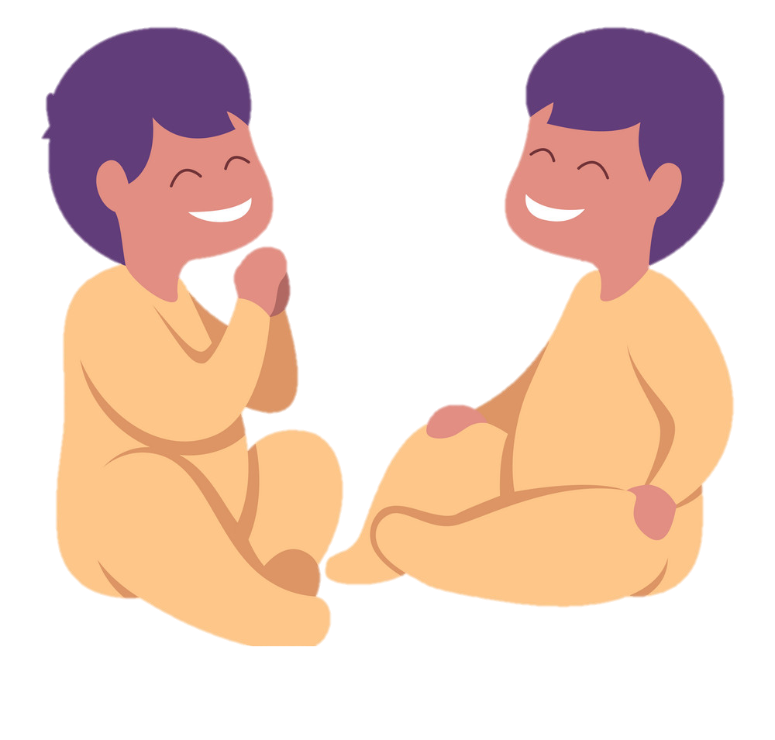
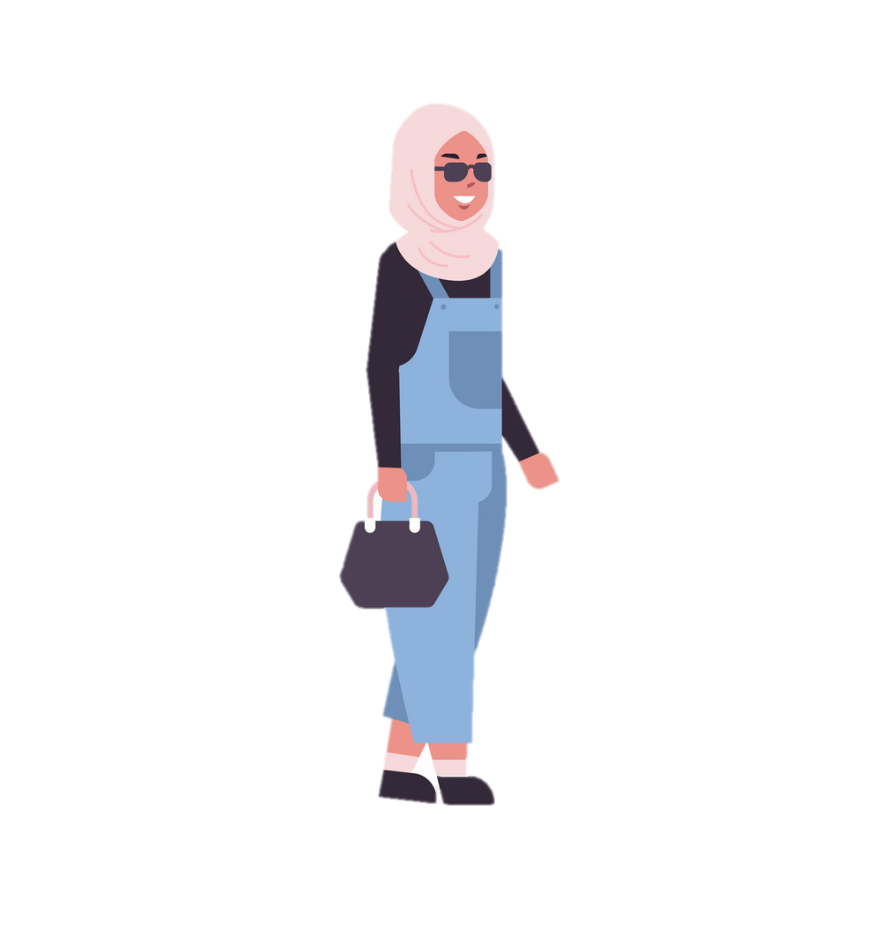
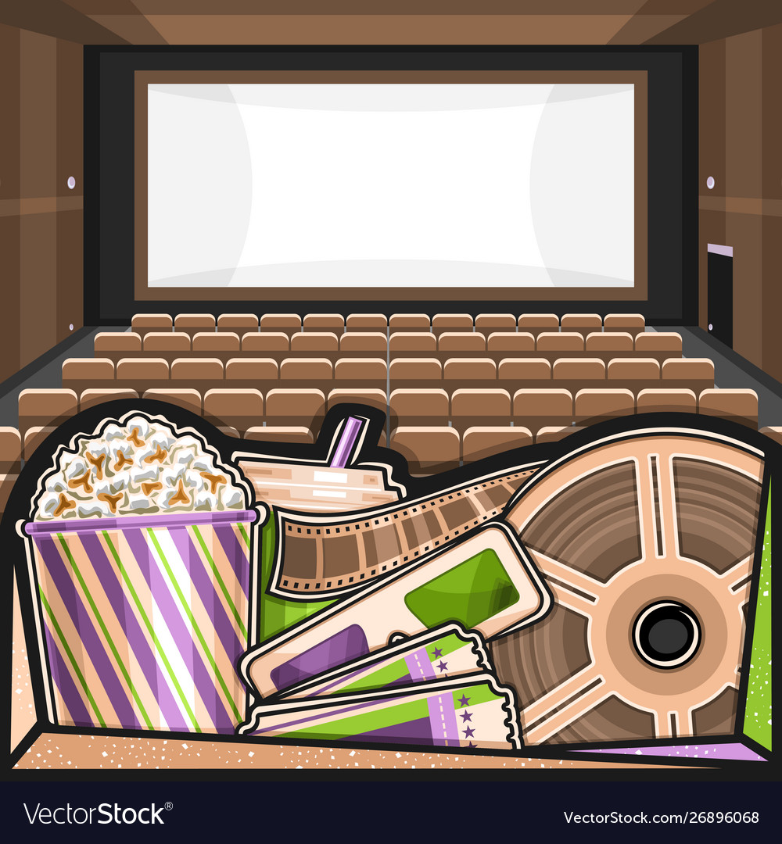
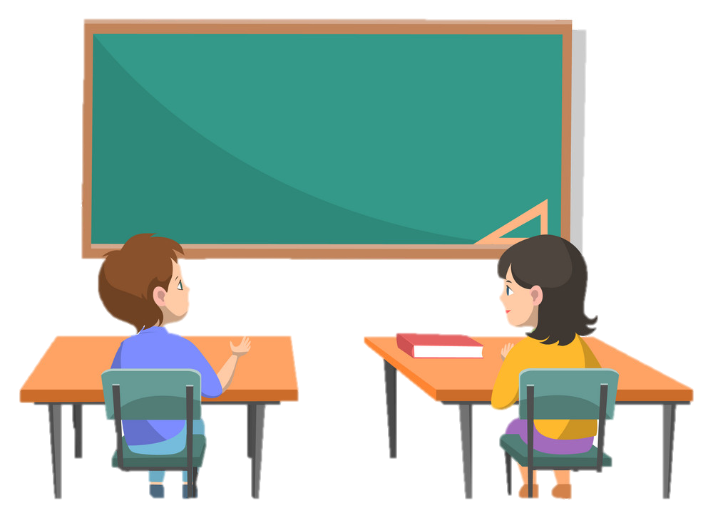
1.
NARTEST İNGİLİZCE
6.
Fill in the blanks according to the pictures.
__________________
__________________
__________________
__________________
__________________
__________________
glasses
headscarf
shelf
2.
classmate
5.
movie
twin
3.
4.

Slide 9
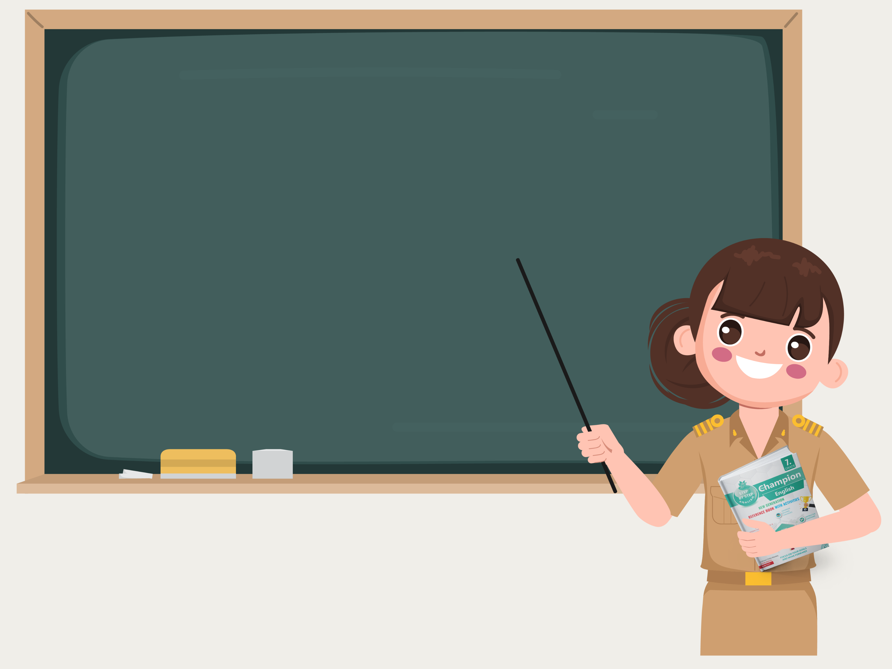
THE CHAMPION’DAN VOCABULARY TEST SORULARI İLE ÖĞRENDİKLERİMİZİ TEST EDELİM

Slide 10
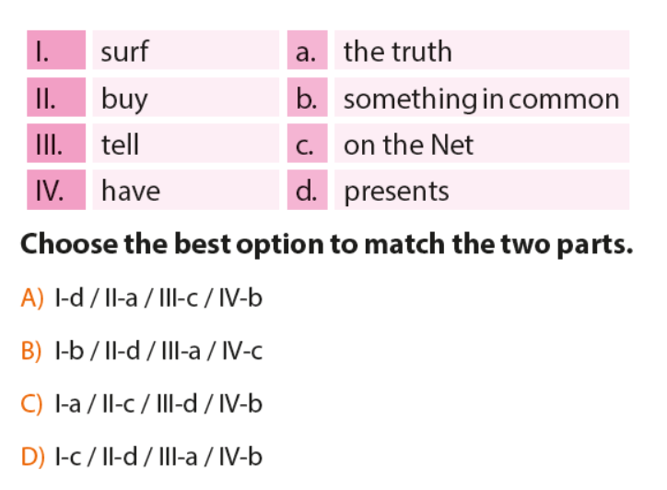
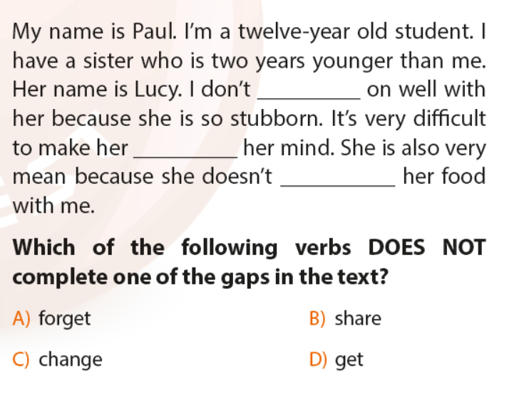
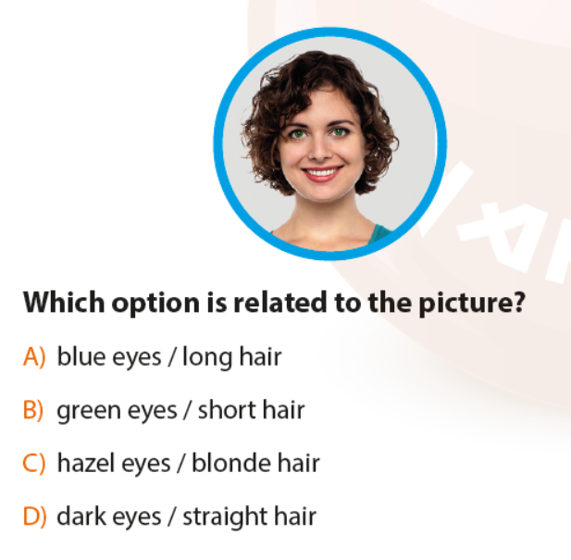
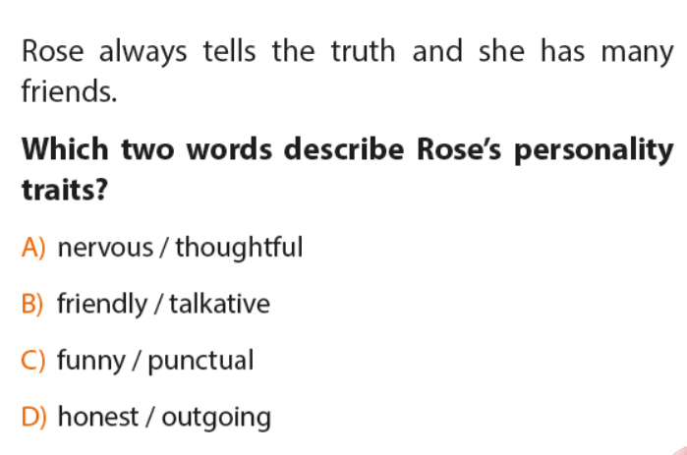

Slide 11
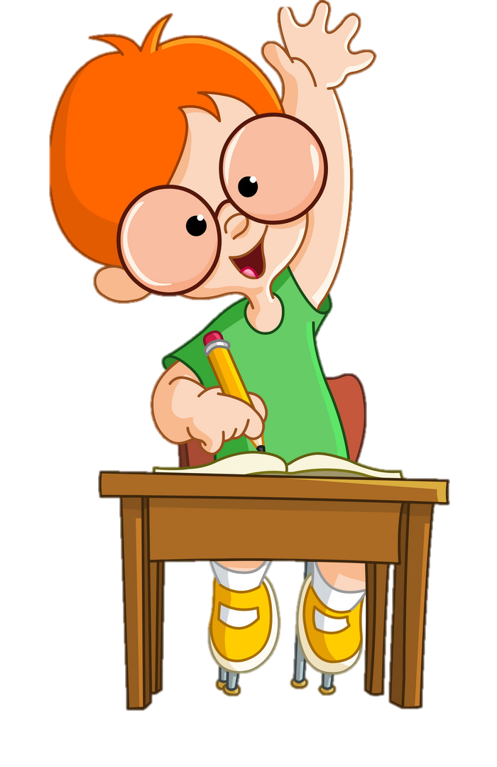
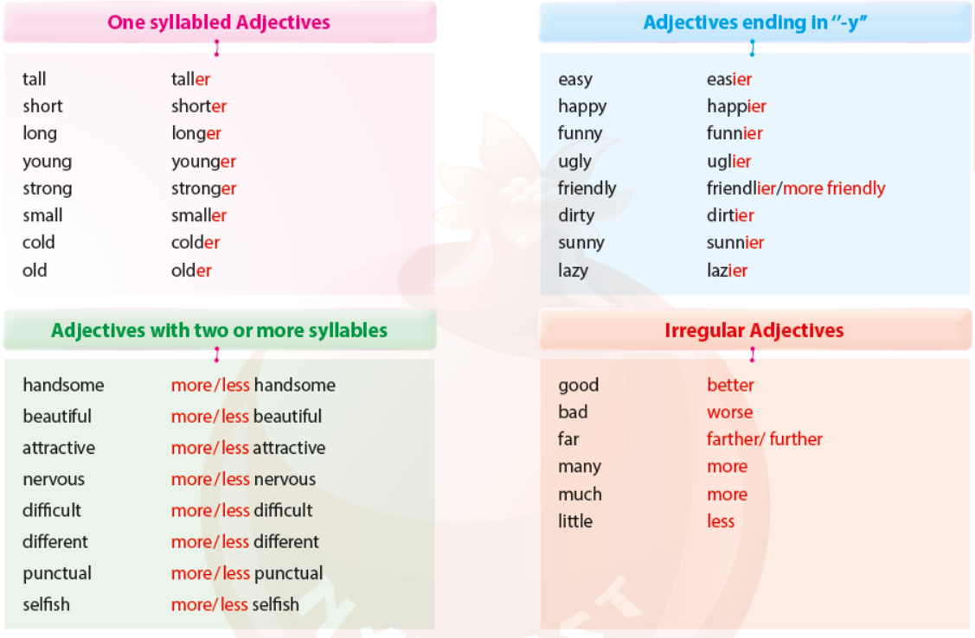
GRAMMAR
Making Comparisons
We use comparative adjectives to make comparisons between two things or objects.
We use than when we want to compare one thing with another.
A
We use ‘’less’’ or ‘’more’’ in front of long adjectives (two or more syllables) to compare things. Study the examples below.
Jack is more hardworking than Lucy.
Melissa is less generous than Tim.

Slide 12
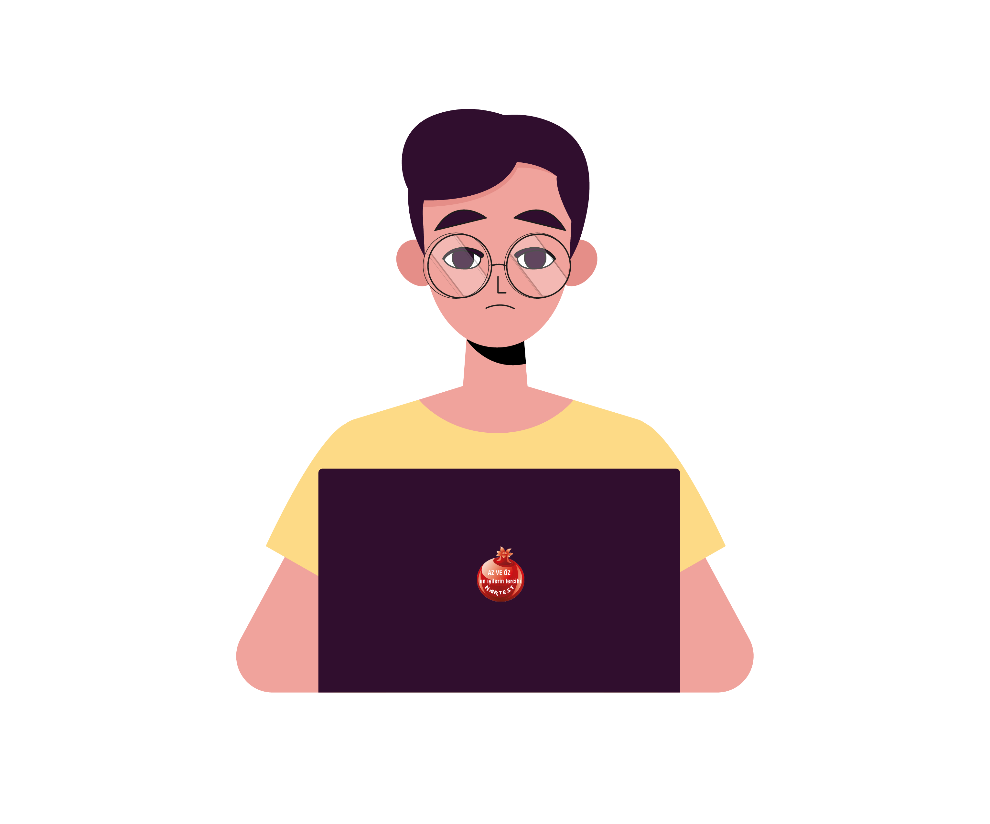
EXERCISES
1. Complete the sentences with the correct comparative forms of the adjectives in the brackets.
more punctual
1. Liam is __________________ (punctual) than Carlos.
2. I think Liz is _______________ ( beautiful ) than Veronica.
3. Harold is _________ (tall) than Brad.
4. My computer skills are ______________ (good) than Reece’s computer skills.
5. Qyburn is ______________ (old) than his brother.
6. Bradley is ______________ (selfish) than Amelie.
7. My science is ______________ (bad) than my social studies.
8. Zach is ______________ (young) than Alex.
more beautiful
taller
better
older
I’m not outgoing.
more selfish
worse
younger

Slide 13
2. Write the comparative forms of the adjectives.
3. Find and correct the mistakes in the sentences below.
1. far
____________________
2. many
____________________
3. good
____________________
4. bad
____________________
5. handsome
____________________
6. small
____________________
7. cold
____________________
farther/further
1. Mia is strong than her sister.
___________________________
2. I am more young than Jim.
___________________________
3. The weather is cold than yesterday.
___________________________
4. I think math is easy than English.
___________________________
5. Dogs are more bigger than cats.
___________________________
stronger
more
Nartest İngilizce
younger
better
colder
worse
easier
more handsome
bigger
smaller
colder

Slide 14
THE CHAMPION’DAN YENİ NESİL TEST SORULARI İLE ÖĞRENDİKLERİMİZİ TEST EDELİM

Slide 15
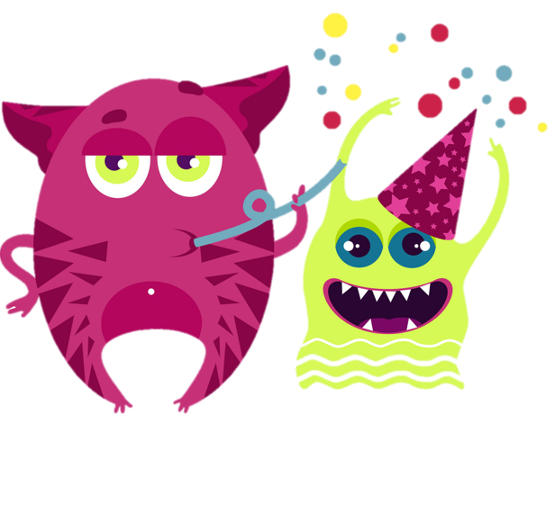

Slide 16
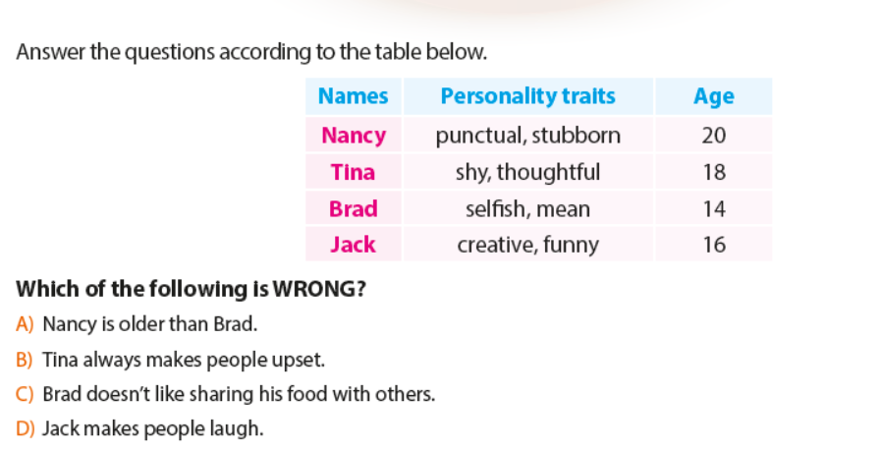
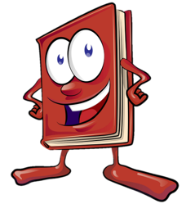

Slide 19
NARTEST İNGİLİZCE KALİTESİNE DAHA FAZLA ULAŞMAK İÇİN
www.altinkarne.com Sitemizden Kitaplarımızın PDF hallerine, Akıllı Tahta Uygulamalarına ve Ücretsiz Birçok Dokümana Ulaşabilirsiniz.

