Slide 1
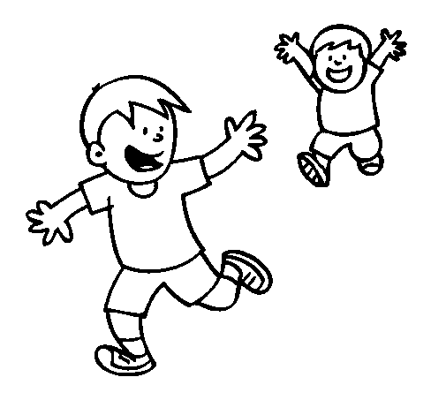
Hello, I’m James and this is my brother, Mike. I love him so much. He is honest and reliable.
1)
Which one is wrong?
A) Mike is reliable person.
B) They are brothers
C) James hates Mike
D) James loves his brother.

Slide 2
Hello, I’m James and this is my brother, Mike. I love him so much. He is honest and reliable.
1)
Which one is wrong?
A) Mike is reliable person.
B) They are brothers
C) James hates Mike
D) James loves his brother.

Slide 3
2) Elaine: Are you going to do anything on the weekend? Would you like to come cinema with me?
Who accepts offer?
A) Rose: Why not?
B) Lisa: I’d love to but I’m visiting my grandmother.
C) Dann: Thank you so much but we will go to a family picnic.
D) Sandra: I can’t come.

Slide 4
2) Elaine: Are you going to do anything on the weekend? Would you like to come cinema with me?
Who accepts offer?
A) Rose: Why not?
B) Lisa: I’d love to but I’m visiting my grandmother.
C) Dann: Thank you so much but we will go to a family picnic.
D) Sandra: I can’t come.

Slide 5
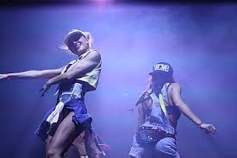
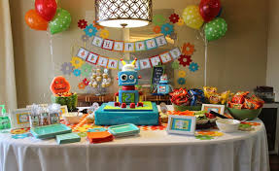
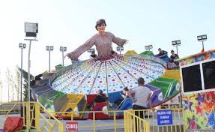
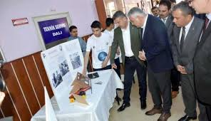
3) Hi, my name is Sam. I have a birthday party next week. According to the text, what is the event?
A) B)
C) D)

Slide 6
3) Hi, my name is Sam. I have a birthday party next week. According to the text, what is the event?
A) B)
C) D)

Slide 7
4) Margaret: Hey, mom! I want to delete some of my files.
Mom: Okey, sweetie. What is the problem?
Margaret: I don't want to delete my wrong files. Can you help me?
Mom: Click on the file you will delete and click here.
What should Margaret click on?
A) B) C) D)

Slide 8
4) Margaret: Hey, mom! I want to delete some of my files.
Mom: Okey, sweetie. What is the problem?
Margaret: I don't want to delete my wrong files. Can you help me?
Mom: Click on the file you will delete and click here.
What should Margaret click on?
A) B) C) D)

Slide 9
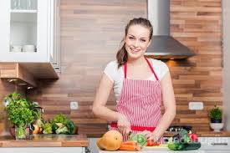
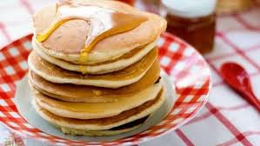
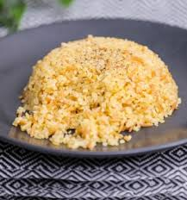
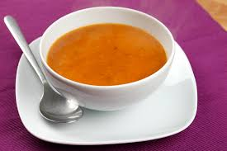
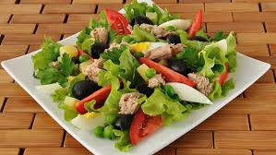
5)
A) B) C) D)
We will make a great salad today. if you're ready, let's start.
Which food will she cook?

Slide 10
5)
A) B) C) D)
We will make a great salad today. if you're ready, let's start.
Which food will she cook?

