Slide 1
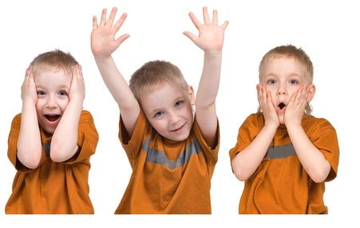
APPEARANCE
PERSONALITY

Slide 2
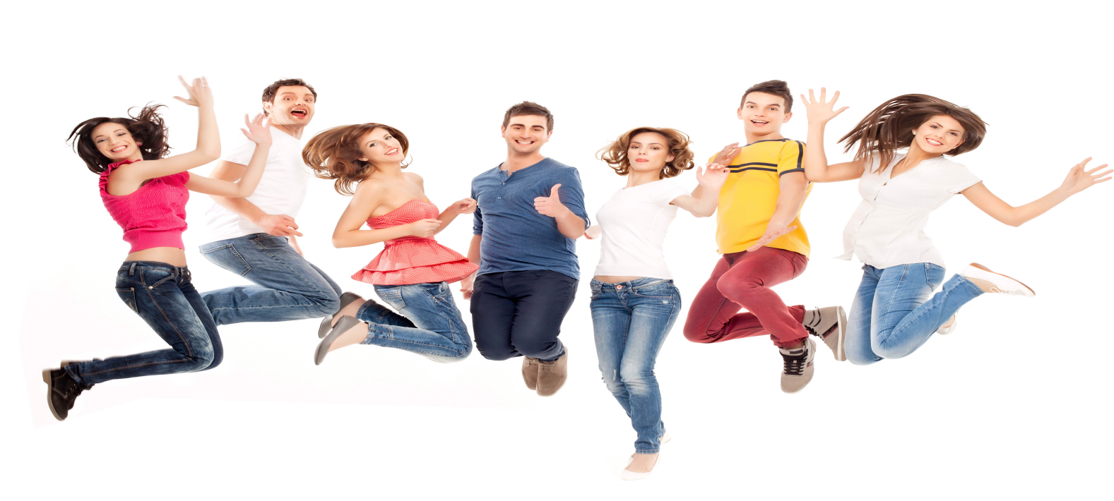
attractive
clumsy
easygoing
forgetful
generous
honest
outgoing
owerweight
punctual
selfish
slim
stubborn
thoughtful
well-built

Slide 3
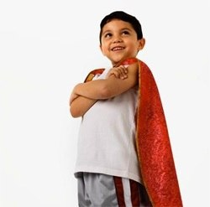
What kind of person are you?

Slide 4
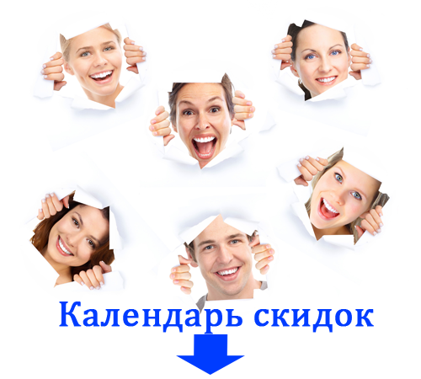
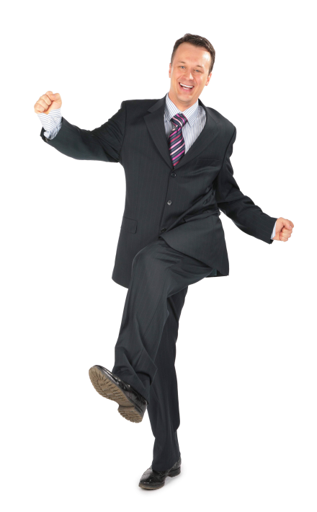
POSITIVE ☺ | NEGATIVE ☹
POSITIVE ☺ | NEGATIVE ☹
??? | ???

Slide 5
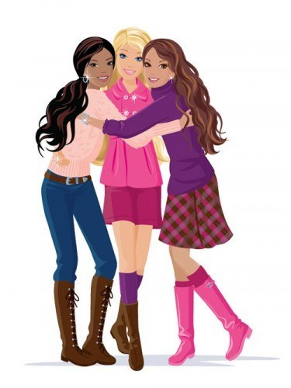
PYHSICAL APPEARANCE(fiziksel görünüş)
Height(boy
Tall
Short
Medium-height
Weight(kilo)
Slim/thin
fat
Overweight
Hair(saç)
Blonde
Curly
Straight
Wavy
Short
Long
Appearance(görünüm)
Beautiful/handsome
Ugly
Plump
Well-built
Dark
Pale
Fair
Eyes(göz)
Big
Small
Black
Green
Blue
Green
Age(yaş
Young
Teenager
Adut
Middle-aged
old

Slide 6
What does she/he does look like ? (Birinin dış görünüşü hakkında soru sorarken kullanılan soru kalıbıdır. )

Slide 7
What does she/he look lıke?
She is beautiful/She is ugly.

Slide 8
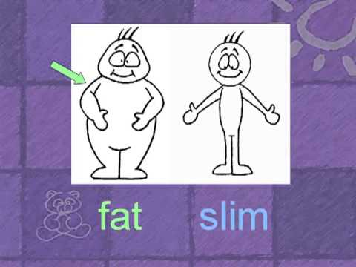
What does she/he look lıke?
He is fat/He is slim.

Slide 9
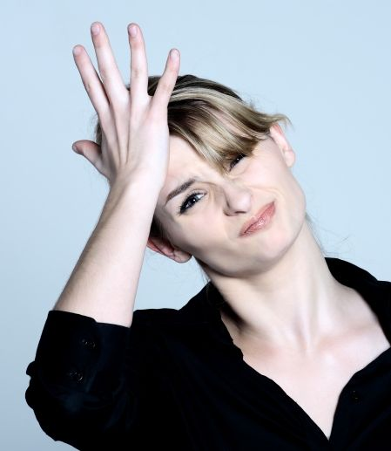
What is She like? (birinin karakteri ile soru sorarken kullanılan soru kalıbıdr.)

Slide 10
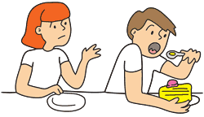
What is he like?
He is selfish.

Slide 11
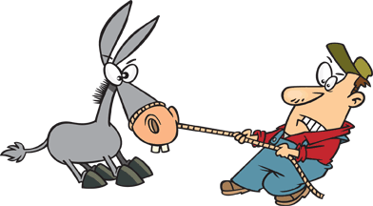
What is IT like?
He is stubborn

Slide 12
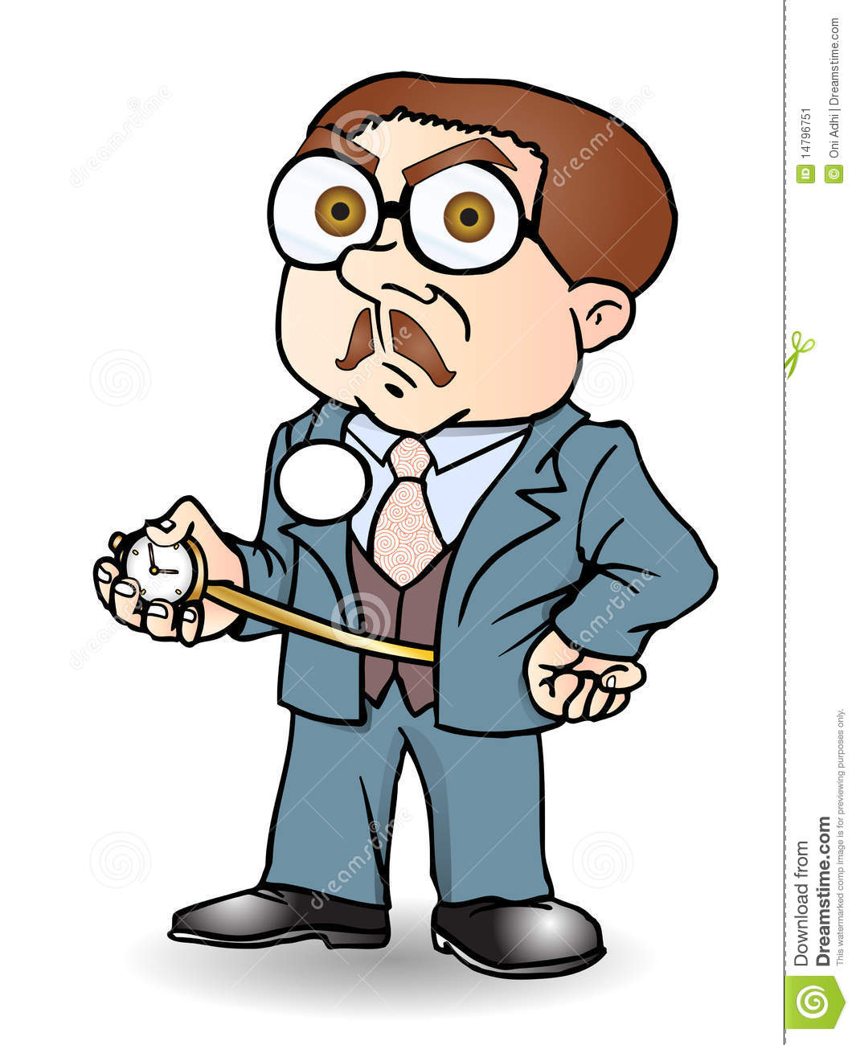
What is he like?
He is punctual.

Slide 13
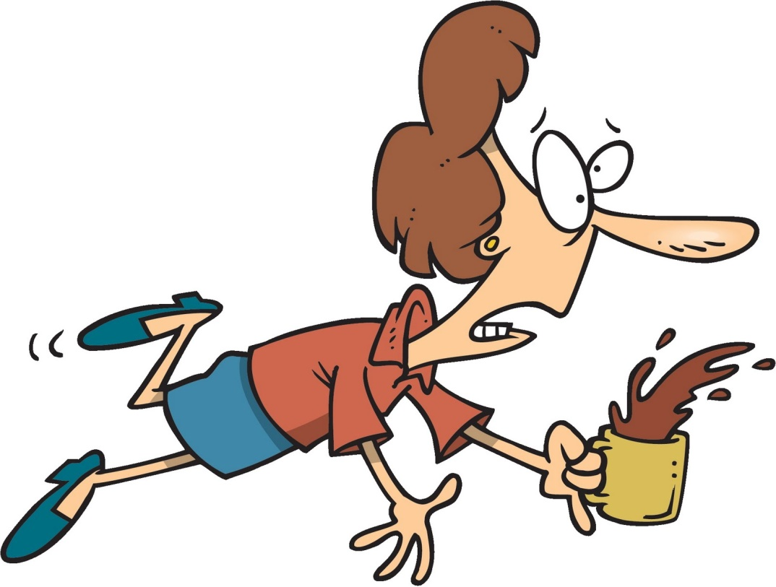
What Is she like?
He is clumsy.

Slide 14
THANK YOU ☺ ☺

