Slide 1
BODY , HEALTH & MEDİCİNE
BODY
İLLNESS & İNJURY
MEDİCAL TRATMENT
MEDİCİNE

Slide 2
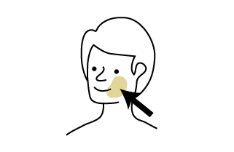
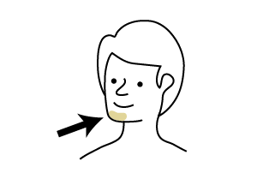
1. BODY
CHEEK
CHİN

Slide 3
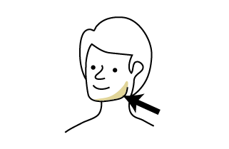
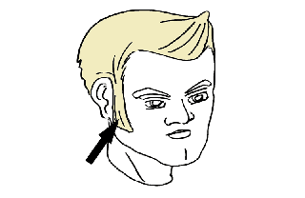
JAW
SİDEBURNS

Slide 4
EAR
EYE

Slide 5
MOUTH
LİPS

Slide 6
TOOTH
TEETH

Slide 7
NOSE

Slide 8
NECK
SHOULDER

Slide 9
ARM
ELBOW

Slide 10
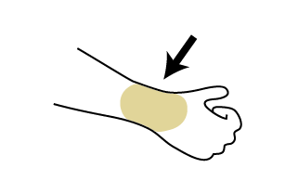
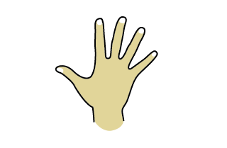
WRİST
HAND

Slide 11
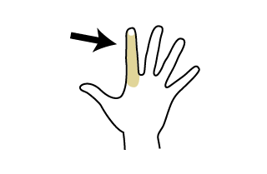
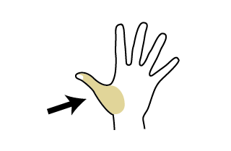
FİNGER
THUMB

Slide 12
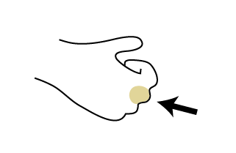
KNUCKLE

Slide 13
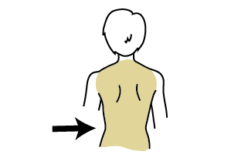
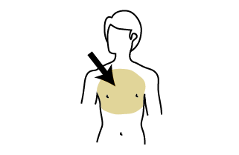
BACK
CHEST

Slide 14
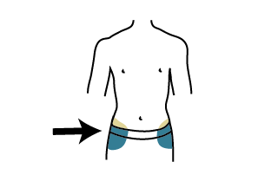
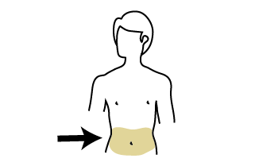
HİPS
WAİST

Slide 15
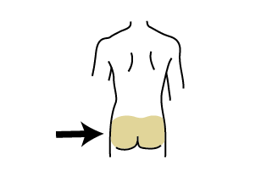
BUM

Slide 16
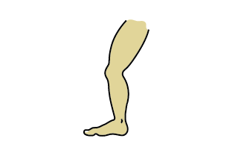
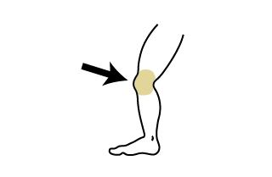
LEG
KNEE

Slide 17
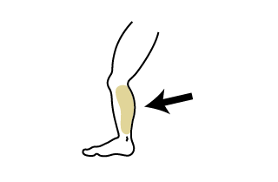
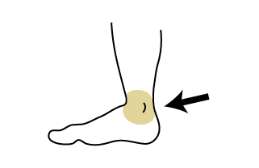
CALF
ANKLE

Slide 18
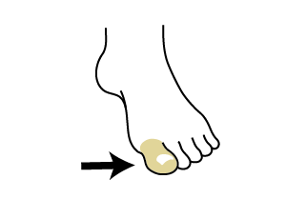
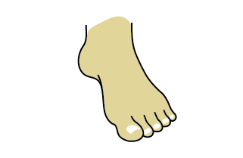
TOE
FOOT

Slide 19
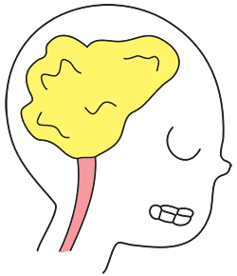
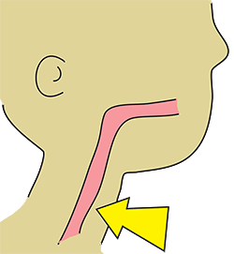
BRAİN
THROAT

Slide 20
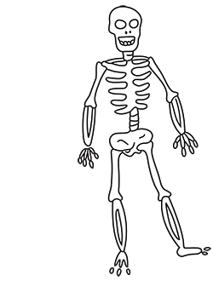
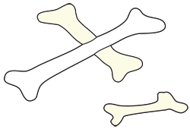
SKELETON
BONES

Slide 21
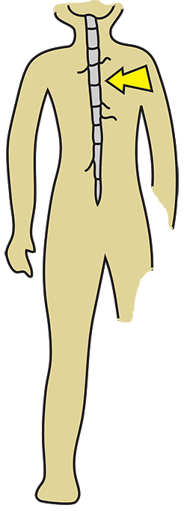
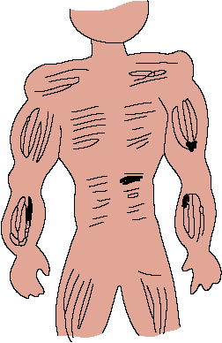
SPİNAL CORD
MUSCLE

Slide 22
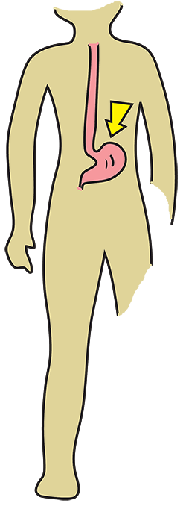
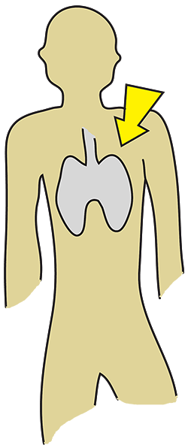
STOMACH
LUNGS

Slide 23
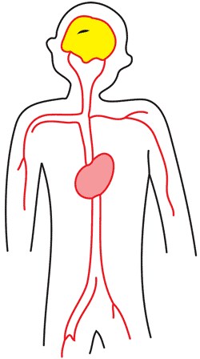
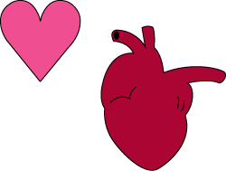
ARTERİES
HEART

Slide 24
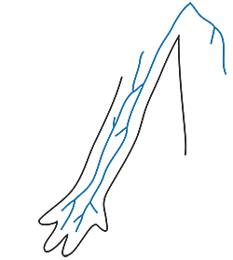
VEİNS

Slide 25
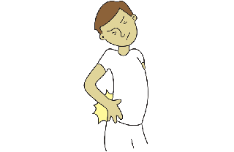
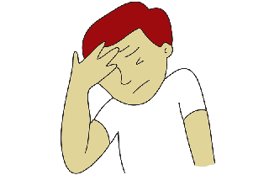
2. İLLNESS & İNJURY
BACKACHE
HEADACHE

Slide 26
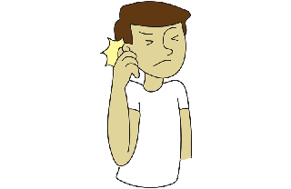
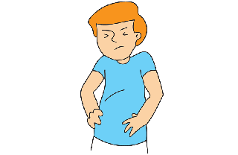
EARACHE
STOMACHACHE

Slide 27
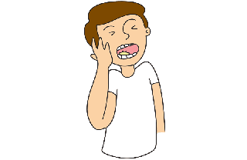
TOOTHACHE
CAVİTY

Slide 28
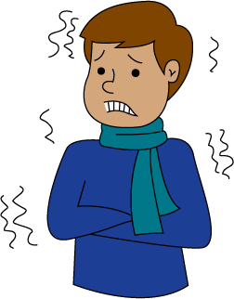
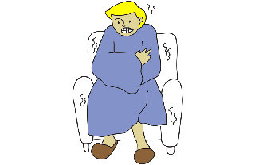
COLD
CHİLLS

Slide 29
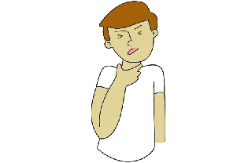
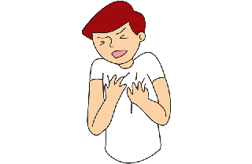
SORE THROAT
CHEST PAİN

Slide 30
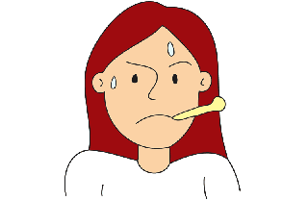
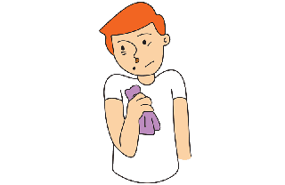
FEVER
RUNNY NOSE

Slide 31
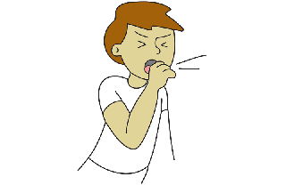
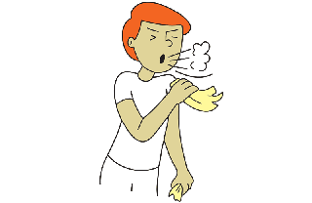
COUGH
SNEEZE

Slide 32
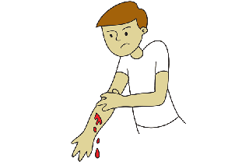
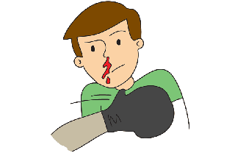
BLEED
NOSEBLEED

Slide 33
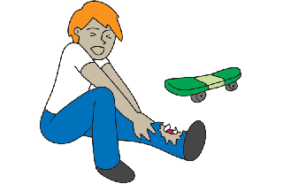
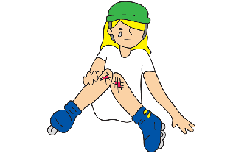
BREAK
SCRAPT

Slide 34
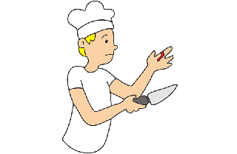
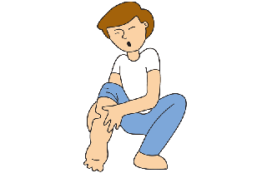
CUT
SWOLLEN

Slide 35
DİARRHEA
VOMİT

Slide 36
SUNBURN
BURN

Slide 37
SHORTNESS OF BREATH
EXHAUSTED

Slide 38
BLOATED
CRAMPS

Slide 39
BURP
NAUSEOUS

Slide 40
BRUİSE
DİSLOCATE

Slide 41
BİTE
SCRATCH

Slide 42
CONGESTED
DİZZY

Slide 43
FAİNT
SPRAİN

Slide 44
HİCCUPS
LARYNGİTİS

Slide 45
RASH
STİFF NECK

Slide 46
TWİST
VİRUS

Slide 47
WARD

Slide 48
3. MEDİCAL TREATMENT
GARGLE
X-RAY

Slide 49
NEEDLE
İNJECTİON

Slide 50
STİTCHES
IV

Slide 51
SLİNG
PHYSİCAL TERAPY

Slide 52
PRESCRİPTİON

Slide 53
4. MEDİCİNE
COUGH SYRUP
COUGH MEDİCİNE

Slide 54
COLD TABLET
VİTAMİNS

Slide 55
ASPİRİN
CAPSULE

Slide 56
PİLL
TABLET

Slide 57
ANTACİD
DECONGSTANT

Slide 58
EYE DROPS
OİNTMENT

Slide 59
CREAM
LOTİON

Slide 60
İCE PACK
HEATİNG PAD

Slide 61
THROAT LOZENGES

Slide 62
PREPARED BY KUBİLAY ERTÜRK DOSTSEVER

