Slide 1
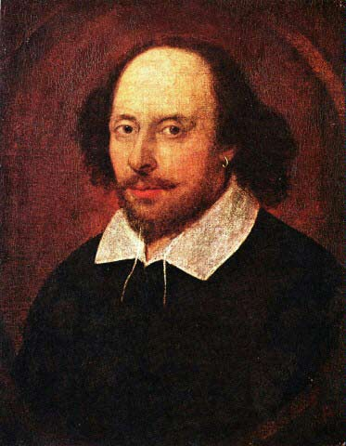
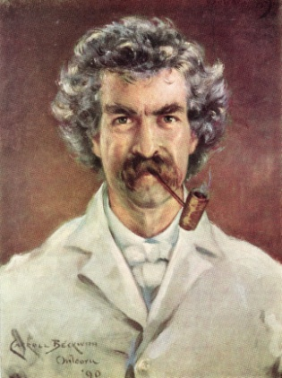
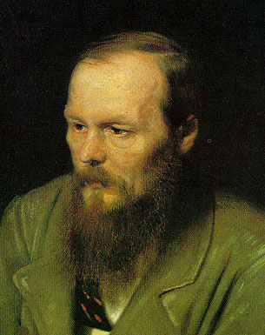
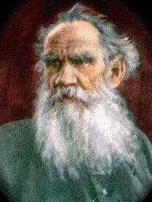
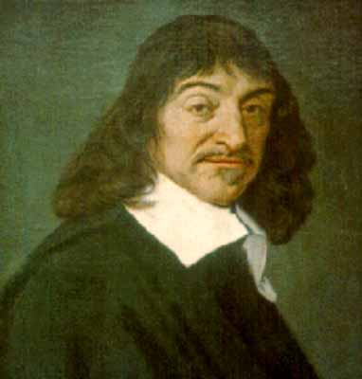
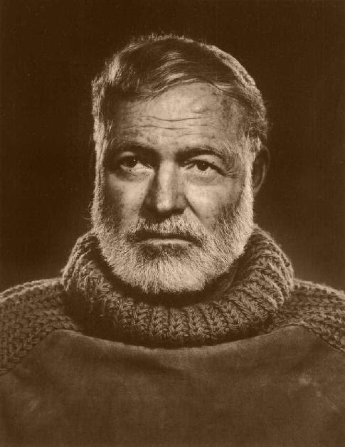
The Grammar-Translation Method
HUM 403 Methodology in ELT
Yakup Cetin

Slide 2
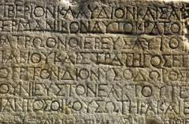
The GTM is also known as the Classical Method since it was first used in the teaching of the classical languages, Latin and Greek (Chastain 1988).
The GTM was used for the purpose of helping students read and appreciate foreign language (L2) literature.

Slide 3
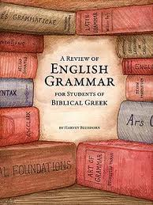
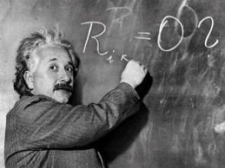
It was believed that, through the study of the grammar of the L2, students would become more familiar with the grammar of their native language (L1) and that this familiarity would help them speak and write their L1 better.
It was thought that FL learning would help students grow intellectually; students would probably never use the L2, but the mental exercise of learning it would be beneficial.

Slide 4
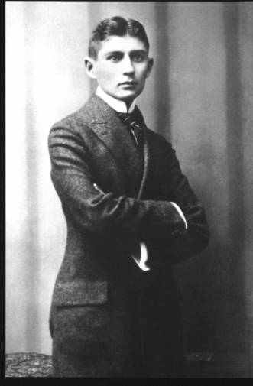
EXPERIENCE - SAMPLE TEACHING

Slide 5
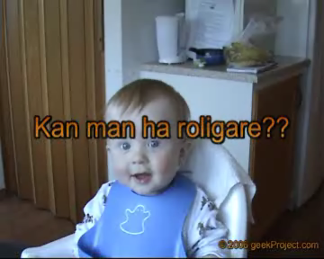
ENERGIZER

Slide 6
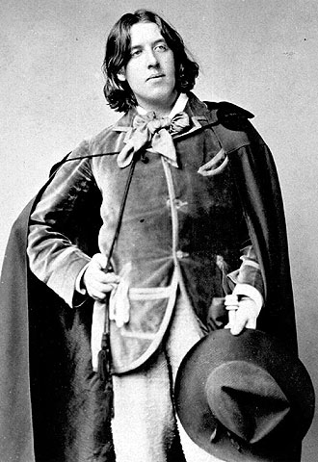
THINKING ABOUT THE EXPERIENCE
Observations
1 The class is reading an excerpt (or a reading passage) from Mark Twain's Life on the Mississippi.
Principles
A fundamental purpose of learning a FL is to be able to read literature of L2.
Written language is superior to spoken language.
Students' study of the L2 is limited to its literature and fine arts.
Oscar Wilde

Slide 7
O. 2 Students translate the passage from English to Spanish/Turkish.
An important goal is for students to be able to translate each language into L2. If students can translate from one language into another, they are considered successful language learners.
O. 3 The teacher asks students in their L1 if they have any questions. A student asks one and is answered in her L1.
P. The ability to communicate in L2 is not a goal of FL instruction.

Slide 8
O 4 Students write out the answers to reading comprehension questions.
P 4 The primary skills to be develop are reading and writing. Little attention is given to speaking and listening, and almost none to pronunciation.
O5 The teacher decides whether an answer is correct or not. If the answer is incorrect, the teacher selects a different student to supply the correct answer or the teacher herself gives the right answer.
P5The teacher is the authority in the classroom. It is very important that students get the correct answer.

Slide 9
ENERGIZER

Slide 10
O6 Students translate new words from English (L2) into Spanish (L1).
P6 It is possible to find native language equivalents for all target language words.
O7 Students learn that English '-ty' corresponds to -dad and -tad in Spanish.
P7 Learning is facilitated through attention to similarities between the L1 and the L2.
O8 Students are given a grammar rule for the use of a direct object with two-word verbs.
P8 It is important for students to learn about the form of the L2.

Slide 11
O9 Students apply a rule to examples they are given.
P9 Deductive application of an explicit grammar rule is a useful pedagogical technique.
O10 Students memorize vocabulary.
P10 Language learning provides good mental exercise.
O11 The teacher asks students to state the grammar rule.
P 11 Students should be conscious of the grammatical rules of the L2.
O12 Students memorize present tense, past tense, and past participle forms of one set of irregular verbs.
P 12 Wherever possible, verb conjugations and other grammatical paradigms should be committed to memory.

Slide 12
ENERGIZER

Slide 13
REVIEWING THE PRINCIPLES
1 What are the goals of teachers who use the Grammar-Translation Method?
To be able to read literature written in the target language.
To do this, students need to learn about the grammar rules and vocabulary of the target language.
To study a FL provides students with good mental exercise.
2 What is the role of the teacher? What is the role of the students?
The roles are very traditional.
The teacher is the authority in the class­room.
3 What are some characteristics of the teaching/learning process?
To translate from one language to another.
To study grammar deductively
To memorize all grammar rules.
To memorize L2 equivalents for L2 vocabulary words.

Slide 14
4 What is the nature of student-teacher interaction? What is the nature of student-student interaction?
Interaction is from the teacher to the students.
There is little student initiation and little student-student interaction.
5 How are the feelings of the students dealt with?
There are no principles of the method which relate to this area.
6 How is the language viewed? How is culture viewed?
Focus is on Literary language.
Spoken language is ignored.
Teaching culture includes literature and the fine arts.
7 What areas of language are emphasized? What language skills are emphasized?
Focus is on vocabulary and grammar .
Reading and writing are the main skills.
Speaking, listening, and pronunciation are ignored.

Slide 15
8 What is the role of the students' native language?
L2 is translated into the students' native language.
Classroom language is mostly in L2.
9 How is evaluation accomplished?
Written tests with translations.
Comprehension questions.
Application of grammar rules.
10.How does the teacher respond to student errors?
Correct answer is very significant.
If necessary, the teacher provides the correct answer.

Slide 16
ENERGIZER

Slide 17
QUESTIONS
Do you believe that a fundamental reason for learning a foreign lan­guage is to be able to read the literature written in the target language?
Do you think it is important to learn about the target language?
Should culture be viewed as consisting of literature and the fine arts?
Is translation a valuable exercise?
Is answering reading comprehension questions of the type described here helpful?
Should grammar be presented deductively?
Are these or any of the other techniques of the Grammar-Translation Method ones which will be useful to you in your own teaching? Which ones?

