Slide 1


Slide 2
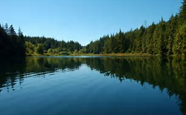
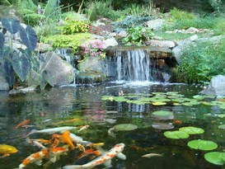
LAKE
POND

Slide 3
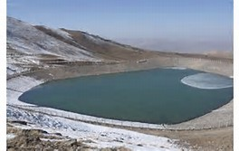
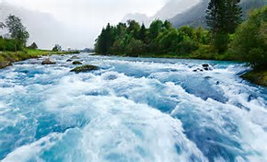
POOL
RİVER

Slide 4
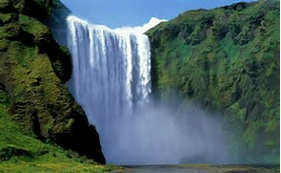
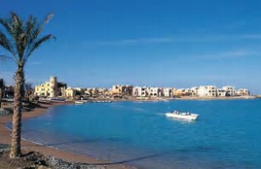
WATERFALL
SEA

Slide 5


OCEAN
BEACH

Slide 6
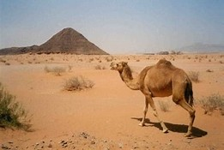

DESERT
FOREST

Slide 7

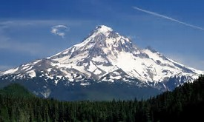
HİLL
MOUNTAİN

Slide 8

ISLAND

Slide 9
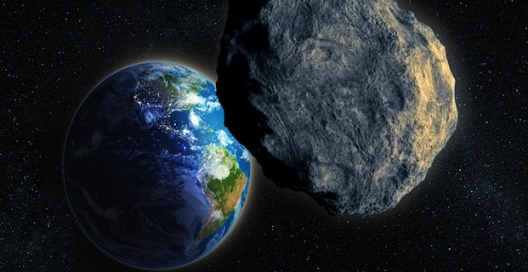
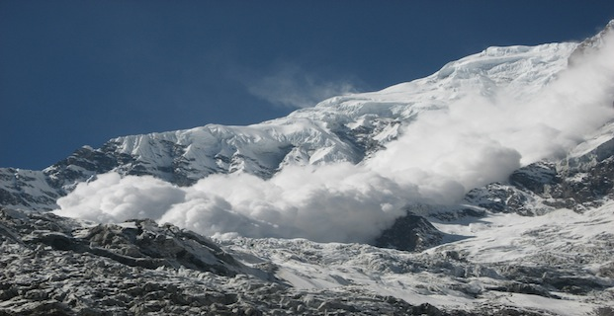
NATURAL DİSASTERS
ASTEROİD
AVALANCHE

Slide 10
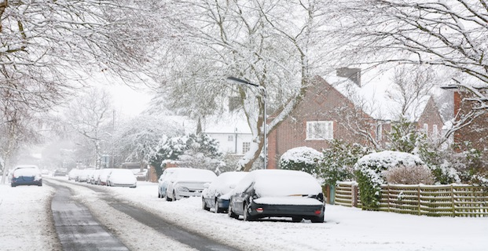
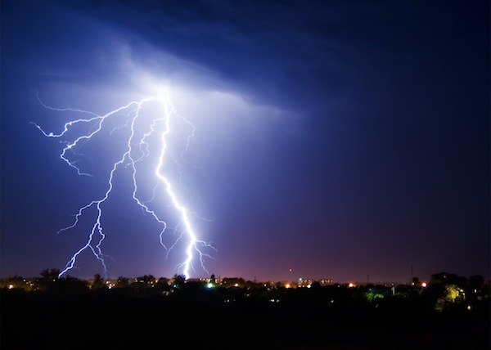
BLİZZARD
THUNDERSTORM

Slide 11
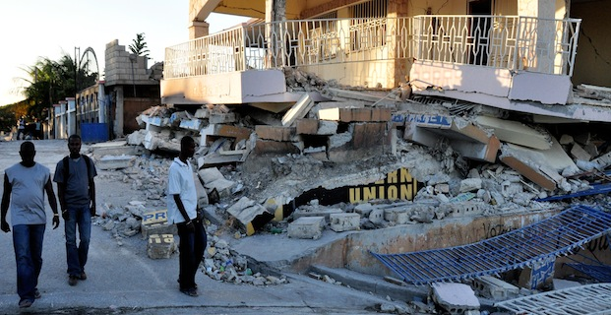
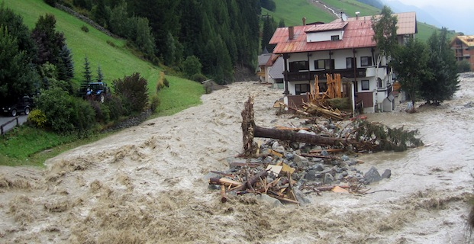
EARTHQUAKE
FLOOD

Slide 12
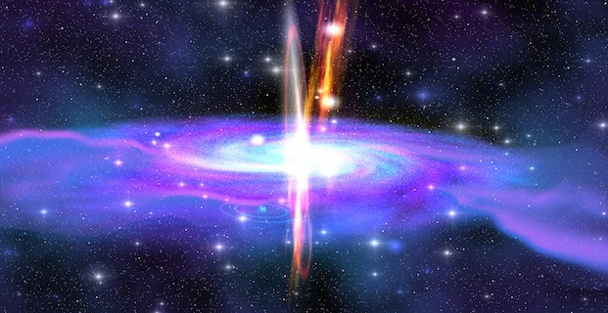
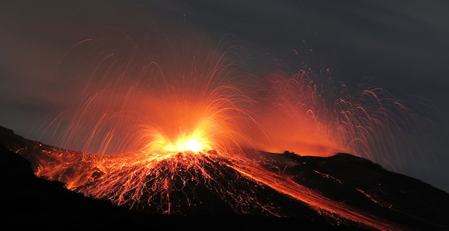
GAMMA-RAY BURST
VOLCANO ERUPTİON

Slide 13
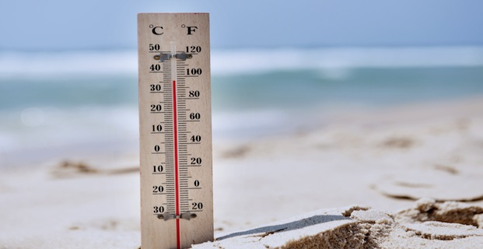
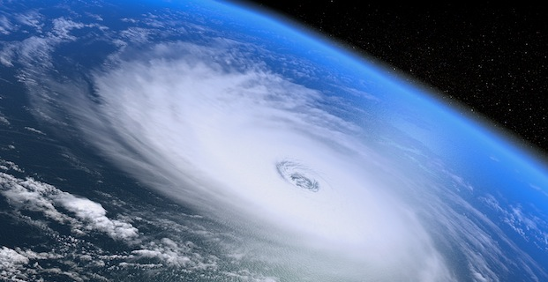
HEAT WAVE
HURRİCANE

Slide 14
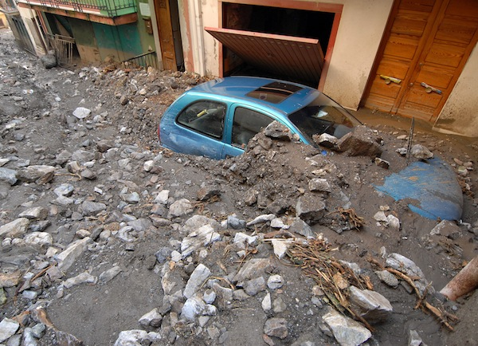
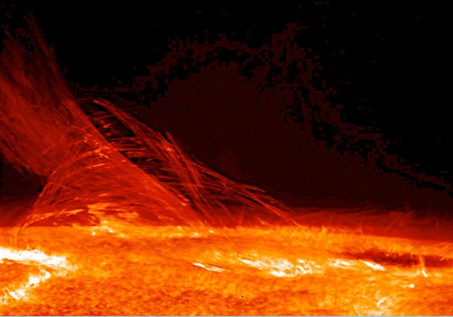
LANDSLİDE
SOLAR FLARE

Slide 15
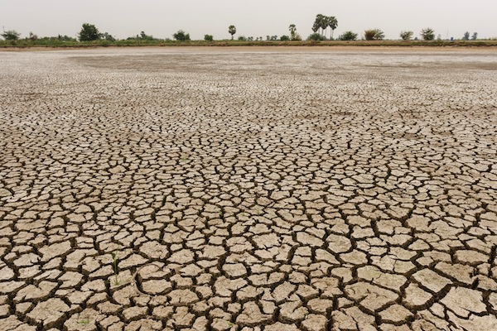
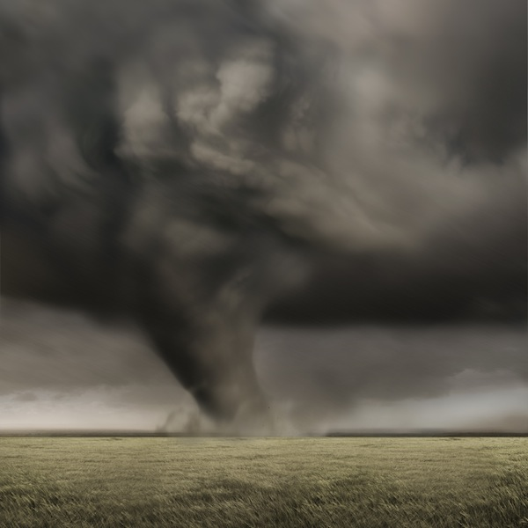
DROUGHT
TORNADO

Slide 16
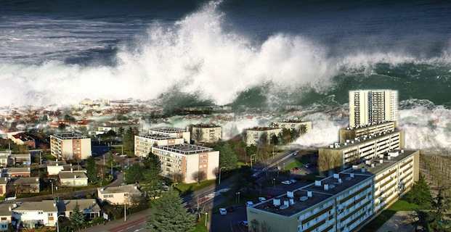
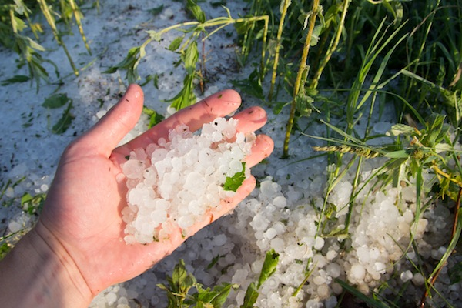
TSUNAMİ
HAİL

Slide 17
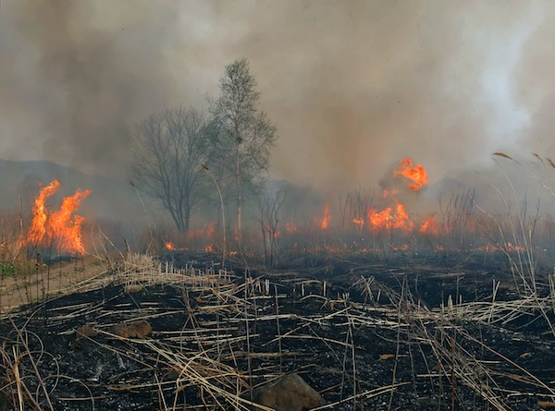
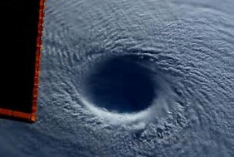
WİLDFİRE
TYPHOONE

Slide 18
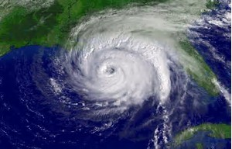
CYCLONE

Slide 19

HURRICANE, TYPHOON, CYCLONE – WHAT IS THE DIFFERENCE?

Slide 20
A hurricane, a typhoon, and a cyclone are essentially the same type of weather phenomenon.
THERE IS NO DIFFERENCE!
So why are there three different words for the same thing?
Well, the only real difference is WHERE the storm forms and takes place or happens.
DID YOU KNOW?
Hurricanes and Typhoons in the Northern Hemisphere spin a counter-clockwise OR anti-clockwise direction.
Cyclones, which are in the Southern hemisphere, spin in a clockwise direction.
NOTE:
COUNTER-CLOCKWISE: American English
ANTI-CLOCKWISE: British English

Slide 21
If it happens in the Northeast Pacific Ocean or the Atlantic Ocean, then it is called a Hurricane.
If it happens in the Northwest Pacific Ocean, which is near Asia, then it is called a Typhoon.
If it happens in the South Pacific Ocean or the Indian Ocean, then it is called a Cyclone.
HURRICANE: Northeast Pacific Ocean and Atlantic Ocean
TYPHOON: Northwest Pacific Ocean
CYCLONE: South Pacific Ocean and Indian Ocean.

Slide 22
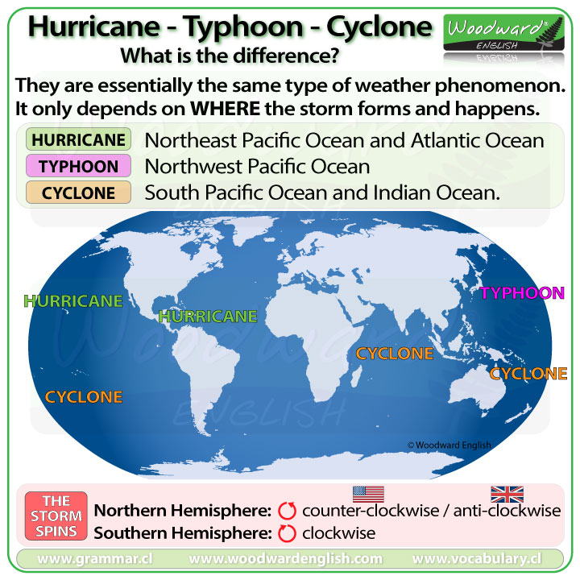
SUMMARY CHARTS

