Slide 1
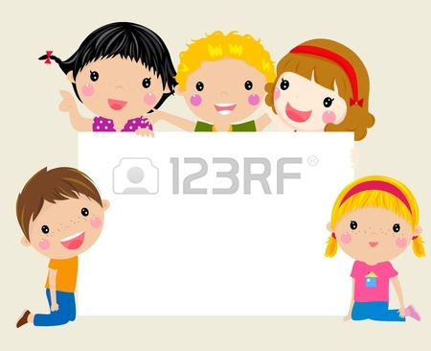
PHYSICAL APPEARANCE
JOYFUL ENGLISH 4
Betül Sümeyra TOPCU

Slide 2
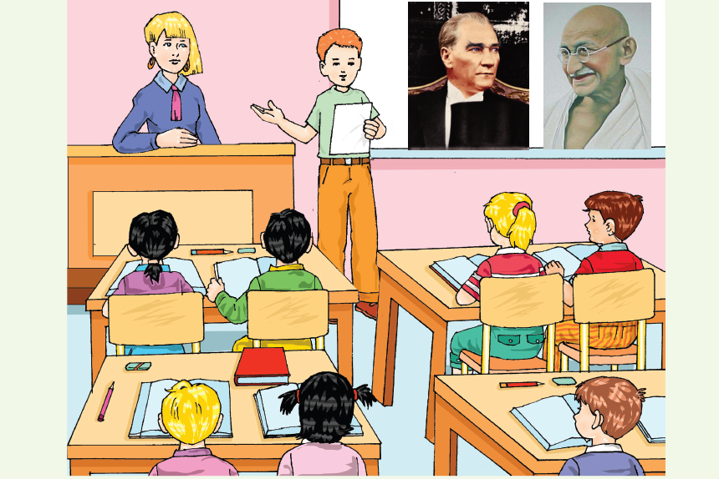

A.Listening and Reading
a.Listen and Read
Mark: He has got short blond hair. He has got blue eyes. He is a famous Turkish
leader. Guess! Who is he?
Students: Atatürk!!
Sam: He hasn't got any hair. He is bald. He has got brown eyes. He has got glasses.
He has got a moustache. He is a famous Indian leader. Guess! Who is he?
Students: Gandhi!!

Slide 3
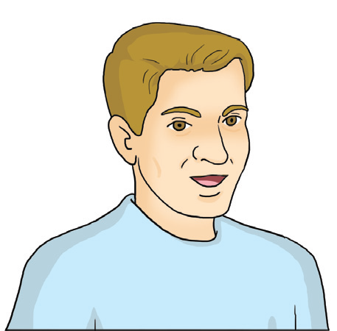
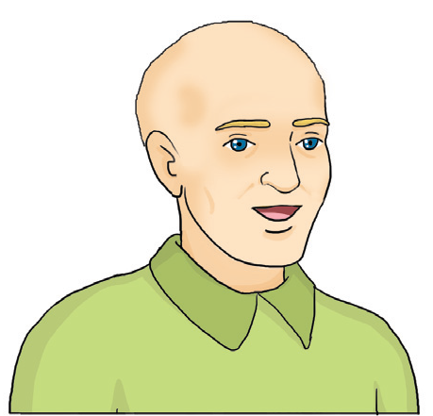
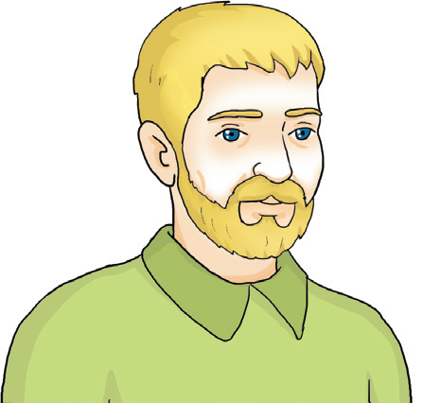
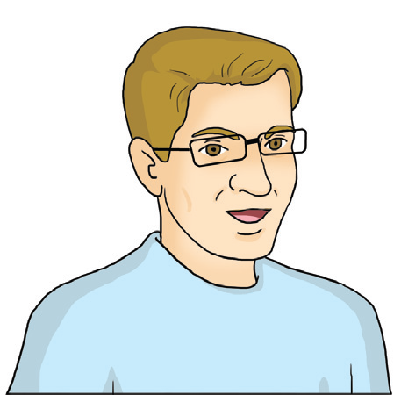
b. Match the pictures with the words.
short hair
bald
beard
glasses
moustache

Slide 4
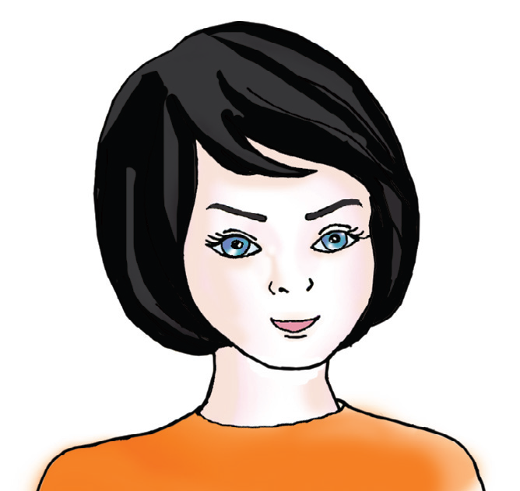
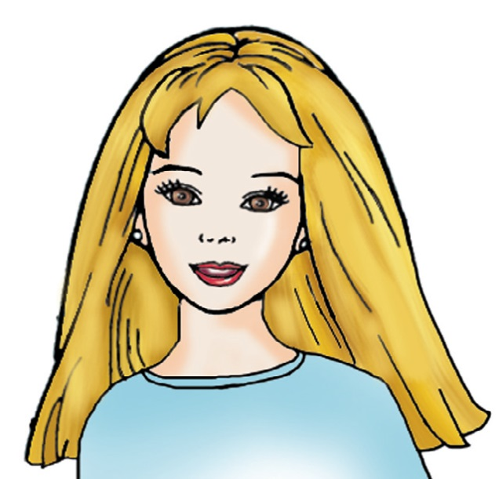
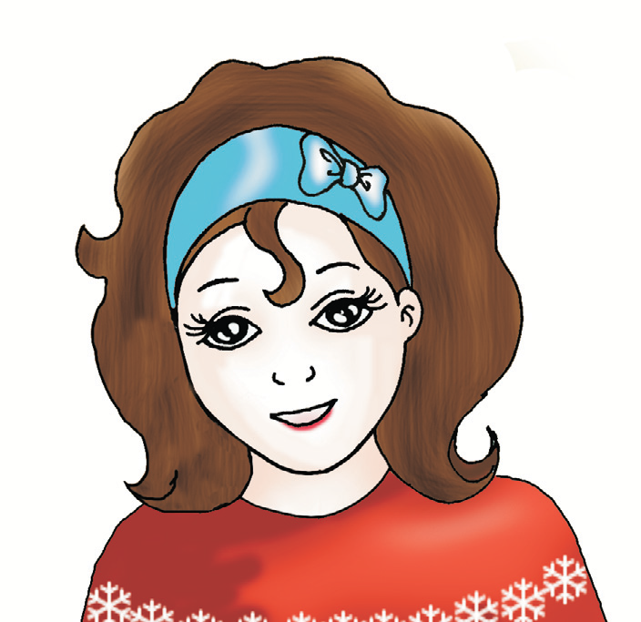
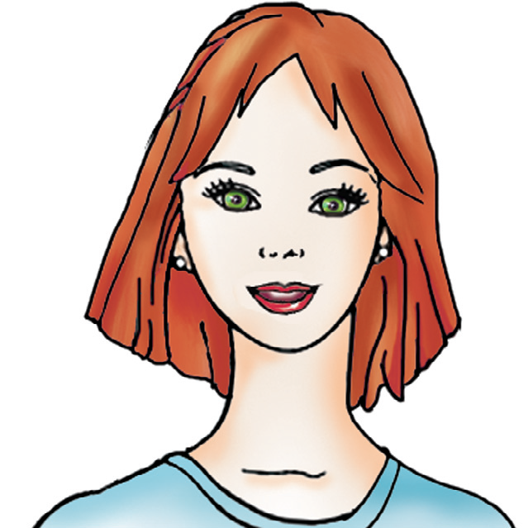
Focus 1
My hair is blonde.
My eyes are brown
My hair is black.
My eyes are blue.
She has got black hair.
She has got blue eyes.
She has got blonde hair.
She has got brown eyes.
My hair is red.
My eyes are green.
My hair is brown.
My eyes are black
She has got brown hair.
She has got black eyes.
She has got red hair.
She has got green eyes.

Slide 5
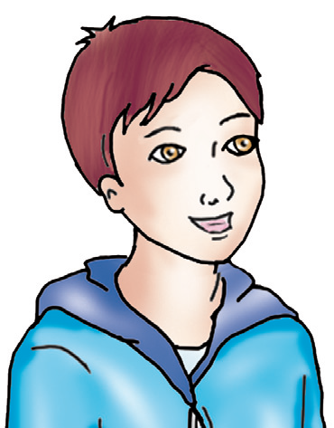
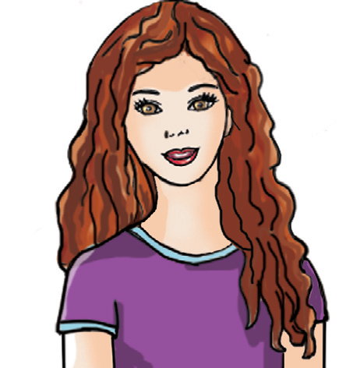
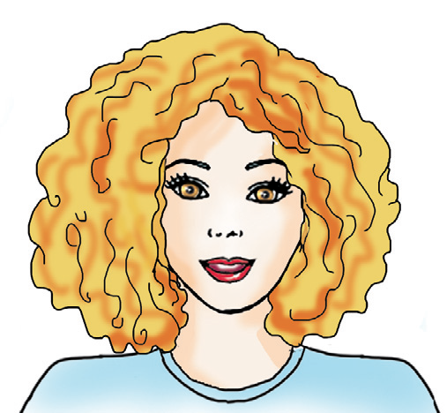
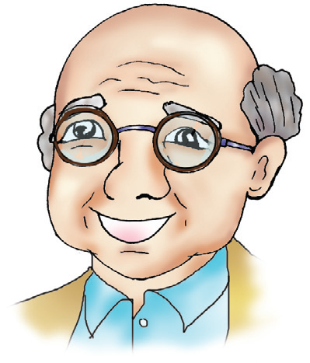
Hair Type
short hair
He has got straight hair.
His hair is short.
She has got wavy hair.
Her hair is long.
long hair
medium length hair
bald
She has got curly hair.
Her hair is medium length.
He is bald.

Slide 6
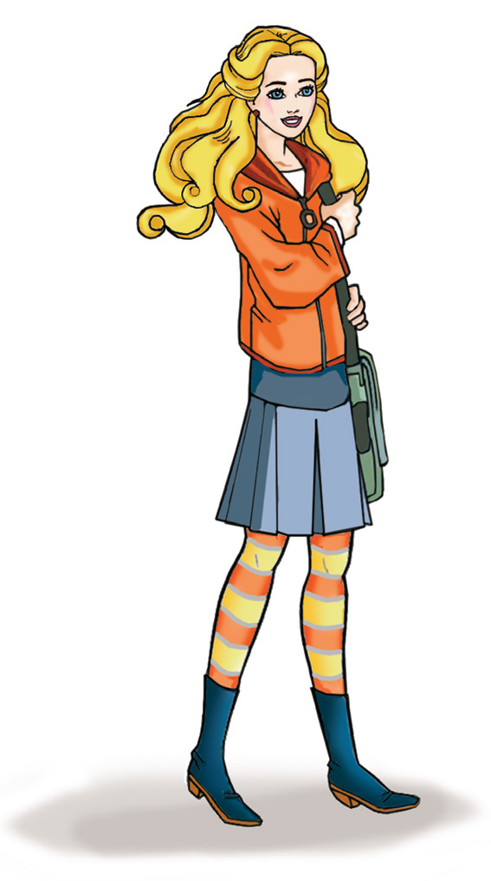
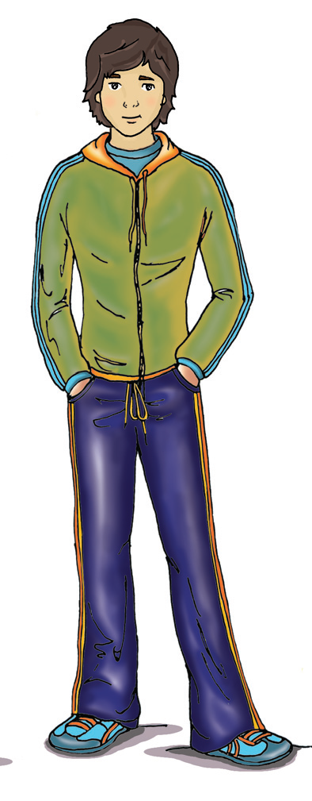
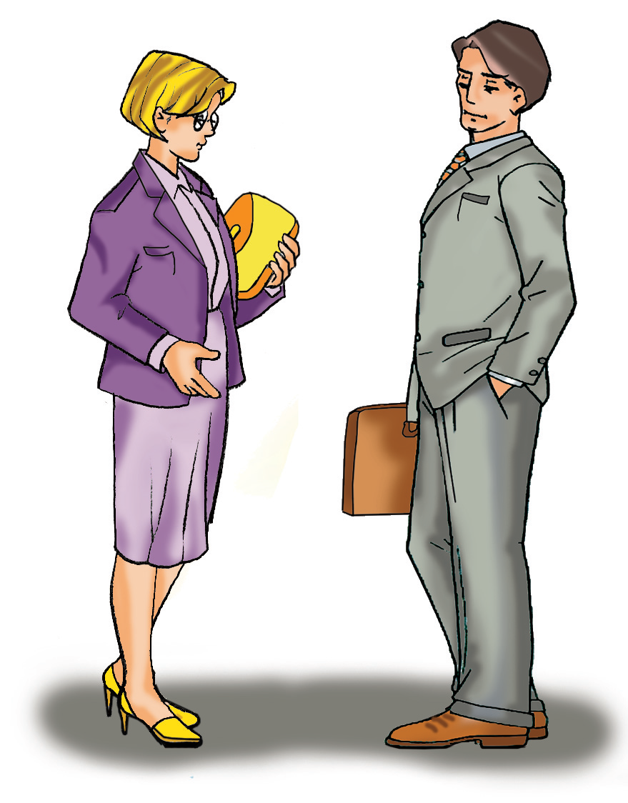
General
beautiful(for girls)
handsome (for boys)
good-looking(for boys and girls)
She is beautiful
He is handsome
They are good-looking.

Slide 7
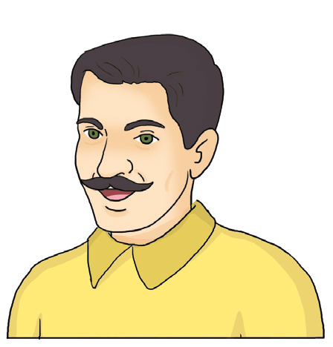
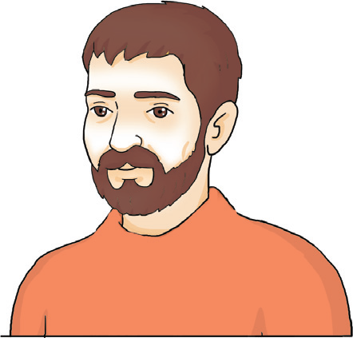
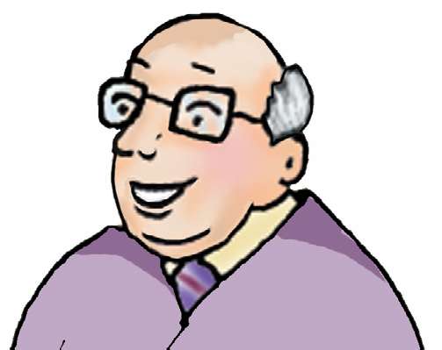
Other
beard
moustache
He has got a beard
He has got a moustache
glasses.
He has got glasses.

Slide 8
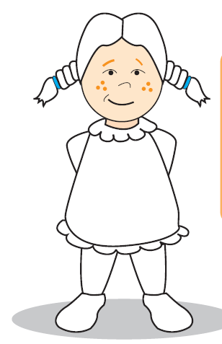
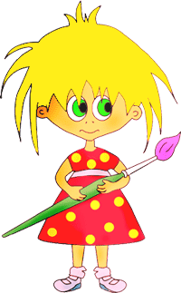
B.Listening
a. Listen and complete the sentences. Colour Mary.
blonde
This is Mary. She has got ………………hair. Her hair is………………. Her eyes are ………… . She has got pink …………. and ……… shoes. Her dress is……….. .
long
brown
tights
green
blue

Slide 9
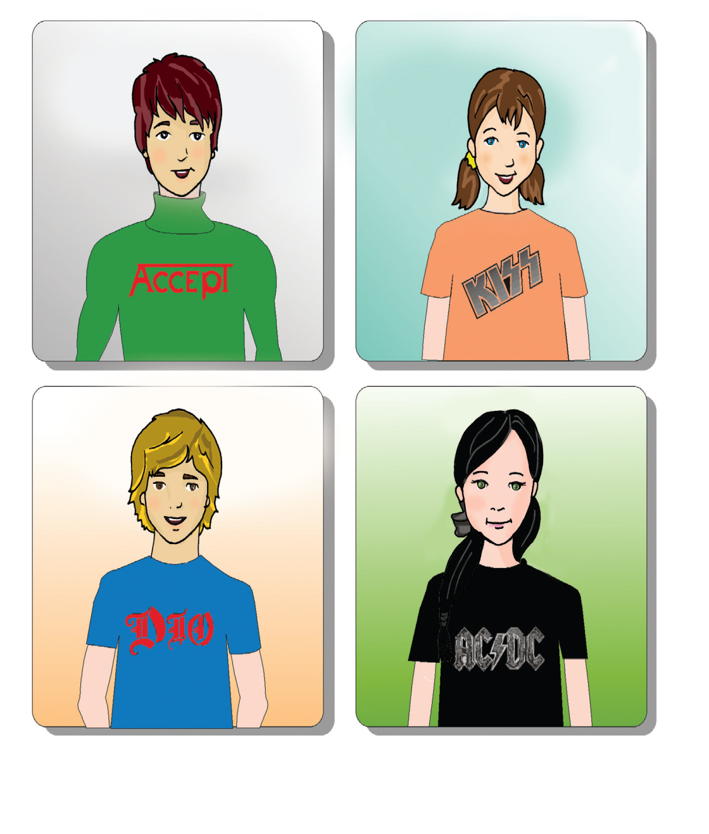
b. Listen and match the names with the pictures.
CAROL
1
JAMES
2
JACK
3
SUZIE
4
c. Describe yourself and your friend.

Slide 10
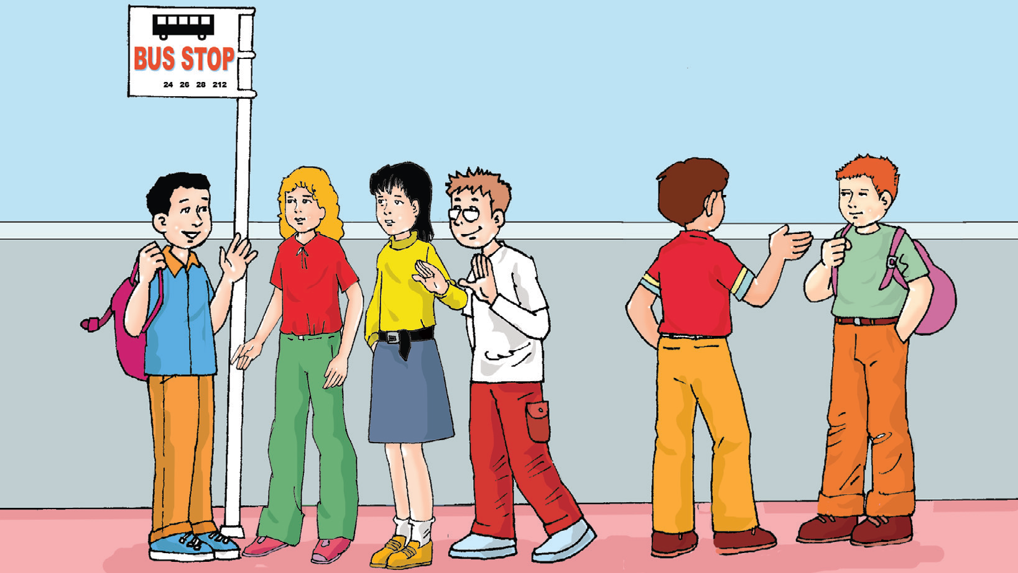
C.Listening and Reading
a. Listen and read.
Eric : Look! There are different people. Let's play “Guess Who”.
Mark : OK!
Eric : He has got short brown hair. His eyes are black. He is tall and thin.
Mark : Give me one more clue!
Eric : He has got glasses.
Mark : Oh! Here he is. He is the fourth one.

Slide 11

b. Look at the second person at the bus stop and complete the sentences.
She has got ................. hair. She has got .................................
pants. She is ....................... and ........................... .
blonde
green
tall
thin
c. Look at the bus stop again. Choose a person and describe him / her.
Ask your friends “Who is this person?”.
…………………………………………………

Slide 12
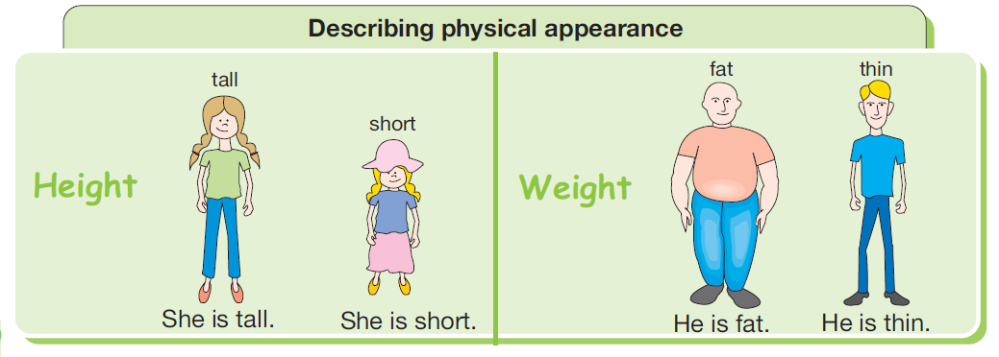
Focus 2
Look at the pictures and study the sentences.

Slide 13
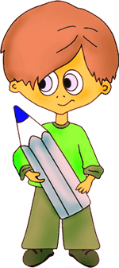
D.SPEAKING
a.Read the dialogue
Gökhan: He has got short brown hair. He has got green eyes.
Mary: Give me a clue.
Gökhan: He is thin. He has got glasses.
Mary: Ali!
Gökhan: Yes. Now it is your turn!
Useful Language
Give me one more clue
b. Choose someone in your class. Ask questions about him/her. Guess your friend.
........................................................................................................................................................................................................................................................................................................................

Slide 14

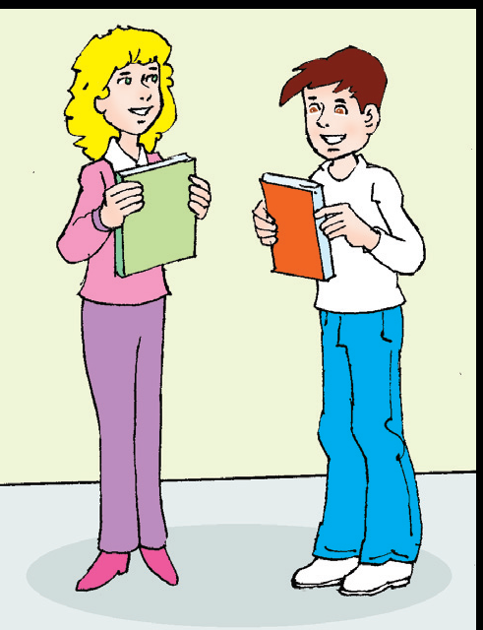
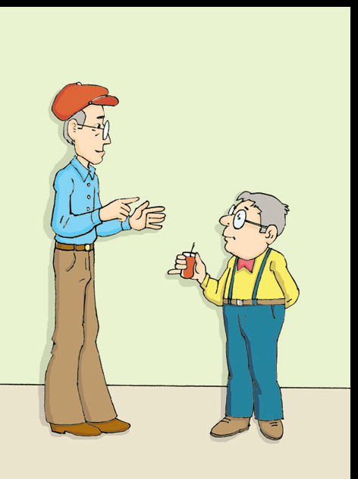
Focus 3
I’m 1 metre 85 cm tall.
My eyes are brown
How tall are you?
How heavy are you?
What colour
are your eyes?
I’m 65 kilos.
I have got blonde hair
What colour is your hair?

Slide 15






Focus 4
Aa. Study the sentences.
A: Where are you from?
B: I’m from Mexico.
A: What nationality are you?
B: I am Mexican.
Country
Nationality
Country
Nationality
Turkey
Turkish
Azerbaijan
Azerbaijani
Germany
German
India
Indian
Japanese
Japan
Brazil
Brazilian

Slide 16
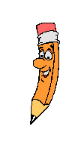
E. SPEAKING
a. Look at the example dialogues.
Sue: Where are you from?
Burak: I'm from Turkey.
Sue: What nationality are you?
Burak: I'm Turkish. And you?
Sue: I'm English.
Jane: What nationality is he?
Tom: He is Chinese.
Jane: Where is he from?
Tom: He is from China.
b. Make a dialogue and act it out with your partner.

Slide 17
c. Ask and answer questions.
Ann: Where are you from? I'm from Japan.
Ann: What nationality are you? I'm Japanese.
Where are you from
1. Ali: ......................................................? Vince: I’m from France
Ali: ......................................................? Vince: .............................................
What nationality are you
I’m from French
Where are you from
I’m from Germany
2. Ayşe: ..................................................? Hans: .....................................................
Ayşe: ..................................................? Hans: I'm German.
What nationality are you

Slide 18
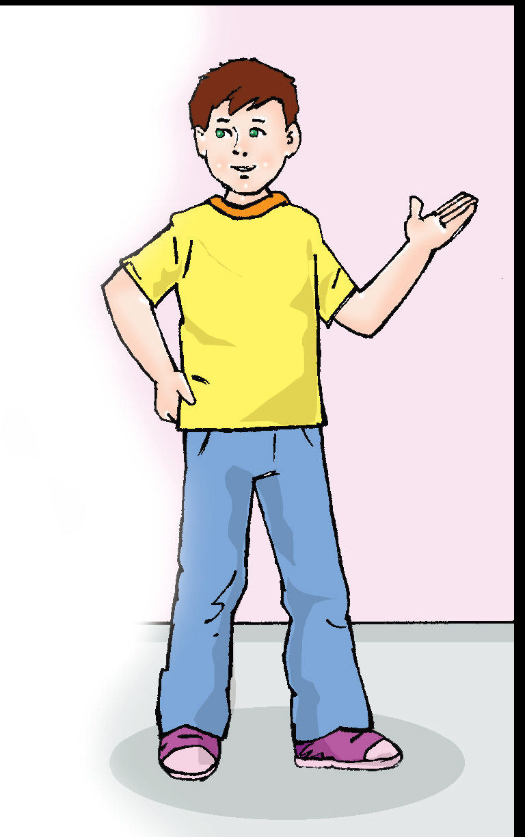
F. Reading
a. Look at the form. Write True (T) or False (F).
Name | Martin
Surname | Luther
Date of birth | 05.03.2000
Gender | Male
Nationality | English
Country | UK
Job | Student
Height | 1.30 m
Weight | 45 kg
Hair colour | Dark brown
Eye colour | Green
T
……1. He is a student.
..... 2. Martin’s birthday is on May 3rd.
..... 3. His hair is dark brown.
..... 4. He is tall.
..... 5. His eyes are green.
..... 6. He is American.
F
T
F
T
T

Slide 19
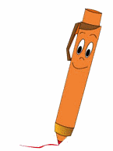
b. Fill in your own form.
Name: |  | Country:
Surname: |  | Job:
Date of birth: |  | Height:
Age: |  | Weight:
Gender: |  | Hair color
Nationality: |  | Eye color

Slide 20


c. Work in pairs. Ask and answer questions.
What is your name?
...................................................................................................
2. How old are you?
...................................................................................................
3. When is your birthday?
...................................................................................................
4. What is your gender?
...................................................................................................
5. What is your address?
...................................................................................................
6. Where are you from?
..................................................................................................
7. Who are your family members? (brothers / sisters / parents / grandparents?, etc.)
...................................................................................................
8. How tall are you?
......................................................................................................
9. How heavy are you?
......................................................................................................
10. What colour are your eyes?
......................................................................................................
11. What colour is your hair?
........................................................................................................
12. What is your favourite food?
........................................................................................................
Ask your partner!

Slide 21
G. Reading
a. Categorize the words below.
thin
beard
beautiful
short
curly
green
good looking
blue
brown
tall
moustache
blond
straight
blonde
bald
fat
glasses
Hair | Eyes | Physical appearance | Weight | Height | Order

Slide 22
b. Read the texts. Match the words with the phrases.
Sally has got dark curly hair.
Her hair is long. She has got blue
eyes. Her eyes are big.
Mark has got short wavy hair.
It is black. His eyes are green.
They are beautiful.
wavy black hair
blue eyes
curly
.....................................
.......................................
.......................................
.......................................
.......................................
.......................................
.......................................
big
beautiful green eyes
long dark hair
short dark hair
dark hair
beautiful
green eyes
long
big blue eyes
wavy
curly black hair
black hair
short

Slide 23

WORKBOOK

Slide 24

A. Read the text. Draw and colour the person.
Hi, everybody! My name is Jeremy.
I’m eleven. I’m quite handsome.
I’m blond.
I have got big blue eyes and lovely red glasses.
I like smiling very much

Slide 25
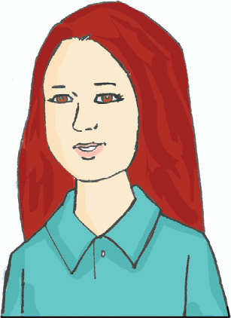

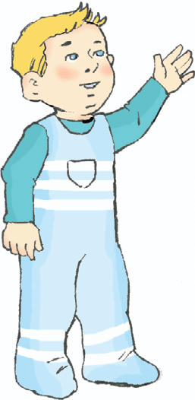
B. Write descriptions for each picture.
………………………………………………………………………………………………………………………………………………………………………………………………………………………………………………………………………………………………................................................
………………………………………………………………………………………………………………………………………………………………………………………………………………………………………………………………………………………………............................................................................

Slide 26
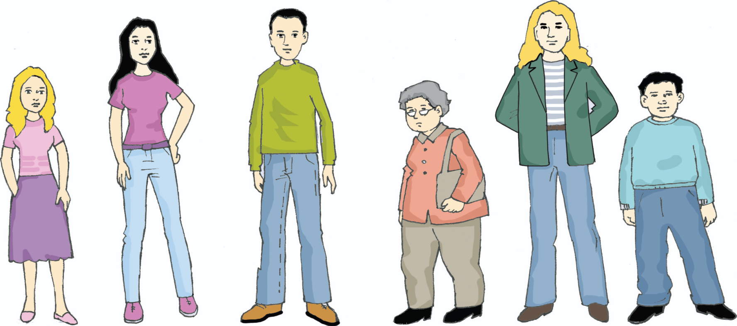
C. Complete the texts. Then match the descriptions with the pictures.
5
He ………… long
blond hair. He ………
tall and thin. He
……… handsome.
1
has
She ....................... long
black hair. She ..........
tall and thin. She .........
good-looking. She
............... trousers.
has
is
is
has
3
He ………… short
black hair. He
………… trousers.
He ….. short and fat
is
is
has
has
is
6
She ……….. old. She
…………. short hair.
She …… short and fat
is
2
has
4
He ……….tall. He
……………. short
black hair.
She …………… long
blonde hair. She
……… short and thin.
She ……….. beautiful.
has
is
is
is
is
is

Slide 27
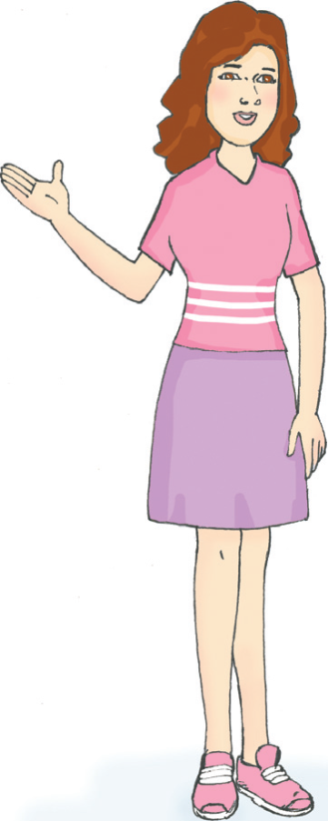
D. Ask and answer the questions.
What colour is your hair?
Çelik: ...........................................................................
Mary: I have got ..................................................hair.
Çelik: ...........................................................................
Mary: My eyes ............................................................
Çelik: ...........................................................................
Mary: I'm 163 cm tall.
Çelik: ...........................................................................
Mary: I'm 55 kilos.
red
What colour are your eyes?
are brown
How tall are you?
How heavy are you?

Slide 28



E. Work with your partner. Ask and answer about the pictures
1. .........................................................................?
......................................................................... .
.........................................................................?
......................................................................... .
Where is he from
He is from Azerbaijan
What nationality is he
He is Azerbaijani
2. ..................................................................................?
.................................................................................. .
..................................................................................?
.................................................................................. .
Iran
3. .................................................................................?
................................................................................. .
.................................................................................?
................................................................................. .
Syria

Slide 29
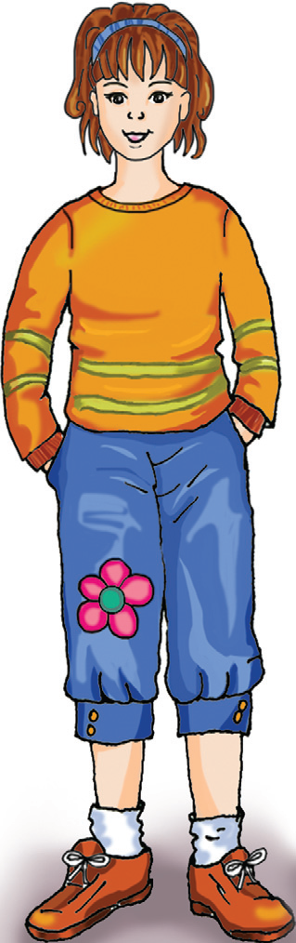
F. Read the text and fill in the form for Sandra.
This is Sandra Biel. She is a-ten-year old student. Her date of birth is 3rd March, 2000. She is American. She is
1.45 m and 36 kg. She has got brown hair and black eyes. Her favourite food is ice cream. She likes her school. Her
favourite school subjects are science and technology and English.

Slide 30
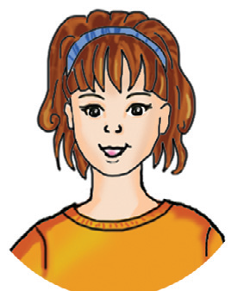
Name/Surname:
Age:
Date of birth:
Gender:
Nationality:
Favourite school subject:
Height:
Weight:
Eye colour:
Hair colour:
Favourite food:
Sandra Biel
10
3rd March 2000
Female
American
Science, Technology, Englisha
1.45 m
36 kg
Black eyes
Brown hair
Ice cream

