Slide 1
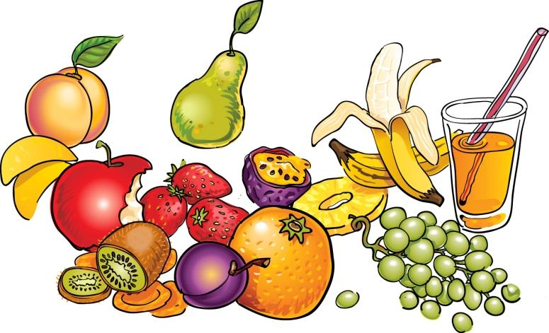
FOOD AND DRINKS

Slide 2
APPLE

Slide 3
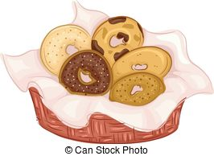
BAGEL

Slide 4
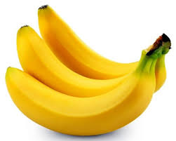
BANANA

Slide 5
BLUEBERRY

Slide 6
BUTTER

Slide 7
CEREAL

Slide 8
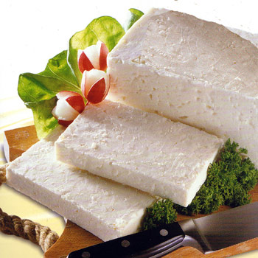
CHEESE

Slide 9
COFFEE

Slide 10
CROISSANT

Slide 11
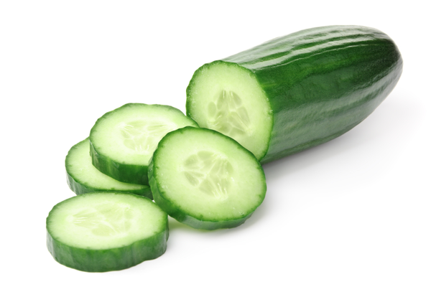
CUCUMBER

Slide 12
EGG

Slide 13
FISH

Slide 14
GRILLED

Slide 15
HONEY

Slide 16
JAM

Slide 17
MILK

Slide 18
MISO SOUP

Slide 19
MUFFIN

Slide 20
OLIVE

Slide 21
ORANGE JUICE

Slide 22
PANCAKE

Slide 23
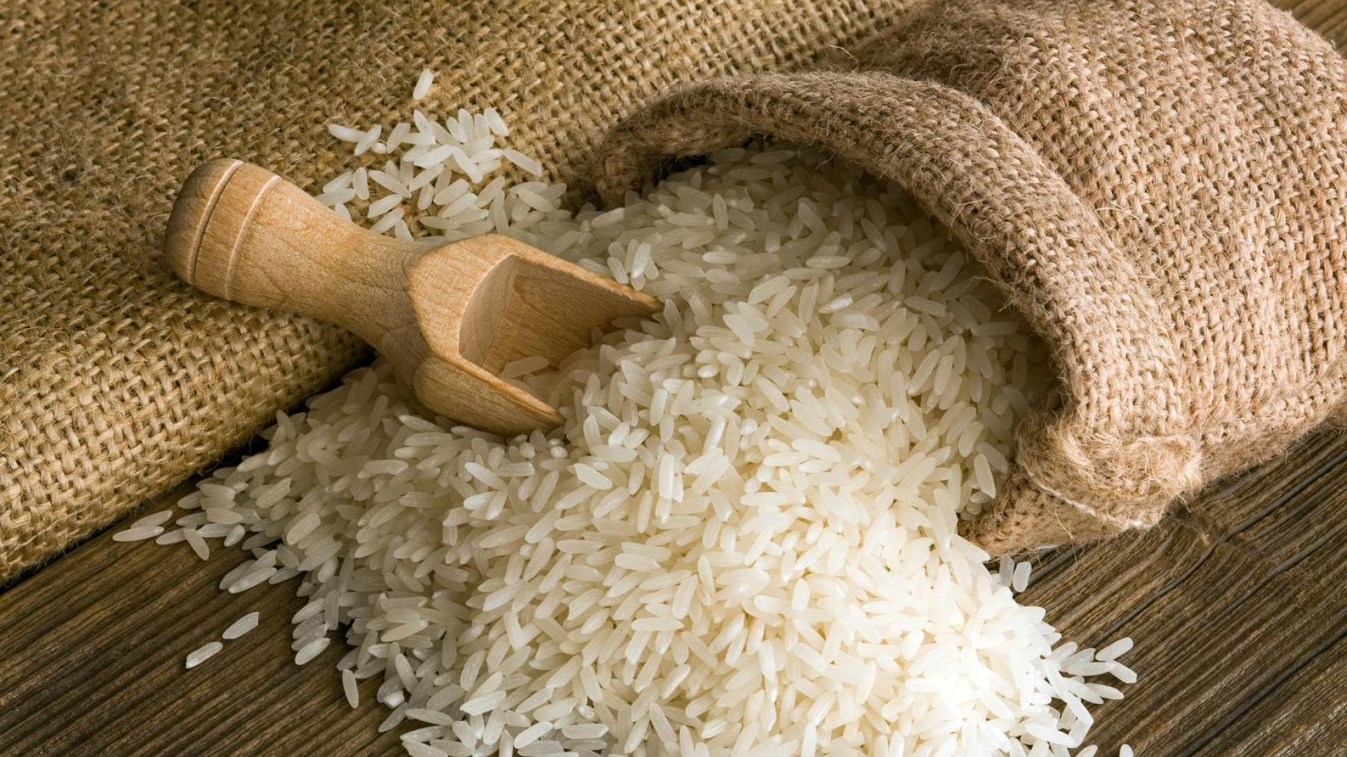
RICE

Slide 24
SALAMI

Slide 25
SAUSAGE

Slide 26
SEAWEED

Slide 27
SOYBEAN

Slide 28
SUSHI

Slide 29
TOMATO

Slide 30
TEA

Slide 31
FRUIT - VEGETABLE

Slide 32
YUMMY

Slide 33
MEHİBE ŞENEL
ELT

