Slide 1
MY FAMİLY

Slide 2
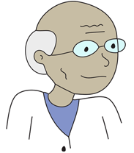
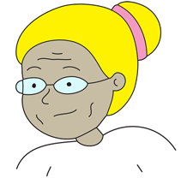
GRANDFATHER
GRANDMOTHER

Slide 3
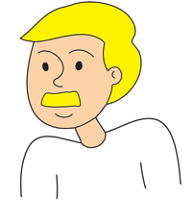
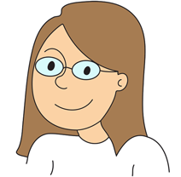
FATHER
MOTHER

Slide 4
BROTHER
SİSTER

Slide 5
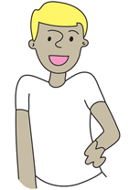
UNCLE
AUNT

Slide 6
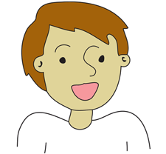
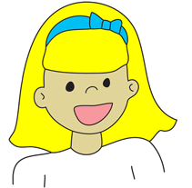
NEPHEW
NİECE

Slide 7
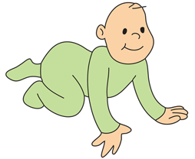
BABY

Slide 8
PREPARED BY KUBİLAY ERTÜRK DOSTSEVER

