Slide 1

Natural Approach
Dr. Yakup Çetin
The aim of this presentaiton is to provide general -- but detailed -- information about one of the most recent and the most promising approaches to language teaching, the Natural Approach and of course, its applicability to foreign or second language classes.

Slide 2

BACKGROUND
The Natural Approach (NA) is a method of Stephen Krashen that stresses that adults can still acquire second languages and that the ability to 'pick up' languages does not disappear at puberty.
Thus, Krashen's contribution to Chomsky's LAD proposition is that adults follow the same principles of Universal Grammar.

Slide 3
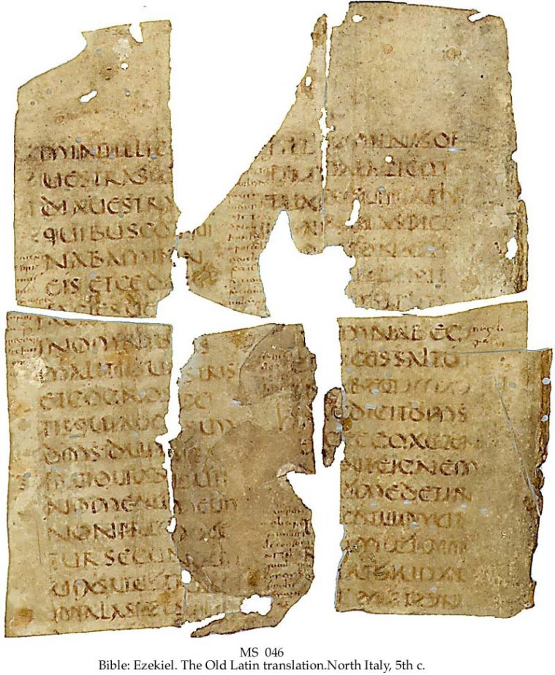
Krashen refers to the method of picking up ability in another language directly without instruction.
According to Krashen, “Natural Approach” acquiring a language in its natural environment, is older than Grammar Translation Method but nobody is aware of it.

Slide 4

The term 'natural' emphasizes that the principles behind the NA are believed to conform to the naturalistic principles found in successful second language acquisition.
The Direct Method and the Natural Approach differ in that the former lays more emphasis on teacher monologues, formal questions and answers, and error correction.

Slide 5

energizer

Slide 6

The Natural Approach, like TPR, is regarded as a comprehension-based approach because of its emphasis on initial delay (silent period) in the production of language.
What is novel is that the NA focuses on exposure to input instead of grammar practice, and on emotional preparedness for acquisition to take place.

Slide 7

Theory of Language
Krashen regards 'communication' as the main function of language. The focus is on teaching communicative abilities.
According to Krashen, 'acquisition' can take place only when people comprehend messages in the TL. Thus, a ‘meaningful communication' is emphasized.

Slide 8
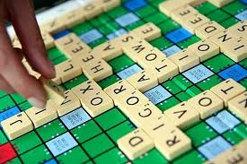
Krashen believes that a language is essentially its lexicon. They stress the importance of vocabulary and view language as a vehicle for 'communicating meanings' and 'messages'.

Slide 9

energizer

Slide 10



(1) Acquisition-Learning Hypothesis
Krashen suggests that adults have two different ways of developing competence in second languages: Acquisition and learning. "'Acquisition' is a subconscious process identical in all important ways to the process children utilize in acquiring their first language, ... [and] 'learning' ..., [which is] a conscious process that results in 'knowing about' [the rules of] language" (Krashen 1985:1).
When one reads, LAD focuses on both ‘meaning and form’.

Slide 11

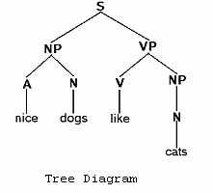
(2) Natural Order Hypothesis
According to Krashen, the acquisition of grammatical structures proceeds in a predicted progression. Certain grammatical structures or morphemes are acquired before others in first language acquisition and there is a similar natural order in SLA.
-Ing--------Aux---------Irregular------Regular Past
Plural----->Article---->Past---------->3rd Sing.
Copula--------------------------------Possessive
The implication of natural order is not that second or foreign language teaching materials should be arranged in accordance with this sequence but that acquisition is subconscious and free from conscious intervention.
- Mostly handouts are misleading or insufficient because they don’t address students’ level and interest

Slide 12

energizer

Slide 13


3) Krashen’s Input Hypothesis
This hypothesis relates to acquisition, not to learning. Krashen claims that people acquire language best by understanding input that is a little beyond their present level of competence. Consequently, Krashen believes that 'comprehensible input' (that is, i + 1) should be provided. The 'input' should be relevant and 'not grammatically sequenced'.
".. child acquirers of a first language are provided with samples of 'caretaker' speech, rough - tuned to their present level of understanding, ..[and] adult acquirers of a second language [should be] provided with simple codes that facilitate second language comprehension."
(Richards, J. 1986:133)
At age of 5 a child speaks mother language very fluently and accurately.
Comprehensible input plays the major role all the rest is minor in SLA

Slide 14
(4) Krashen’s Monitor Hypothesis:
As it is mentioned, adult second language learners have two means for internalizing the target language. The first is 'acquisition' which is a subconscious and intuitive process of constructing the system of a language. The second means is a conscious learning process in which learners attend to form, figure out rules and are generally aware of their own process.
The 'monitor' is an aspect of this second process. It edits and makes corrections to the output. Krashen believes that 'fluency' in second language performance is due to 'what we have acquired', not 'what we have learned': Adults should do as much acquiring as possible for the purpose of achieving communicative fluency.
Krashen suggests three conditions for Monitor use: (1) there must be enough time; (2) the focus must be on form and not on meaning; (3) the learner must know the rule.

Slide 15

energizer

Slide 16

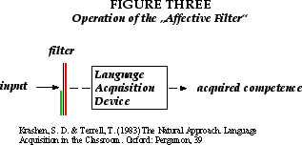
  (5) Krashen’s Affective Filter Hypothesis
  The learner's emotional state, according to Krashen, is just like an adjustable filter which freely passes or hinders input necessary to acquisition. In other words, input must be achieved in low-anxiety contexts since acquirers with a low affective filter receive more input and interact with confidence. The filter is 'affective' because there are some factors which regulate its strength. These factors are self-confidence, motivation and anxiety state.

Slide 17
THANK YOU FOR PARTICIPATION!

