Slide 1
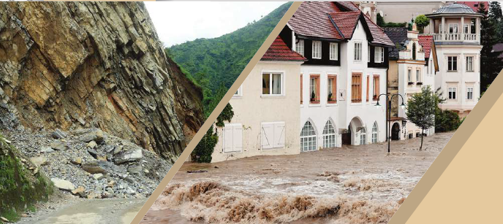
NATURAL FORCES

Slide 2
EARTHQUAKE
a sudden violent movement of the Earth’s surface

Slide 3
TORNADO

Slide 4
hurrıcane
a violent wind

Slide 5
avalance
a large amount of ice,
snow, and rock falling
quickly down the side
of a mountain

Slide 6
tsunamı
an extremely large
wave

Slide 7
flood
a large amount of
water

Slide 8
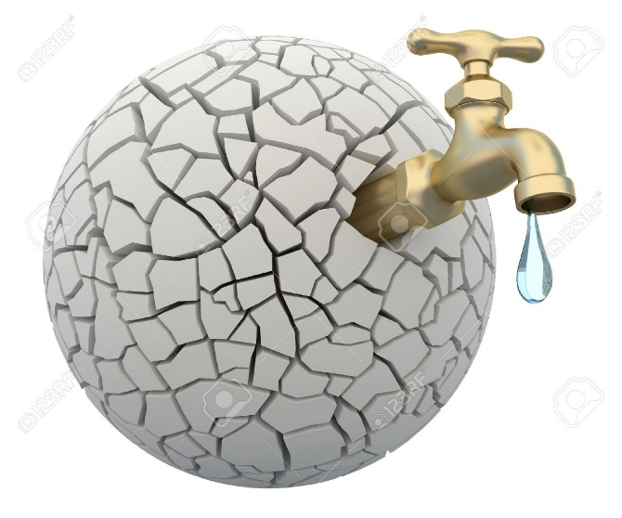
drought
a long period when
there is little or no
rain

Slide 9
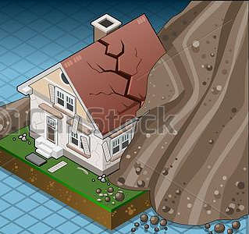
landslıde
a mass of rock
and earth moving
suddenly and quickly

Slide 10
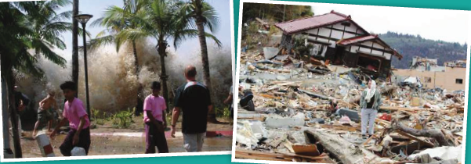
Earthquake ın sumatra, ındonesıa

Slide 11
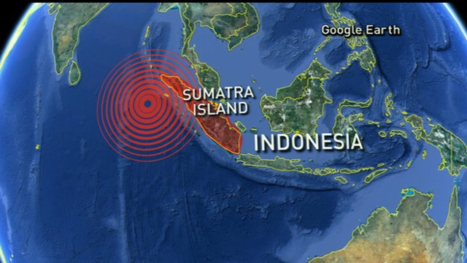
On December 26, 2004, a huge earthquake took place off the northwest coast of the Indonesian island of Sumatra.

Slide 12
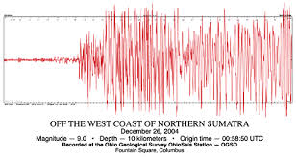
The earthquake, 9.0 in magnitude, was the most powerful one to shake the Earth in 40 years.

Slide 13
As a result of this massive earthquake,
huge waves formed in the ocean.
They traveled at speeds of up to 480 kilometers per hour.

Slide 14
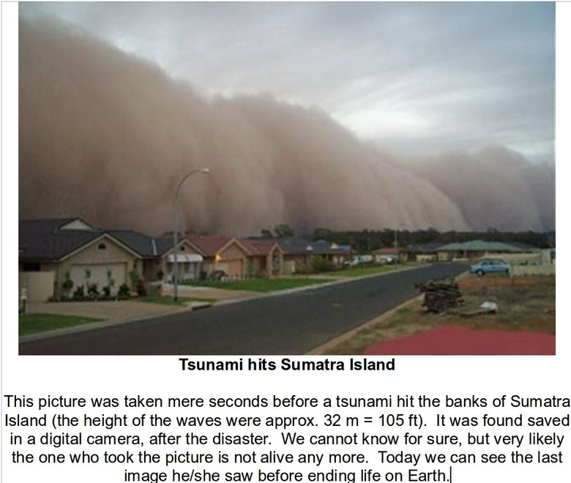
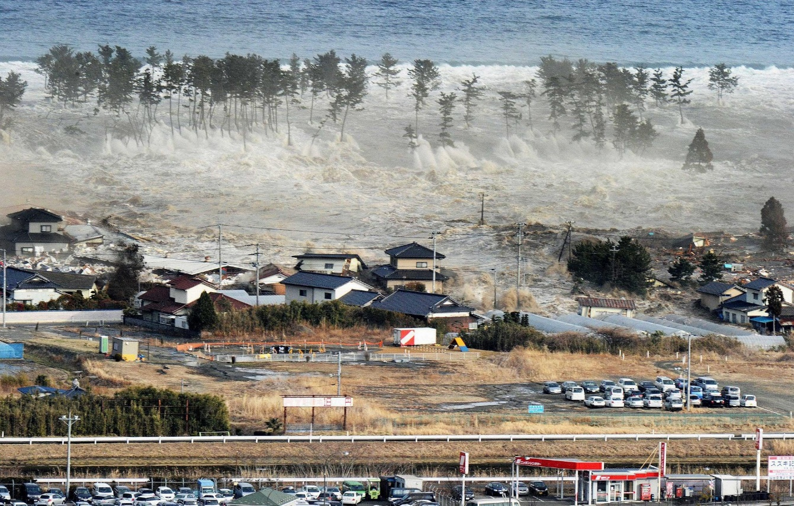
Within 75 minutes, they hit places as far as 600 km away, such as the coast of Africa.

Slide 15
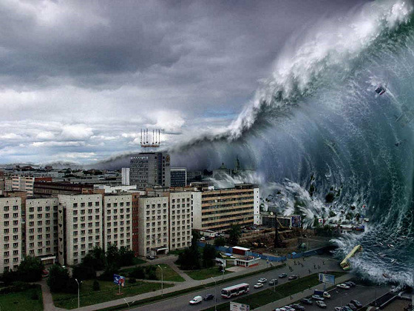
These giant waves affected eleven countries.
Hardest hit was in Indonesia, Sri Lanka, India, Thailand, and the Maldives

Slide 16
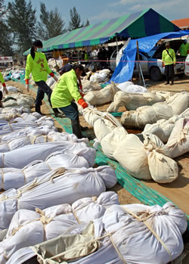
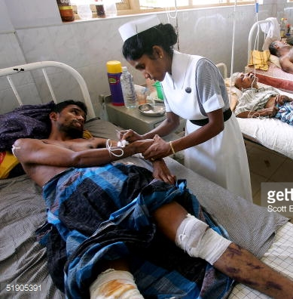
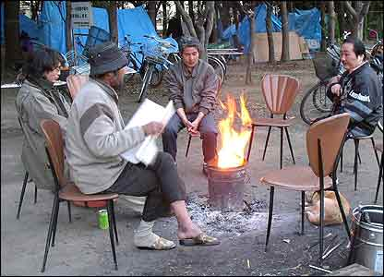
More than 300,000 people died from the disaster,
half a million were injured,
thousands still remain missing,
and millions were left homeless

Slide 17
Scientists have a special name for these destructive waves.
They call them by the Japanese name tsunami.
“Tsu,” means “harbor” and “nami,” means “wave.”

Slide 18
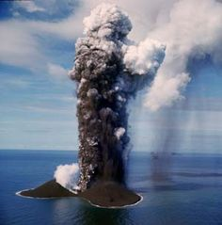
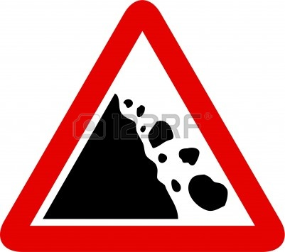
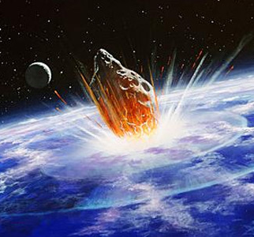
There are many reasons for tsunamis such as
underwater volcanic eruptions,
Landslides
meteor crashing onto the ocean floor,
4) an underwater earthquake

